Slide 1
Recognize Note Block sound samples in a music file
Vértesaljai Bálint
Consultant: György László Grad-Gyenge
BSc in IT engineering, independent laboratory

Slide 2
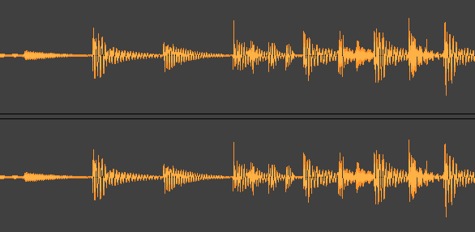
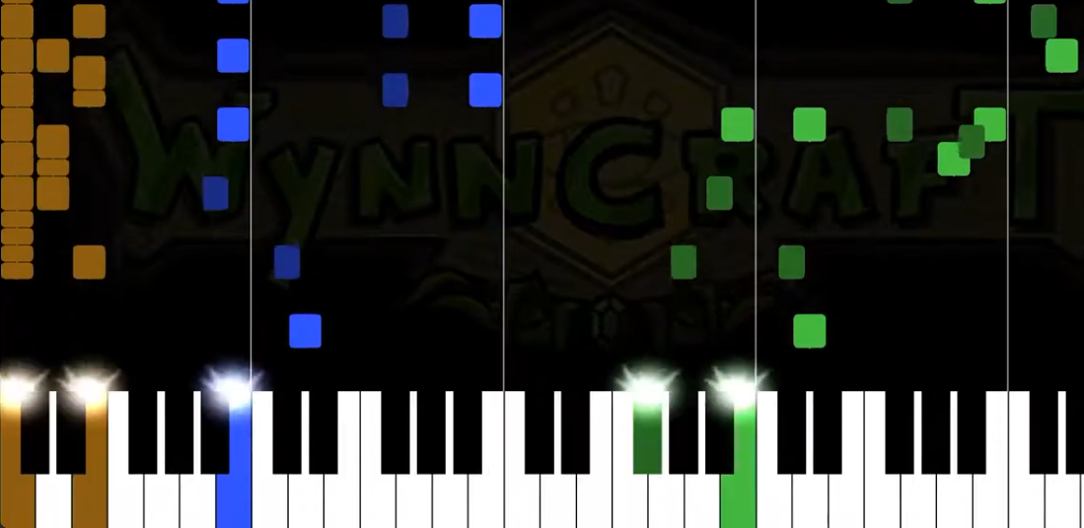
Audio file format
Wave: wav/mp3/ogg/…
Float values ​​44100 times per second e.g.
Midi: ~kotta
Music start and end times
Conversion is not clear, not easy (especially wave → midi)
1p

Slide 3
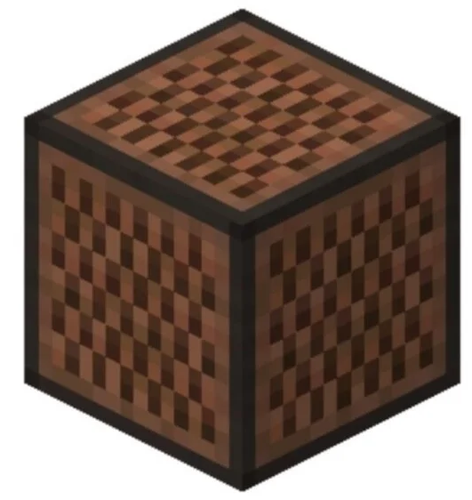
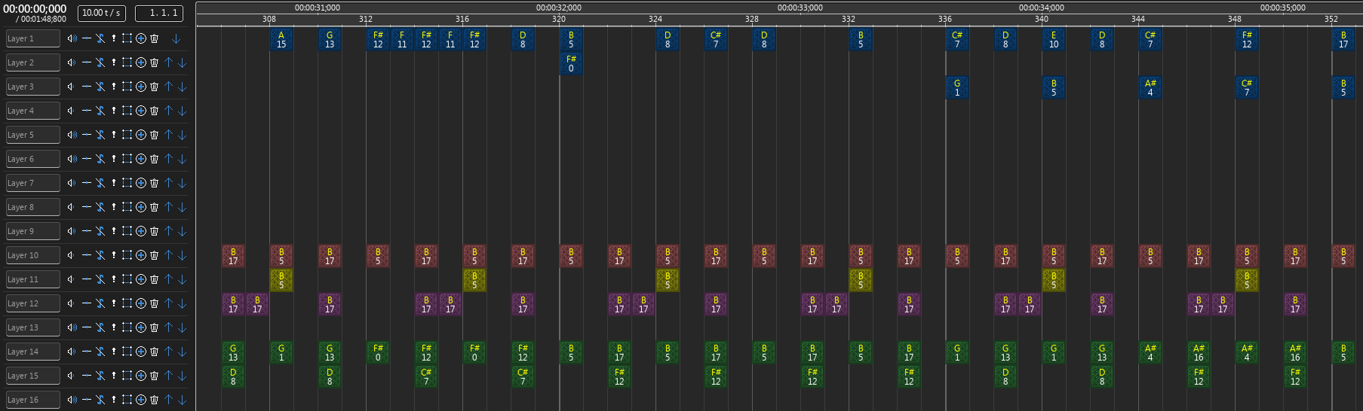
Note Block Studio
Minecraft Note Blocks as patterns
Note Block Studio: editing program
NBS file format
~Midi, but more special: a moment in time, specific patterns
1p

Slide 4

Project purpose
Input: Wave file
Recognition of sound samples at a given time, pitch and volume
Output: Nbs file
Music is similar to notation, a special case of it
Implementation in Rust
2p

Slide 5
Video
Note Block sound samples
Wave file (input)
Spectrogram (important for conversion)
Midi visualization (part of motivation)
Playing in the game (part of motivation)
Original Nbs file (expected output)
Recognized Nbs file (actual output)
2p

Slide 7
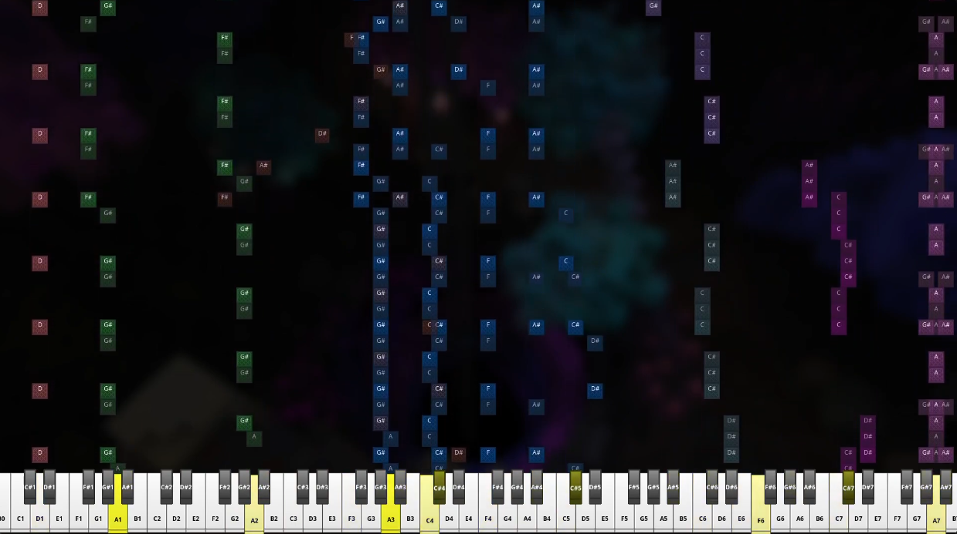
Motivation
Many authors make such music
Visualization
Remix / Rework
Sheet music making
Play on an instrument
Wave→Midi→Nbs is very imprecise, intervention is required
5p

Slide 8
Data properties
Various instruments (5..16), currently tested with 4
2 octaves of pitch (25)
Volume between 0.0 and 1.0
Timing in tps (tick: smallest time unit), column in ONBS
5p

Slide 9
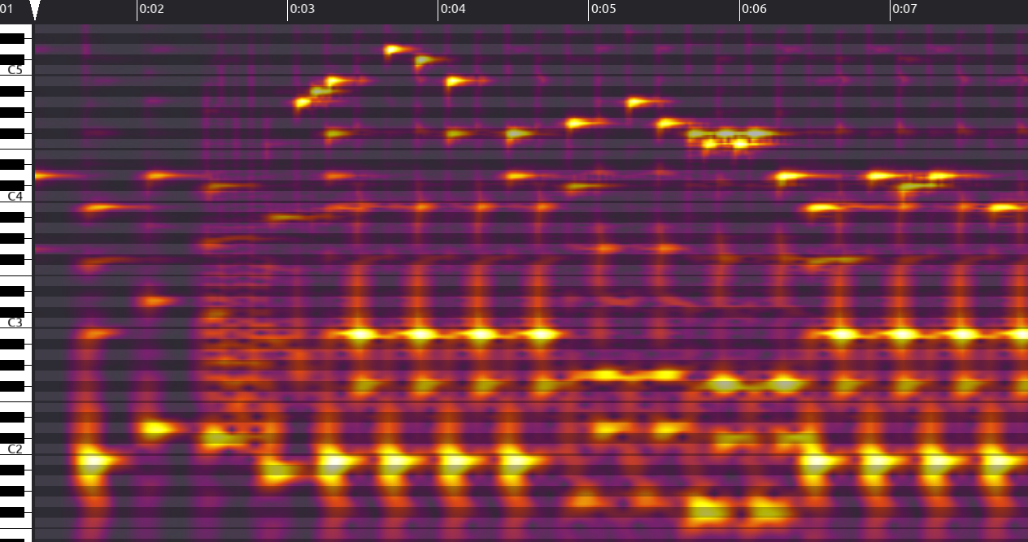
Conversion, search method
Spectrogram:
Fourier transforms
at fixed intervals
Moments of time to be examined
Precognition is the state space
in order to reduce
Optimization using the Nelder-Mead method
6p

Slide 10

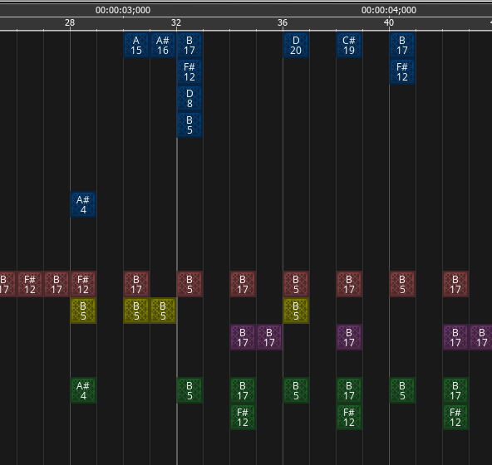
Spectrogram (can be generated from wave) and the original NBS
7p
Harp

Slide 11
Cost function for optimization
Cost function:
input: n floats with the guessed volumes
output: a float, the error / cost (smaller = better)
Calculation:
synthesis: adding waves of samples at the guessed volume
spectrogram calculation
absolute value of difference per pixel
Important: do not need its derivative
Expensive
8p

Slide 12
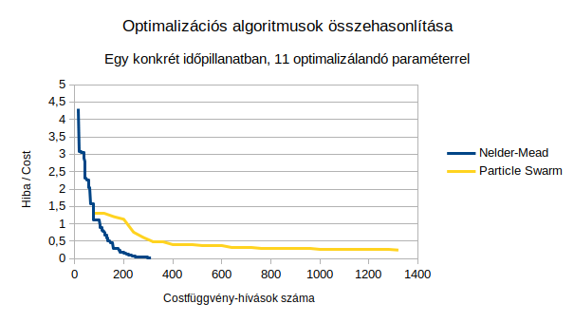
Comparison of optimization algorithms
9p

Slide 13
Evaluation
A largely successful recognition
It could be improved in many ways
10p

Slide 14

Development opportunities, thank you for your attention!
recognition of multiple instruments
testing with more music
refinement of recognition, for example by adding a wave of sounds recognized in the previous tick during the current recognition
Giving a more meaningful initial value to Nelder-Mead optimization based on the result of pre-recognition
automatic tps and overdrive compensation recognition
command line switches for frequently changed parameters
more robust recognition of sound files generated by other nbs to wave exporters / methods
testing with other resource packs / soundfonts
runtime optimization
measuring the accuracy of recognition on a larger data set, after the recognition is already sufficiently good
stereo recognition, the same sound multiple times at the same time
trying to recognize layers that usually have sounds at the same volume, rounding these volumes to the recognized volume, and using layer volumes
10p

