Slide 1



Prepared for:
Thesis Proposal Defense Committee
Department of Computer Science and Engineering
IUBAT–INTERNATIONAL UNIVERSITY OF BUSINESS AGRICULTURE AND TECHNOLOGY
Founded 1991 by Md. Alimullah Miyan
Exoplanet Transit Detection Using Traditional ML and 1D Convolutional Deep Networks
Course Code: CSC 488 (Thesis)
Supervised by:
Supervisor Name: Kazi Johir Raihan Suny
Designation: Lecturer
Prepared by:
Student1_Name: Kaniz Fatema ID:22203135
Student2_Name: Fahim Ferdous ID:21303015
25 November, 2025

Slide 2
Contents
Introduction
Literature Review
Research Methodology
Work Plan
Conclusion
References
2

Slide 3
Introduction
Background
Exoplanets are discovered by observing tiny drops in star brightness (transits).Missions like Kepler and TESS have produced millions of light curves, making manual inspection impossible. Traditional ML gives feature-based explanations, while deep learning can analyze the raw light curve shape more effectively.
Motivation
Existing models struggle with noise, false positives, and lack proper explanations.
Deep learning can detect subtle patterns in raw light curves, Grad-CAM can visually highlight transit regions.
Exoplanet Transit Detection Using Traditional ML and 1D Convolutional Deep Networks
3

Slide 4
Literature Review
Paper | Author | Method | Dataset | Summary | Limitations
Machine Learning for High-Contrast Spectroscopy | Garvin et al. (2024) | Perceptron, 1D CNN, MLCCS | Synthetic planets + SINFONI noise | Enhances CCS with ML , CNN detects 77× more planets than S/N, Works on spectral data only | Performance drops at extreme noise, Template-dependent, High training time, Limited interpretability
ML Models on Synthetic Kepler Light Curves | Lo & Lo (2025) | Logistic Regression, KNN, Random Forest | Synthetic + Kepler light curves | Simple ML performs well after SMOTE Logistic Regression highest F | Severe class imbalance, Heavy synthetic dependence, No DL models
Comparative ML Analysis Using Kepler Data | Karimi et al. (2025) | Logistic Regression, Decision Tree, KNN, Random Forest | Real Kepler dataset | RF achieves 99.8% accuracy, SMOTE improves results, effective for time-series photometry | Small positive class (37 planets), Risk of overfitting, No DL comparison, Transit method limitations
Statistical Methods for Exoplanet Detection with Radial Velocities | Nathan C. Hara & Eric B. Ford | Periodograms, Bayesian model comparison, Gaussian Processes, MCMC | Real & simulated RV data from spectrographs and the Sun. | Reviews the challenges and statistical methods for finding exoplanets in noisy, unevenly sampled radial velocity data. | Computationally expensive; sensitive to model choice; hard to validate except on solar data.
Exoplanet Transit Detection Using Traditional ML and 1D Convolutional Deep Networks
4

Slide 5
Problem Statement
Current exoplanet detection methods either lack accuracy or lack explanations.
Traditional ML models provide only feature importance, which does not show where the transit occurs.
Deep learning models used in literature rarely provide visual explanations, making them hard to trust.
There is a need for a system that combines accuracy + visual explanation + reduced false positives.
Exoplanet Transit Detection Using Traditional ML and 1D Convolutional Deep Networks
5

Slide 6
Research Objectives and Goal:
Collect and preprocess Kepler and TESS light-curve subsets.
Develop a main model using 1D-CNN + Grad-CAM for raw light-curve learning and visual explanations.
Compare the two models to show the difference between traditional and deep-learning.
Analyze false positives and apply techniques to reduce them.
Evaluate the system on cross-mission data (Kepler → TESS).
Exoplanet Transit Detection Using Traditional ML and 1D Convolutional Deep Networks
6

Slide 7
Research Methodology
1.Data Collection
Selecting a two subsets “Kepler objects of interest” table and “TESS Candidates” table from Kepler KOI and TESS TOI datasets.
Dataset | Source | What is contains
Kepler Objects of Interest | NASA Exoplanet Archive | Labeled signals (planet/not planet) from Kepler telescope
TESS Candidates | NASA Exoplanet Archive | Labeled signals from TESS telescope
2.Preprocessing:
Employing ”Savitzky–Golay” filtering to denoise the light curves.
Normalize flux values for each light curve.
Crop light curves to a consistent fixed window length.
Use data augmentation techniques to enhance model robustness.
Handle missing values by imputation or masking.
Exoplanet Transit Detection Using Traditional ML and 1D Convolutional Deep Networks
7

Slide 8
Research Methodology cntd.
3.Baseline Model: XGBoost + SHAP
Extract tabular features:
Transit depth
Duration
Periodicity
Train an XGBoost classifier using these features and evaluate performance using metrics.
Metric | Formula | Description
Accuracy | TP+TN TP+TN+FP+FN | Fraction of correct predictions
Precision | TP TP+FP | How many predicted transits are truly transits (purity)
Recall | TP TP+FN | How many true transits are detected (coverage)
F1 Score | 2×Precision×Recall Precision+ Recall | Harmonic mean of Precision and Recall
Exoplanet Transit Detection Using Traditional ML and 1D Convolutional Deep Networks
8

Slide 9
Research Methodology cntd.
Use SHAP(Shapley Additive explanations) to interpret feature importance and explain the model's predictions.
Analyze strengths and limitations of traditional ML explainability on light curves.
4.Main Model: 1D CNN + Grad-CAM
Use raw light curve data as input to a 1D Convolutional Neural Network (CNN).
Design and train the CNN to classify transits.
Evaluate with the same metrics as the baseline.
Apply Grad-CAM to generate visual attribution maps, highlighting which time steps influenced each CNN prediction.
Compare interpretability with the XGBoost+SHAP approach.
Exoplanet Transit Detection Using Traditional ML and 1D Convolutional Deep Networks
9

Slide 10
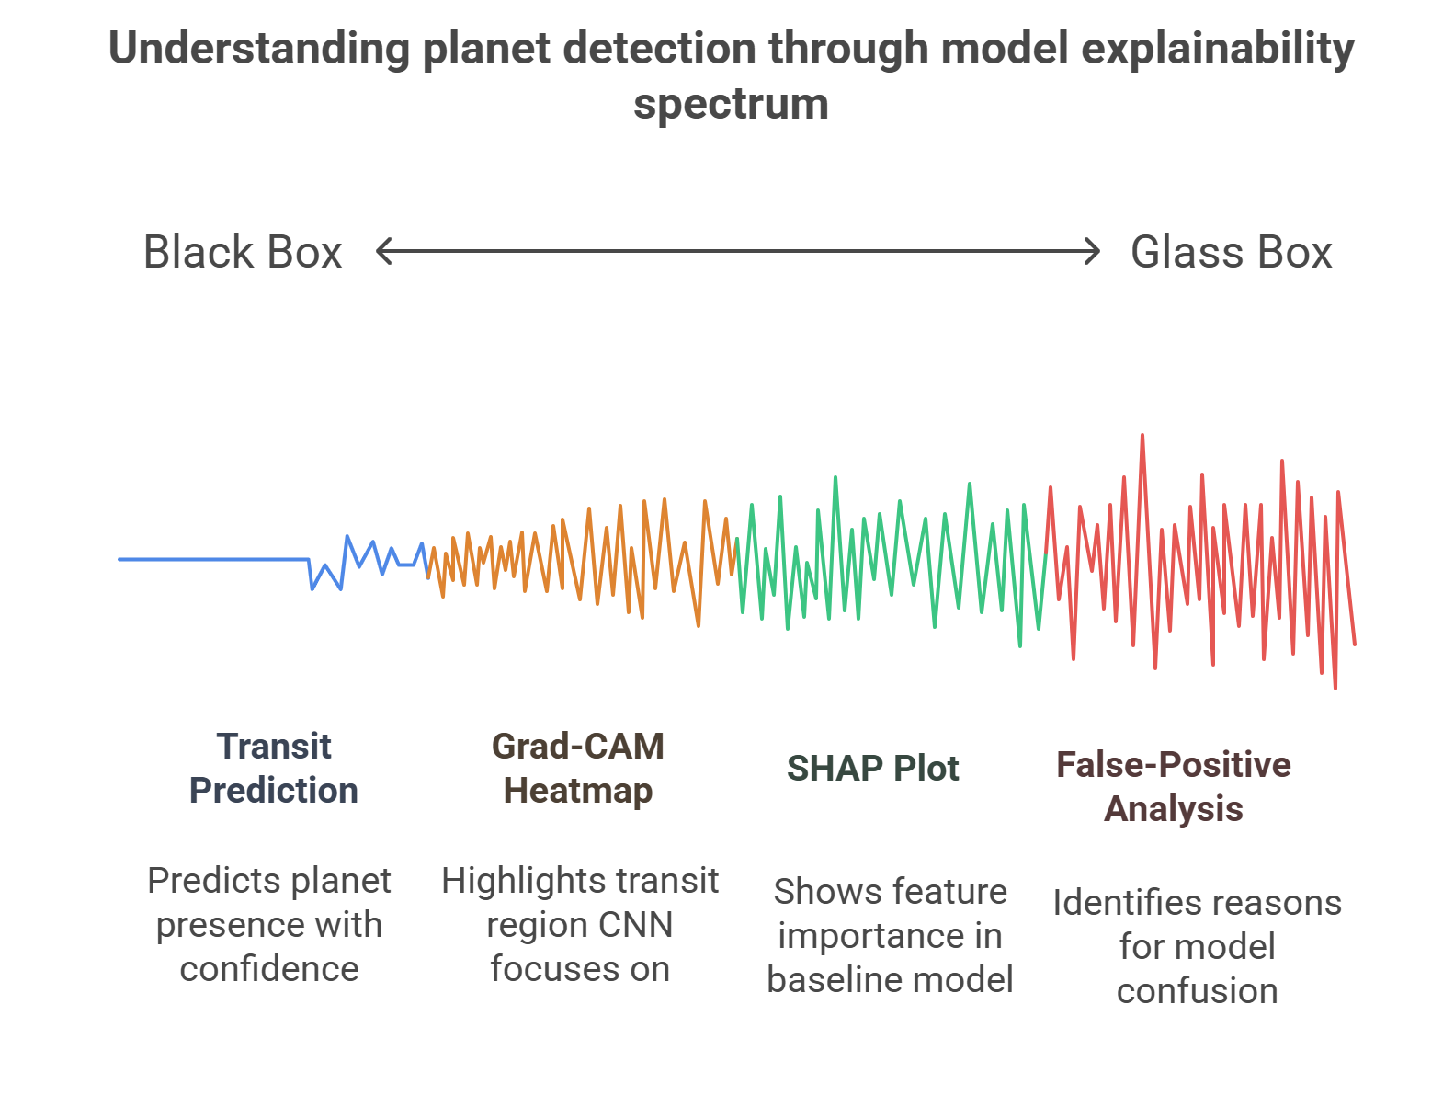
Exoplanet Transit Detection Using Traditional ML and 1D Convolutional Deep Networks
10

Slide 11
Research Methodology cntd.
5. Experimental Design
Experiment 1: Noise Ablation: Compare CNN performance with raw (noisy) vs. denoised (Savitzky–Golay filtered) data to quantify preprocessing impact.
Experiment 2: False Positive Diagnosis: Use Grad-CAM to analyze model mistakes:
Categorize false positives
Identify patterns in erroneous predictions
Experiment 3: Explanation Consistency
Probe whether Grad-CAM consistently highlights real transit regions for true-positive detections.
Exoplanet Transit Detection Using Traditional ML and 1D Convolutional Deep Networks
11

Slide 12
Research Methodology cntd.
7. Comparative analysis and Output
Baseline Model: Performance and SHAP-based feature explanations are reported. Limitations in capturing complex transit features and explanation granularity are discussed.
Main Model: 1D CNN results are interpreted with Grad-CAM visualizations, illustrating the localization of time regions responsible for predictions.
Experimental Insights: Noise ablation studies and false positive analyses reveal preprocessing utility and model interpretability.
Cross-Mission Results: Comparative performance across Kepler and TESS assesses generalization
Exoplanet Transit Detection Using Traditional ML and 1D Convolutional Deep Networks
12

Slide 13
Research Methodology cntd.
Final Output
A combined, explainable ML+DL framework.
Visual explanation tool for transit regions.
Comparison results showing the improvement from baseline to CNN.
Exoplanet Transit Detection Using Traditional ML and 1D Convolutional Deep Networks
13

Slide 14
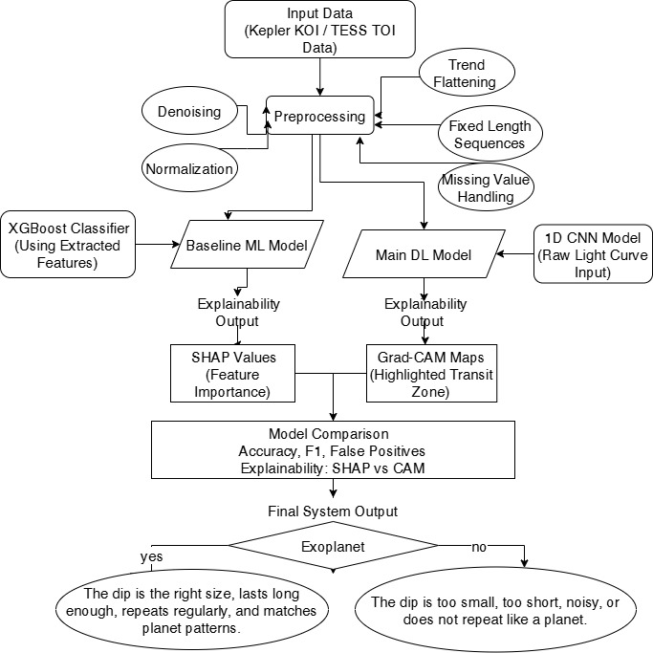
Research Methodology cntd.
Exoplanet Transit Detection Using Traditional ML and 1D Convolutional Deep Networks
14

Slide 15
Work Plan
Week 1 – Dataset Preparation
Download Kepler KOI and TESS TOI subsets
Clean, label, and organize datasets
Apply all preprocessing:
denoise → flatten → normalize → fix sequence length
Week 2 – Baseline Model (XGBoost + SHAP)
Extract numerical features from each light curve
Train XGBoost classifier
Evaluate performance (accuracy, F1-score)
Generate SHAP feature-importance explanations
Week 3 – Main Model (1D CNN + Grad-CAM)
Build and train the 1D-CNN model on raw light curves
Validate model and tune hyperparameters
Generate Grad-CAM visual heatmaps
Exoplanet Transit Detection Using Traditional ML and 1D Convolutional Deep Networks
15

Slide 16
Work Plan cntd.
Week 4 – Model Comparison & Analysis
Compare baseline vs deep learning:
Analyze misclassified samples
Reduce false positives using thresholding, filtering, or feedback
Week 5 – Cross-Mission Testing
Train on Kepler to Test on TESS
Analyze generalization results
Explain differences using Grad-CAM / SHAP
Week 6 – Final Writing & Presentation
Document methodology, experiments, and results
Prepare visual explanation charts
Prepare final thesis and presentation slides
Exoplanet Transit Detection Using Traditional ML and 1D Convolutional Deep Networks
16

Slide 17
Conclusion
This research aims to build an explainable and reliable system for detecting exoplanet transits using space telescope light-curve data. By combining a traditional machine-learning baseline (XGBoost + SHAP) with a deep-learning main model (1D-CNN + Grad-CAM), the study provides both numerical and visual explanations, addressing major gaps in current literature. The methodology improves interpretability, reduces false positives, and tests generalization across different missions (Kepler → TESS). The final outcome is a complete, scientifically meaningful framework that enhances accuracy while making model decisions clearer and more trustworthy for astronomers and researchers.
Exoplanet Transit Detection Using Traditional ML and 1D Convolutional Deep Networks
17

Slide 18
References
Karimi, R., Mousavi-Sadr, M., Zhoolideh Haghighi, M. H., & Tabatabaei, F. S. (2025). Machine learning for exoplanet detection in high-contrast spectroscopy. arXiv Preprint arXiv:2508.09689.
Lo, E., & Lo, D. C.-T. (2025). Exoplanet detection using machine learning models trained on synthetic light curves (Version 1). arXiv. https://arxiv.org/abs/2507.19520
Garvin, E. O., Bonse, M. J., Hayoz, J., Cugno, G., Spiller, J., Patapis, P. A., Petit dit de la Roche, D., Nath-Ranga, R., Absil, O., Meinshausen, N. F., & Quanz, S. P. (2024). Machine learning for exoplanet detection in high-contrast spectroscopy: Revealing exoplanets by leveraging hidden molecular signatures in cross-correlated spectra with convolutional neural networks.
diagrams.net. (n.d.). draw.io [Software]. https://www.draw.io/
18

Slide 19
Thank You

