Slide 1
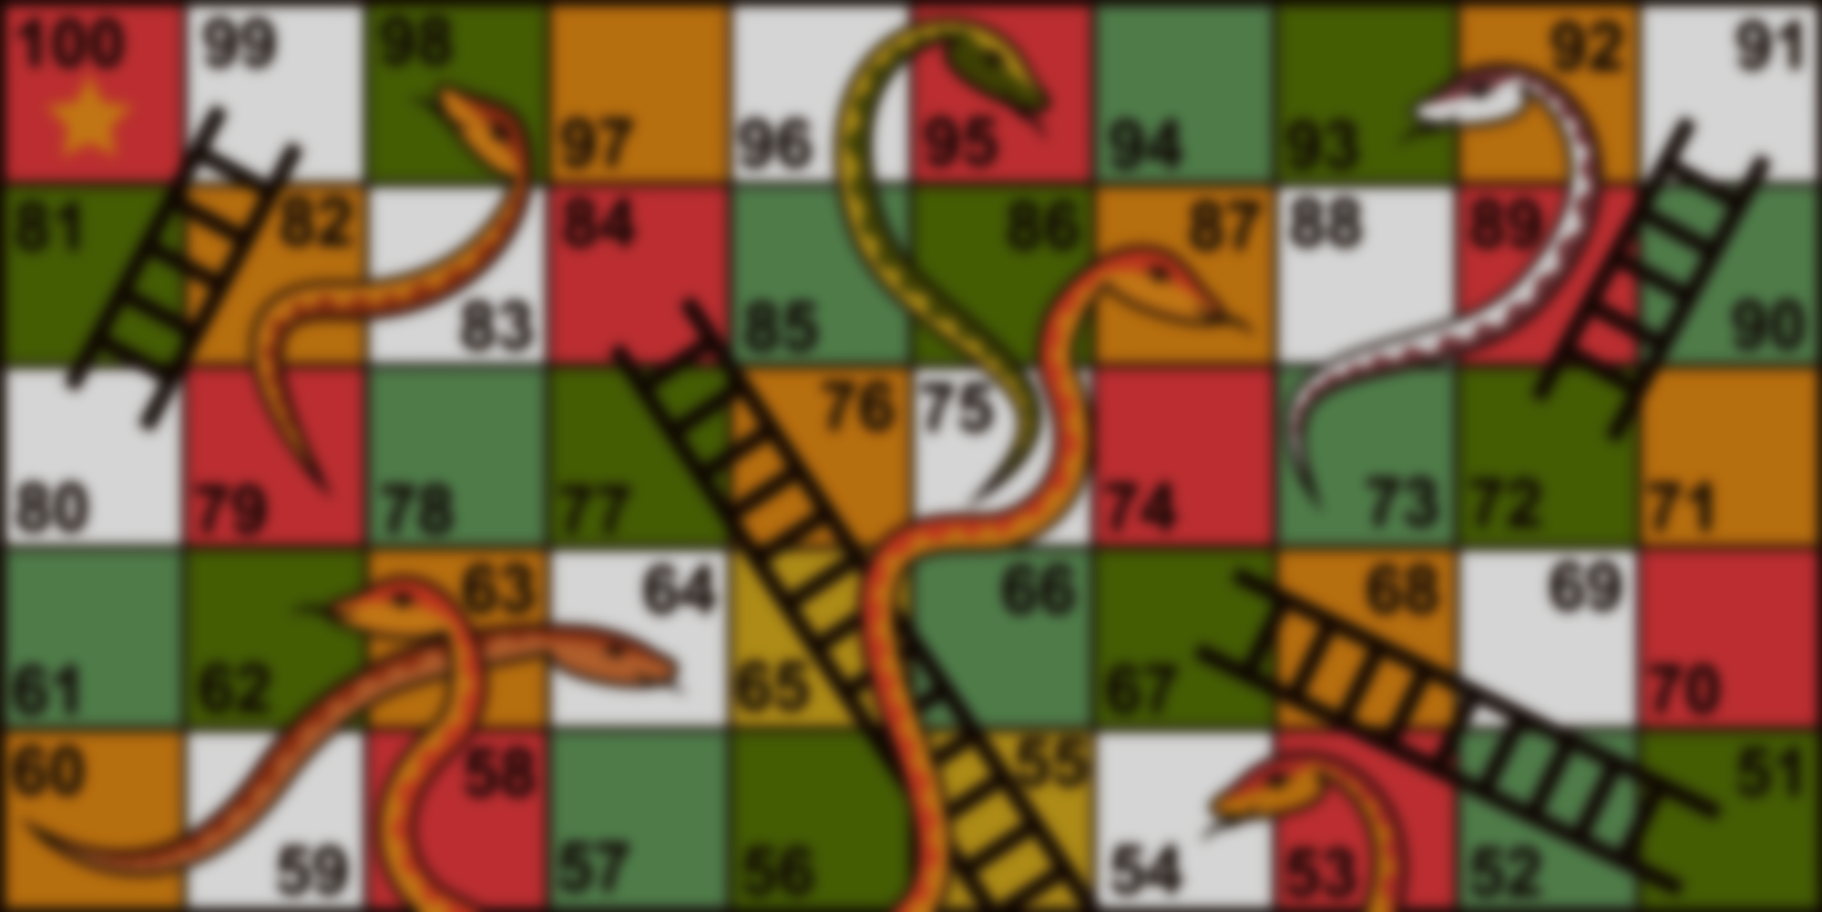
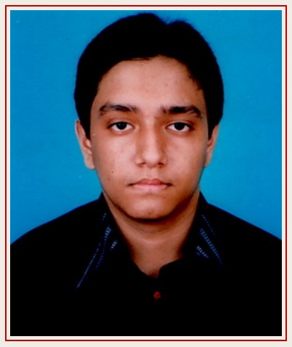
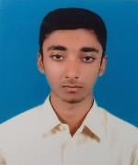
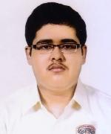
Credits
Project: Network Snakes and Ladders
Created under the Supervision of
Md. Tarikul Islam Papon
Dept. of CSE
BUET
And Created by
Md. Redwanul Haque
Ajmain Yasar Ahmed
Student ID: 1605004
Student ID: 1605023

