Slide 1
EMA filter
FPGA project

Slide 2
General equation
y[n] = α*x[n] + (1−α)*y[n−1]
LUTs are used to perform the multiplications
Two LUT modules were created for each of the multiplications α*x[n] and (1−α)*y[n−1] and all entries were manually entered for inputs from 0 to 255.

Slide 3
Outputs
To verify if the output values were correct, all the output was dumped into a textfile through the testbench
Later the input and output graphs were plotted using Python for comparision

Slide 4
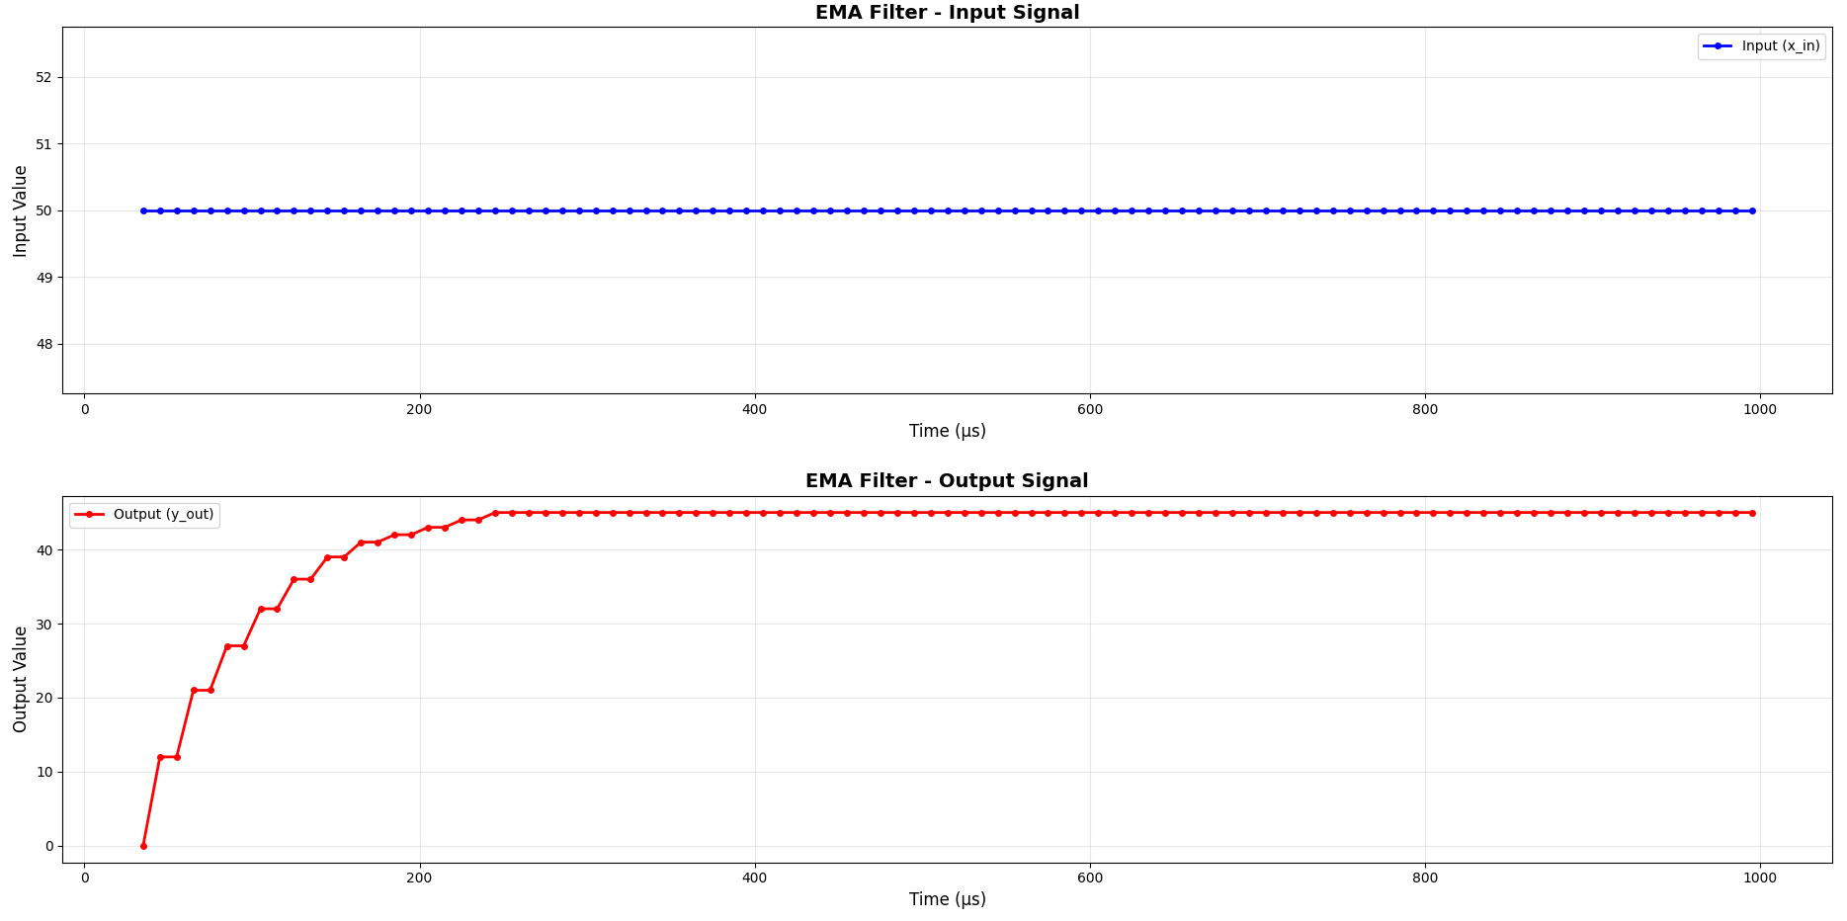
Test cases

Slide 5
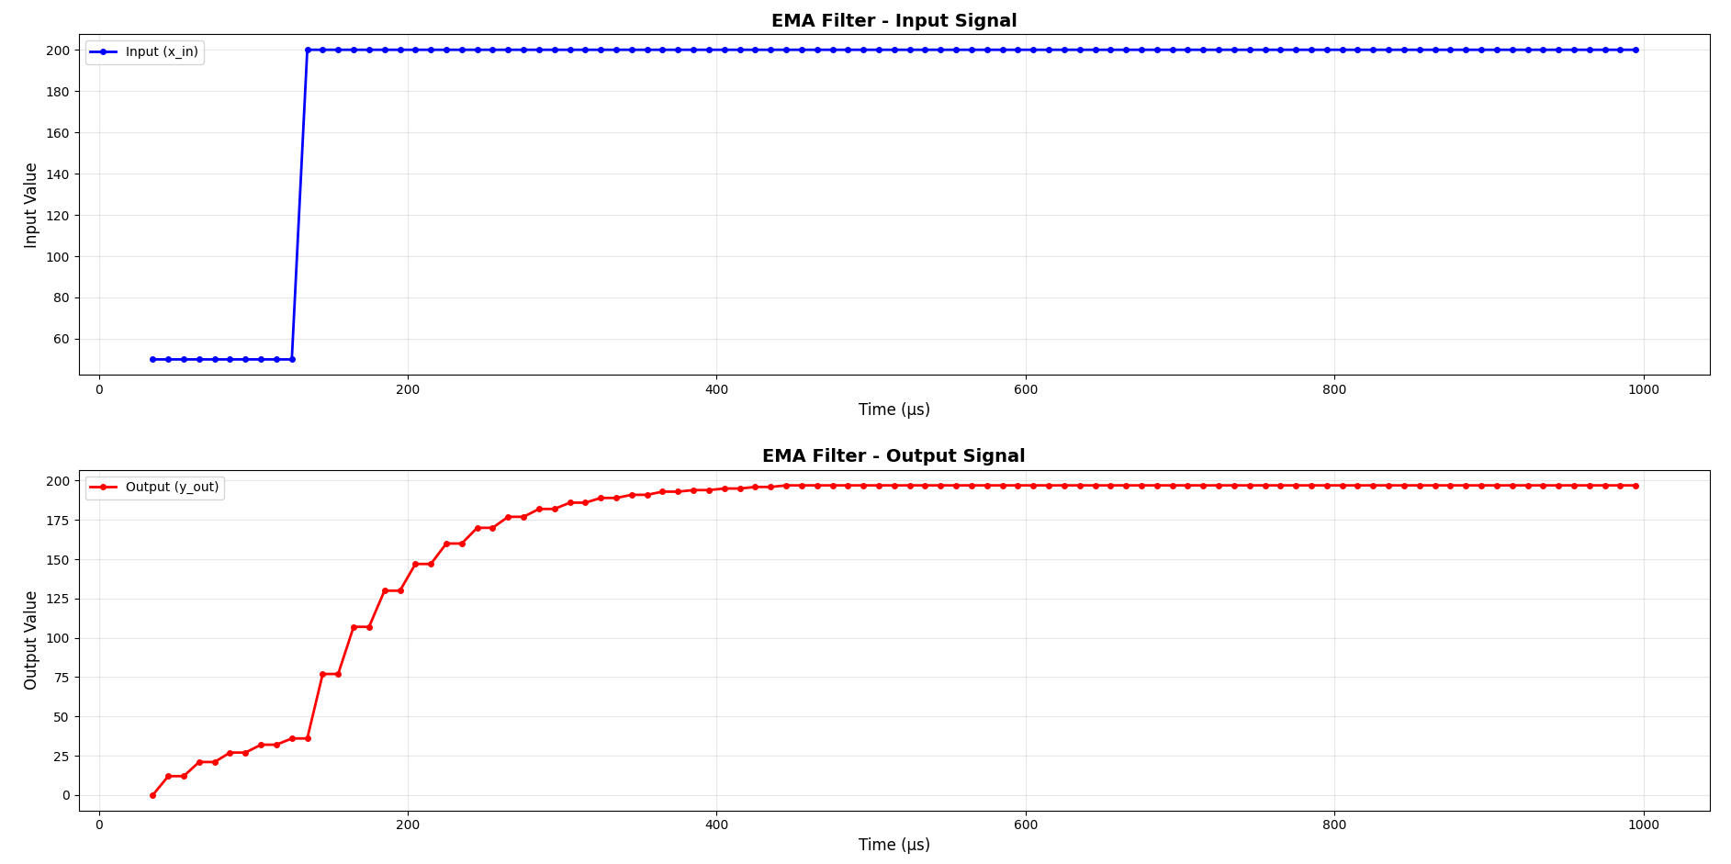
Test cases

Slide 6
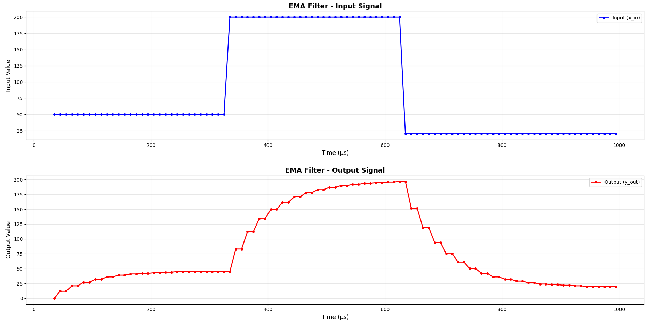
Test cases

Slide 7
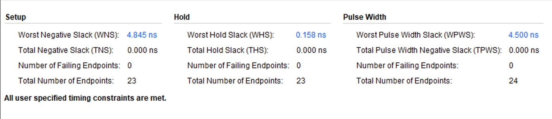
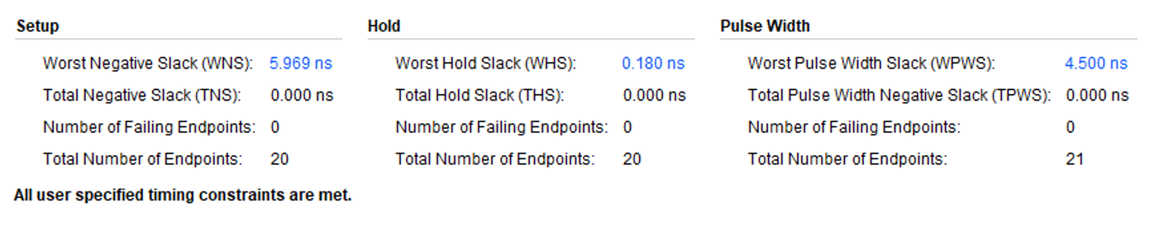
Timing Without v/s With LUT

