Slide 1
Tomato Plant Disease Detection
By:
Afsana Anowar
Roll: 1707048
&
Redwona Islam
Roll: 1707113
Department of Computer Science and Engineering,
Khulna University of Engineering and Technology,
Khulna

Slide 2
Outline
Objectives
Introduction
Related Works
Languages
Implementation Tools
Datasets
Methodology
System Architecture
Experimental Results
User Interface
Challenges
Future Works
Conclusion

Slide 3
Objectives
To design the model for tomato plant disease detection .
To obtain Feature Extraction and classification of images using ‘Xception’ architecture.
To use User Interface in the model as website for the output section.

Slide 4
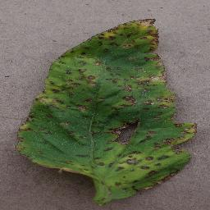
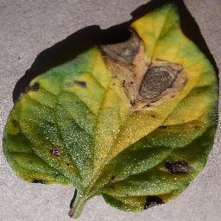
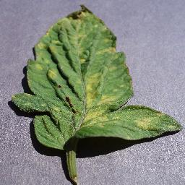
Introduction
Identifying diseases from the image of the plant is one of the interesting research areas in computer vision and agricultural field. There are some popular tomato plant diseases namely ‘Bacterial spot’, ‘Early blight’, ‘Leaf mold’, 'Septoria leaf spot’, 'Tomato Mosaic Virus' etc.
Bacterial spot
Early Blight
Leaf mold

Slide 5
Related Works
(I) MNIST Handwritten Digit Classification Using CNN.
(II) CNN cifar10 Dataset Classification.
(III) IRIS Flower Image Classification using Transfer Leering.
(IV) Animal Identification Using CNN and Transfer Learning (VGG_16, RESNET50, InceptionV3) and comparing the results between them.
(V) Keras Fashion MNIST using CNN.
(VI) Image Segmentation Project.

Slide 6
Languages
Python Fundamental:
(I) Python basic
(II) OOP (Object Oriented Programming)
(III) Data structure and algorithm
Implementation Tools
Keras
Tensorflow
Google colab
Numpy
Matplotlib
Gradio User interface

Slide 7
Datasets
We took datasets from Kaggle website where many images of tomato leaves were included.
we divided the datasets into 3 categories,
(I) Train Dataset (75% images)
(II) Valid Dataset and (13% images)
(III) Test Dataset (12% images)
Total used: 11442 images
For training: 8695 images
For validation: 1388 images
For testing: 1359 images
The datasets included with total 8 classes of Tomato Plant disease which are----
‘Bacterial spot’, ‘Early blight’, ‘Healthy Tomato’, ‘Late blight’, ‘Leaf mold’, 'Septoria Leaf Spot’, ‘Tomato target spot’, ‘Tomato Mosaic Virus;.

Slide 8
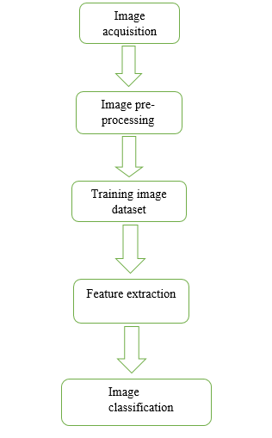
Methodology
Image preprocessing
Image classification using Transfer learning

Slide 9
Image preprocessing
Image Augmentation:
Rescales
Flips
Brightness
Zoom
Shears etc are used in our model.
ImageDataGenerator methods: Flow_from_directory
target _size=(224,224),
color _mode= ‘rgb’
batch_size=64.
class _mode='categorical'.
shuffle=False.
seed=42.

Slide 10
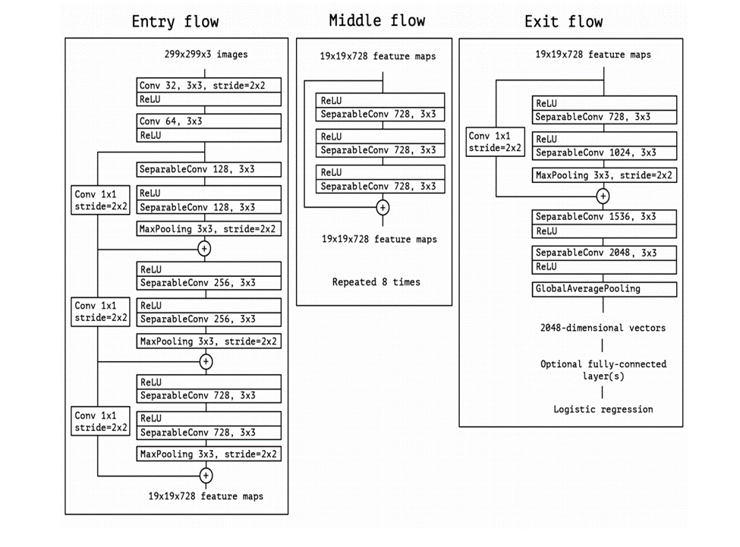
Feature Extraction using Xception architecture

Slide 11
In the Xception model, those steps are used:
(I) The top of the model was included as False.
(II) Used ‘imagenet’ as weights and resized the input shape as (224,224,3).
(III) Maxpolling was used here.
(IV) Base Model Trainable layers are included as false.
(V) Flatten the Base Model Output.
(VI) Included 3 Dense layers in the model.
(VII) At the second layer ReLu activation function was used and in the last/output layer
Softmax activation function was used.

Slide 12
Compiling the model
Optimizer: Adam
Loss: Categorical_Crossentropy loss
Metrics: Accuracy
Fitting the Model
Training dataset
Validation dataset
70 epochs

Slide 13
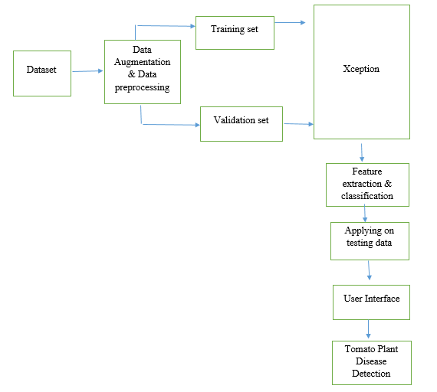
System Architecture

Slide 14
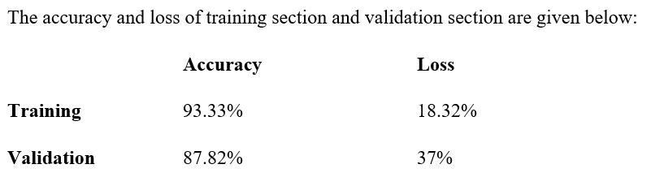
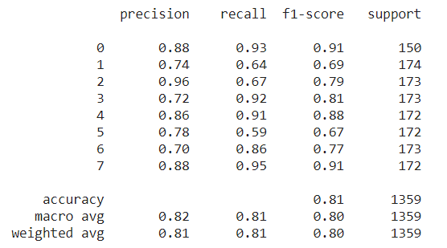
Experimental Result

Slide 15
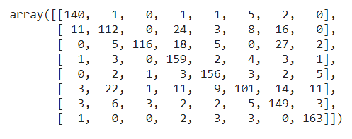
Confusion Matrix:

Slide 16
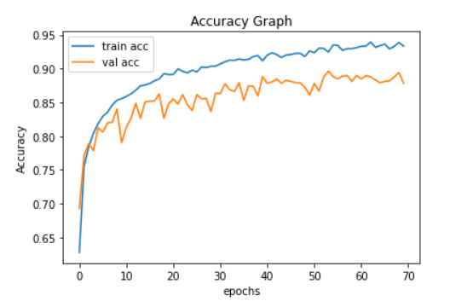
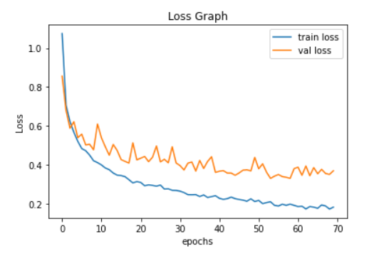
Plotting Graph

Slide 17
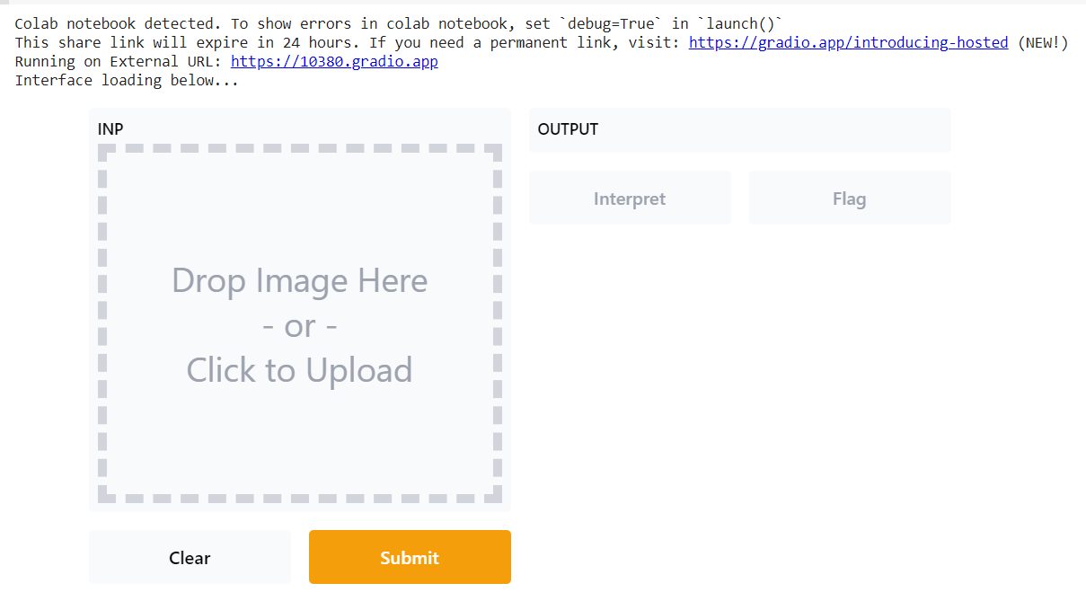
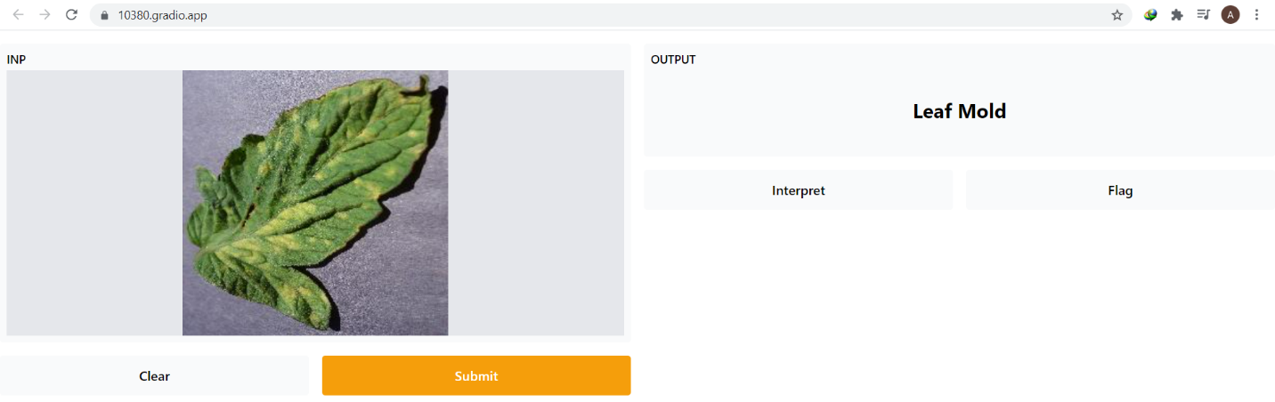
User Interface

Slide 18
Challenges
1. Collection of real images from tomato field by ourselves.
2. Disease segmentation with their symptoms.
3. Hyper parameter tuning to get better accuracy.
4. If some diseases have similar characteristics, then it is difficult to distinguish.

Slide 19
Future Work
(I) Rice Plant Disease Recognition & use it on an Android App.
(II) Face Mask Detection.
(III) Traffic Sign Recognition.
(IV) Image Caption Generator.
(V) Cancer Cell Detection.
(VI) COVID-19 Detection using chest x-ray.

Slide 20
Conclusion
This project concentrates on identifying tomato leaf disease using deep convolutional neural network by transfer learning. The utilized networks are based on the pretrained deep learning model called Xception where we get a better performance but not too much perfect. In future, we will try to get best result by increasing dataset sizes, using another transfer learning and address more challenging disease detection problems.

Slide 21
Thank you

