Slide 1

https://i.pinimg.com/originals/35/40/96/3540963f968365cb9e34dc993ac146ad.png

Slide 2
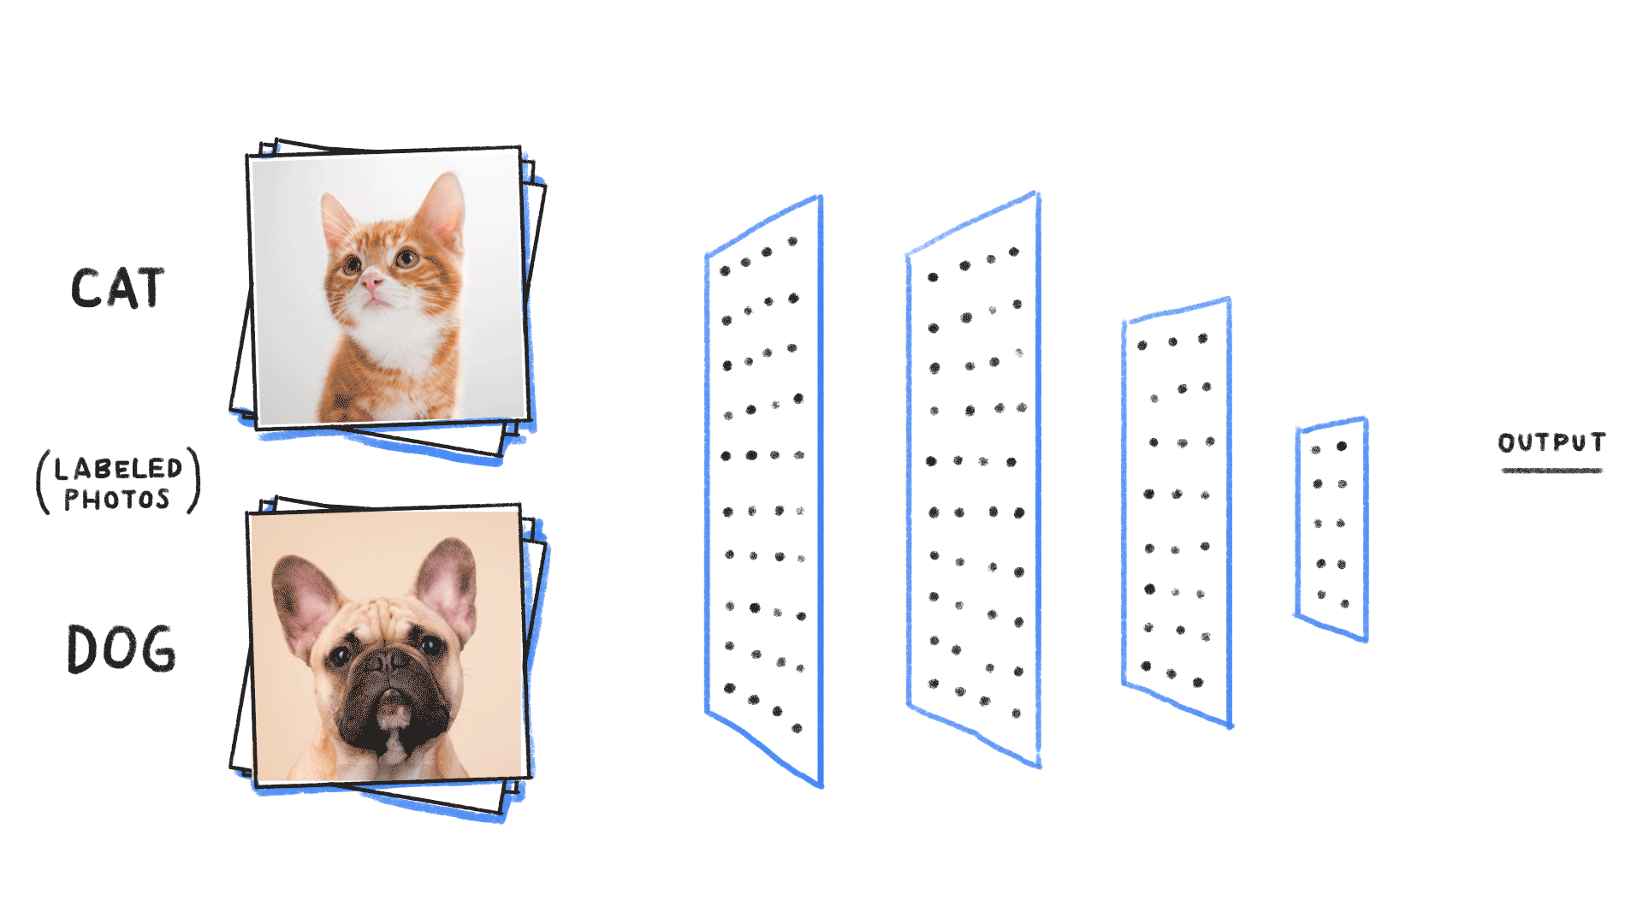
https://miro.medium.com/max/3840/1*oB3S5yHHhvougJkPXuc8og.gif

Slide 3
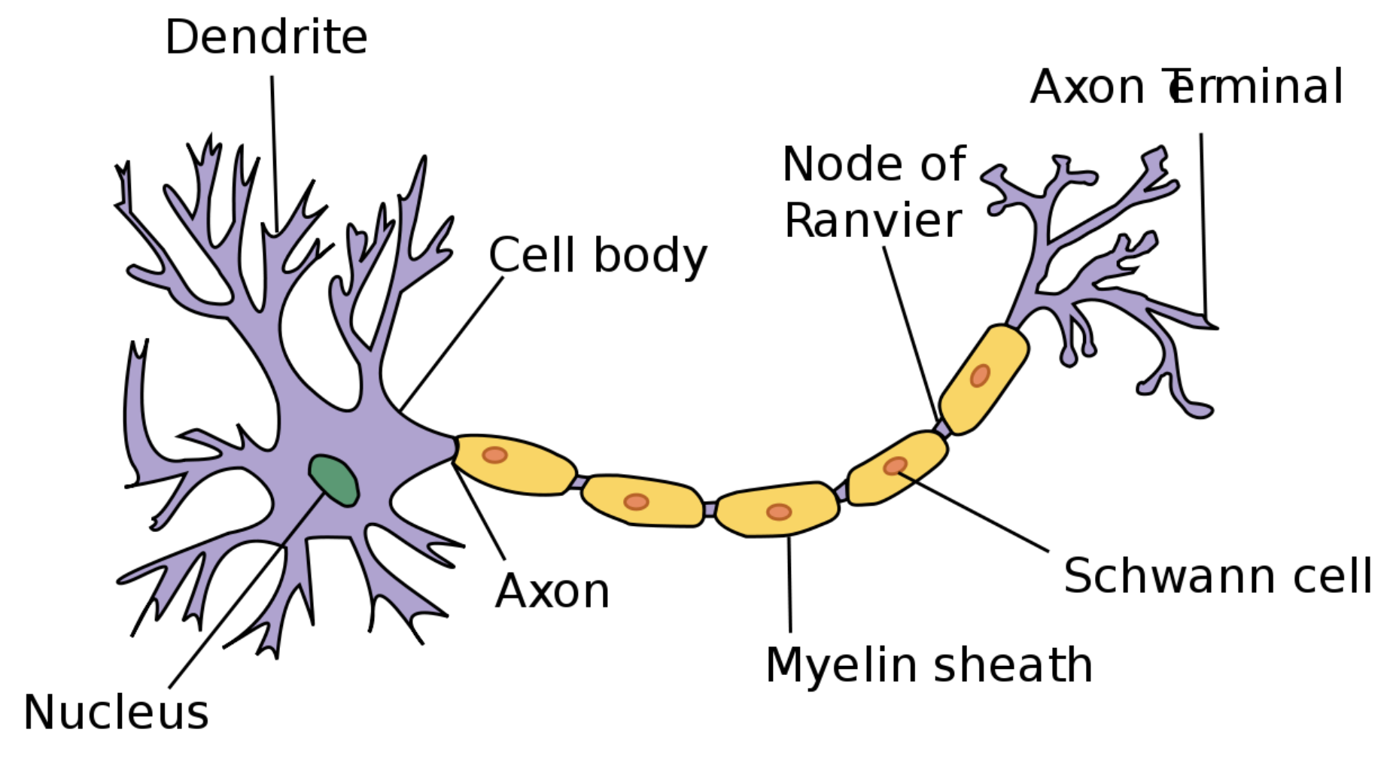

Slide 4
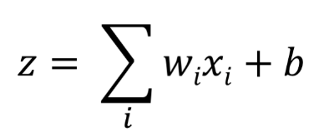
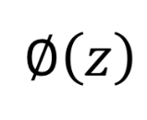
Input
Single Neuron
Output
Input
1
Input
2
N1
Activation
Output
1
Input
3
Linear sum
Transfer function
Nonlinear action
Activation function

Slide 5
N1
Input
1
N2
O1
Output
1
Input
2
N3
O2
Output
2
Input
3
N4
Input
Hidden layer
Output layer
Output

Slide 6
N11
Nk1
Input
1
N12
Nk2
O1
Output
1
…
Input
2
…
…
…
N13
Nk3
Om
Output
m
Input
n
…
…
N1n
Nkj
n-Input
k-Hidden layers → deep layer
m-Output layer

Slide 7
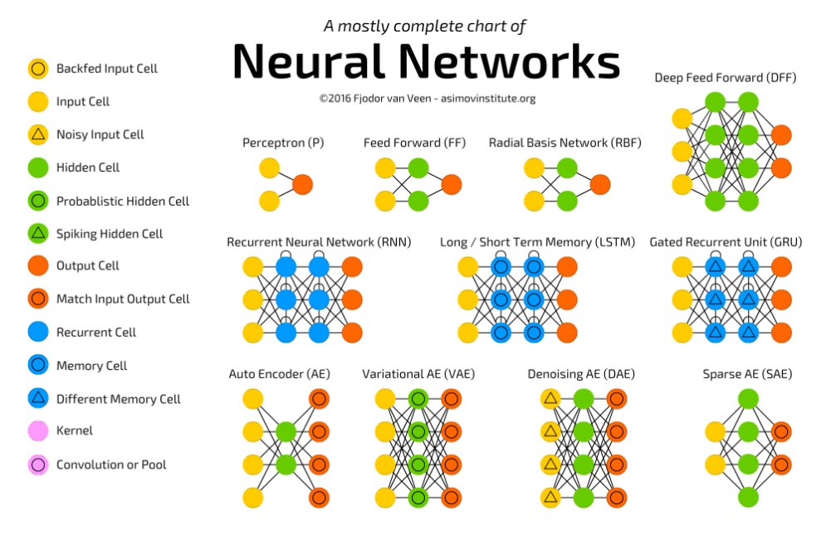
https://leonardoaraujosantos.gitbooks.io/artificial-inteligence/content/neural_networks.html

Slide 8
Deep Learning of Images
→ Conv2D

Slide 9
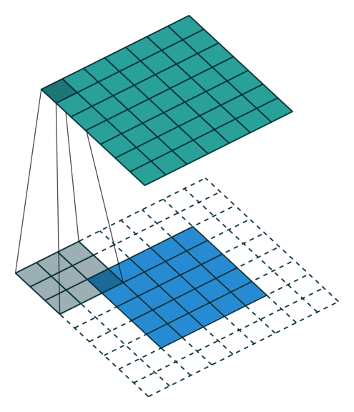
Conv2D

Slide 10
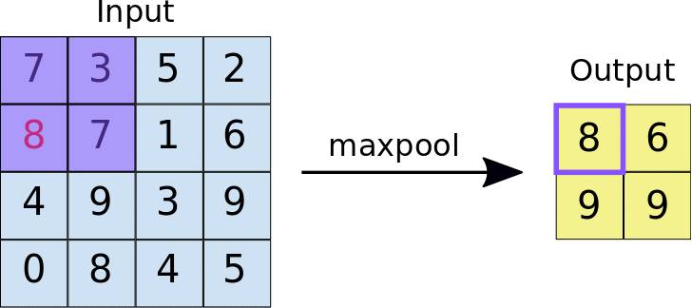
Max-Pooling
https://developers.google.com/machine-learning/practica/image-classification/convolutional-neural-networks

Slide 11
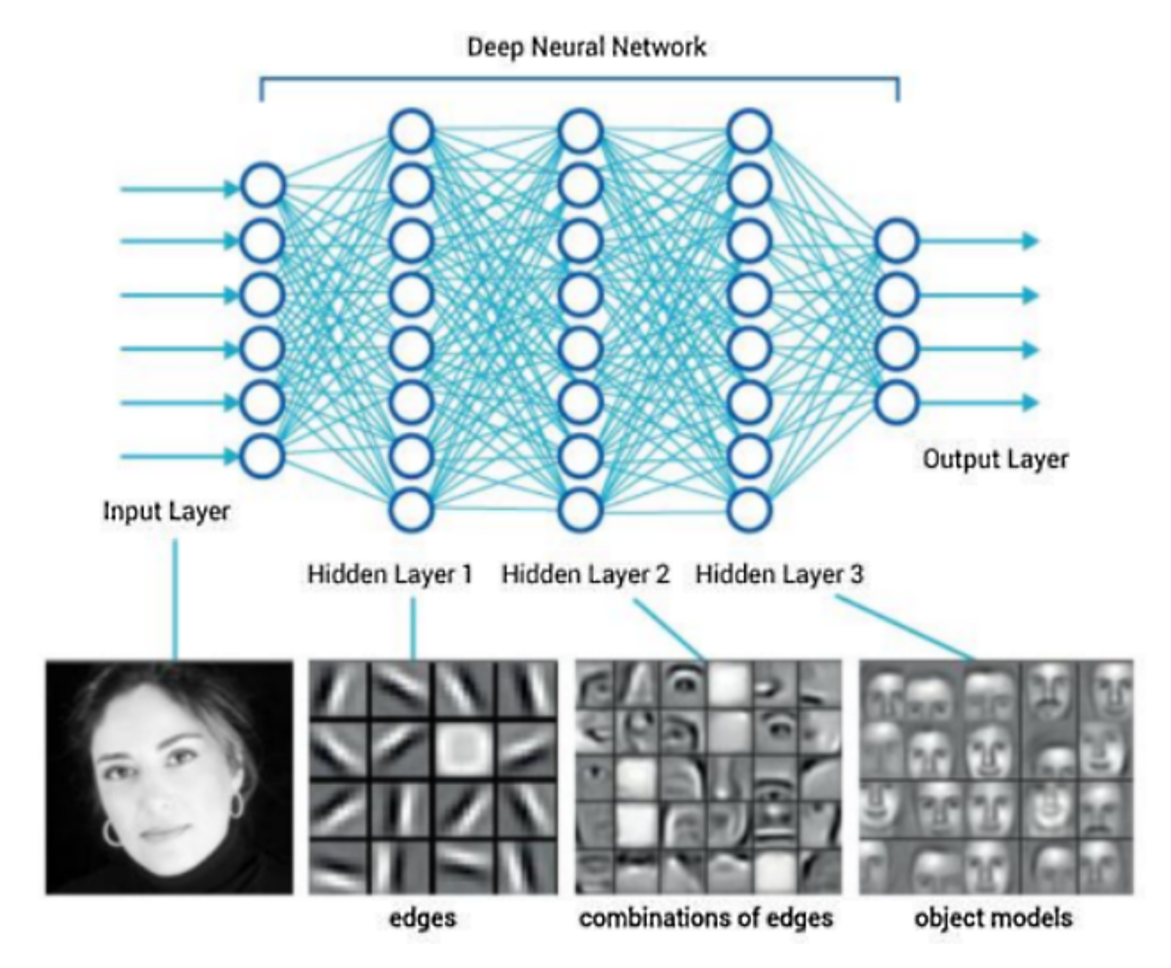
How does DL work on images?
https://miro.medium.com/max/616/1*Uhr-4VDJD0-gnteUNFzZTw.jpeg

Slide 12
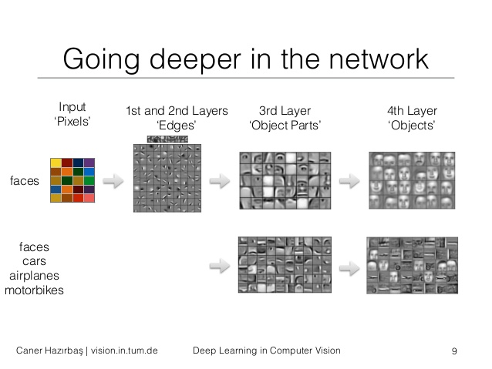
https://image.slidesharecdn.com/deeplearningincomputervision2-150711091158-lva1-app6891/95/deep-learning-in-computer-vision-9-638.jpg?cb=1436605943

Slide 13
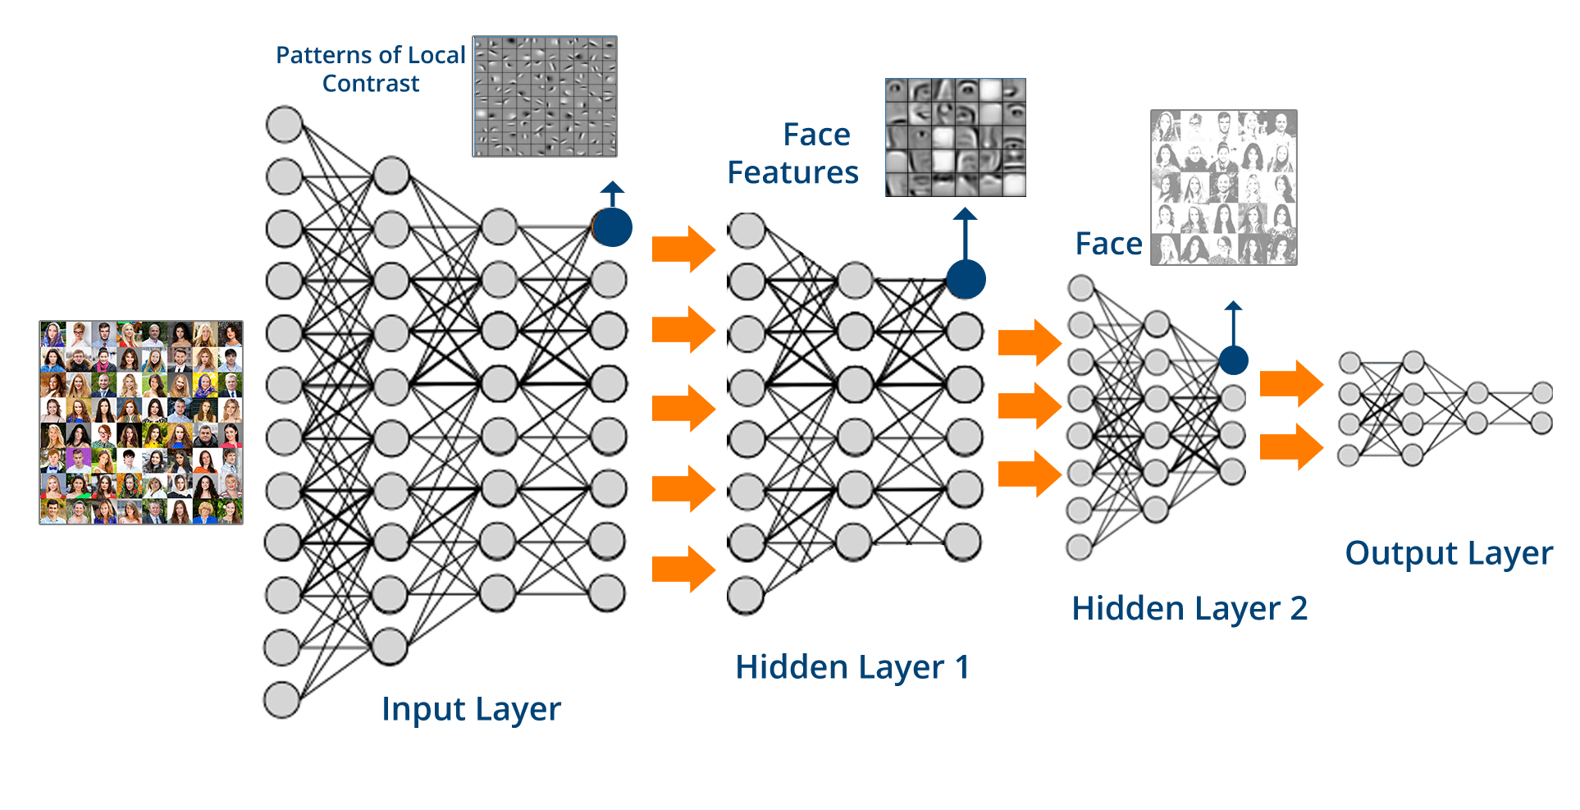
https://cdn.edureka.co/blog/wp-content/uploads/2017/05/Deep-Neural-Network-What-is-Deep-Learning-Edureka.png

