Slide 1


PROBLEM BASED TASK 1 (PBT1)
LIBRARY MANAGEMENT
Class : DDT4A
PREPARED FOR :
SITI NUR THAZLIAH BINTI MOHD THAZALI

Slide 2

TABLE OF CONTENTS
Introduction
01
02
Coding
Output
03
04
Conclusion
Purpose Of PBT1
Develop to allow admins and students
Result of building the program
Features of the coding used

Slide 3



GROUP MEMBER
NAME:MUHAMMAD REDZUAN BIN PARSIKUN
MATRIX NUMBER: 03DDT21F1005
NAME:CHAIRIS A/L PUM
MATRIX NUMBER: 03DDT21F1088

Slide 4

01
INTRODUCTION

Slide 5

INTRODUCTION
Our problem-based task is to create a program that allows admins to manage books in the library. The program should allow admin
add new books to the library
search for books by title
display all books in the library
delete books from the library
The program should store the library data in a text file for purpose admin to manage it

Slide 6
02
CODING

Slide 7
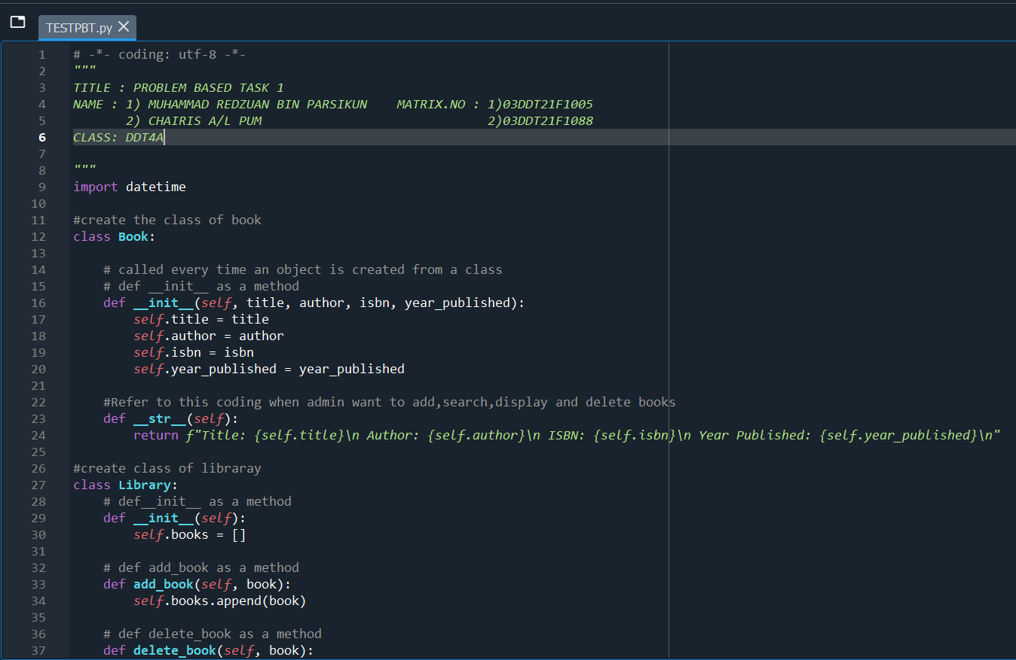
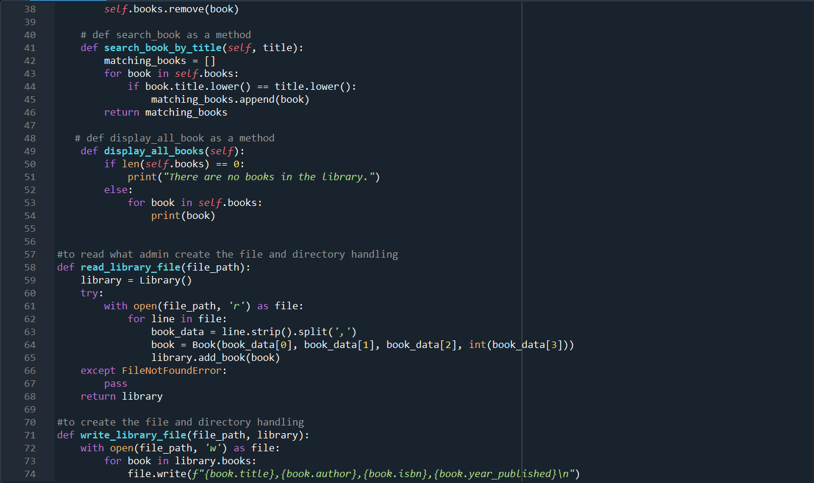
CODING

Slide 8
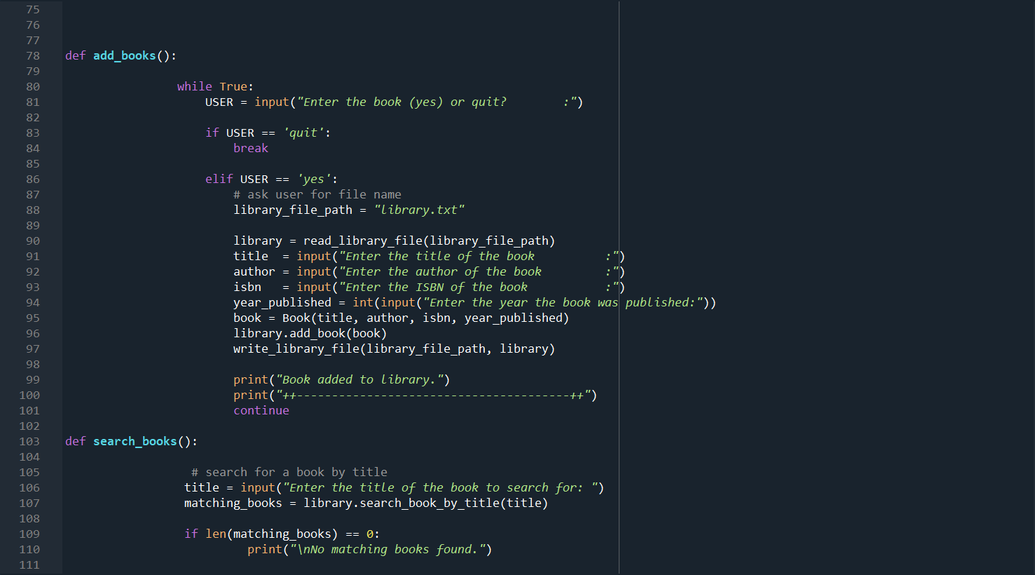
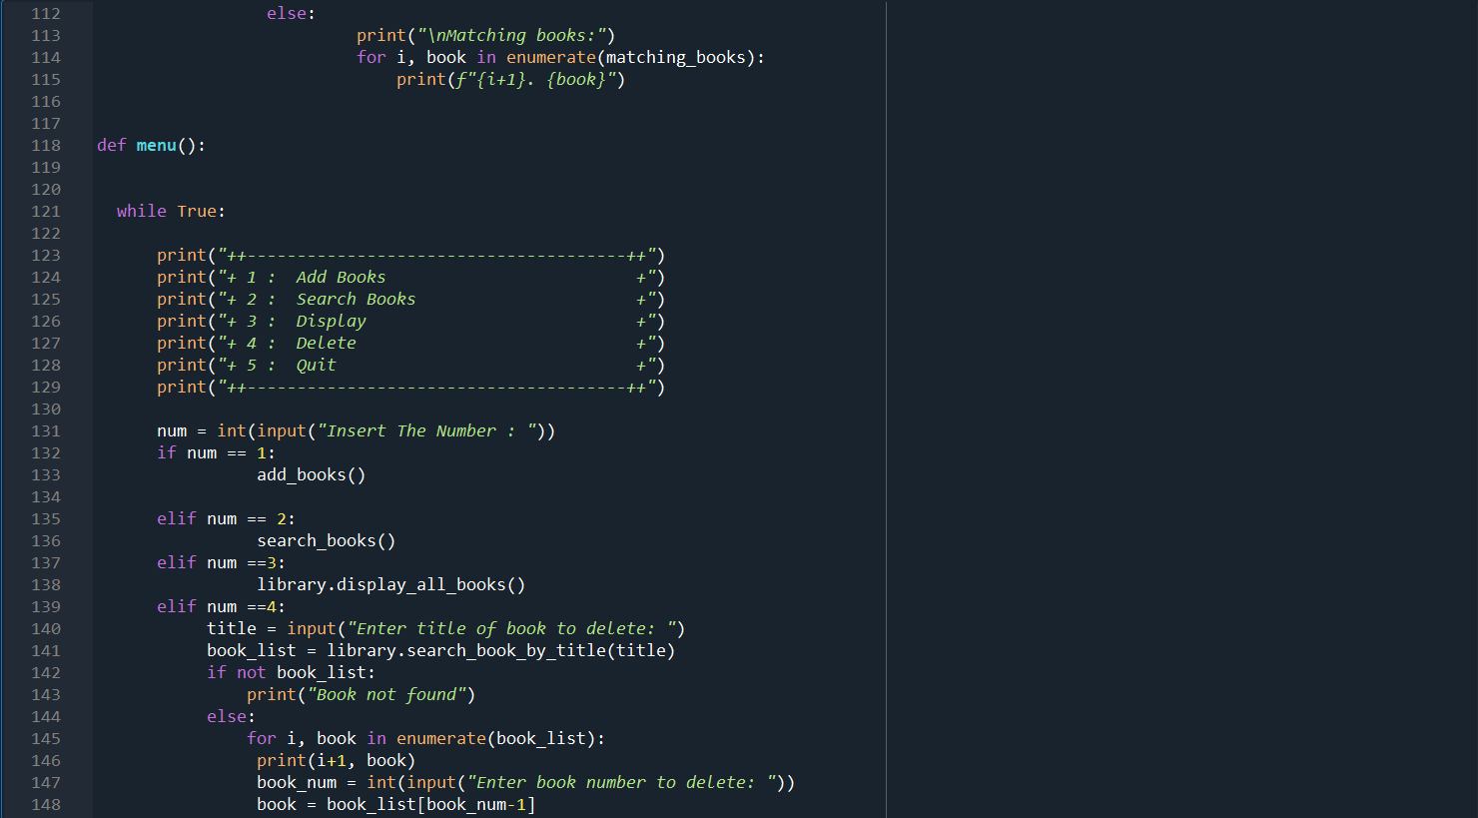
CODING

Slide 9
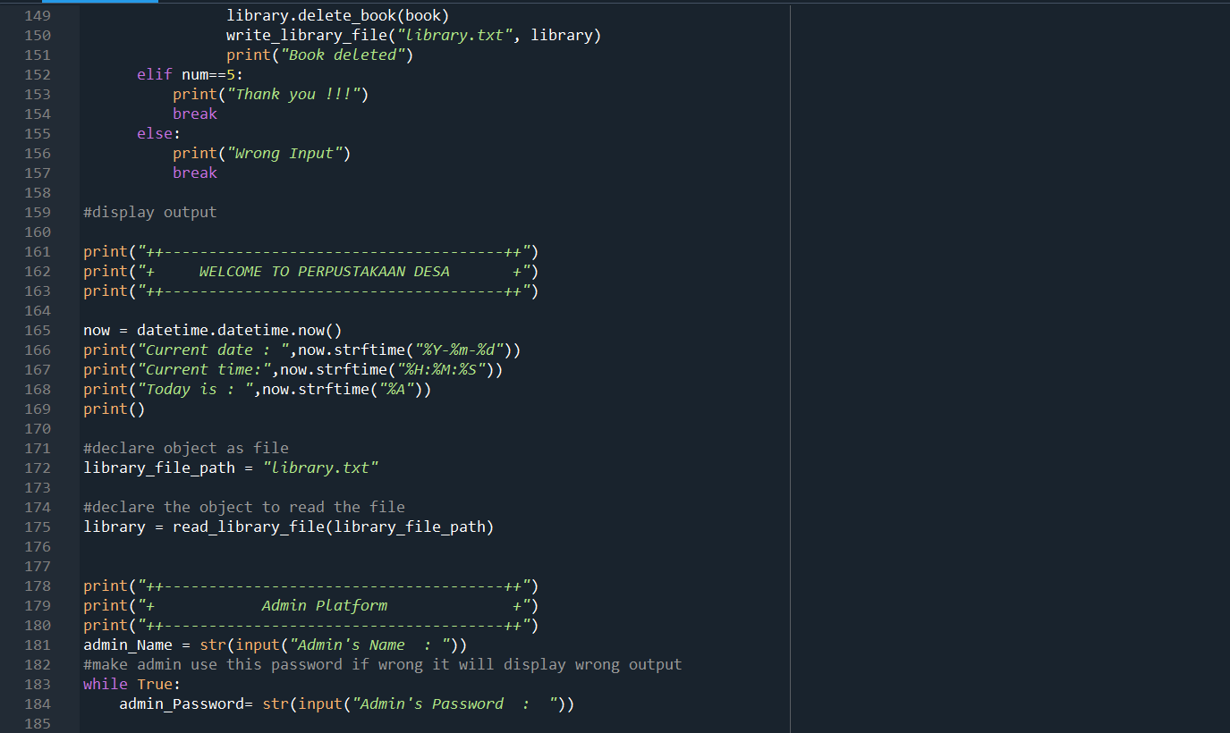
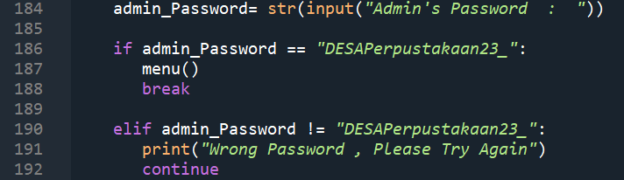
CODING

Slide 10
03
OUTPUT

Slide 11
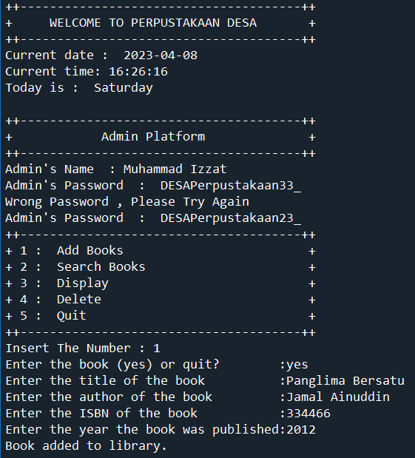
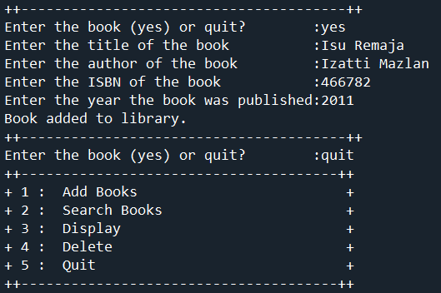
OUTPUT

Slide 12
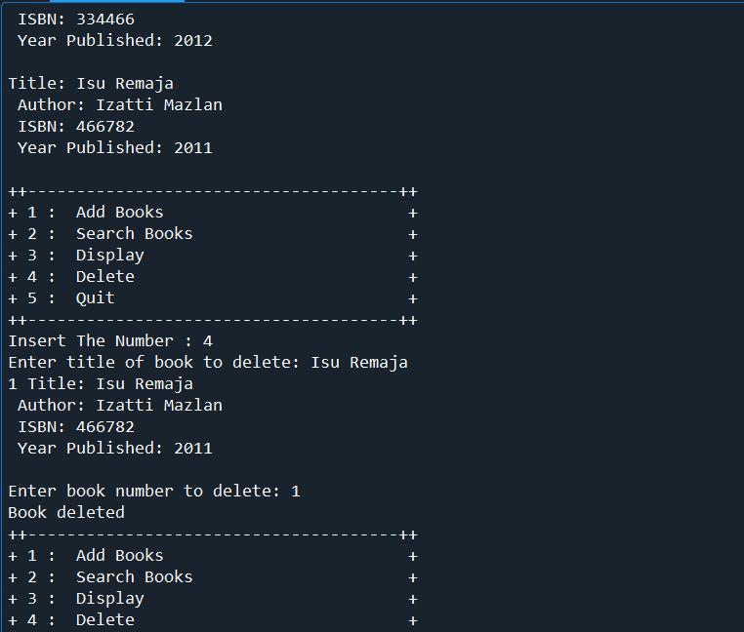
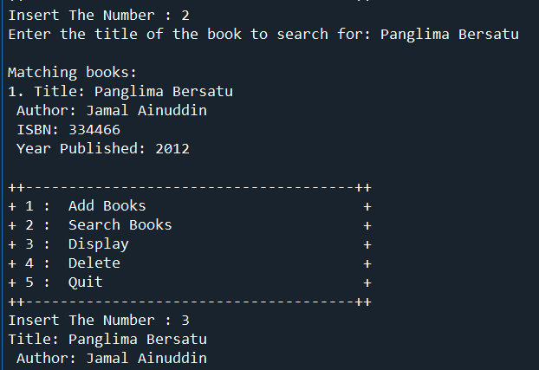

OUTPUT

Slide 13
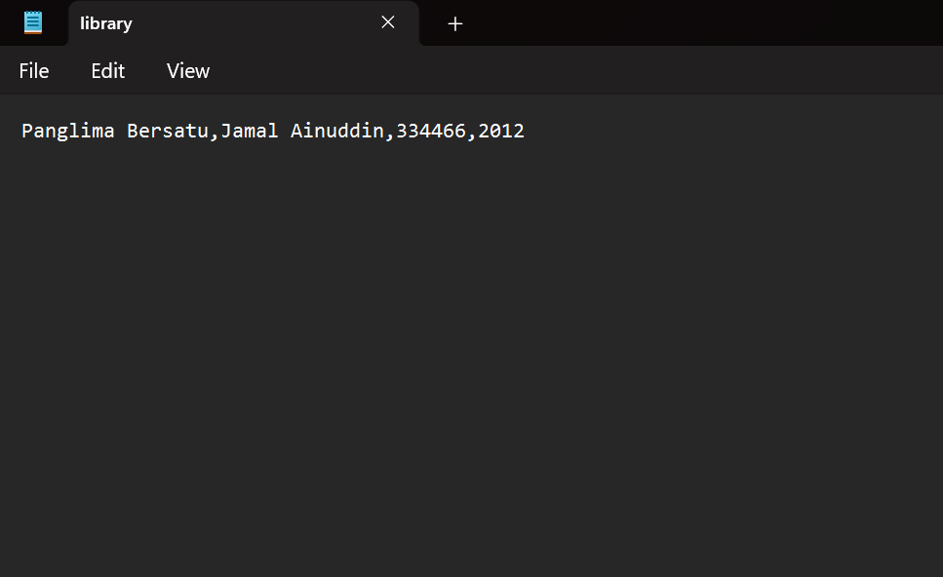
OUTPUT
library.txt

Slide 14
03
CONCLUSION

Slide 15
CONCLUSION
In conclusion, in this assignment, we can learn and understand file and directory handling with function and Object-Oriented Programming (OOP) to develop project which is library management. With file directory handling
the admin is able to use the system clearly
because it can show the contents of the text files that the admin store
In addition, admins are also able to search for book titles that they have saved
. In addition, the admin can also show all the books in the file-directory
Finally, it can also delete the file-directory and make the data disappear.
.

