Slide 1

PROBLEM BASED TASK 2 (PBT2) Restaurant Order System
Class : DDT4A
PREPARED FOR :
SITI NUR THAZLIAH BINTI MOHD THAZALI

Slide 2
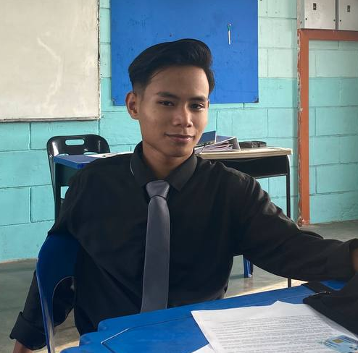


Group Members
MUHAMMAD REDZUAN BIN PARSIKUN
03DDT21F005
SYAKIR ZUFAYRIN BIN KHAIRUL FAIZAL
03DDT21F1085
CHAIRIS A/L PUM
03DDT21F1088

Slide 3
TABLE OF CONTENTS
01
02
03
04
INTRODUCTION
CODING
OUTPUT
CONCLUSION

Slide 4
01
Introduction

Slide 5
Introduction
Our problem-based task is demonstrates a basic restaurant order system. The GUI displays a menu with different dishes and allows the user to :
Add items from their order.
Remove items from their order.
The code defines a dictionary called prices that :
Stores the prices of various dishes in the restaurant.
Creates a Tkinter window as the main interface.
The program includes functions :
such as add() and remove()
-triggered when the user interacts with the GUI buttons.
-update the order details
-calculate the total cost of the order based on the selected items.
Overall, this code provides a foundation for a restaurant order system GUI, allowing users to select dishes and manage their order effectively.

Slide 6
02
Coding

Slide 7
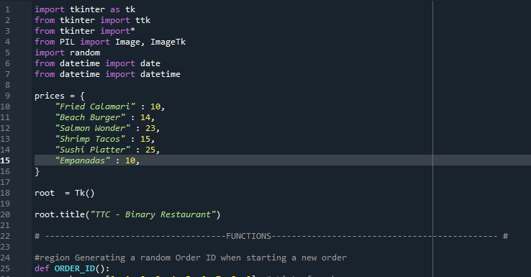

Slide 8
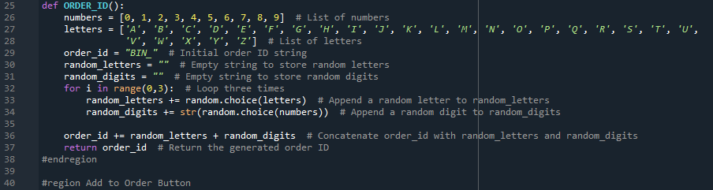

Slide 9
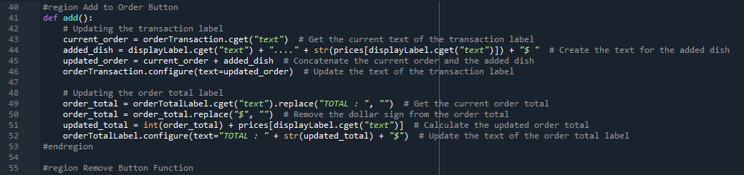

Slide 10
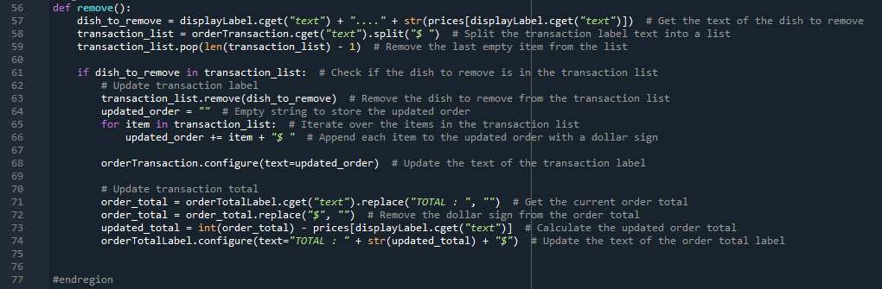

Slide 11
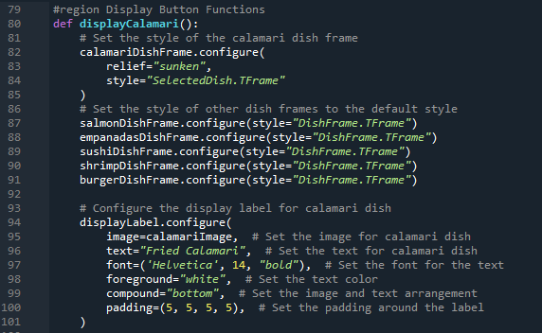

Slide 12
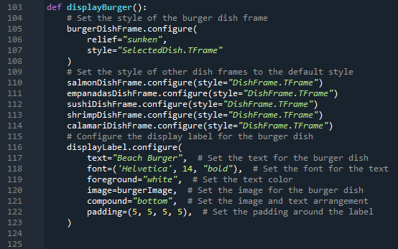

Slide 13
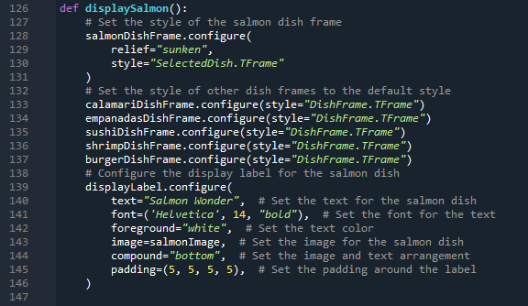

Slide 14
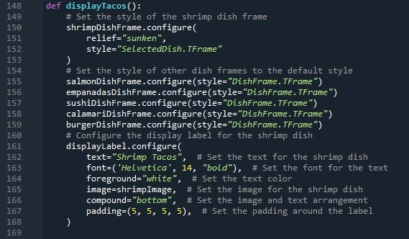

Slide 15
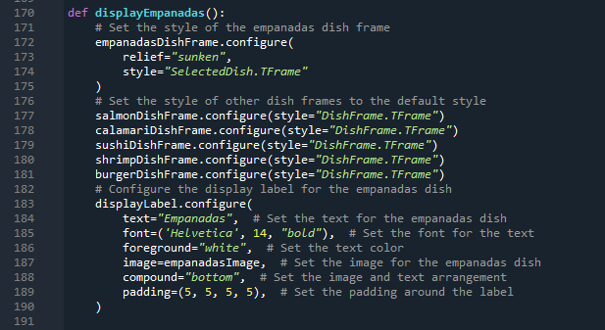

Slide 16
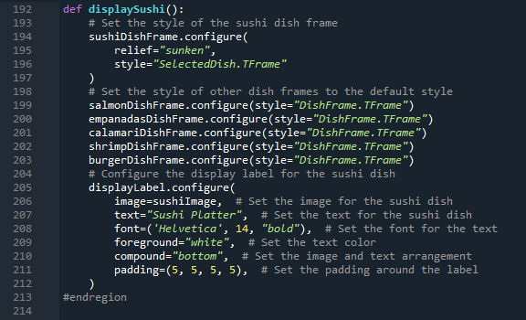

Slide 17
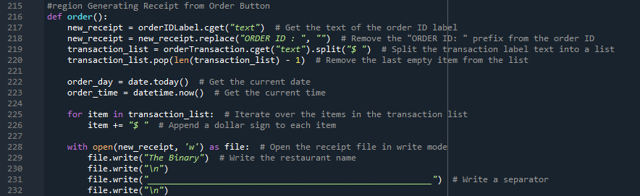

Slide 18
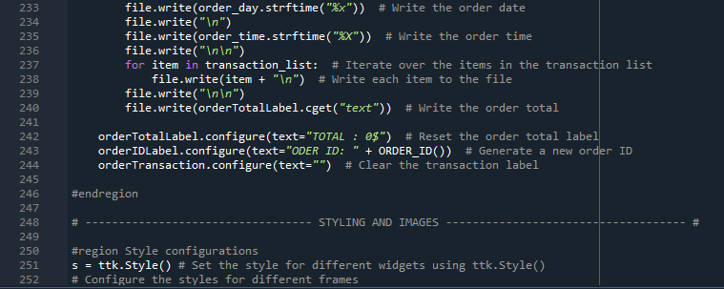

Slide 19
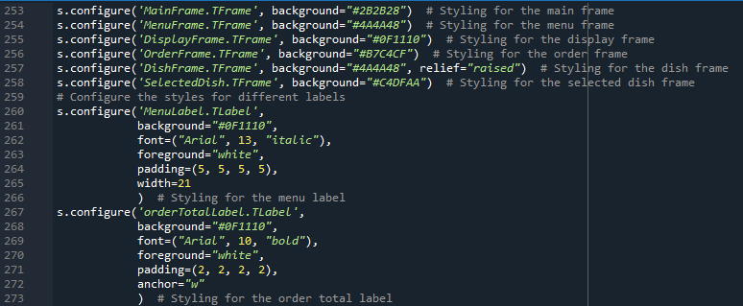

Slide 20
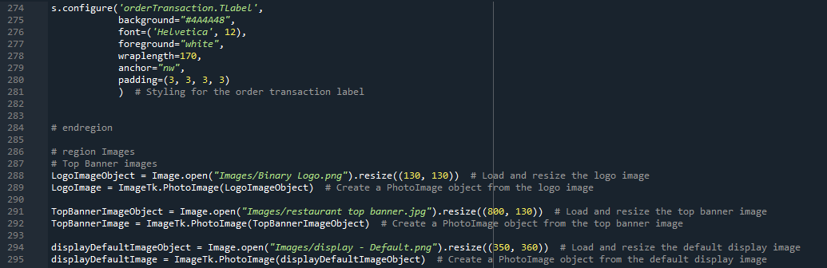

Slide 21
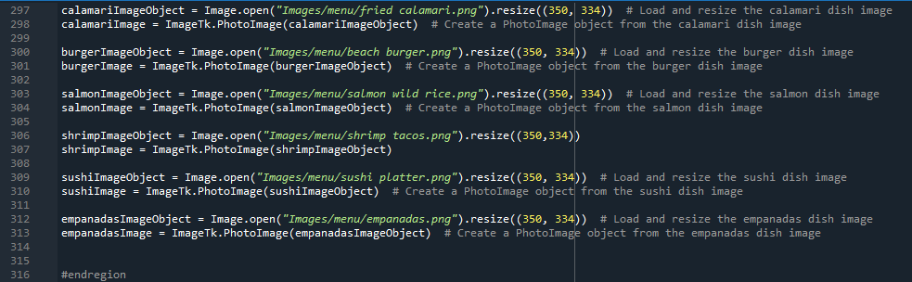

Slide 22
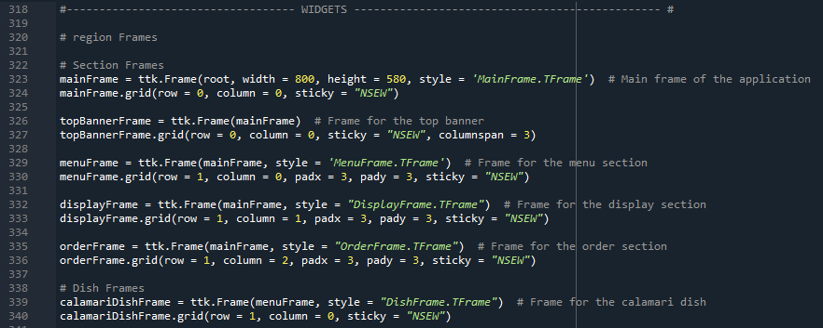

Slide 23
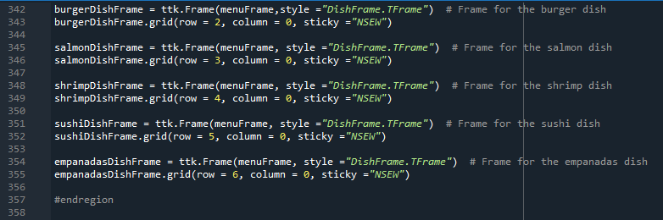

Slide 24
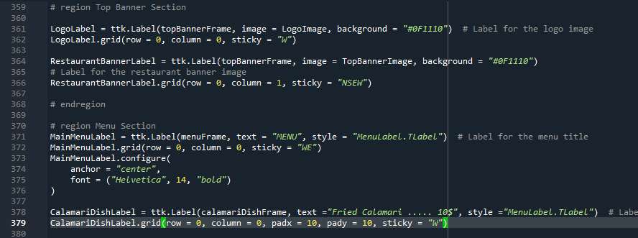

Slide 25
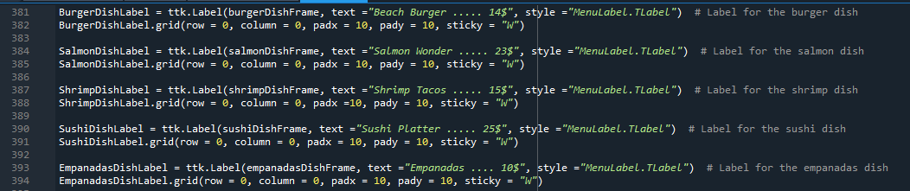

Slide 26
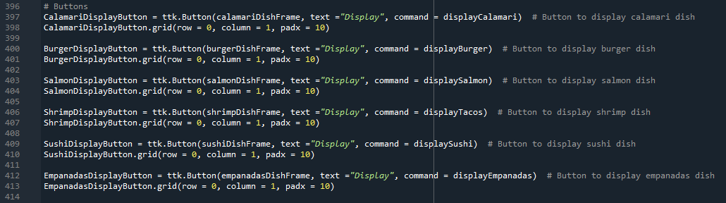

Slide 27
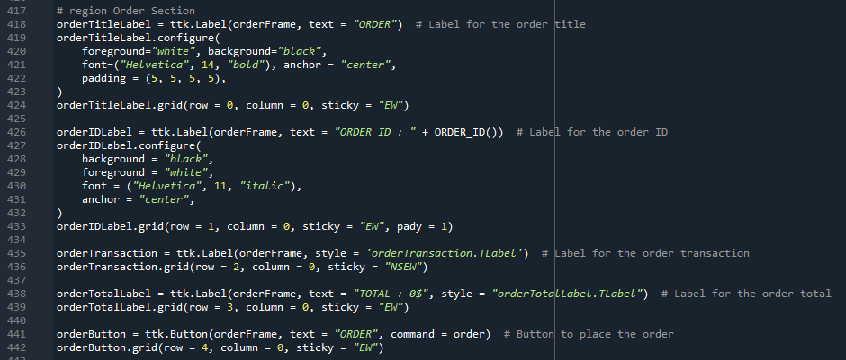

Slide 28
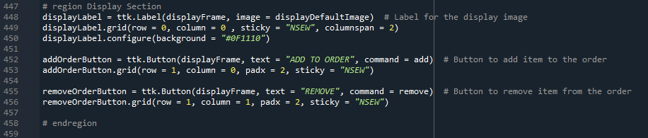

Slide 29
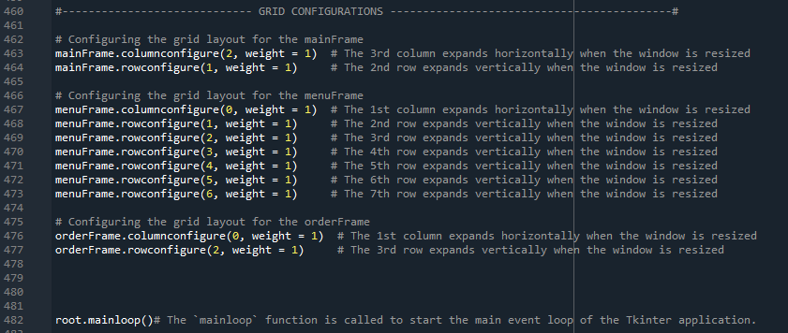

Slide 30
03
Output

Slide 31
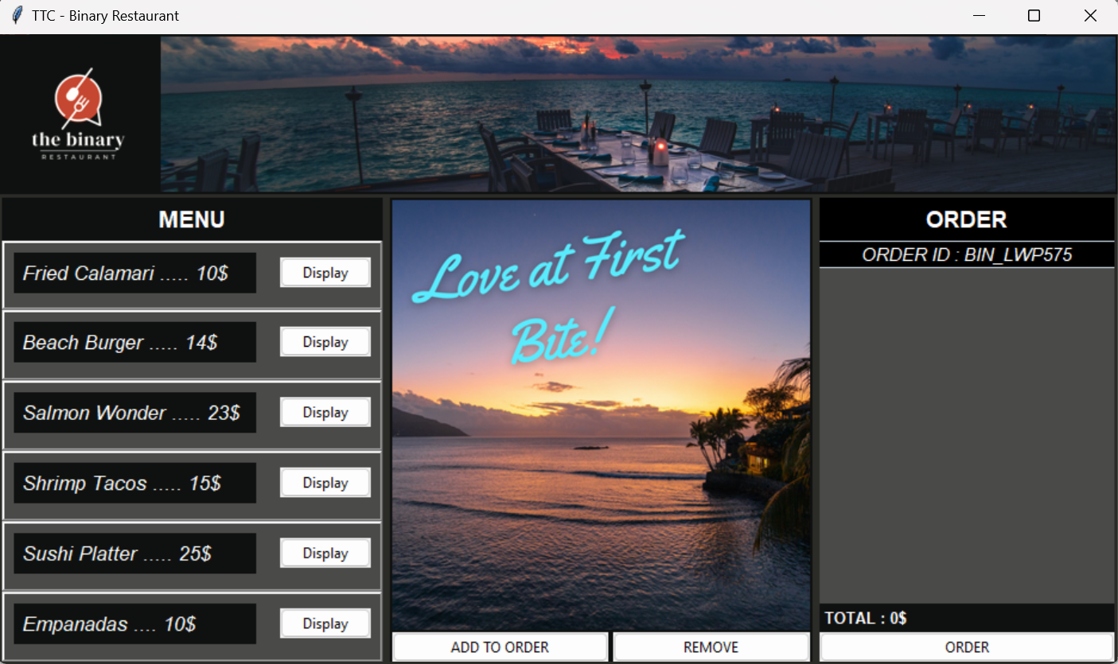
OUTPUT

Slide 32
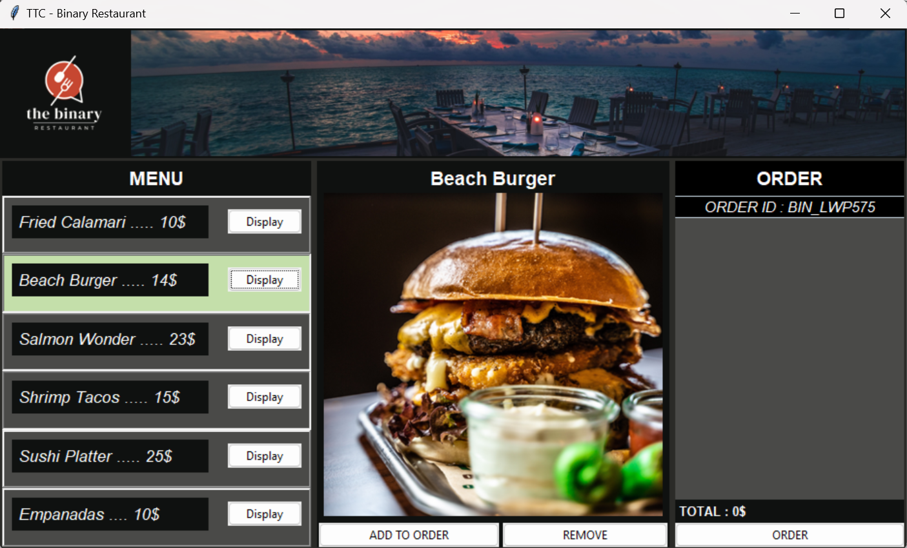
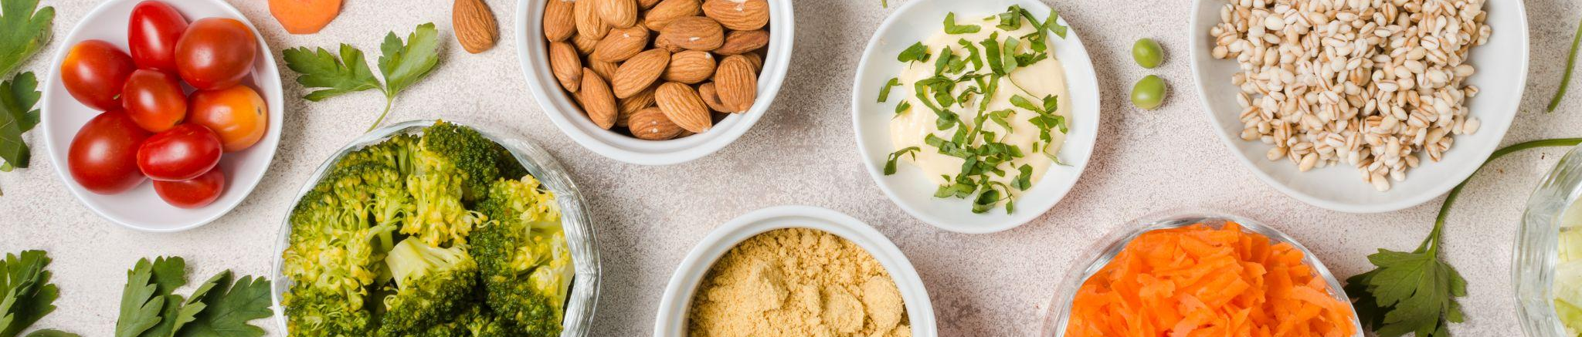
OUTPUT

Slide 33

OUTPUT

Slide 34
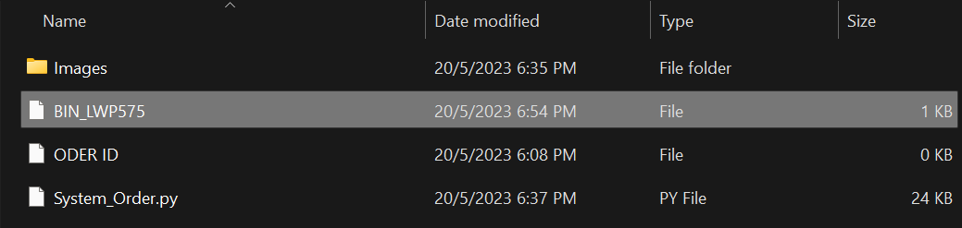
Output + File

Slide 35
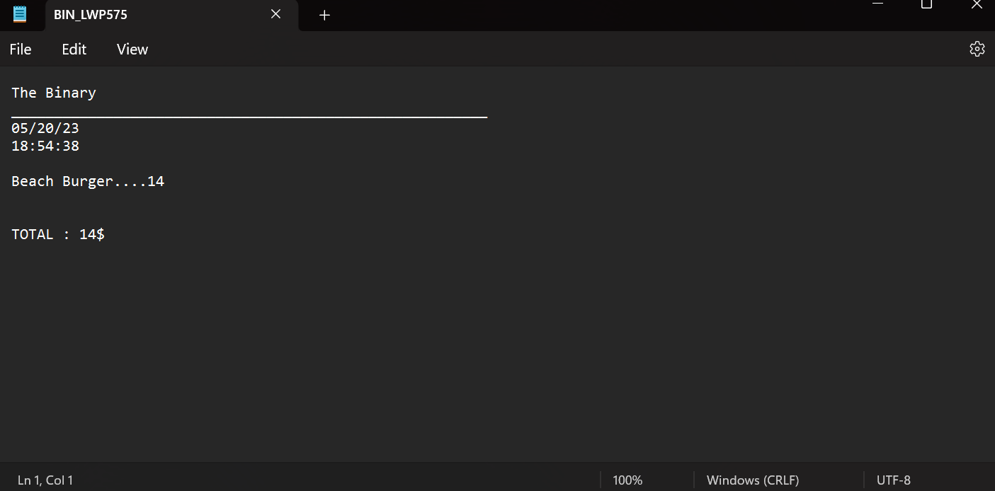
Output + File

Slide 36
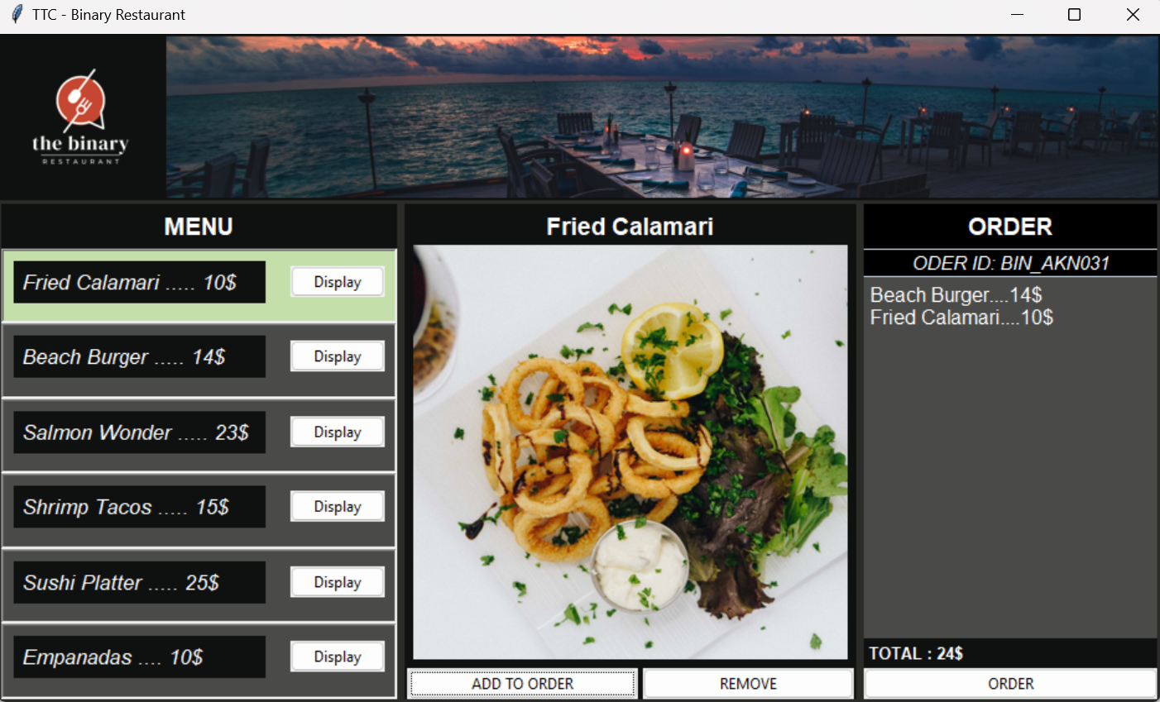
OUTPUT

Slide 37
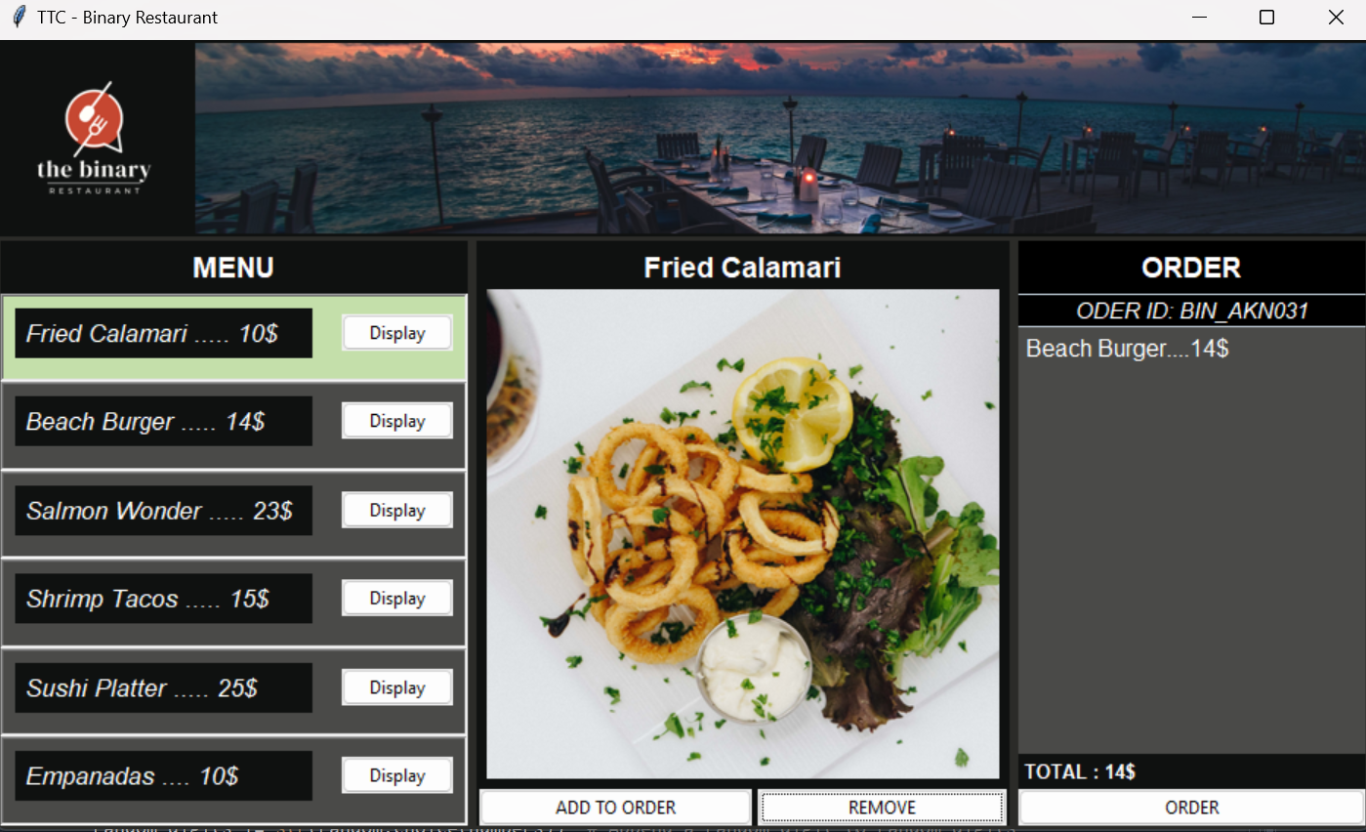
Output

Slide 38
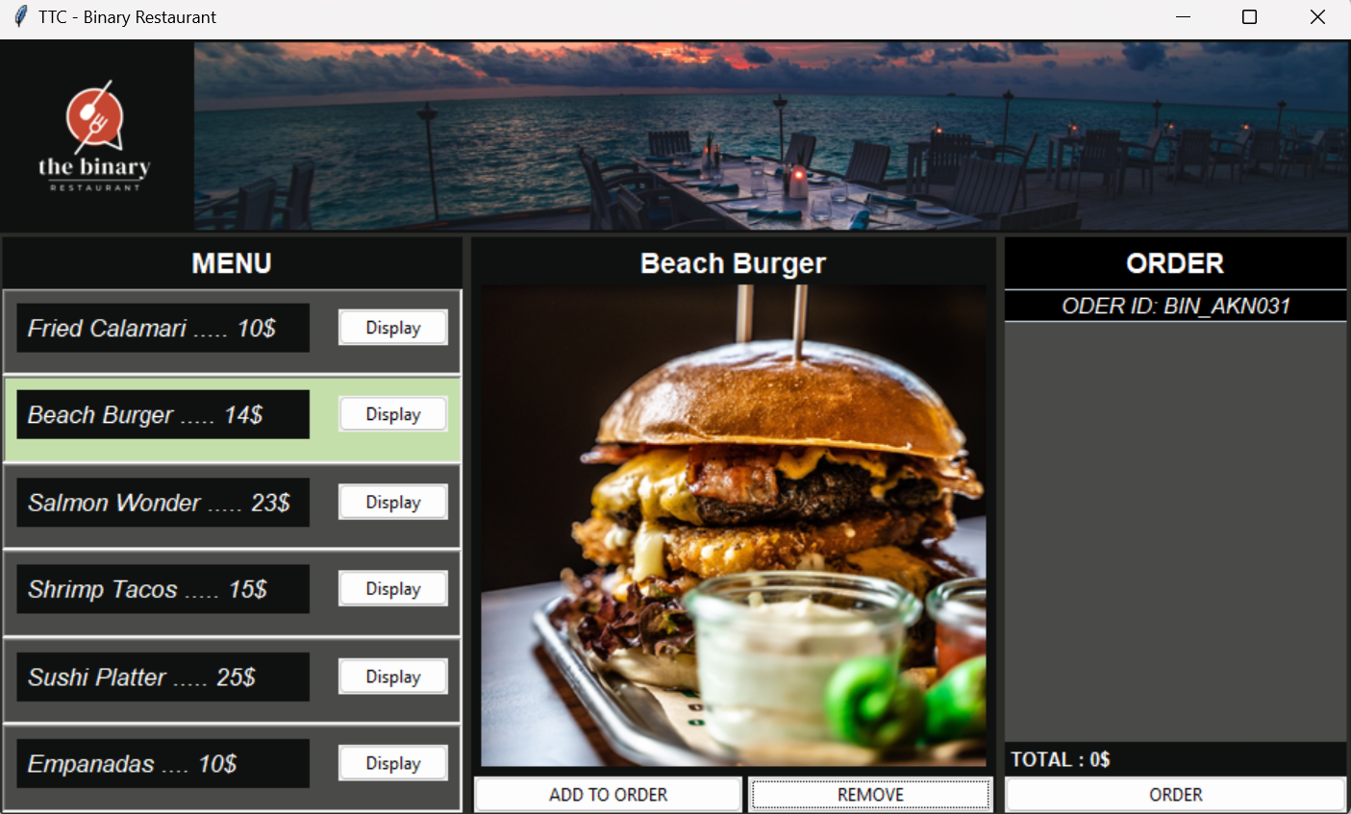
MORE NEWS!

Slide 39
04
Conclusion

Slide 40
Conclusion
It demonstrates a basic restaurant order system. The GUI displays a menu with different dishes and allows the user to add or remove items from their order.
The code defines a dictionary called prices that stores the prices of various dishes in the restaurant. It then creates a Tkinter window as the main interface.
The program includes functions such as add() and remove() that are triggered when the user interacts with the GUI buttons. These functions update the order details and calculate the total cost of the order based on the selected items and saved it in file or receipt
Overall, this code provides a foundation for a restaurant order system GUI, allowing users to select dishes and manage their order effectively.

Slide 41
THANKS!
DO YOU HAVE ANY QUESTIONS?

