Slide 1
003: Reverse Proxy

Slide 2
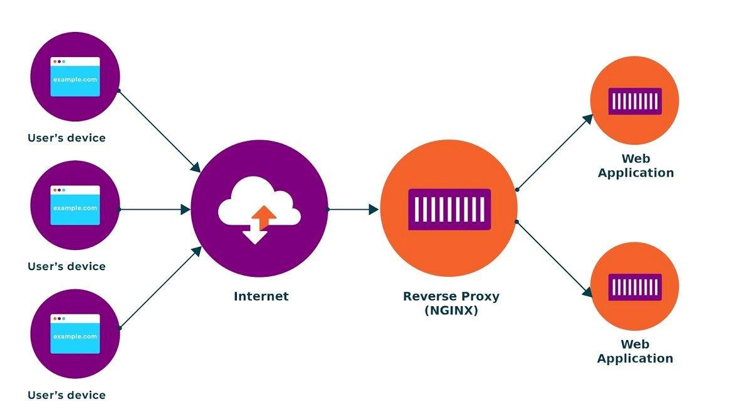
Nginx reverse proxy sits in front of web servers and forwards http requests to the servers and other application
They are used to increase:
Security
Performance
Reliability
Reverse proxy
Notes:
Create diagram of Reverse Proxy

Slide 3
Reverse Proxy Demo

Slide 4
003: nginx reverse proxy

