Slide 1
004: Web Server

Slide 2
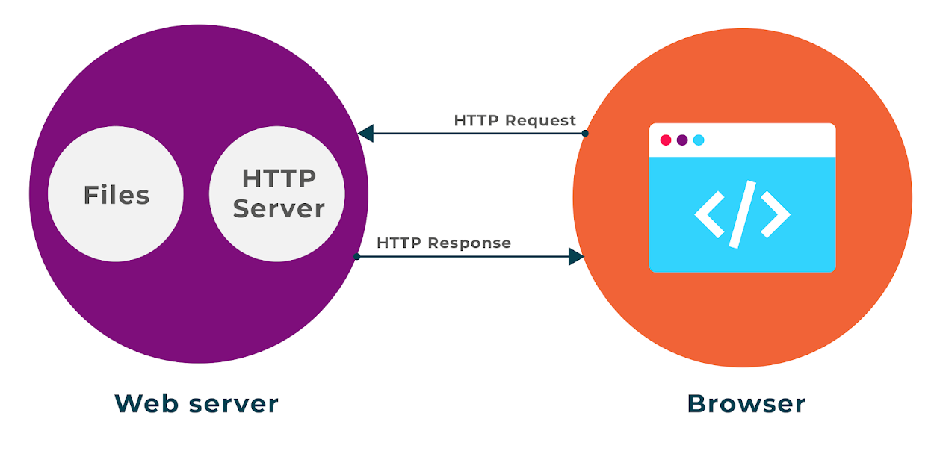
Nginx can be used as a simple web server meaning it can serve web content such as HTML, CSS, JS
Web Server
Notes:
Create diagram of Reverse Proxy

Slide 3
Virtual server
Nginx is configured to create a virtual server which will be what the users access. There are a number of configurations that can be made:
Root – Where are the application files (html, css etc.)
Index – What is the default page for your web app
include – Extra information about the files, allows you to use modern web application frameworks. Configured via the MIME (MultiPurpose Internet Mail Extension) types
Location – ways of accessing other resources if needed

Slide 4
Virtual Server Demo

Slide 5
003: nginx reverse proxy

