Slide 1
006: Docker Images

Slide 2
A Docker image is a read-only file that is effectively a snapshot (the state of a system at a particular point in time) of a container
For instance, if you could take a snapshot of the current state of the computer you are using, move it to another computer and run it so that its in exactly the same state as when you took the snapshot, then this is a similar concept to how Docker images work
Images

Slide 3
Image Layers
Docker images are composed of multiple layers
Layers are read only, if you want to ‘change’ a layer you create a new one and add / place it in the image stack
Images build off of other images, you would start with a simple image and can add new layers to create the new images
nginx
nginx code
Other stuff
ubuntu

Slide 4
Benefits of Layers
Layers in Docker can be reused across multiple images. This is useful for the common infrastructure layers like Ubuntu as a simple OS
The images are not connected by the layers, but you can reuse the source code without needing 3 separate codebases of infrastructure
Image 1
Image 2
Image 3
Website
Backend
nginx
NodeJs
alpine
ubuntu

Slide 5
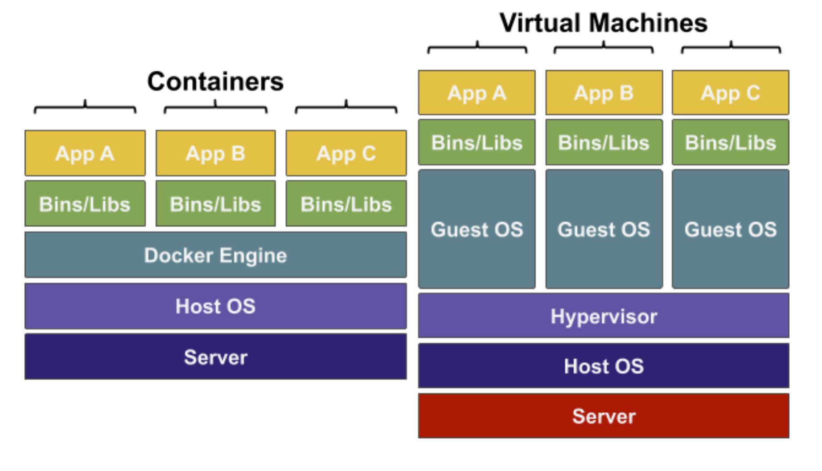
Containers vs Virtual Machines
Server – Physical hardware for the processing power
Host OS – Operating system on the server
Hypervisor – Installed in the Host OS, software to create VMs
Guest OS – Operating system used by the customer (Ubuntu)
Bins/Libs – Program files for the app to run
App – The app to run
Docker Engine – Containerisation Software on Guest OS

Slide 6
Containers
Vs. vms
There are several reasons why developers might use containers over virtual machines:
Containers:
Containers use the same kernel (the core of the operating system) that the host operating system is using
Resources are shared between containers where it is possible
Extremely fast start-up time
Virtual machines:
Virtual machines must emulate an entire computer to support an operating system
There is complete separation between machines
Far more resources are used to isolate the hosted application

Slide 7
Registry - DockerHub
Images are typically stored in remote registries so they can be used by other people and integrated into CI CD pipelines.
Docker has an official registry called Docker Hub which is the default image registry for Docker.
https://hub.docker.com/
(Create accounts for DockerHub)
The Docker CLI works with Docker Hub and you can login with `docker login`

Slide 8
Demo – Logging into Docker

Slide 9
006 Docker images

