Slide 1
009: Docker Network

Slide 2
Networks are system of connected nodes that can communicate in some way
In order for containers to communicate they need to be on the same network
Networks are necessary for microservice architecture where you have multiple apps rather than a single monolith
networking

Slide 3
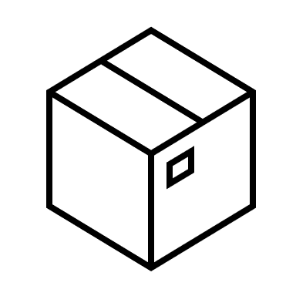

When creating a container it is assigned to the network default. It gets assigned an internal IP address allowing the host machine to connect to this node directly.
Default container network
Default Network
Host Computer
Nginx_1
Nginx_2
Connect to
nginx_1 via IP
Private IP –
172.10.2.0
Private IP –
172.10.2.2

Slide 4
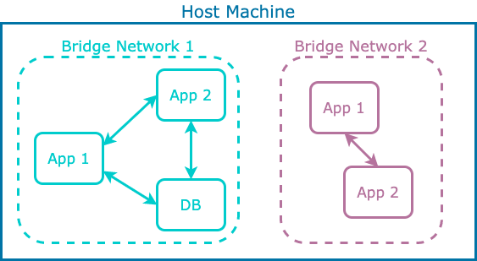
Bridge Network
Bridge Networks connect multiple containers on a single host. The default network is a bridge network, but custom networks allow you to specify custom DNS names and self contained networks.
Bridge networks are the most common type of network and what we will be focusing on

Slide 5
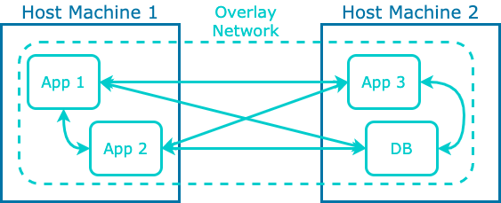
Overlay Network
Overlay networks allow connectivity across multiple host machines / nodes. Allows you to scale up your application easily.
Overlay networks are generally used by Dockers orchestration tool Docker Swarm, with K8s having its own version of an Overlay Network

Slide 6
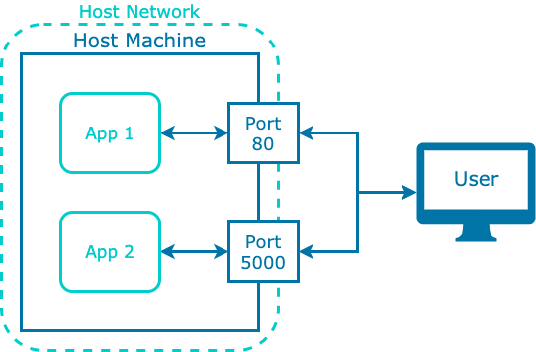
Host Network
Host networks allow you to connect to a container directly with the same namespace rather than an IP address.
When running a container on a host network it shares the IP and DNS as the host machine.
Useful for optimising performance as there is no need for NAT (Network address translation) but may not be as secure

Slide 7
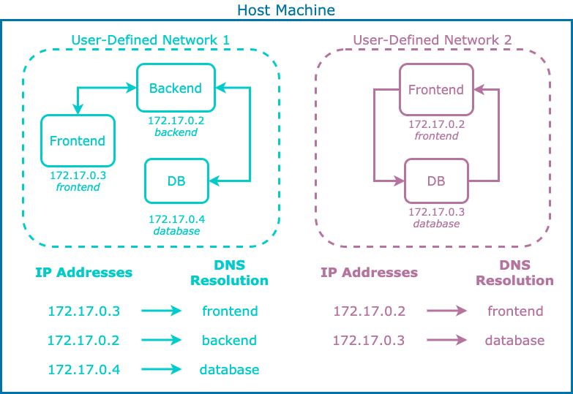
User Defined Networks
When creating user defined Bridge networks they can do the following functions:
Automatic DNS Resolution:
Containers created to a bridge network are given a DNS name based on the container name
Container Isolation:
Containers can be isolated from one another by putting them in separate networks, containers in the same can freely talk
Connect and Disconnect:
Containers can be connected to and disconnected without stopping them

Slide 8
Demo – Using networks

Slide 9
007 Docker containers

Slide 10
When running our application inside a container its important to be able to interact with them individually and collectively.
There are limited commands to running and managing a number of containers, container orchestration tools such as Kubernetes make this job easier.
Other container commands
Command | Function
ps (-a) | Lists all running containers (-a shows all containers)
logs | Returns logs of the container
exec | Connect to an individual terminal via a shell
start | Starts a stopped containers (Run creates and starts container)
Stop | Stops a running container
rm (-f) | Deletes a container (-f forces it to be removed)
rename | Renames a container

Slide 11
Demo – Container commands

Slide 12
008 Docker commands

