Slide 1
002: Jenkins Builds

Slide 2
Jenkins can be modified and setup through the Jenkins GUI. The GUI is accessed via <public ip>:8080 for the EC2 it is installed on
You should have a username and password saved from setting up the Server (generated when you access the GUI for the first time) which can be used to access
Jenkins Access

Slide 3
Jenkins supports a number of builds and jobs such as:
Freestyle Project
Pipeline
Multi Configuration
Multibranch Pipeline
A number of different types based on addons or extensions installed
The simplest is a Freestyle project which has little configuration and allows simple bash commands
Generally Pipeline are a better use, which allow more complex tasks to be followed based on a Jenkinsfile as a single Source of Truth
Jenkins Jobs

Slide 4
When creating a project a number of settings and options are there for customisation of the project:
Source Code Management: The repo you wish the CI CD server to download into the jobs workspace
Build Triggers: When do you want the project to build, simplest is manually triggering a build but other options have ‘help’ to explain
Build Environment: What settings and options do you want for when it is built
Build: What do you want the job to do when it is build
Post build action: What to happen after the job has completed, could be a fail or a success to change the action
Jenkins freestyle Project

Slide 5
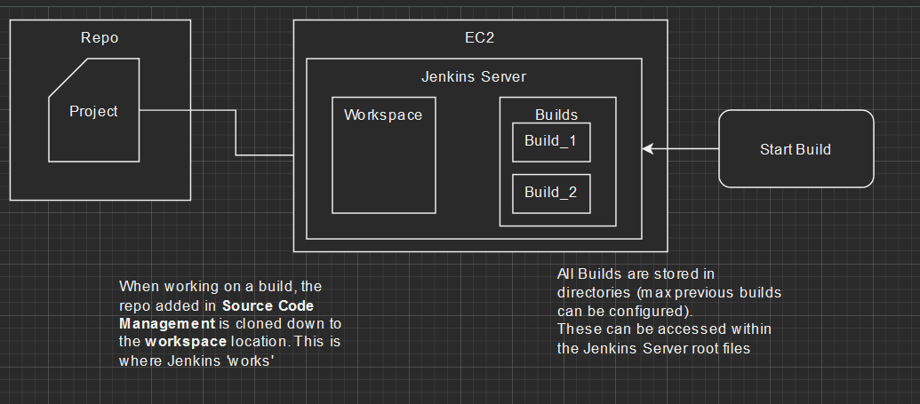
Jenkins Workspace

Slide 6
Demo – Basic Jenkins Build

Slide 7
002 Jenkins build

