Slide 1
001: Docker Intro

Slide 2
Containers
Containers within DevOps are components that can be used to hold or transport code in a specific environment.
Containerisation is a lightweight alternative to virtual machines, with less computing power being spent on unnecessary processes.
Nginx A
Nginx B
Nginx C
EC2 A
EC2 B
EC2 C

Slide 3
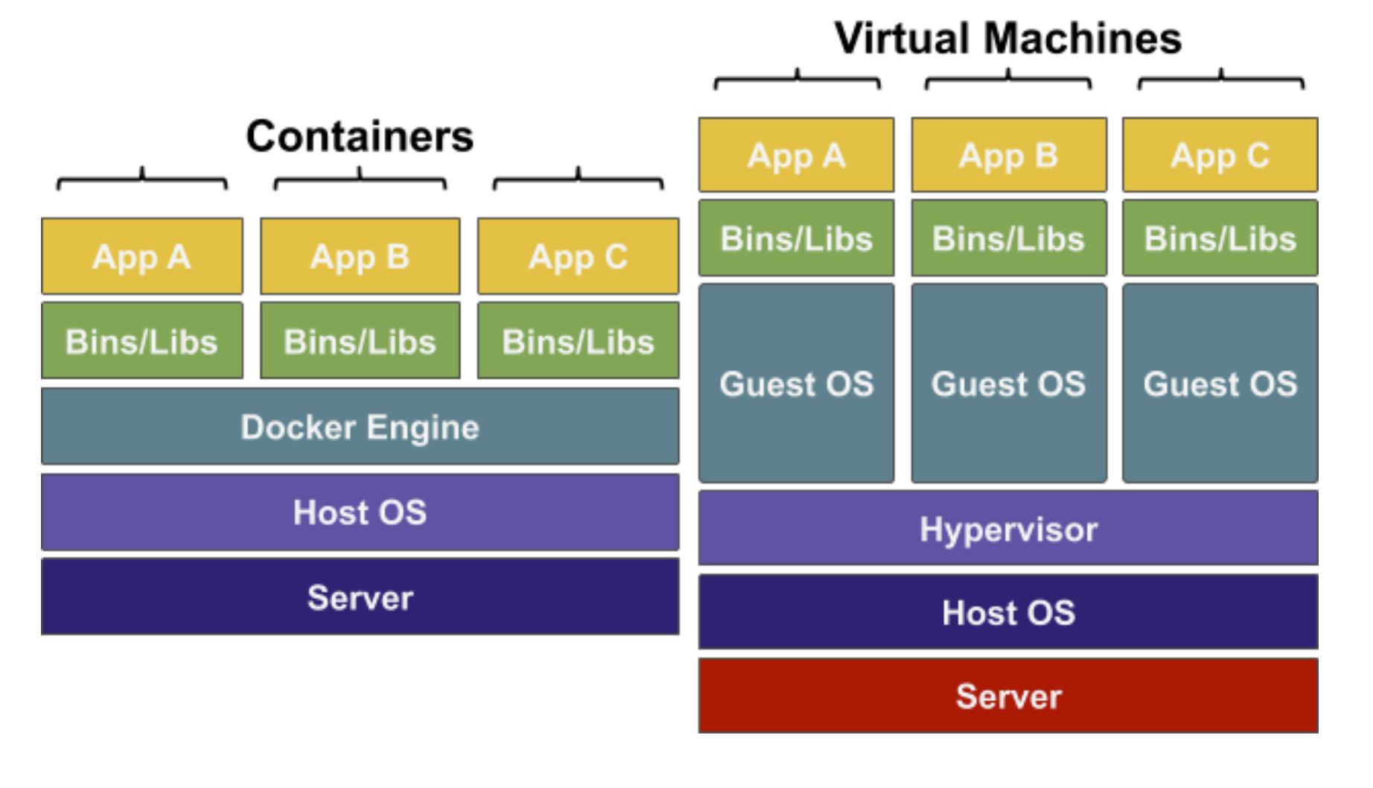
Containers vs Virtual Machines
Server – Physical hardware for the processing power
Host OS – Operating system on the server
Hypervisor – Installed in the Host OS, software to create VMs
Guest OS – Operating system used by the customer (Ubuntu)
Bins/Libs – Program files for the app to run
App – The app to run
Docker Engine – Containerisation Software on Guest OS

Slide 4
Containers
Vs. vms
There are several reasons why developers might use containers over virtual machines:
Containers:
Containers use the same kernel (the core of the operating system) that the host operating system is using
Resources are shared between containers where it is possible
Extremely fast start-up time
Virtual machines:
Virtual machines must emulate an entire computer to support an operating system
There is complete separation between machines
Far more resources are used to isolate the hosted application

Slide 5
What is Docker?
Docker is a simple open source containerisation tool, that is well known in the DevOps and System Admin space.
Docker lets you easily configure and replicate environments so developers can focus on the code.
By using a containerisation tool you require less computing power as you do not need a guest OS on each container
Docker can be installed easily with a remote script hosted on https://get.docker.com or can be installed directly on Windows or Mac

Slide 6
Demo – Installing and using Docker

Slide 7
005: docker INSTALL

