Slide 1
Evaluating Offensive Tools with Ball Tracking Data
By Reece Calvin

Slide 2
Important Note
Preventing Over-Fitting was a Priority
ML Models Trained on 2016, 2017, 2020, and 2021
Separate Regression Model trained using 2018 and 2019 Data
Used 2022 and 2023 for overall evaluations

Slide 3
Baseball Offensive Tools
Swing Decision
Contact
Power
Speed

Slide 4
Baseball Offensive Tools
Swing Decision
Contact
Power
Speed

Slide 5
Swing Decision
Objectives:
Judge each pitch based on its velo, movement, and location
Score the pitch based on the expected run value
Punish hitters for swinging at bad pitches
Reward hitters for swinging at good pitches
Notes:
Remember when they player whiffed at a pitch in the dirt. While it didn’t really effect their contract score, it does effect their swing decision score.
Each pitch is assigned a swing score, take score, and pitch score
Based on pitches velo, movement, location and count
Each pitch also gets a swing probability and called ball vs strike probability, given the pitch was taken

Slide 6
Swing Decision Models
Swing Value
Outputs Probability of each possible result given Swing
Maps to the expected run value of each result and sums to a final expected run value
Swing Prob.
Likelihood the average batter will swing at a pitch, based on pitch characteristics
Called Strike Prob.
Odds pitch is called a strike based on the pitch location, given the player does not swing

Slide 7

Swing Decision Formulas
Take Value
Run-Value of a Ball, acknowledging the count
Strike Value
Run-Value of a Strike, acknowledging the count
Pitch Value
$Swing Prob. ∗Swing Value$
Take Value
$Strike Value ∗Strike Prob. +$ $Ball Value∗Ball Prob.$

Slide 8
How is the Final Score Calculated
Swing Decision Grade is:
If the hitter swings
If the Hitter Takes
Swing Value – Pitch Value
Take Value – Pitch Value

Slide 9
Swing Decisions Leaders
 | Name | 2023 Grade | 2024 Grade
1 | Marcus Semien | 70 | 70
2 | Chris Taylor | 70 | 70
3 | Brandon Belt | 70
4 | Kyle Tucker | 70 | 70
5 | J.D. Davis | 70 | 65
6 | Edouard Julien | 70 | 60
7 | Juan Soto | 70 | 70
8 | Corey Seager | 70 | 65
9 | Andrew Mccutchen | 65 | 70
10 | George Springer | 65 | 70
 | Name | 2023 Grade | 2024 Grade
1 | Kyle Tucker | 70 | 70
2 | Juan Soto | 70 | 70
3 | Chris Taylor | 70 | 70
4 | George Springer | 65 | 70
5 | Marcus Semien | 70 | 70
6 | Andrew Mccutchen | 65 | 70
7 | Ronald Acuña | 60 | 70
8 | Dansby Swanson | 65 | 65
9 | Gleyber Torres | 60 | 65
10 | Brandon Lowe | 55 | 65

Slide 10
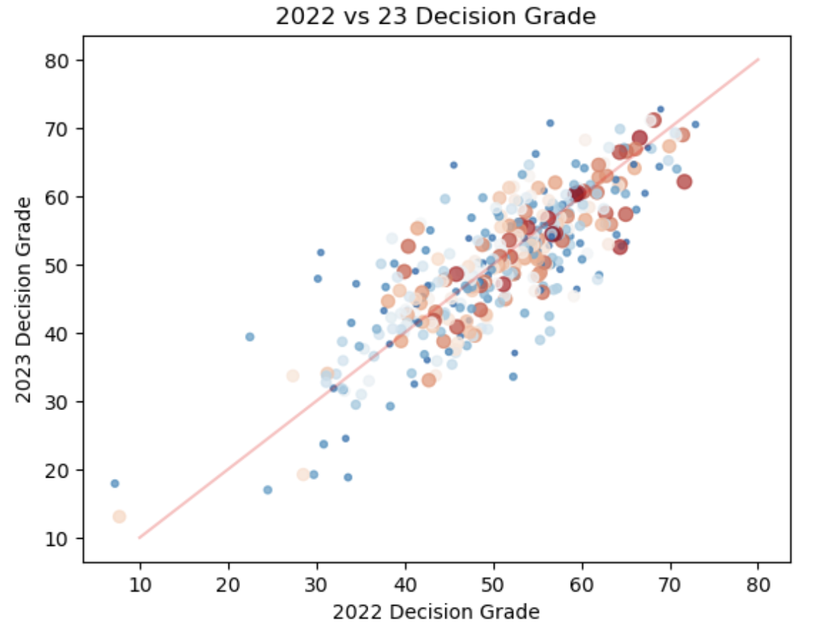
Check Out That Stickiness

Slide 11
Green Baseball Offensive Tools
Swing Decision
Contact
Power
Speed

Slide 12
Contact
Objectives:
Judge a player's ability to make contact when they swing
Do not factor in swing decision
Notes:
Remember when they player whiffed at a pitch in the dirt. While it didn’t really effect their contract score, it does effect their swing decision score.
Each pitch is assigned a swing score, take score, and pitch score
Based on pitches velo, movement, location and count
Each pitch also gets a swing probability and called ball vs strike probability, given the pitch was taken

Slide 13
Contact Score
xContact
Given a player swings, odds they make contact with the ball
Contact Score
Made Contact: Score = 1-xContact
Swing-and-Miss:
Score = 0-xContact

Slide 14
Contact Leaders
 | Name | 2023 Grade | 2024 Grade
1 | Luis Arráez
2 | Keibert Ruiz
3 | Nico Hoerner
4 | Steven Kwan
5 | Alejandro Kirk
6 | José Ramírez
7 | Mauricio Dubón
8 | Miguel Rojas
9 | Jeff McNeil
10 | Josh Naylor
 | Name | 2023 Grade | 2024 Grade
1 | Kyle Tucker | 70 | 70
2 | Juan Soto | 70 | 70
3 | Chris Taylor | 70 | 70
4 | George Springer | 65 | 70
5 | Marcus Semien | 70 | 70
6 | Andrew Mccutchen | 65 | 70
7 | Ronald Acuña | 60 | 70
8 | Dansby Swanson | 65 | 65
9 | Gleyber Torres | 60 | 65
10 | Brandon Lowe | 55 | 65

Slide 15
Power
Exit Velocity over Expected EV, Given contact
Evaluated at a player's 95th percentile output

Slide 16
Power Leaders
 | Name | 2023 Grade | 2024 Grade
1 | Aaron Judge | 80 | 70
2 | Rafael Devers | 75 | 70
3 | Shohei Ohtani | 75 | 70
4 | Giancarlo Stanton | 75 | 80
5 | Joey Gallo | 70 | 65
6 | Jake Burger | 70 | N/A
7 | Ronald Acuña | 70 | 60
 | Name | 2023 Grade | 2024 Grade
1 | Giancarlo Stanton | 75 | 80
2 | Anthony Santander | 65 | 75
3 | Oneil Cruz | N/A | 70
4 | Rafael Devers | 75 | 70
5 | Aaron Judge | 80 | 70
6 | Shohei Ohtani | 75 | 70
7 | Carlos Correa | 60 | 65

Slide 17
Speed
Home to First Times

Slide 18
Speed Leaders
 | Name | 2023 Grade | 2024 Grade
1 | Ji Hwan Bae | 70 | N/A
2 | Corbin Carroll | 65 | 65
3 | Akil Baddoo | 65 | N/A
4 | Bobby Witt | 65 | 70
5 | Elly De La Cruz | 65 | 60
6 | Trea Turner | 65 | 65
7 | Myles Straw | 65 | N/A
 | Name | 2023 Grade | 2024 Grade
1 | Jazz Chisholm | 65 | 70
2 | Evan Carter | N/A | 70
3 | Bobby Witt | 65 | 70
4 | Corbin Carroll | 65 | 65
5 | Shohei Ohtani | 65 | 65
6 | Jung Hoo Lee | N/A | 65
7 | Jarren Duran | 65 | 65

Slide 19
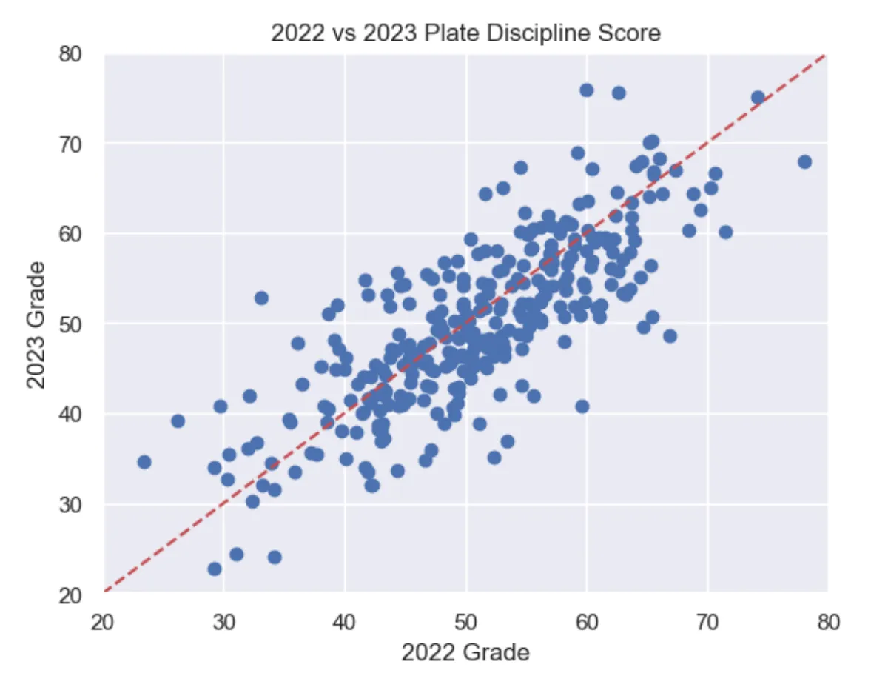
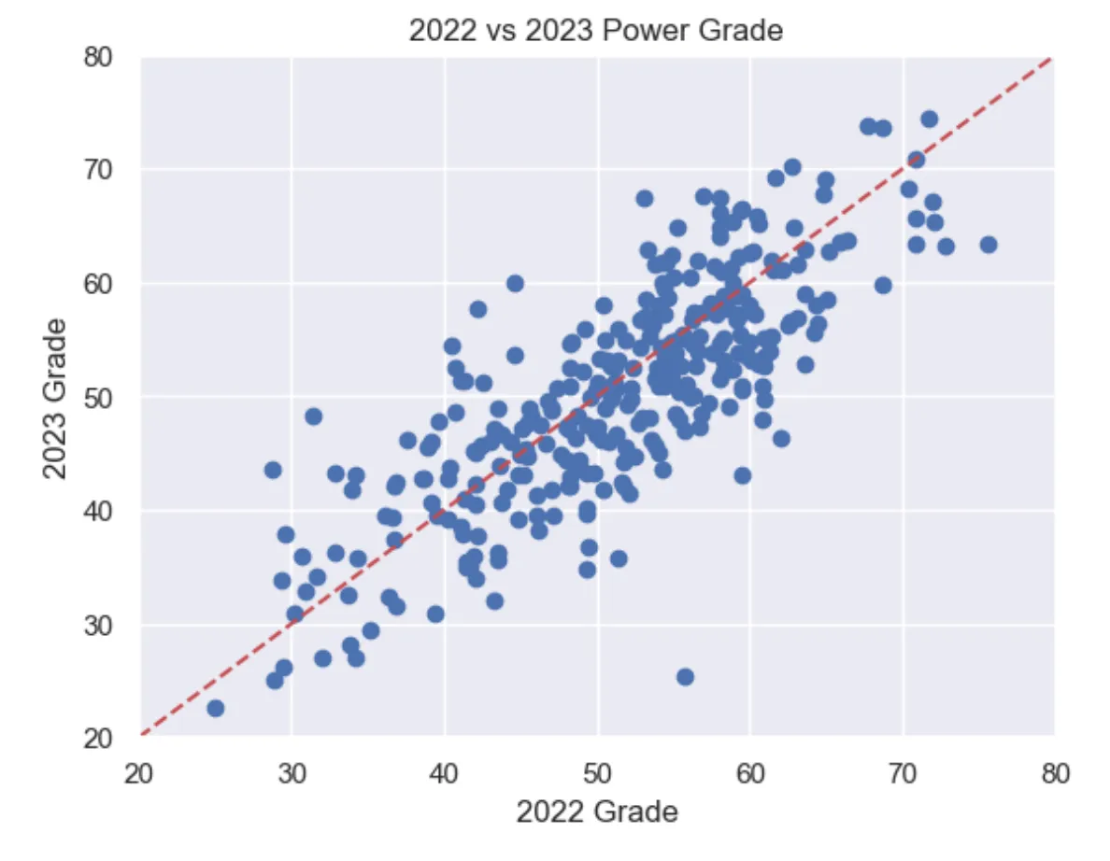

Slide 20
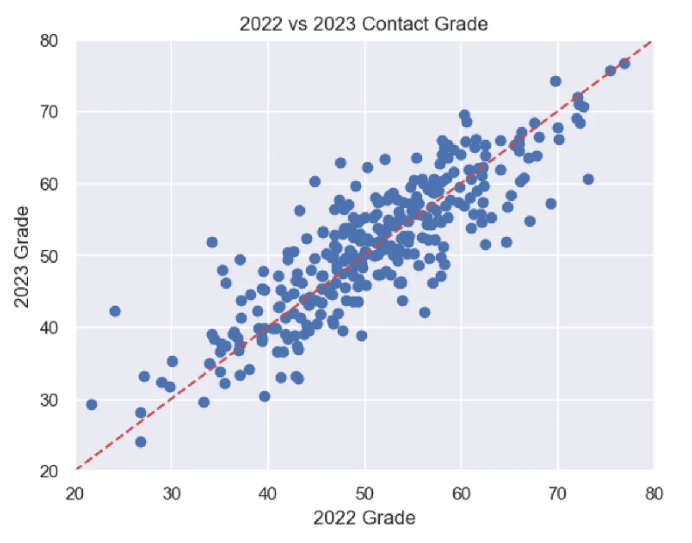
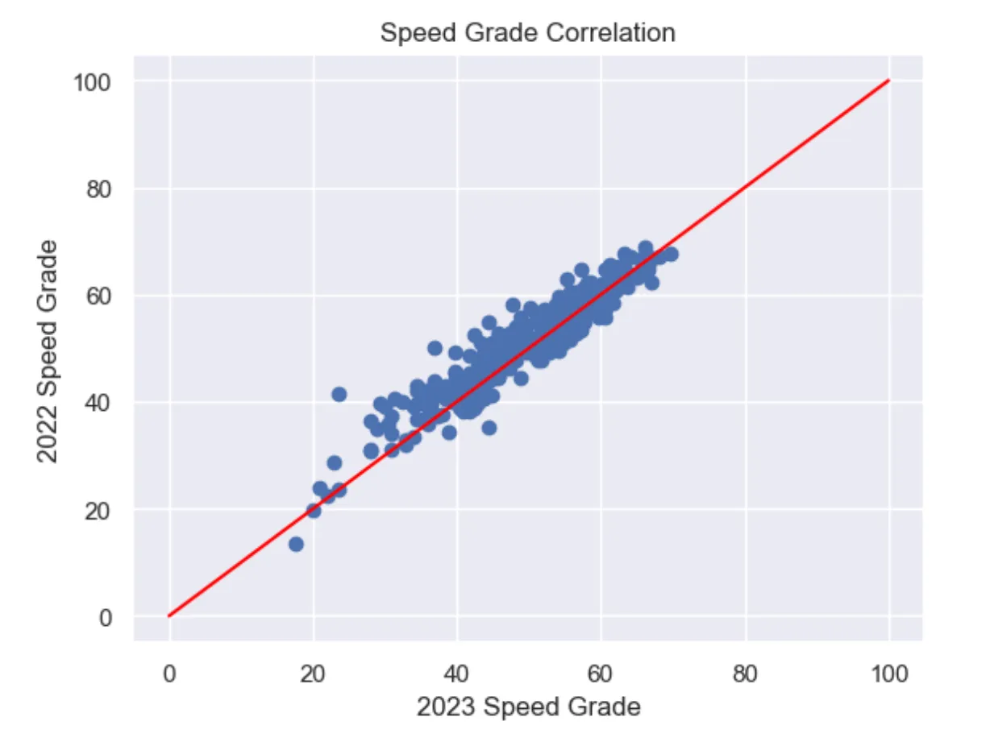

Slide 21
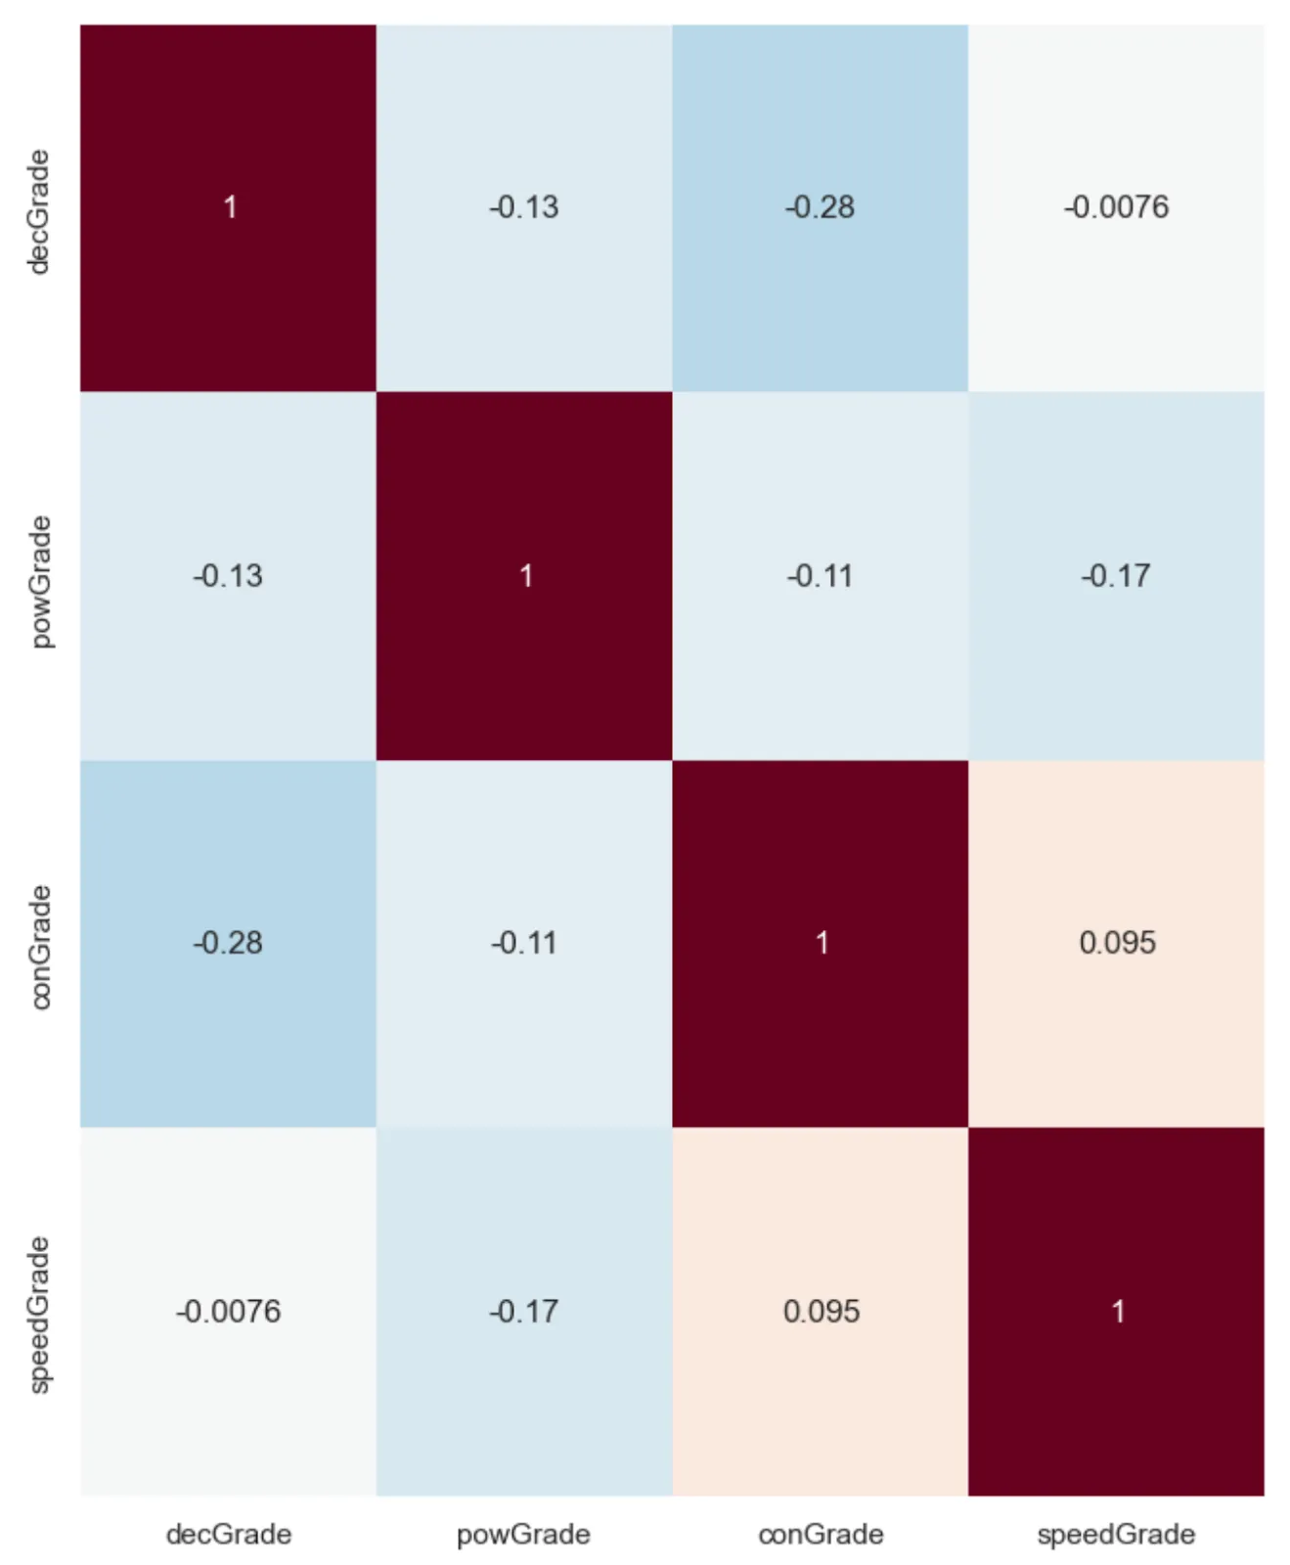

Slide 22
Predicting wOBA
Using linear regression to predict future wOBA
45% Power Grade
25% Decision Grade
17% Contact Grade
13% Speed Grade

Slide 23
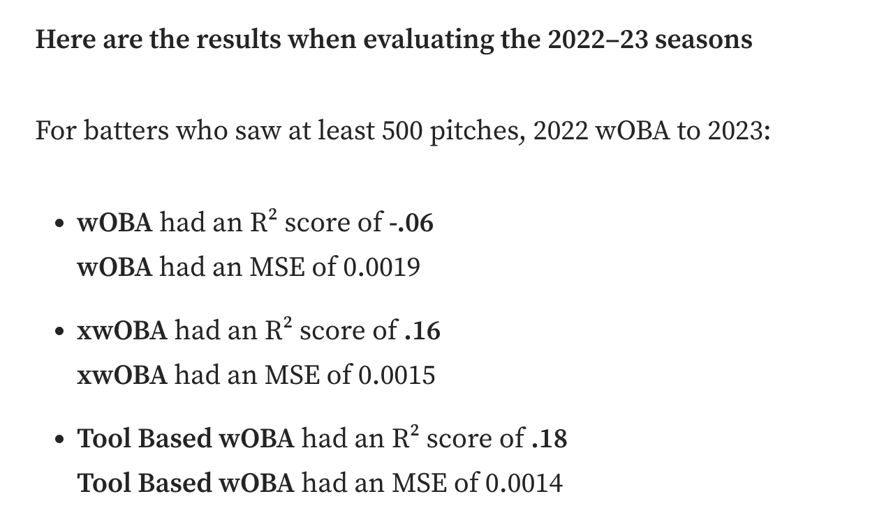
Pre 05/15/23 Stats | Post 05/15/23 wOBA correlation
Tool Grade | 44%
xwOBA | 36%
Power Grade | 36%
wOBA | 21%
Decision Grade | 17%

