Slide 1
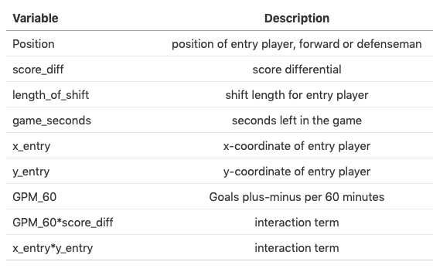

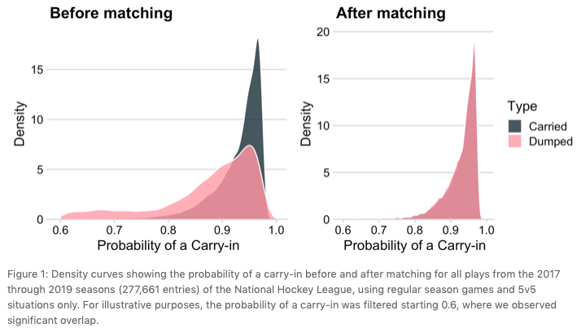
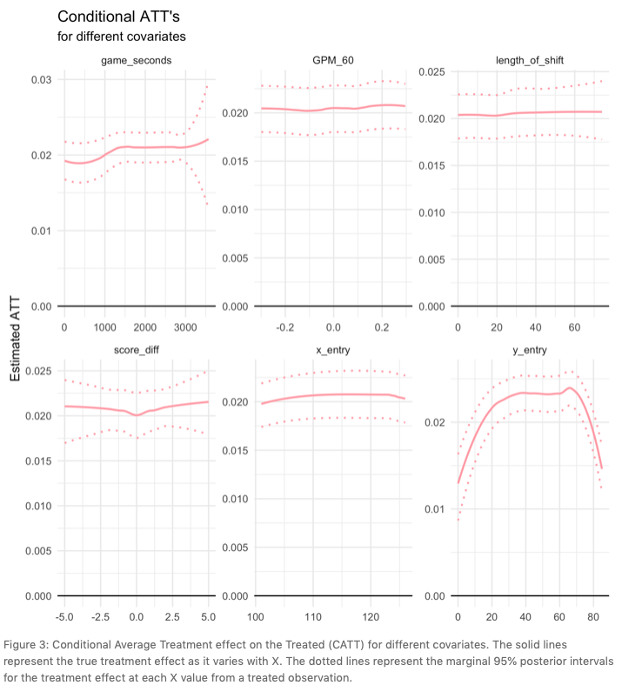

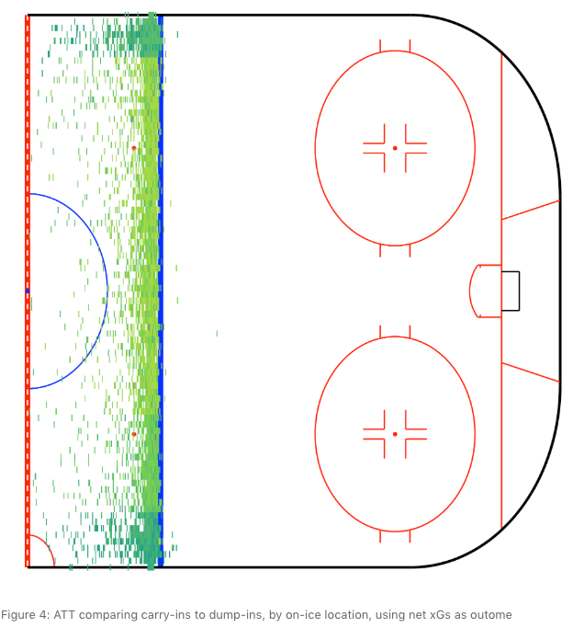





FROM GRAPES AND PRUNES TO APPLES AND APPLES: USING MATCHED METHIODS TO ESTIMATE OPTIMAL ZONE ENTRY DECISION-MAKING IN THE NATIONAL HOCKEY LEAGUE
Asmae Toumi¹ , Michael Lopez² ¹ Columbia University, New York, NY, USA; ² National Football League (NFL), New York, NY, USA
Background
Methods
Data
Previous research in the National Hockey League has suggested that teams’ decisions to gain the offensive zone with puck possession (“carry-ins”) is preferred over dumping the puck in and chasing after it (“dump-ins”). However, standard comparisons of zone entry strategy are confounded by factors such as offensive and defensive talent, location on the ice, and shift time, each of which impact player choice. Indeed, contrasting carry-ins to dump-ins isn’t exactly an apples-to-apples comparison; instead, it is more like studying grapes versus prunes.
Using two methods – propensity score matching and Bayesian additive regression trees – we leverage player-tracking data to estimate the causal benefits due to zone-entry decisions. Given that carrying it in is considered the most efficient zone strategy, it’s important to estimate its causal benefit among the group who carried it in. To do so, we selected the Average Treatment Effect on Treated (ATT) as the estimand. To estimate the ATT, we used two approaches: Propensity Score Matching and Bayesian Additive Regression Trees (BART).
We matched only within even-strength situations for the 2017-18 and 2018-19 NHL seasons, leaving n = 277,661 entries, of which n = 158,808 were carry-ins and n = 118,853 were dump-ins. We used regularized goal plus-minus per 60 minutes to account for player skill, as well as the following covariates:
When it comes to NHL zone entry strategies,
carry-ins are preferred,
but not all carry-ins are created equal.
* Analyzing NHL zone entries using causal inference is hard as shit, but we tried anyways.
Contact
Asmae Toumi
Michael Lopez
We acknowledge the support of Stathletes© and www.evolving-hockey.com
atoumi.cu@gmail.com
Michael.Lopez@nfl.com
asmae_toumi
statsbylopez

