Slide 1
Artificial Intelligence
应伟勤
Email： yingweiqin@scut.edu.cn
华南理工大学软件学院

Slide 2
Lecture 1
Introduction to Artificial Intelligence
Intelligent machines, or what machines can do
The history of artificial intelligence
Research & Application Field of AI

Slide 3
Intelligent machines, or what machines can do
Philosophers have been trying for over 2000 years to understand and resolve two Big Questions of the Universe: How does a human mind work, and Can non-humans have minds?
  These questions are still unanswered.
Intelligence
  1. Someone’s Intelligence is their ability to understand and learn things.
  2 Intelligence is the ability to think and understand instead of doing things by instinct or automatically.
(Essential English Dictionary, Collins, London, 1990)

Slide 4
■ In order to think, someone or something has to have a brain, or an organ that enables someone or something to learn and understand things, to solve problems and to make decisions. So we can define intelligence as the ability to learn and understand, to solve problems and to make decisions.
■ The goal of artificial intelligence (AI) as a science is to make machines do things that would require intelligence if done by humans. Therefore, the answer to the question Can Machines Think? was vitally important to the discipline.
  ■ The answer is not a simple “Yes” or “ No ”.

Slide 5
■ One of the most significant papers on machine intelligence, “Computing Machinery and Intelligence”, was written by the British mathematician Alan Turing（图灵） over sixty years ago. However, it still stands up well under the test of time, and the Turing’s approach remains universal.
■ He asked: Is there thought without experience? Is there mind without communication? Is there language without living? Is there intelligence without life? All these questions, as you can see, are just variations on the fundamental question of artificial intelligence, Can machines think?

Slide 6
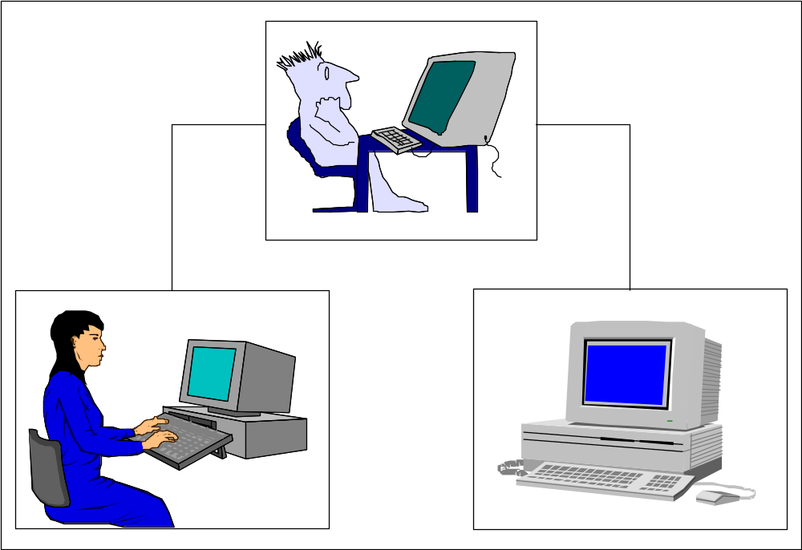
Turing did not provide definitions of machines and thinking, he just avoided semantic arguments by inventing a game, the Turing Test.
The Turing Test measures the performance of an intelligent machine against that of a human being.
Instead of asking, ‘Can machines think?’, Turing said we should ask, ‘Can machines pass a behaviour test for intelligence?’

Slide 7
Turing Test
The test places the machine and a human counterpart in rooms apart from a second human being, referred to as the interrogator. The interrogator is not able to see or speak directly to either of them, does not know which entity is actually the machine, and may communicate with them solely by use of a textual device such as a terminal.

Slide 8
The interrogator are asked to distinguish the computer from the human being solely on the basis of their answers to questions asked over this device. If the interrogator cannot distinguish the computer from the human, then Turing argues, the machine may be assumed to be intelligent.

Slide 9
He predicted that by the year 2000, a computer could be programmed to have a conversation with a human interrogator for five minutes and would have a 30 percent chance of deceiving the interrogator that it was a human.

Slide 10
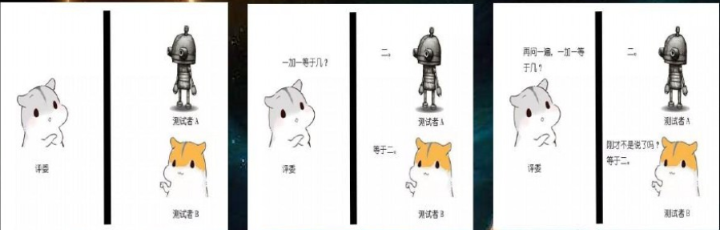
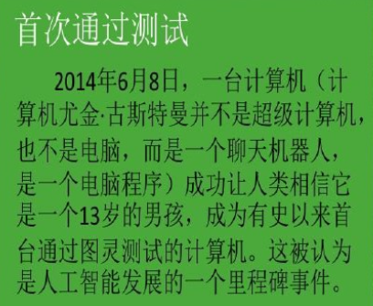
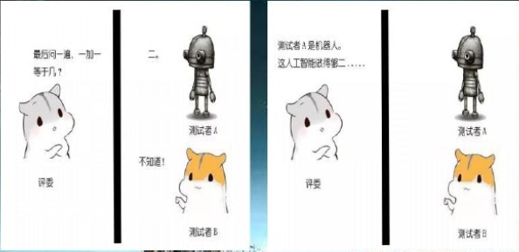

Slide 11
The Turing test provides a basis for the verification and validation of knowledge-based systems.
A machine or program thought intelligent in some narrow area of expertise is evaluated by comparing its performance with the performance of a human expert.
To build an intelligent computer system, we have to capture, organise and use human expert knowledge in some narrow area of expertise.

Slide 12
The history of artificial intelligence
1.The birth of artificial intelligence (1943 – 1956)
The first work recognised in the field of AI was presented by Warren McCulloch（麦卡洛克） and Walter Pitts（皮茨） in 1943. They proposed a model of an artificial neural network and demonstrated that simple network structures could learn.
McCulloch, the second “founding father” of AI after Alan Turing, had created the corner stone of neural computing and artificial neural networks (ANN).

Slide 13
The third founder of AI was John von Neumann（冯诺依曼）, the brilliant Hungarian-born mathematician. He was an adviser for the Electronic Numerical Integrator and Calculator project at the University of Pennsylvania and helped to design the Electronic Discrete Variable Calculator. He was influenced by McCulloch and Pitts’s neural network model. When Marvin Minsky（明斯基） and Dean Edmonds, two graduate students in the Princeton mathematics department, built the first neural network computer in 1951, von Neumann encouraged and supported them.

Slide 14
Another of the first generation researchers was Claude Shannon（香农）. He graduated from MIT and joined Bell Telephone Laboratories in 1941. Shannon shared Alan Turing’s ideas on the possibility of machine intelligence. In 1950, he published a paper on chess-playing machines, which pointed out that a typical chess game involved about 10¹²⁰ possible moves (Shannon, 1950). Even if the new von Neumann-type computer could examine one move per microsecond, it would take 3*10¹⁰⁶ years to make its first move. Thus Shannon demonstrated the need to use heuristics in the search for the solution.

Slide 15
In 1956, John McCarthy, Martin Minsky and Claude Shannon organised a summer workshop at Dartmouth College. They brought together researchers interested in the study of machine intelligence, artificial neural networks and automata theory. Although there were just ten researchers, this workshop gave birth to a new science called artificial intelligence.

Slide 16
2.The rise of artificial intelligence, or the era of
great expectations (1956 – late 1960s)
The early works on neural computing and artificial neural networks started by McCulloch and Pitts was continued. Learning methods were improved and Frank Rosenblatt（罗森布拉特） proved the perceptron convergence theorem, demonstrating that his learning algorithm could adjust the connection strengths of a perceptron.
Notes:
罗森布拉特

Slide 17
One of the most ambitious projects of the era of great expectations was the General Problem Solver (GPS). Allen Newell（纽厄尔） and Herbert Simon（西蒙） from the Carnegie Mellon University developed a general-purpose program to simulate human-solving methods.

Slide 18
However, GPS failed to solve complex problems.
In the sixties, AI researchers attempted to simulate the thinking process by inventing general methods for solving broad classes of problems. They used the general-purpose search mechanism to find a solution to the problem. Such approaches, now referred to as weak methods, applied weak information about the problem domain.

Slide 19
3.Unfulfilled promises, or the impact of reality
(late 1960s – early 1970s)
Because AI researchers were developing general methods for broad classes of problems, early programs contained little or even no knowledge about a problem domain.
To solve problems, programs applied a search strategy by trying out different combinations of small steps, until the right one was found. This approach was quite feasible for simple toy problems, so it seemed reasonable that, if the programs could be “scaled up” to solve large problems, they would finally succeed.

Slide 20
Many of the problems that AI attempted to solve were too broad and too difficult.
A typical task for early AI was machine translation. For example, the National Research Council, USA, funded the translation of Russian scientific papers after the launch of the first artificial satellite (Sputnik) in 1957. Initially, the project team tried simply replacing Russian words with English, using an electronic dictionary. However, it was soon found that translation requires a general understanding of the subject to choose the correct words. This task was too difficult. In 1966, all translation projects funded by the US government were cancelled.

Slide 21
In 1971, the British government also suspended support for AI research. Sir James Lighthill had been commissioned by the Science Research Council of Great Britain to review the current state of AI. He did not find any major or even significant results from AI research, and therefore saw no need to have a separate science called “artificial intelligence”.
Notes:
莱特希尔

Slide 22
Probably the most important development in the seventies was the realisation that the domain for intelligent machines had to be sufficiently restricted.
4.The technology of expert systems, or the key to success (early 1970s – mid-1980s)

Slide 23
DENDRAL
DENDRAL was developed at Stanford University to determine the molecular structure of Martian soil. The project was supported by NASA. Edward Feigenbaum (费根鲍姆)(Simmon的弟子), Bruce Buchanan (布坎南)(a computer scientist) and Joshua Lederberg(莱德伯格)(a Nobel prize winner in genetics) formed a team.
There was no scientific algorithm for mapping the mass spectrum into its molecular structure. Feigenbaum’s job was to incorporate the expertise of Lederberg into a computer program to make it perform at a human expert level. Such programs were later called expert systems.
Notes:
费根鲍姆
莱德伯格
布坎南

Slide 24
DENDRAL marked a major “paradigm shift” in AI: a shift from general-purpose, knowledge-sparse weak methods to domain-specific, knowledge-intensive techniques.
The DENDRAL project originated the fundamental idea of expert systems – knowledge engineering, which encompassed techniques of capturing, analysing and expressing in rules an expert’s “know-how”.

Slide 25
MYCIN
MYCIN was a rule-based expert system for the diagnosis of infectious blood diseases. It also provided a doctor with therapeutic advice in a convenient, user- friendly manner.
MYCIN’s knowledge consisted of about 450 rules derived from human knowledge in a narrow domain through extensive interviewing of experts.

Slide 26
A 1986 survey (Waterman, 1986) reported a remarkable number of successful expert system applications in different areas: chemistry, electronics, engineering, geology, management, medicine, process control and military science. Although Waterman found nearly 200 expert systems, most of the applications were in the field of medical diagnosis.
Seven years later a similar survey reported over 2500 developed expert systems (Durkin, 1994).
Notes:
沃特曼
杜尔金

Slide 27
However:
Expert systems are restricted to a very narrow domain of expertise.
  For example, MYCIN, which was developed for the diagnosis of infectious blood diseases, lacks any real knowledge of human physiology. If a patient has more than one disease, we cannot rely on MYCIN. In fact, therapy prescribed for the blood disease might even be harmful because of the other disease.

Slide 28
Expert systems have difficulty in recognising domain boundaries. When given a task different from the typical problems, an expert system might attempt to solve it and fail in rather unpredictable ways.
Expert systems are built individually and cannot be developed fast. Complex systems can take over 30 person-years to build.
Expert systems, especially the first generation, have little or no ability to learn from their experience.

Slide 29
5.How to make a machine learn, or the rebirth of neural networks (mid-1980s – onwards)
Disillusions about the applicability of expert system technology even led to people predicting an AI “winter” with severely squeezed funding for AI projects.
AI researchers decided to have a new look at neural networks.

Slide 30
In the eighties, because of the need for brain-like information processing, as well as the advances in computer technology and progress in neuroscience, the field of neural networks experienced a dramatic resurgence. Major contributions to both theory and design were made on several fronts.

Slide 31
Hopfield introduced neural networks with feedback –Hopfield networks, which attracted much attention in the eighties (Hopfield, 1982).
Kohonen published a paper on self-organising maps (Kohonen, 1982).
Barto, Sutton and Anderson published their work on
reinforcement learning and its application in
control (Barto et al., 1983).

Slide 32
But the real breakthrough came in 1986 when the back-propagation learning algorithm, first introduced by Bryson and Ho in 1969 (Bryson & Ho, 1969), was reinvented by Hinton, Rumelhart (鲁梅哈特) and McClelland (麦克利兰) in Parallel Distributed Processing (1986).

Slide 33
6.Evolutionary computation, or learning by doing(early 1970s–onwards)
Natural intelligence is a product of evolution. Therefore, by simulating biological evolution, we might expect to discover how living systems are propelled towards high-level intelligence. Nature learns by doing; The fittest species have a greater chance to reproduce, and thereby to pass their genetic material to the next generation.
The evolutionary approach to artificial intelligence is based on the computational models of natural selection and genetics. Evolutionary computation works by simulating a population of individuals, evaluating their performance, generating a new population, and repeating this process a number of times.

Slide 34
Evolutionary computation combines three main techniques: genetic algorithms, evolutionary strategies, and genetic programming.
  The concept of genetic algorithms was introduced by John Holland in the early 1970s (Holland, 1975). He developed an algorithm for manipulating artificial ‘chromosomes’ (strings of binary digits), using such genetic operations as selection, crossover and mutation.
  Ingo Rechenberg and Hans-Paul Schwefel, students of the Technical University of Berlin, proposed evolutionary strategies (Rechenberg, 1965). Evolutionary strategies were designed specifically for solving parameter optimisation problems in engineering.
  Genetic programming is to evolve a computer code that solves the problem. That is, genetic programming generates computer programs as the solution.(Koza,1992)

Slide 35
7.Deep Learning (2006–onwards)
2006年， Hinton提出“深度学习”的神经网络。深度学习本身是神经网络算法的衍生，在图像、语音等富媒体的分类和识别上取得了非常好的效果。
2012年，计算机视觉界顶级比赛ILSVRC中，多伦多大学Hinton团队所提出的深度卷积神经网络结构AlexNet一鸣惊人，同时也拉开了深度卷积神经网络在计算机视觉领域广泛应用的序幕。成功原因：
  大量数据，Deep Learning领域应该感谢李飞飞团队搞出来如此大的标注数据集合ImageNet；
  算法的改进，包括网络变深、数据增强、ReLU、Dropout等；
  算力，GPU这种高度并行的计算神器确实助了洪荒之力，没有神器在手，Alex估计不敢搞太复杂的模型。

Slide 36
7.Deep Learning (2006–onwards)
2013年，深度学习算法在语音和视觉识别上有重大突破，识别率超过99%和95%。
2014年，Ian Goodfellow因提出了生成对抗网络（GANs）而闻名，他被誉为“GANs之父”，甚至被推举为人工智能领域的顶级专家。
2016年，Deepmind团队的AlphaGo运用深度学习算法战胜围棋冠军李世石，震惊了世界
2019年3月27日，美国计算机协会（ACM）宣布把2018年的图灵奖（Turing Award）颁给深度学习的三位先驱Geoffrey Hinton、Yoshua Bengio和Yann LeCun，以表彰他们为当前人工智能的发展所做出的贡献。

Slide 37
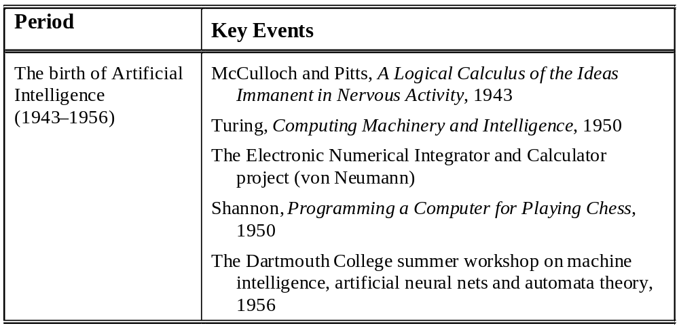
Main events in the history of AI

Slide 38

Period Key Events
The rise of artificial
intelligence
(1956–late 1960s)
LISP (McCarthy)
The General Problem Solver (GPR) project (Newell and Simon)
Newell and Simon, Human Problem Solving, 1972
Minsky, A Framework for Representing Knowledge, 1975
The disillusionment
in artificial
intelligence (late
1960s–early 1970s)
Cook, The Complexity of Theorem Proving Procedures, 1971
Karp, Reducibility Among Combinatorial Problems, 1972
The Lighthill Report, 1971

Slide 39
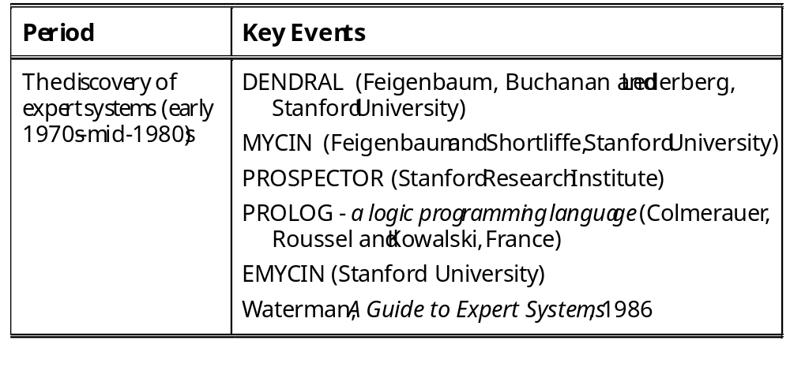

Slide 40
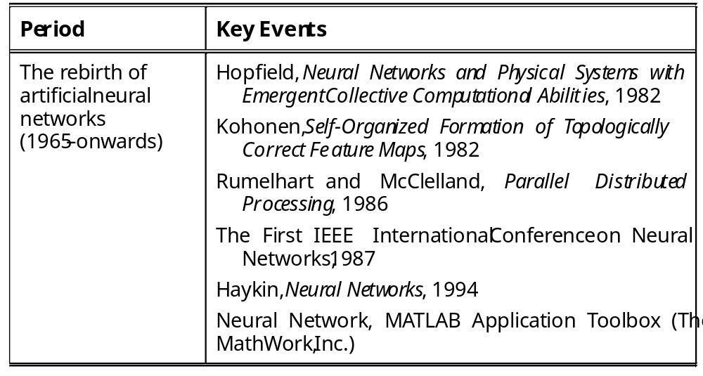

Slide 41
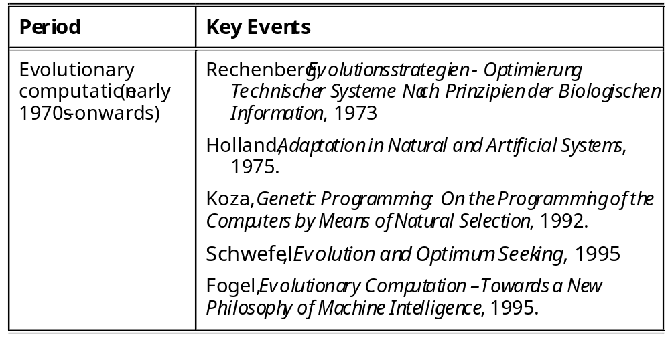

Slide 42
Research & Application Field of AI (What Can Be Done by AI)
1. 智能思维-Game playing
国际象棋机器博弈：
IBM Deep Blue vs Ќажпаров in 1996 (2:4)
& 1997 (3.5:2.5)

Slide 43
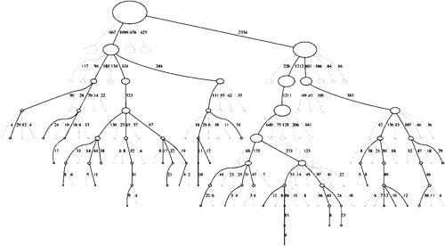
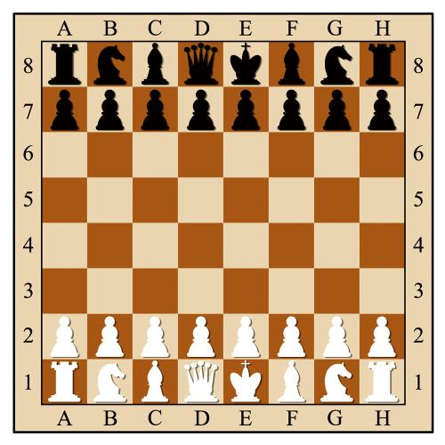
AlphaGo
国际象棋机器博弈：IBM Deeper Blue vs Ќажпаров in 1997 （使用直观的局面评估+剪枝搜索）
自2006年起，欧美传统里的顶级人类智力游戏国际象棋，已经在电脑面前一败涂地。围棋成了人类智力游戏最后一块高地。

Slide 44
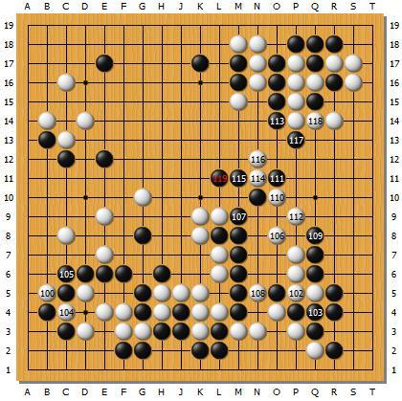
AlphaGo
然而围棋的复杂度比国际象棋高许多，且其局面评估极其复杂困难
2006年前的早期: 棋力极弱
2011年最好的围棋AI日本的Zen，可以战胜一般业余棋手，不如业余高手

Slide 45
AlphaGo
2015年11月，连笑七段让四子、五子轻松战胜计算机围棋AI冠军Dolbram。
当时人类职业围棋界对计算机围棋AI兴趣不大，认为围棋AI要想战胜人类还很遥远。聂卫平、俞斌：100年。

Slide 46
Research & Application Field of AI (What Can Be Done by AI)
1. 智能思维-Game playing
国际象棋机器博弈：
IBM Deep Blue vs Ќажпаров in 1996 (2:4)
& 1997 (3.5:2.5)
围棋机器博弈：
Google AlphaGo Lee vs 李世石 in March 2016(4:1)
Google AlphaGo Master vs 柯洁 in May 2017(3:0)

Slide 47
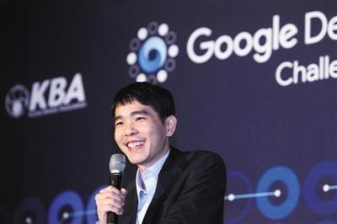
AlphaGo
围棋AI战胜人类的导火索：深度学习；最重要最根本技术突破：策略价值网络。谷歌开发的AlphaGo-Lee使用人类高手10万局棋谱2000万手棋进行深度学习训练网络
2016年3月9日，韩国首尔四季酒店，在谷歌发起的“人机大战”第一局中，手握14个世界冠军头衔的韩国围棋天王李世石轰然倒下，最终AlphaGo以4：1赢得这场比赛。

Slide 48
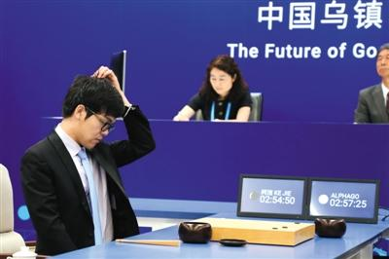
AlphaGo
2017年， AlphaGo Lee升级到AlphaGo Master，改进网络结构，增加网络层数 。
  17年年初，AlphaGo化身Master后在围棋网络平台上创造了连续60场对人类高手不败的恐怖战绩，因此围棋界都希望能够有一名大神站出来打败AlphaGo，以证明人类的实力。
  17年5月23日-27日， AlphaGo Master在浙江乌镇挑战目前世界排名第一的人类棋手柯洁九段，人机大战三番棋第三局中,柯洁执白209手中盘负于AlphaGo,人机大战2.0的结局被定格在了0:3。与此同时，阿尔法围棋团队宣布阿尔法围棋将不再参加围棋比赛。

Slide 49
AlphaGo
五个月后，2017年10月，AlphaGo Master继续升级，DeepMind团队在Nature杂志发表论文，AlphaGo Zero横空出世，不再需要人类棋谱，通过强化学习自我对弈从零开始学习，简而言之， AlphaGo Zero 成为自己的老师。经过三天的训练， AlphaGo Zero能够击败AlphaGo Lee (胜率是100比0)，后者2016年击败了韩国选手李世石。经过大约40天的训练后，AlphaGo Zero完胜AlphaGo Master。

Slide 50
AlphaGo
基于深度学习（Deep Learning）构建的神经网络是让AlphaGo表现智能的关键。哈萨比斯表示，“蒙特卡洛树搜索在10年前是一个很大的创新，但我觉得我们对AlphaGo做的最主要创新是引进了神经网络这种直觉层面的东西。”依靠神经网络，AlphaGo能够跟人一样通过“直觉”判断 “大势”、“局面”，具有良好的“棋感”。在此之前，这一领域的专家原以为这还要再等10年才能实现。

Slide 51
Research & Application Field of AI (What Can Be Done by AI)
1. 智能思维-Game playing
国际象棋机器博弈：
IBM Deep Blue vs Ќажпаров in 1996 (2:4)
& 1997 (3.5:2.5)
围棋机器博弈：
Google AlphaGo Lee vs 李世石 in March 2016(4:1)
Google AlphaGo Master vs 柯洁 in May 2017(3:0)
完全信息博弈（国际象棋、中国象棋、围棋、五子棋）
不完全信息博弈（军旗、扑克斗地主、麻将、星际争霸）

Slide 52
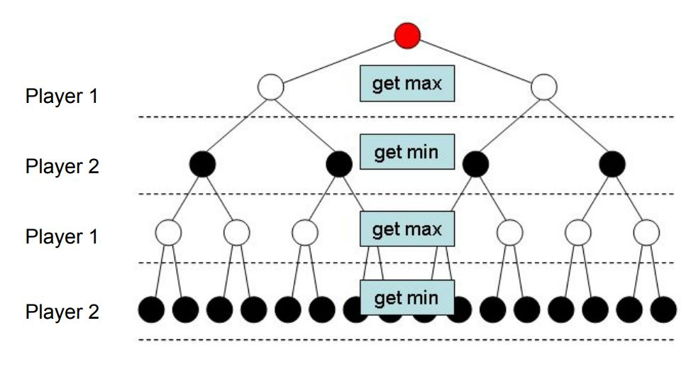
从完全到不完全信息博弈
当博弈是完美信息时，只要算力足够多，那么肯定就能通过搜索的方式找到最优的方案。
我们可以利用搜索树来理解这一过程，例如棋手每一步棋可以看作选择一个子节点，那么整盘棋一定可以表示为某条路径，现在 AI 要做的就是选择能带来胜利的路径。如下是最为经典的一种搜索树，AI 在每一个状态都希望最小化对手的最大收益。

Slide 53
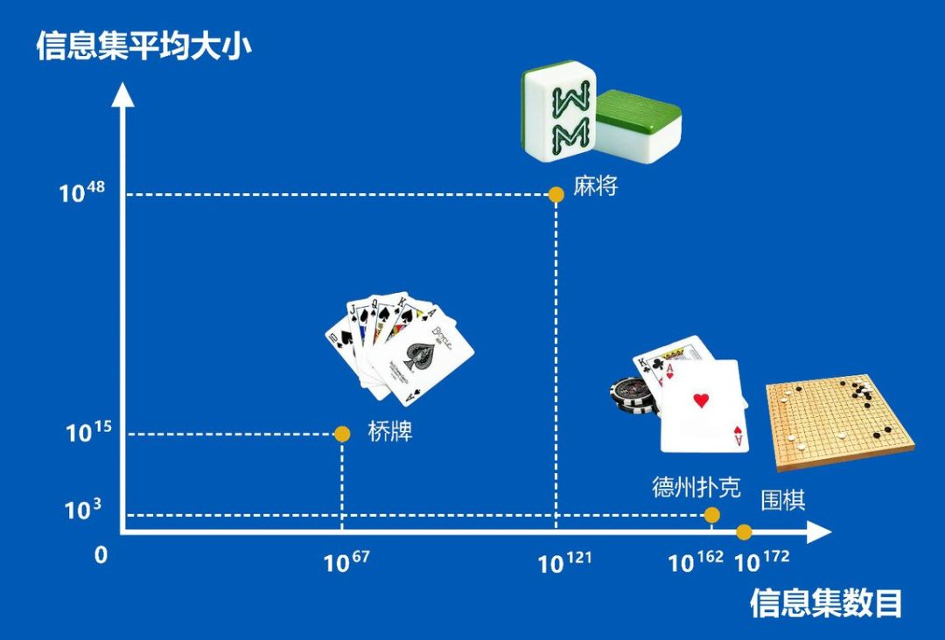
麻将AI
即使是围棋这种状态空间非常复杂的游戏，只要在搜索过程中加一些指导、剪枝，就能在有限算力下找到很好的决策。
而麻将等不完全信息博弈，和围棋有很大的不同。因为参与者互不知道对方的牌是什么，周围缺失信息远远超过已知信息，所以 AI 基本上没法向前推演。对于这样的游戏，模型差不多只能靠「预测」 ，所以核心技术就不再是树搜索，而是需要在某种预测的指导下做决策。

Slide 54
Suphx
近年来，随着人工智能在象棋、围棋等众多棋牌类游戏中获得亮眼的成绩，AI在麻将领域却一直有待跨越性的突破。
2019年8月29日世界人工智能大会上，微软全球执行副总裁沈向洋在演讲中宣布，微软亚洲研究院创造出了史上最强的麻将AI。该麻将AI系统Suphx（超级凤凰），在国际知名的专业麻将平台“天凤”上与人类选手进行了超过5000场对战，成为首个荣升最高段位十段的AI系统， 创造了目前AI系统在麻将领域取得的最好成绩，实力媲美或超越顶级人类选手的平均水平。

Slide 55
AlphaStar
2019年1月15日，DeepMind公司开发的AlphaStar在“星际争霸2”游戏比赛中以10:1的战绩战胜了人类冠军团队。2019年5月31日， DeepMind公司的研究人员在Nature上发表了AlphaStar的相关论文。当时 DeepMind的设计被称为For the Win (FTW)智能体，它达到了人类水平，能够与其它智能体或人类玩家相互合作。而之后，DeepMind又提出了被称为“自我游戏”(self-play)的新智能体，在游戏中甚至能够超越人类选手的水平。

Slide 56
2. Natural Language Understanding
It deals with voice understanding and language translation. This is a very difficult task, a very complex encoding and decoding problem. For do so, we need:
  do voice analysis, syntax structure and semantics understanding
  make frequency-spectrum analysis and recognition
  establish knowledge base of specialized knowledge and common knowledge as well as the context

Slide 57
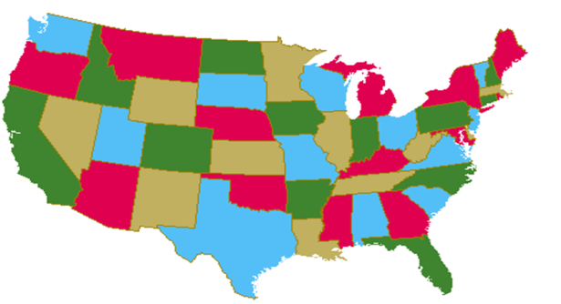
3. Logic Reasoning & Automatic Theorem Proving
Prove theorem by operating the fact data-base
·四色定理：一张地图，用一种颜色对一个地区着色，那么一共只需要四种颜色就能保证每两个相邻的地区颜色不同。
直到1976年6月，美国数学家 K. Appel与 W. Haken，借助3台电子计算机，用了1200小时，才终于完成了“四色猜想”的证明，从而使"四色猜想"成为了四色定理。

Slide 58
4. Robotics
An interested research area of AI. The AI & Robotics promote each other.
The development of Intelligent Robots needs the guidance of the principles and techniques of AI, and Robotics can provide AI a suitable test-bed.
  Many techniques of AI can be used and tested in Robotics, such as sensing, planning, decision-making.
机器人足球世界杯Robocup（Robot World Cup）

Slide 59

Robocup是划时代的计划
 | 阿波罗计划 | 计算机国际象棋 | RoboCup
目标 | 送一个宇航员登陆月球并安全返回地球 | 开发出能战胜人类国际象棋世界冠军的计算机 | 开发出能象人类那样踢球的足球机器人
技术 | 系统工程，航空学，各种电子学等 | 搜索技术，并行算法和并行计算机等 | 机器人、分布式协作智能体等
应用 | 遍布各处 | 各种软件系统、大规模并行计算机 | 现实世界中的机器人和分布式人工智能系统

Slide 60
竞赛平台
Robocup
  每个机器人队员具有交互和自主的行为能力，球员可视为一个智能体
  队员存在与己方队员的合作，与敌方队员的对抗，而且每个队员角色不完全相同（前锋、中场、后卫、守门员），因此球队可视为一个典型的多智能体系统
Robocup举行以下几组机器人足球比赛：
  小型组(Small Size League)
  中型组(Middle Size League)
  标准平台组(Standard Platform League)
  仿真组(Simulation League) - 2D和3D

Slide 61
RoboCup - Small Size League
Year | 1st Place Team | 2nd Place Team | 3rd Place Team | 4th Place Team
2001 | Lucky Star, Singapore | Field Rangers, Singapore | Cornell Big Red, USA | FU-Fighters, Germany
2002 | Cornell Big Red, USA | FU-Fighters, Germany | Lucky Star, Singapore
2003 | Cornell Big Red, USA | RoboRoos, Australia | FU-Fighters, Germany
2004 | FU-Fighters, Germany | RoboRoos, Australia | Lucky Star, Singapore | CMRoboDragons, USA & Japan
2005 | FU-Fighters, Germany | Cornell Big Red, USA | Field Rangers, Singapore | CMRoboDragons, USA & Japan
2006 | CMDragons, USA | 5dpo, Portugal | Plasma-Z, Thailand | Field Rangers, Singapore
2007 | CMDragons, USA | Plasma-Z, Thailand | RoboDragons, Japan | ZjuNlict, China
2008 | Plasma-Z, Thailand | CMDragons, USA | Skuba, Thailand | ZjuNlict, China
2009 | Skuba, Thailand | RoboDragons, Japan | Plasma-Z, Thailand | Odens, Japan
2010 | Skuba, Thailand | CMDragons, USA | MRL, Iran | KIKS, Japan
2011 | Skuba, Thailand | Immortals, Iran | MRL, Iran | KIKS, Japan

Slide 62
RoboCup - Middle Size League
Year | 1st Place Team | 2nd Place Team | 3rd Place Team
2012 | TechUnited, NL | MRL, IR | Water, CN
2011 | Water, CN | TechUnited, NL | CAMBADA, PT
2010 | Water, CN | TechUnited, NL | CAMBADA, PT
2009 | RFC Stuttgart, DE | TechUnited, NL | CAMBADA, PT
2008 | CAMBADA, PT | Tech United, NL | CoPS-Stuttgart, DE
2007 | Tribots, GE | Eigen, JP | CoPS-Stuttgart, DE
2006 | Tribots, DE | CoPS-Stuttgart, DE
2005 | EIGEN, JP | FU-Fighters, DE | Philips, NL
2004 | EIGEN, JP | WinKIT, JP | CoPS-Stuttgart, DE

Slide 63
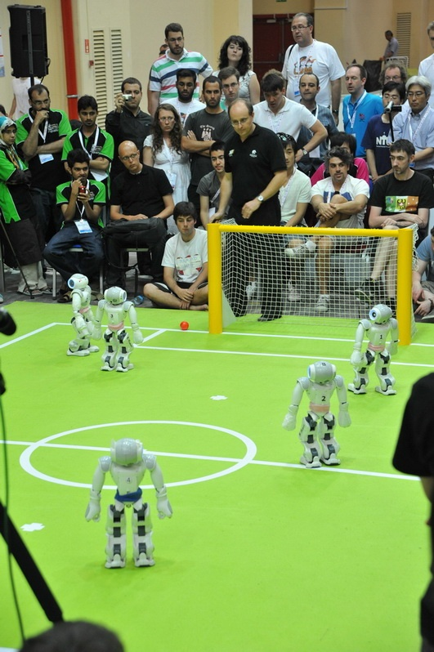
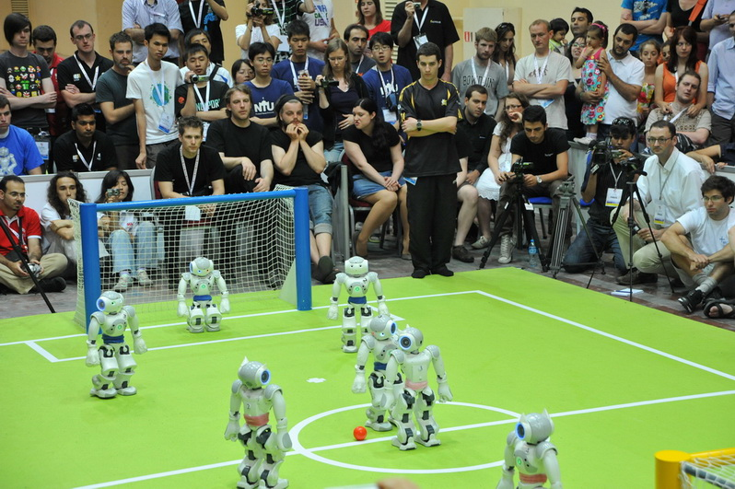
RoboCup 2012 - Standard Platform League
1st Place | UT Austin Villa | Department of Computer Science, The University of Texas at Austin, USA
2nd Place | B-Human | DFKI Bremen University of Bremen, Germany
3rd Place | rUNSWift | School of Computer Science and Engineering, The University of New South Wales, Australia

Slide 64
RoboCup - 2D Simulation League
Year | 1st Place Team | 2nd Place Team | 3rd Place Team
2012 | HELIOS2012, Japan | WrightEagle, China | MarIiK, Iran
2011 | WrightEagle, China | HELIOS2011, Japan | MarliK, Iran
2010 | HELIOS, Japan | WrightEagle, China | Oxsy, Romania
2009 | WrightEagle, China | HELIOS, Japan | Oxsy, Romania
2008 | Brainstormers, Germany | WrightEagle, China | HELIOS, Japan
2007 | Brainstormers, Germany | WrightEagle, China | HELIOS, Japan
2006 | WrightEagle, China | Brainstormers, Germany | Ri-one, Japan
2005 | Brainstormers, Germany | WrightEagle, China | TokyoTechSFC, Japan
2004 | STEP, Russia | Brainstormers, Germany | Mersad, Iran
2003 | UvA Trilearn, The Netherlands | TsinghuAeolus, China | Brainstormers, Germany

Slide 65
5. Expert System
ES is an important and most active application area of AI.
ES is an intelligent computer programming system in which there exists knowledge and experience of specialized area in quantity in expert level, and can use the expert knowledge to handle and solve the problem in the specified domain. ES can be used to medicine, industry, agriculture, business and military.

Slide 66
6. Machine Learning
机器学习试图通过对人类学习能力进行模拟，使机器直接对数据及信息进行分析和处理而产生智能。
实际上机器的学习方式与人类的学习方式还有很大的区别。二者之间最主要的区别在于，现阶段的机器都不具备自主学习、持续学习的能力。现阶段机器学习的成功主要得益于深度学习技术与大数据的结合，并且还需要人类对数据进行大量标注和对算法事先进行训练等。

Slide 67
7. Artificial Neural Network(ANN)
ANN has been applied into the Pattern Recognition, Image Process, Automation Control, Information Process, Robotics and other AI areas.

Slide 68
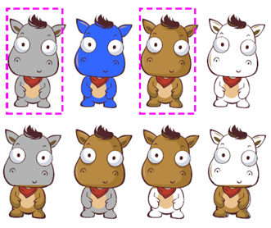
8. Evolutionary computation
Genetic algorithm, evolutionary strategies, and genetic programming
自然计算（Nature-Inspired Computation）：演化算法，模拟退火算法，蚁群算法，粒子群优化算法
  函数优化问题求解（参数优化等）
  组合优化问题求解（0-1背包、TSP、排课、车辆路径、诗词乐曲创作）
  多目标优化

Slide 69
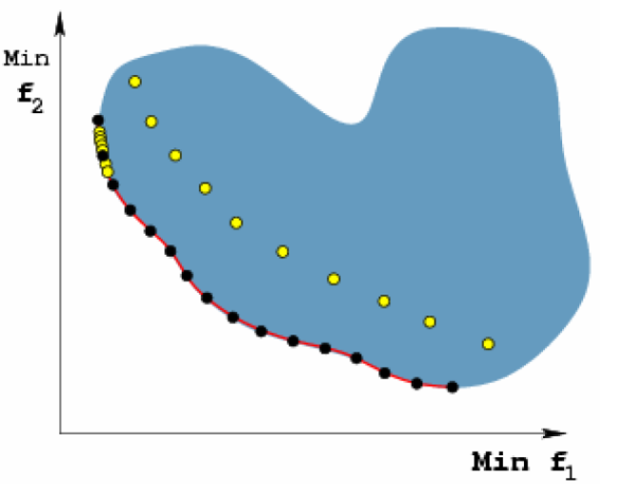
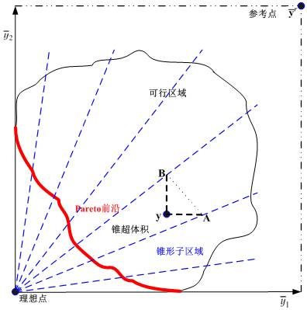
8. Evolutionary computation
基于锥束分解的演化多目标优化

Slide 70

9. Pattern Recognition
Pattern Recognition is to recognize the imitate sample of a given object. The “pattern” can be an object, a graph, a video, a voice, and/or a character.
TV
Camera
Reference
Pattern Base
Pre-processing
Pattern
Representation
Recognition
Output
Fig. 2 A Pattern Recognition Process

Slide 71
Other fields
10. Computer Vision
11. Automatic Programming
12. Intelligent Retrieval
13. Combinational & Scheduling Problem
14. Multi-agent & Distributed AI
……

Slide 72
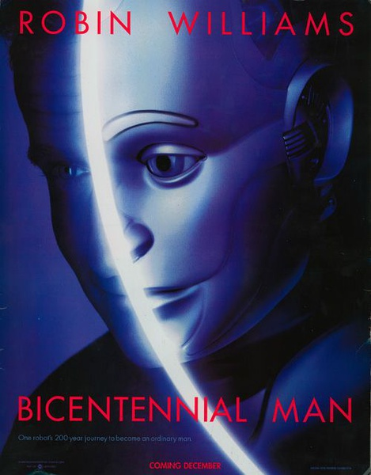
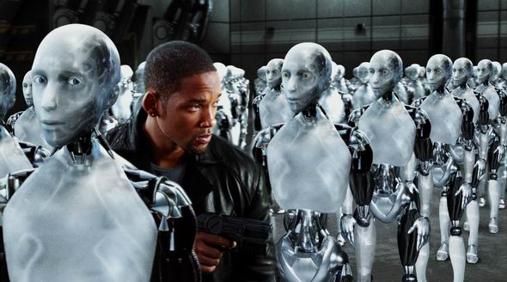
1、机器人（人工智能）会比人聪明吗？
2、机器人会造反吗？

