Slide 1
Rent Burden Across the US and Eviction Rates in King County, WA
Kate Freier, Shaymal Halder, Sarah Hedberg, Han Yu
March 31,2019
SDSS

Slide 2
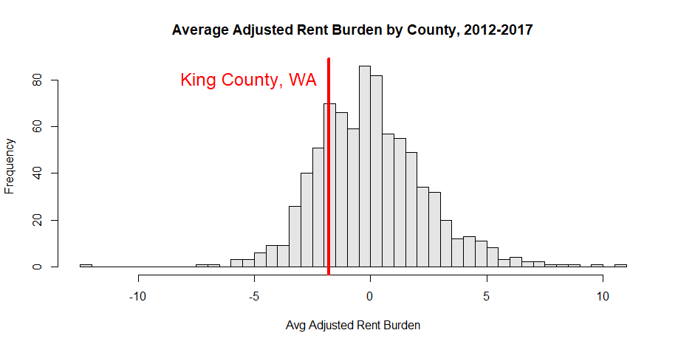
-1.77

Slide 3
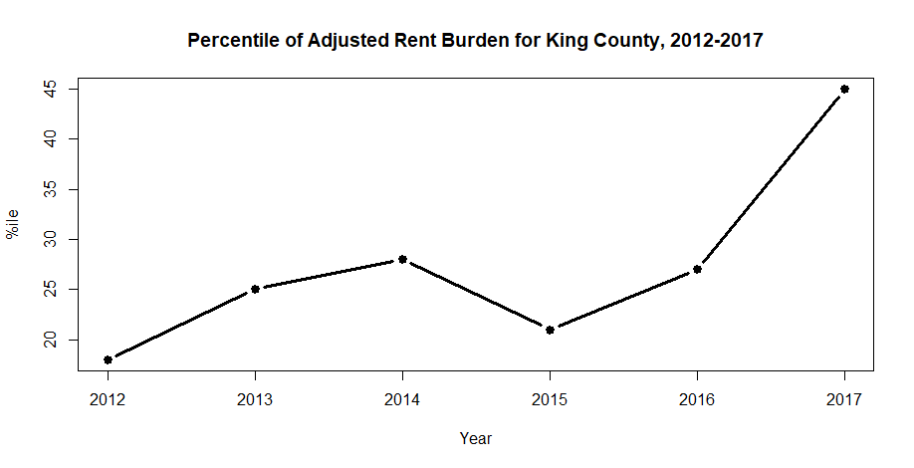
August 2016: Residential Landlord Tenant Act (59.18)
Regulates tenant screening, evictions and return of the security deposit. Limits amount of security deposit.
Interestingly this did not stop the rising tide.

Slide 4
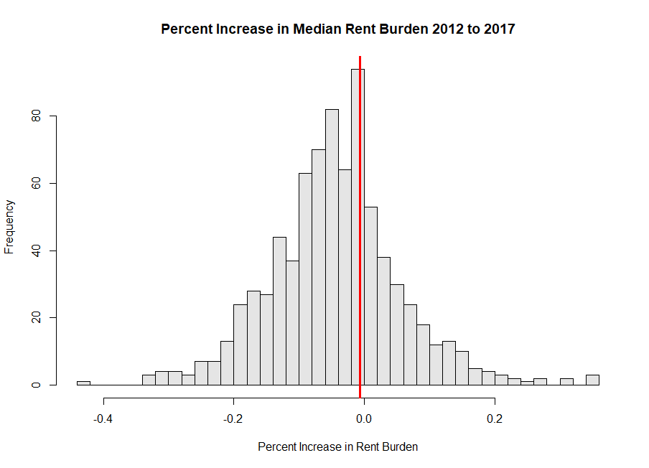
King County, WA
Bedford County, VA
Absorbed neighboring county in 2013

Slide 5
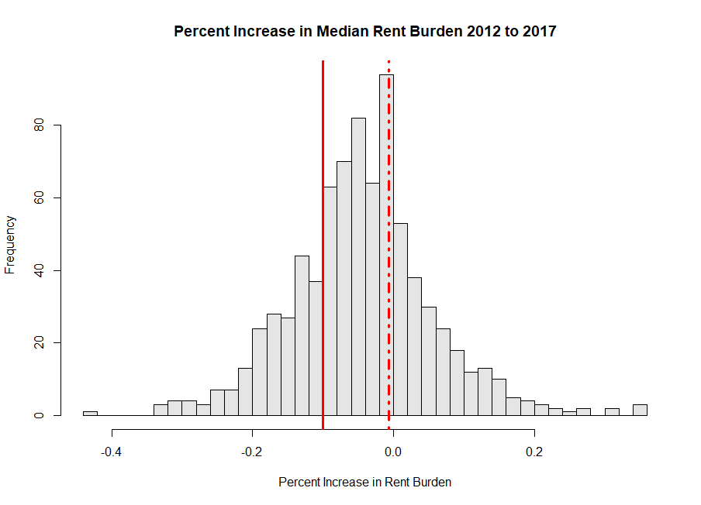
25% decreased by 10% or more

Slide 6
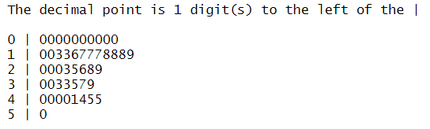
Percent of counties improving rent burden by at least 10%, by state
*due to missing data, DE and ID are ommitted

Slide 7
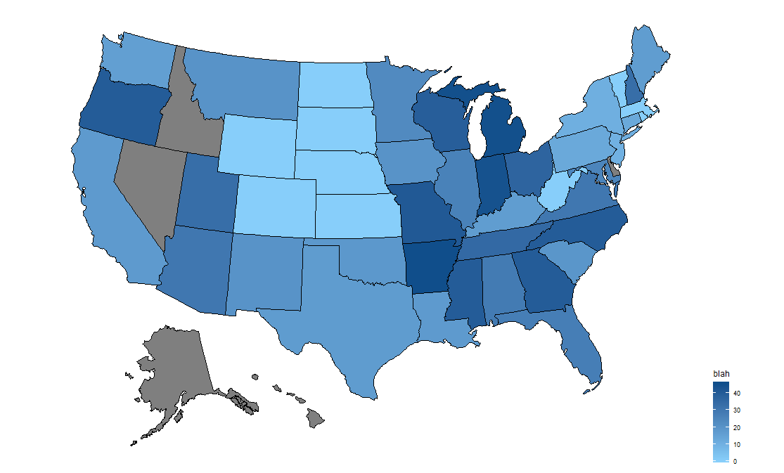
Percent of counties with at least a 10% improvement in Rent Burden 2012-2017
Percent of Counties >10% Improvement

Slide 8
Legislation of Note in States with Improvement in Rent Burden:
Indiana 2015: Regulates discrimination based on income source (Section 8 protections)
Missouri 2016: Regulates landlord-tenant law with regards to security deposits & evictions.
Arkansas: Very few protections for tenants! Only state with a Failure to Vacate statute. This statute was declared unconstitutional by circuit courts in 2015.

Slide 9
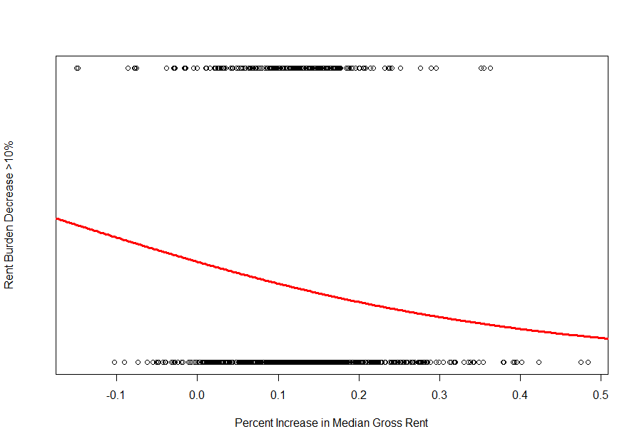
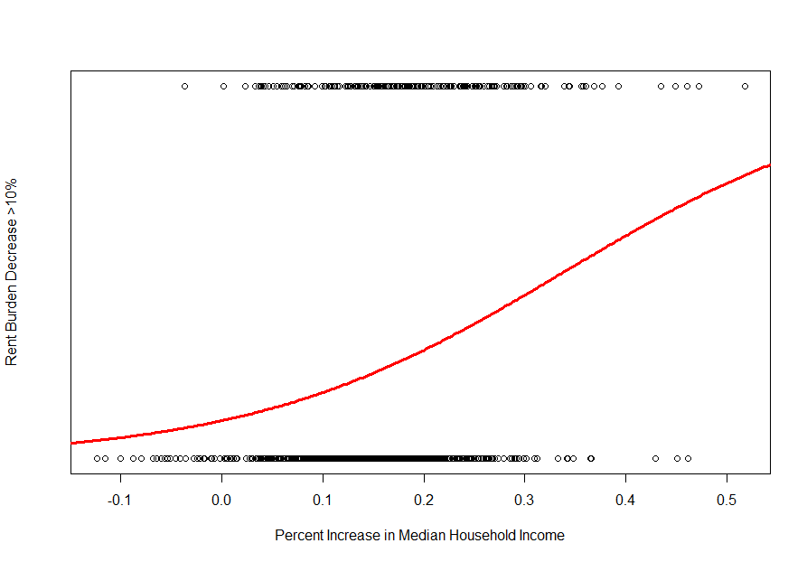
Are large improvements more about
rent level, or income level?
Influence of Rent Changes
Influence of Income Changes

Slide 10
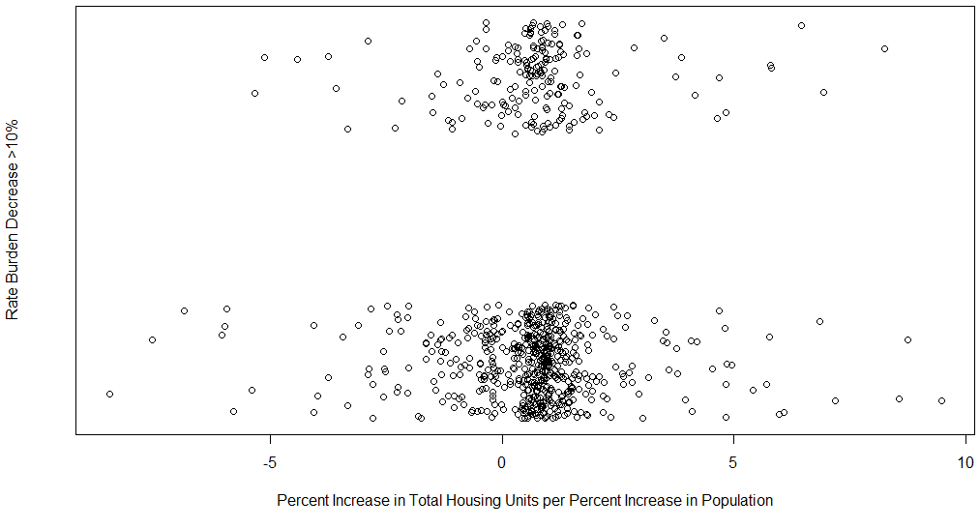
NOT just a matter of building housing faster than population growth
Doña Ana County, New Mexico housing stock went up 6% while population remained flat 2012-2017. Rent Burden decreased 9.7%.
HUD Affordable Housing Plan adopted in 2015.
yes
no

Slide 11
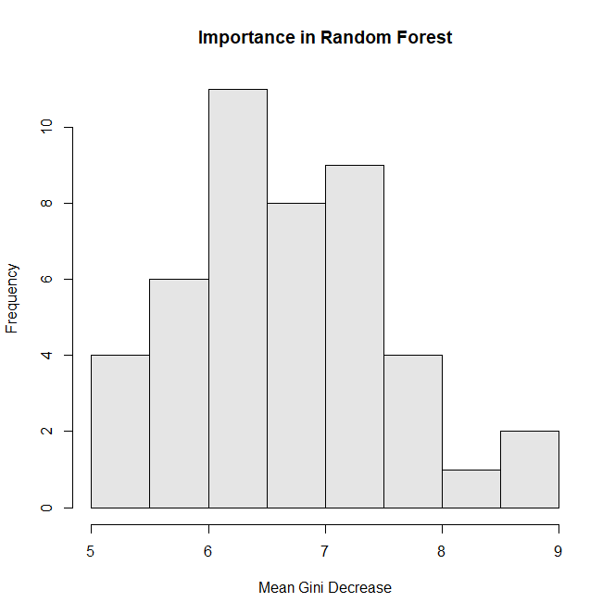
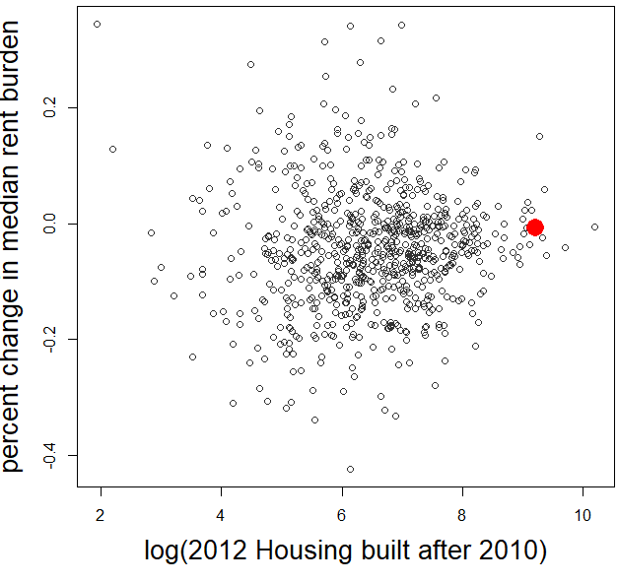
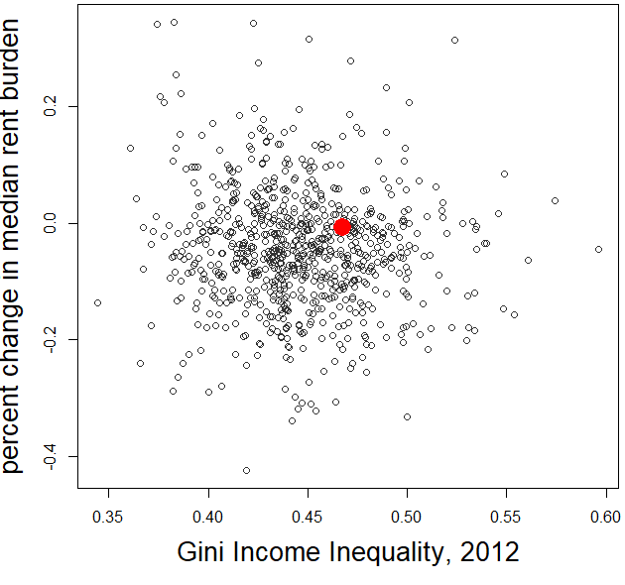
Total Housing Units built after 2010
Gini Index of Income Inequality

Slide 12
Modeling Rent Burden across Space and Time
Rent Burden: Median gross rent as a proportion of household income
Considered 3 different models for Rent Burden to account for changes over time and regions in the lower 48 States
Linear regression using state, year, lat, long.
Loess regression (scatterplot smoothing) using lat, long, and year
Linear regression using year(categorical), division (ex. Pacific, Mountain, Middle Atlantic, West South Central, etc.)

Slide 13
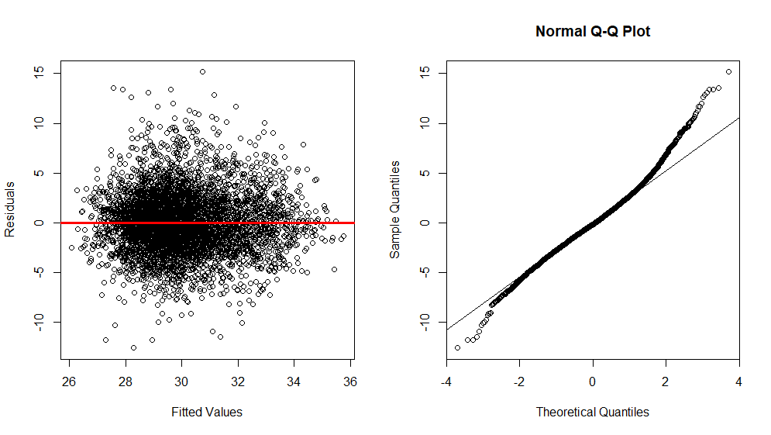
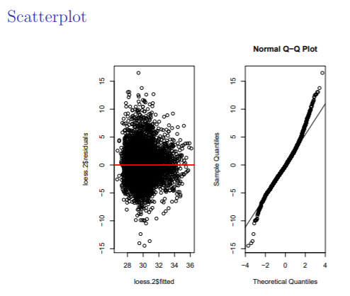
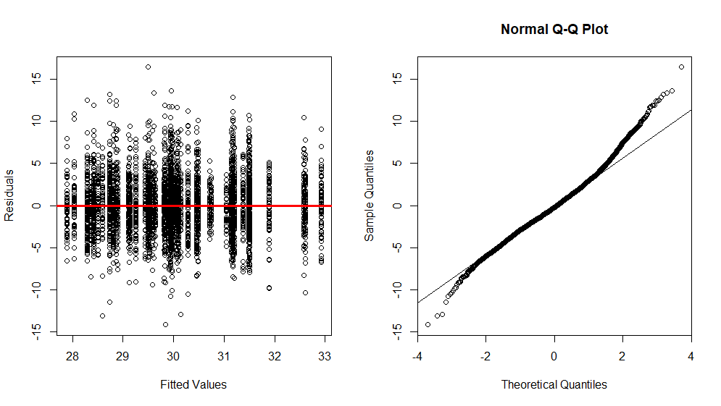
A
B
C

Slide 14
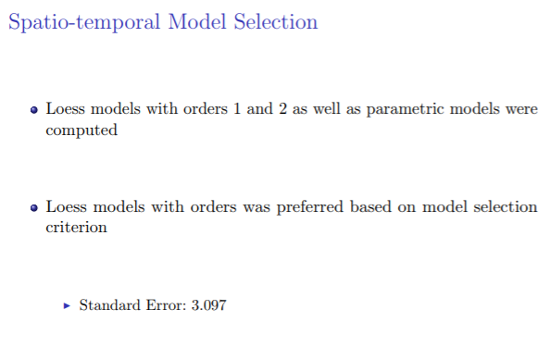

Slide 15
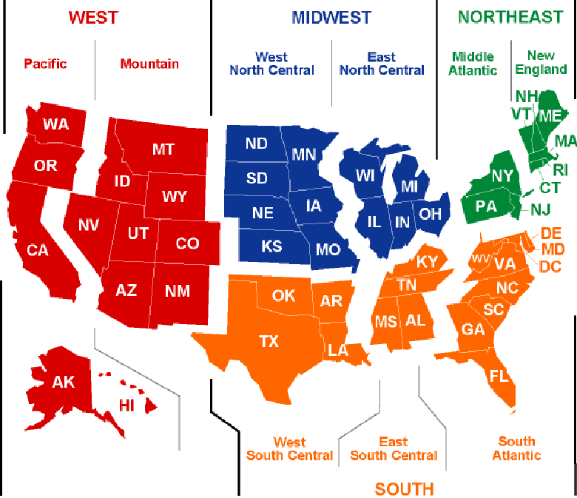
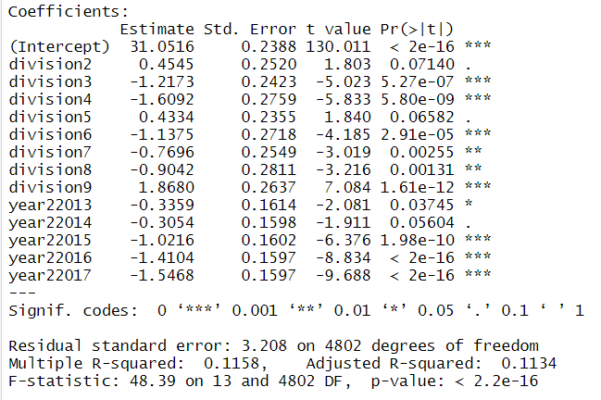
Linear model including division, and year as a factor
Map of US Census Divisions taken from Lacommare, Kristina & H. Eto, Joseph. (2004). Understanding the Cost of Power Interruptions to U.S. Electricity Consumers. 10.2172/834270.

Slide 16
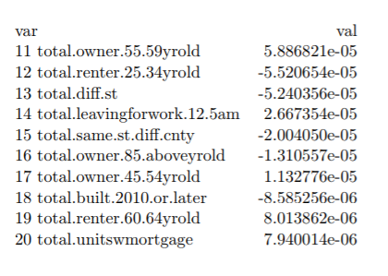
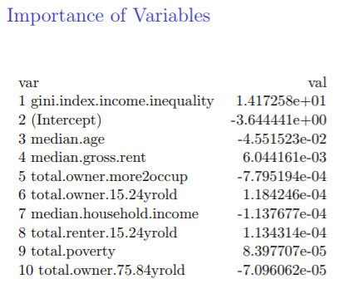
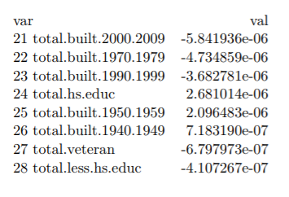

Slide 17
Factors affecting…
Factors affecting severely for high residuals (Isabella County, Michigan)
Median age is 26.6 (compared with mean median age 38.47)
Population size is small as 70436 compared with (the mean population size in each county is 331901)
Total bach.edu is 6573 (mean bach.edu 44741)
Total grad.edu- 3583 is very small as compared with the mean grad.edu 27677.
Total hs.edu is 11755 – very small compared with mean hs.edu 57726
Total.less.hs.edu 3146 compared with mean less.hs.edu 28087

Slide 18
Factors affecting…
Factors affecting severely for less residuals (Apache County, Arizona)
Population size is small as 71828 (mean value- 331901)
Total Assoc.edu is 14010 small compared with mean 64171.95
Total bach.edu is 2633 small enough (mean bach.edu 44741)
Total.built.1939.earlier is 62 -very small compared with the mean value of 12132
Total.built.1940.1949 is 397 small compared with the mean value of 11067

Slide 19
Factors affecting…
Factors affecting severely for less residuals (Apache County, Arizona):
Total built.1950.1959 is 1198 compared with 15050
Total.owner.25.34yrs.old 560 compared with the mean 12249
Renter 15.24 is 122 (mean 4088)
Renter 25.34 is 560 –mean 12249

Slide 20
Apache County, AZ had lower than expected increase in Rent Burden between 2012-2017:
AZ allows more flexible housing alternatives. It is legal to live in RVs, campers, vans, container homes, etc.

Slide 21
Evictions in King County, WA

Slide 24
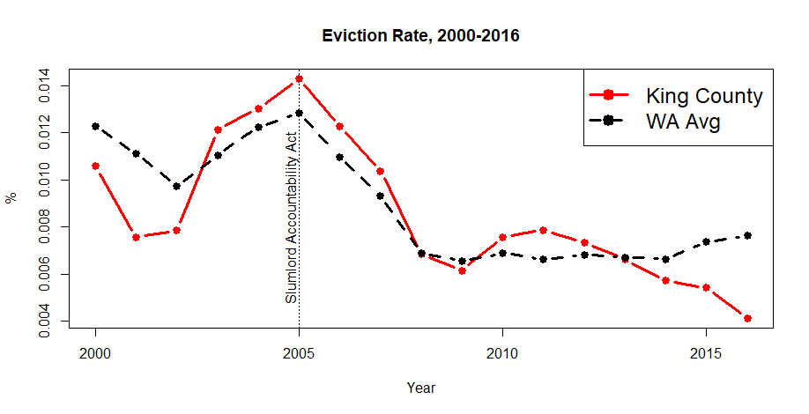
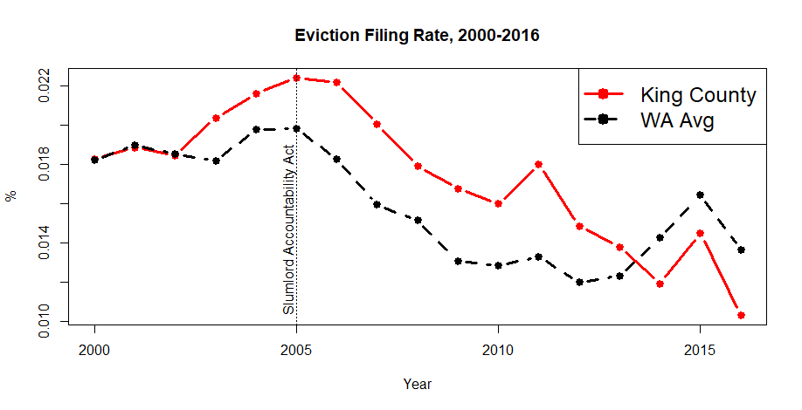
Eviction Filing and actual Eviction Rates in King County peak in 2005. This happens to coincide with the April 2005 WA Slumlord Accountability Act (59.18.085)
The Act regulates eviction and relocation assistance for residents of run down properties.
Until recently King County tended to trend above the WA Avg

