Slide 1
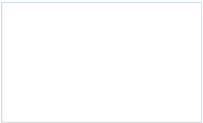
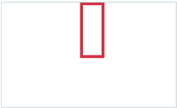
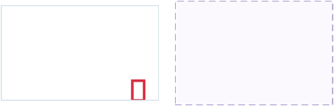
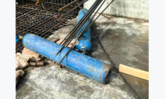
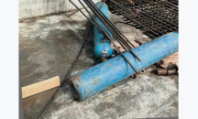
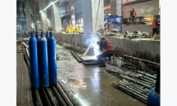
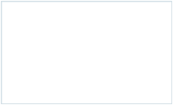
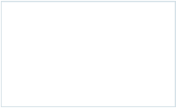
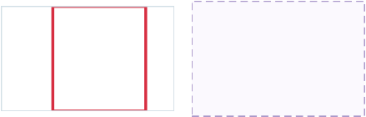
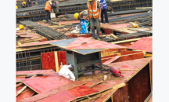
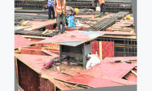
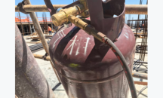
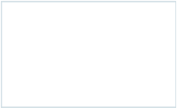

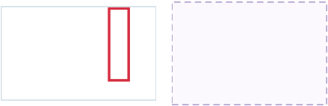
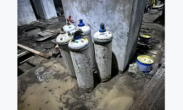
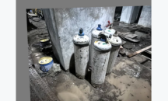
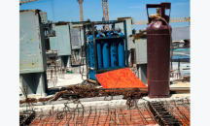
TRAINING IMAGES BY DATA ARM A -> B matched by source / C independent / D reserved
A REAL PHOTO B CLASSICAL AUGMENT C IMAGE EDIT D LORA TEXT-TO-IMAGE
D SAMPLE
RESERVED
real_photo_30 aug1085_0266 Placement_Issues_0001
D SAMPLE
RESERVED
real_photo_50 aug1085_0522 Placement_Issues_0554
D SAMPLE
RESERVED
real_photo_70 aug1085_0780 Placement_Issues_0515
Red outlines are reviewed training labels. Each A-B row shares a real source; C examples are edits of other real93 seeds and are not row-matched.

