Slide 1
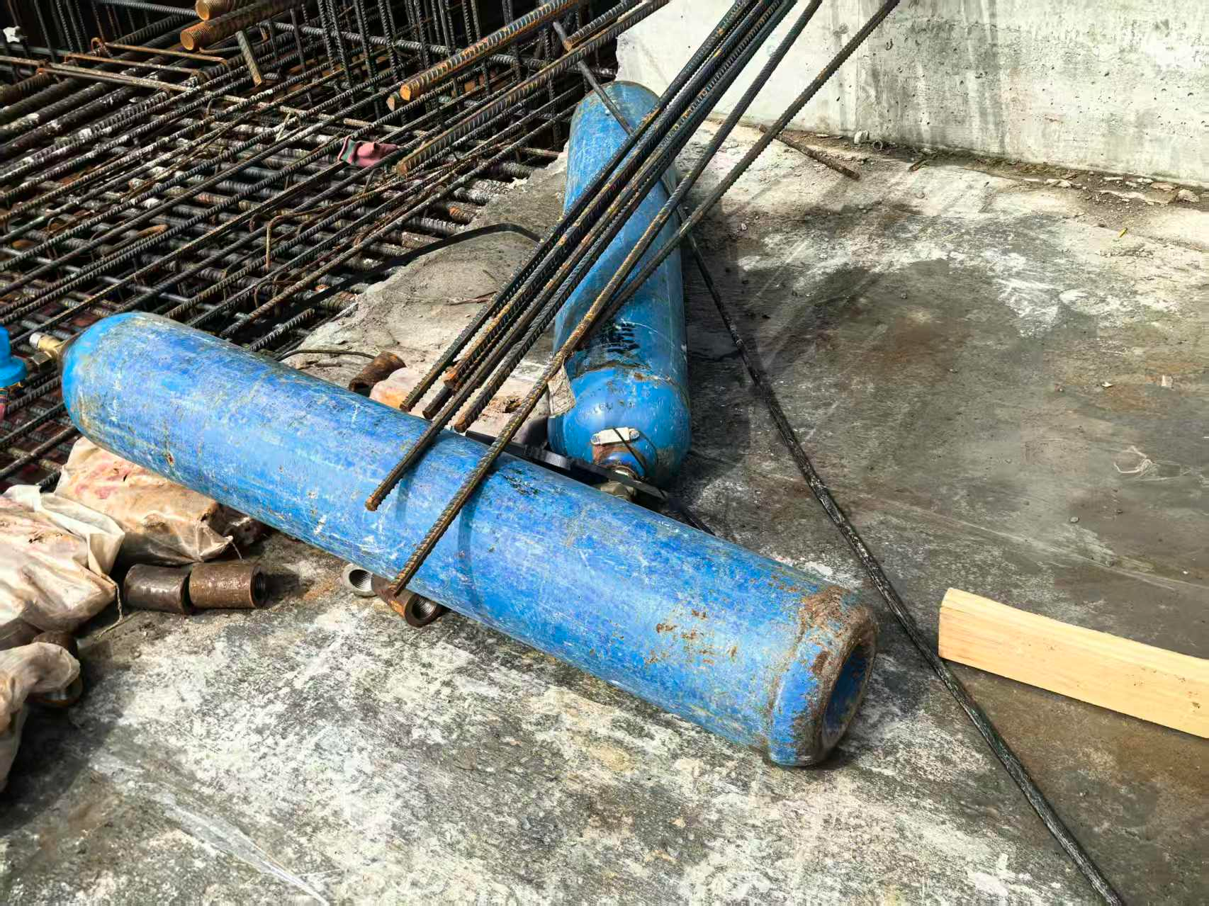
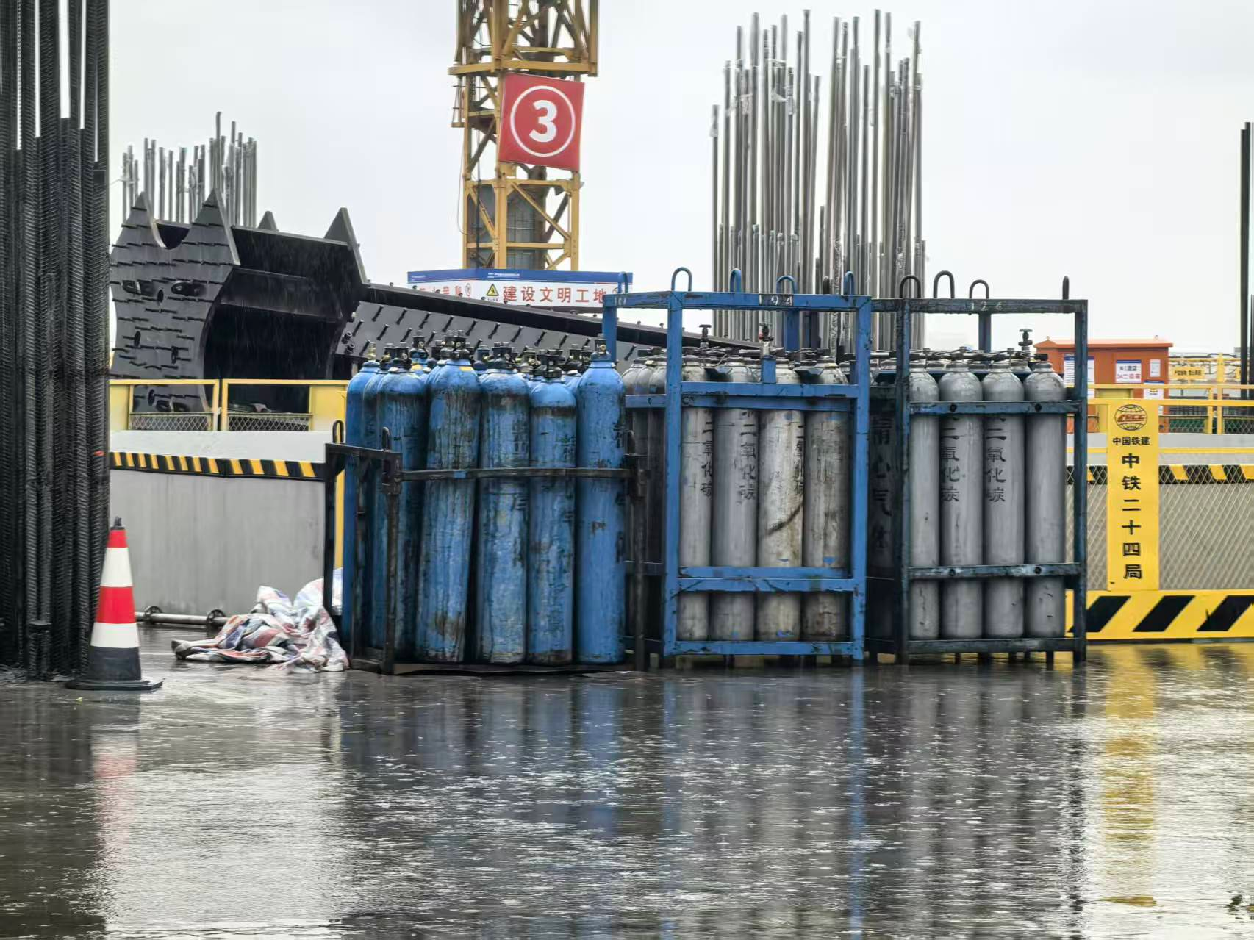

(a) Data construction
(b) Controlled training
(c) Development evaluation
Real-only baseline
93
Six detectors per arm
dev61
61 development images
Excluded from detector training
A
real93
Reviewed labels
Small (s)
Medium (m)
Classical augmentation
1,085
YOLOv8s
YOLOv8m
B
Fixed endpoint
Offline transformations
YOLO11s
YOLO11m
last.pt evaluated on dev61
Image editing
1,085
YOLO26s
YOLO26m
C
Five-fold cross-fitting
Reviewed synthetic images
Joint model + checkpoint; pooled OOF
300 epochs per run
Paired bootstrap: 10,000 resamples
D
LoRA text-to-image
1,085
93 real photographs
On-site and web sources
Checkpoints every 10 epochs
and final last.pt
Deployment selection
Reviewed images and labels
All dev61; development score
All four arms completed. dev61 supports development analysis; a frozen external test remains to be collected.
Notes:
Four-arm study overview updated 2026-10-09. A=93; B/C/D=1085. D image review, annotation, six 300-epoch detector runs and evaluation are complete. Source photographs: real_photo_30 (front/top), real_photo_14 (middle), real_photo_7 (back/bottom). Six detectors: yolov8s/m, yolo11s/m, yolo26s/m. dev61 is a development benchmark, not a frozen external test. Evidence: EXPERIMENTS.md; experiments/v5_d/acceptance.md. Candidate checkpoint labels retain the existing zero-based filename convention.

