Slide 1
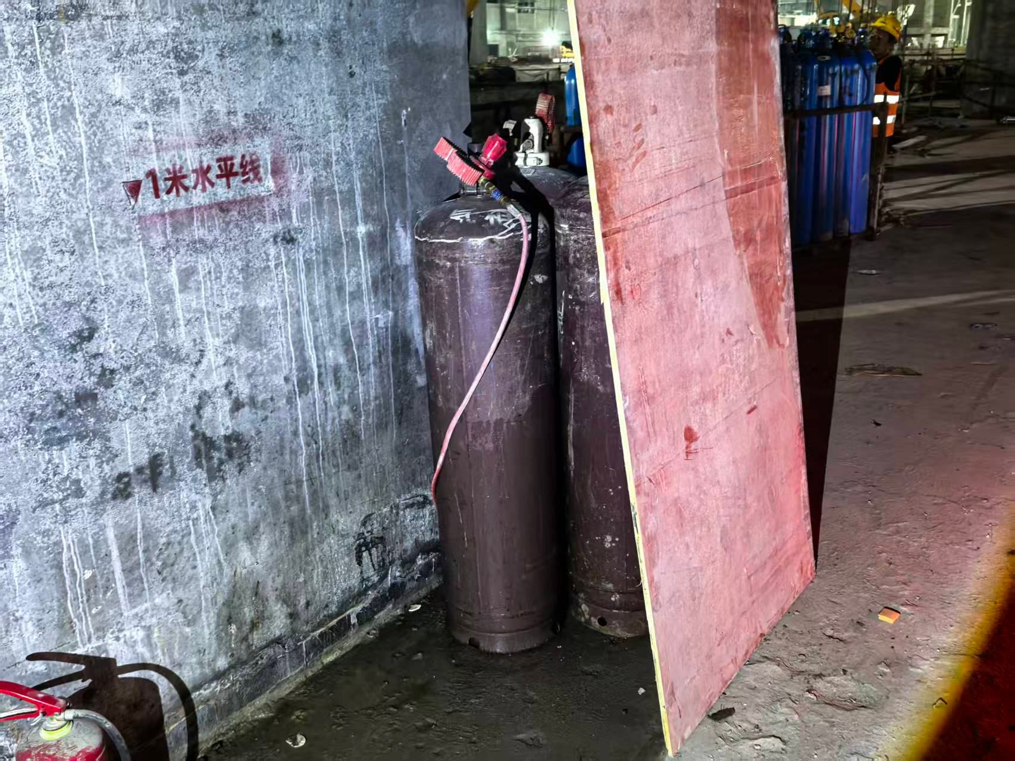
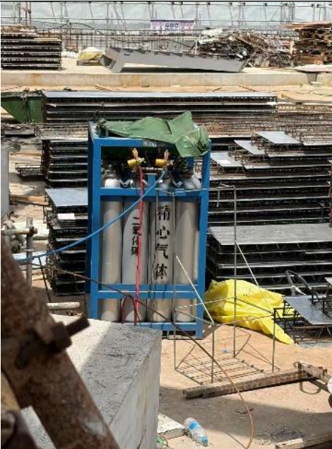
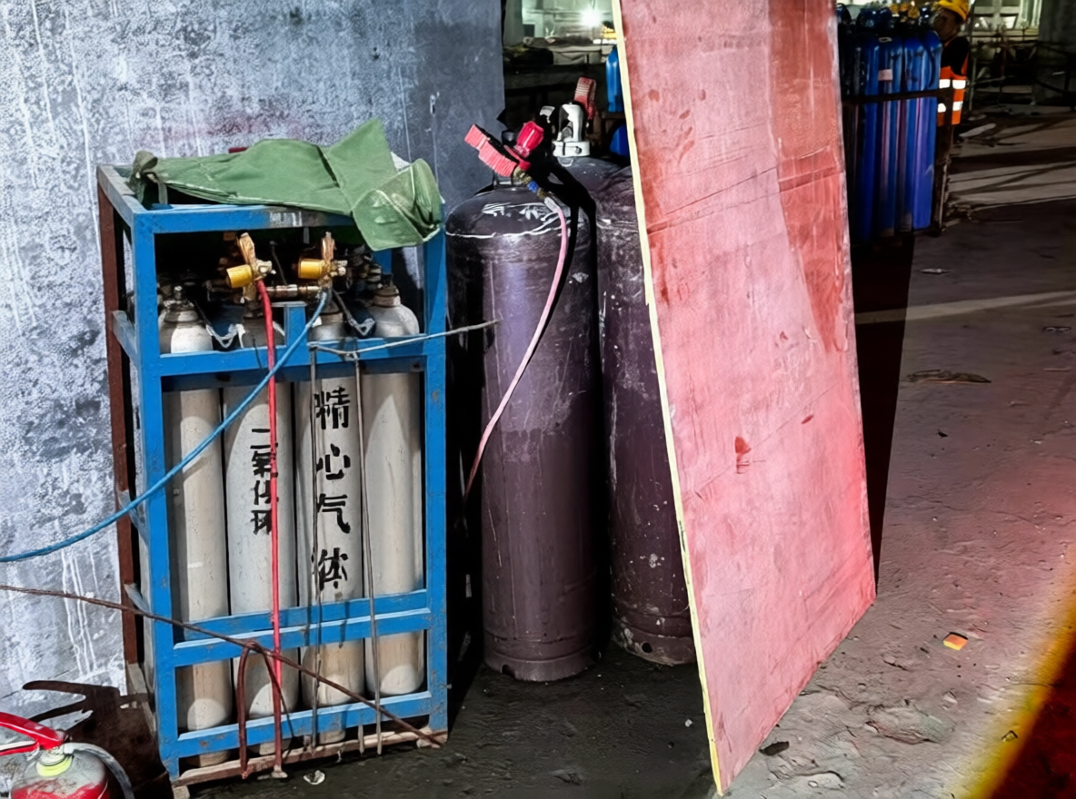
(a) Reference composition
(b) Conditioned image editing and dataset assembly
Multimodal encoder
VAE decoding
Qwen2.5-VL 7B · FP8
Qwen image VAE
+
Visual + text conditioning
Qwen-Image-Edit-2509
Reference 12
Reference 36
Image encoding
FP8 diffusion backbone
Scale + Qwen VAE
Conditioned denoising
Joint visual conditioning
Reference latent
KSampler · Euler / simple
Edit instruction
Generated image 301
Combine the cage and cylinders
with the reference scene
Noise latent
Sampling configuration
Human review
and YOLO annotation
Seed + output size
Standard / optional Lightning path
Two reference photographs
contribute to image 301
Reference pairing shown for image 301; sampling settings can vary across C.
Arm C: 1,085 images
Notes:
Image-Edit workflow. Styling only adapted from supplied Li2025 reference: pale-blue field, separated input/processing regions, pastel modules and direct arrows. No reference scientific content is reused. C example Placement_Issues_0301.png: PNG prompt nodes 23 and 25 explicitly load real_photo_12.png and real_photo_36.png; node 7 conditions on both. The displayed instruction is an English summary, not a verbatim prompt. Model and encoders: docs/v5_prompts/generation_models.md. Lightning is optional across C; do not infer all 1085 images used the same sampling settings. Final C dataset has 1085 retained and annotated images.

