Slide 1
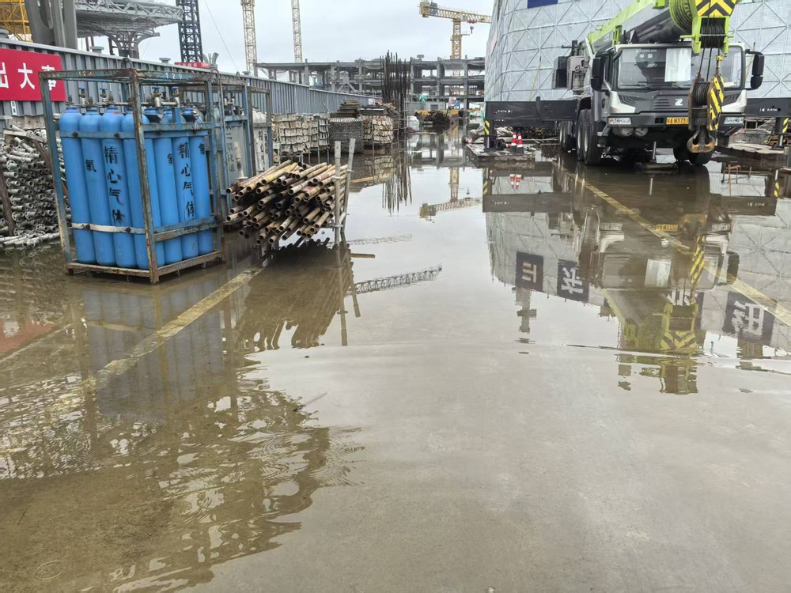
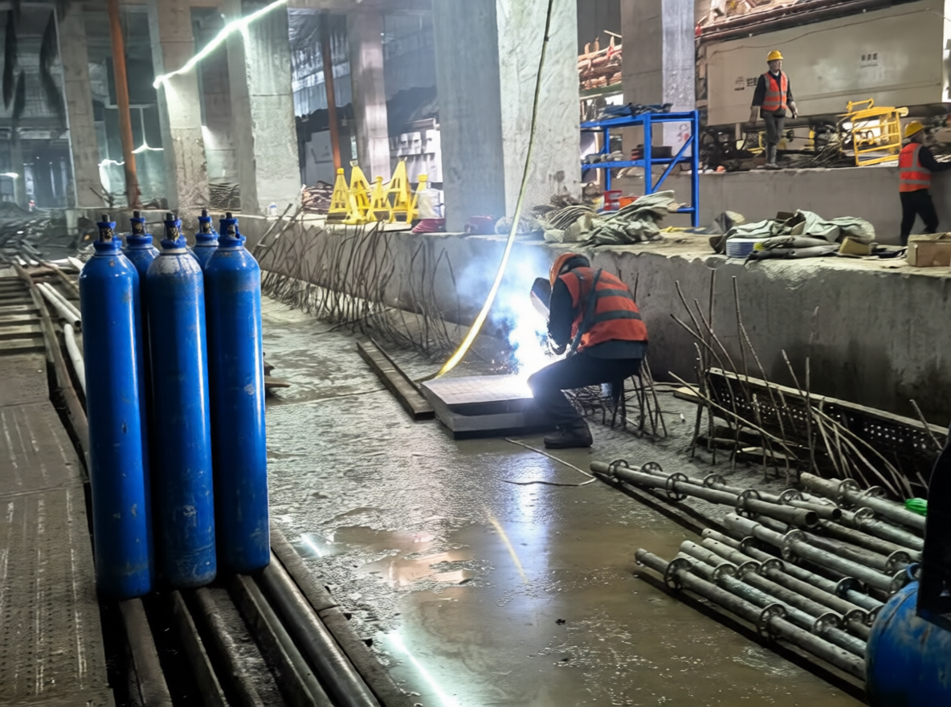
(a) Conditioning and model preparation
(b) Sampling and dataset assembly
Edit instruction
Noise latent
Target safety state
and scene description
Target size and random seed
Reference photograph
Denoising / KSampler
Image encoding
Multimodal encoding
Conditioned iterative sampling
Scale + Qwen VAE
Qwen2.5-VL 7B
FP8 text encoder
z
T
z
t
z
0
Image latent
Text conditioning
Qwen-Image-Edit-2509
VAE decode
FP8 diffusion model
Qwen image VAE
Standard path
Lightning LoRA
Optional four-step path
Generated edit
Model preparation: AuraFlow / CFGNorm
Scene content
Safety state
Image quality
Latent + conditioning + model
Human review and YOLO annotation
Prepared inputs enter the denoising process.
Arm C: 1,085 retained images
Reference and retained example are unpaired; four-step acceleration is optional.
Notes:
Author workflow: reference in archive/drafts/fig1_pipeline.pptx. Exact models: qwen_image_edit_2509_fp8_e4m3fn.safetensors; qwen_2.5_vl_7b_fp8_scaled.safetensors; qwen_image_vae.safetensors; Qwen-Image-Edit-2509-Lightning-4steps-V1.0-bf16.safetensors. The standard/Lightning switch is available; the diagram does not assert all retained C images used four-step sampling. Source photographs and retained example are illustrative and unpaired. Exact per-image C sampling parameters and retained workflow provenance still need archival.

