Slide 1
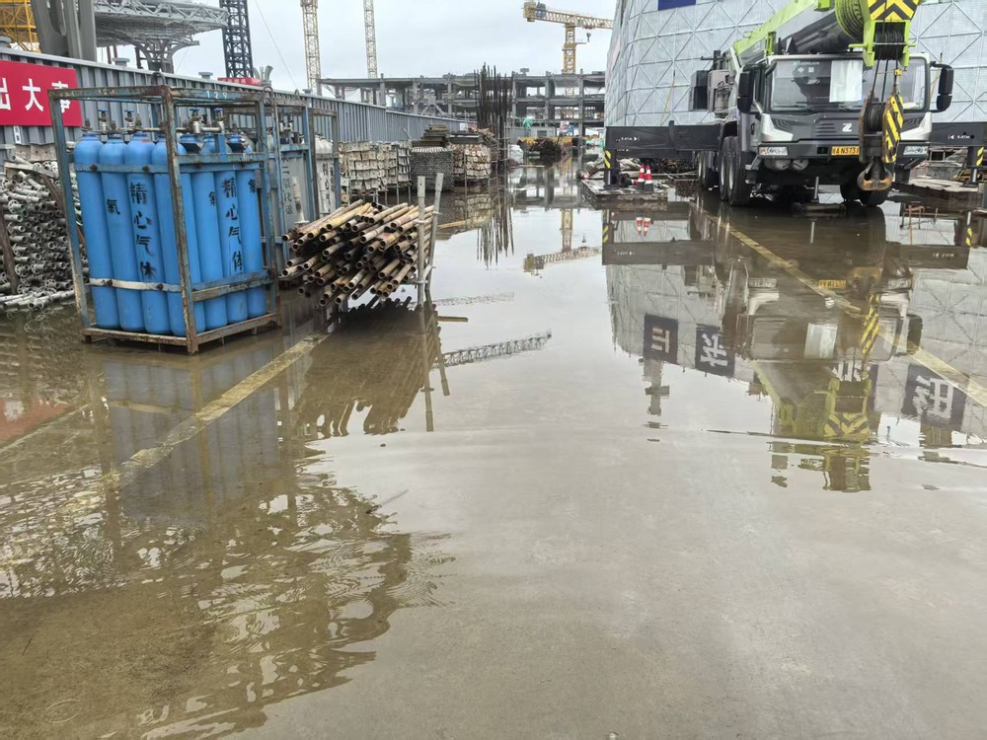
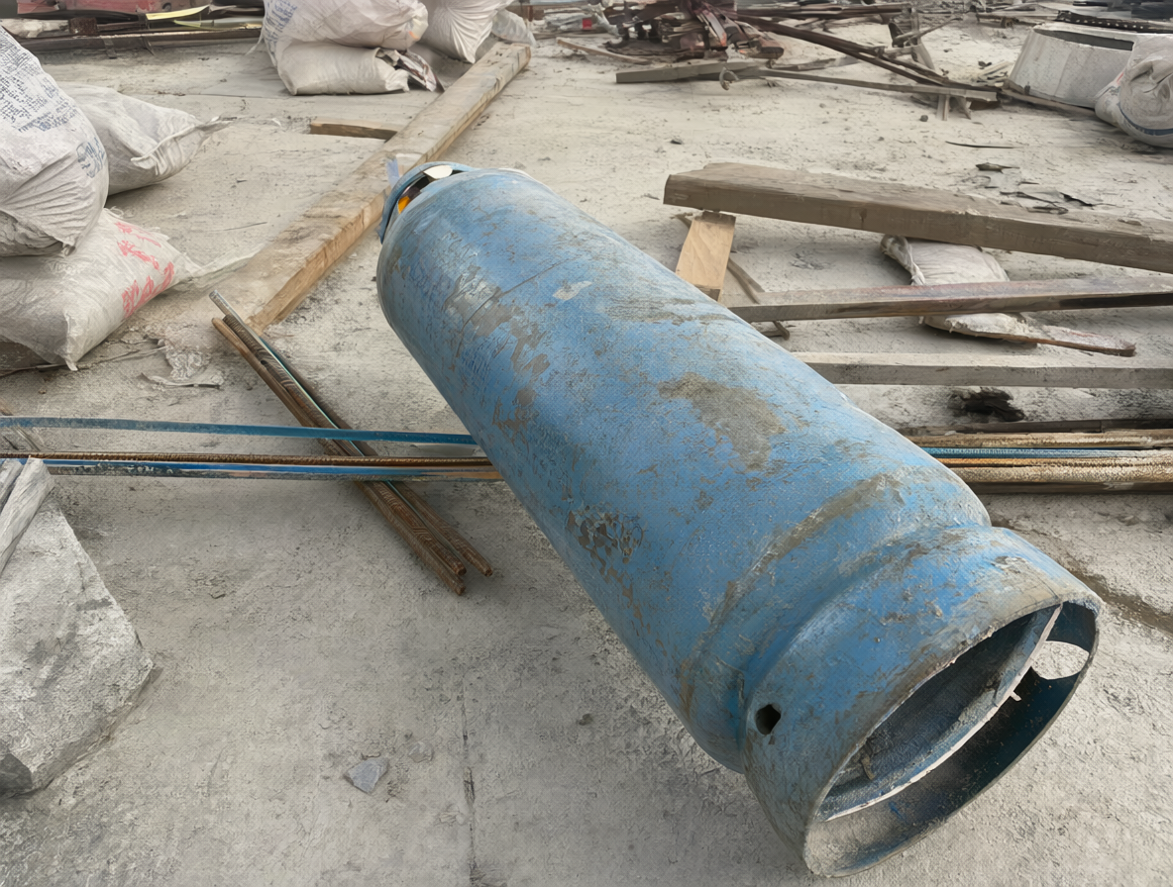
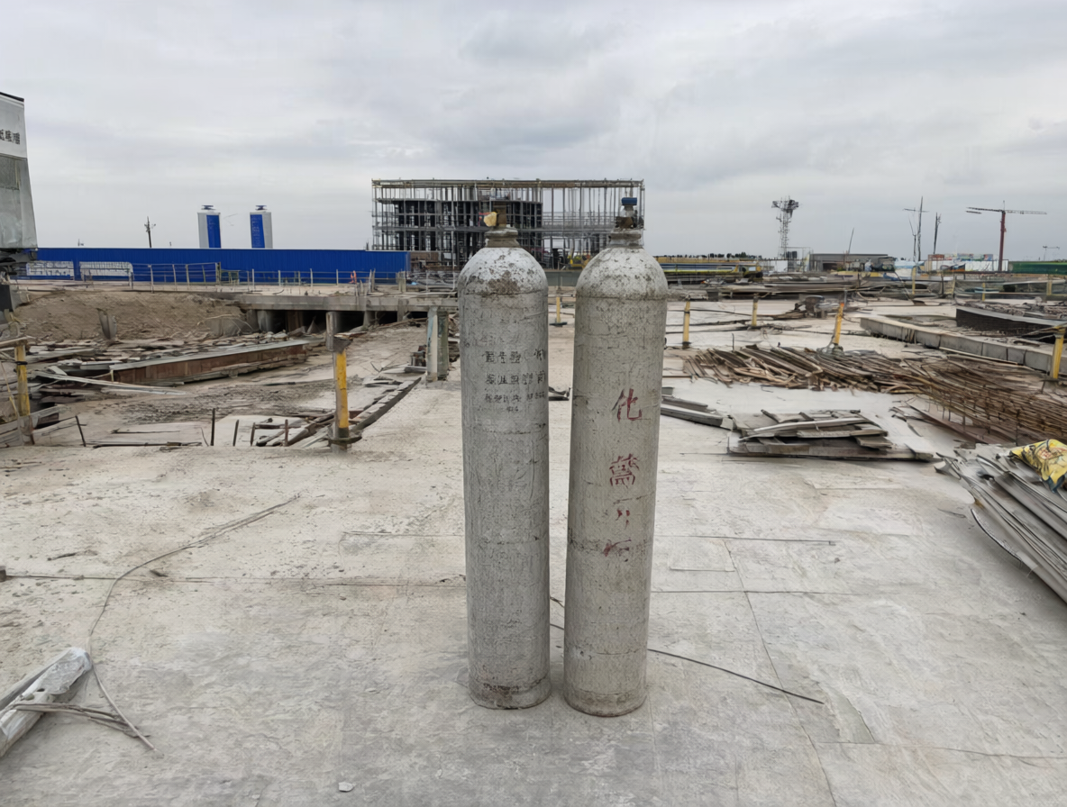
(a) LoRA fitting on real93
(b) Text-to-image generation
93 reviewed image–caption pairs
real93 prompts
new150 prompts
Source
real93
558
750
Trigger
cylsite93
93 prompts × 6
150 prompts × 5
Image VAE encoder
Text encoder
Text conditioning
Qwen3VL 8B (INT8)
Qwen-Image-2.1 DiT
Qwen-Image-2.1 + LoRA
Frozen base
Trainable adapter
Base / adapter
INT8 convrot / step-1860
W
+
×
A
rank 16
Generation settings
B
Adapter strength
0.8
Sampler / schedule
Euler / simple
Optimization settings
Steps / CFG
25 / 1
Framework
DiffSynth-Studio SFT
Seed / denoise
Random / 1
Loss
FlowMatchSFTLoss
Size / batch
1184 × 896 / 1
Optimizer
AdamW
Negative prompt
Empty
Learning rate
1e-4 (constant)
VAE decode → PNG with metadata
Batch / max pixels
1 / 1,048,576
Qwen-Image-2.1 VAE
Images × repeats × epochs
1,308
93 × 5 × 4 = 1,860 optimizer steps
Generated candidates
Unscreened examples
FINAL LORA CHECKPOINT
step-1860.safetensors
Review + annotation: target 465 + 620 = 1,085
Dataset review and detector results pending.
Notes:
Sources: docs/v5_prompts/qwen21_lora_training_validation.md, full_generation_20261004.md, pilot_workflow_api.json. Actual compatible training: Qwen-Image-2.1 DiffSynth-Studio SFT DiT LoRA, rank16, LR1e-4, repeat5, epochs4, batch1, 1860 optimizer steps, max_pixels1048576, FlowMatchSFTLoss, AdamW / ConstantLR. 93 reviewed image-caption pairs; no held-out LoRA validation set. Earlier Liblib 2000-step/0.0004 LoRA is incompatible and is not the formal D weight. Inference: qwen_image_2.1_int8_convrot.safetensors, qwen3vl_8b_int8_convrot.safetensors, qwen_image_2.1_vae_bf16.safetensors, step-1860.safetensors at0.8, random seeds, 1184x896, Euler/simple25steps CFG1 denoise1 empty negative, batch1. 1308 candidates (558+750) completed 2026-10-04. Screening/labels pending, target465+620=1085. Displayed D pictures are unscreened candidates, not evidence of downstream benefit.

