Slide 1
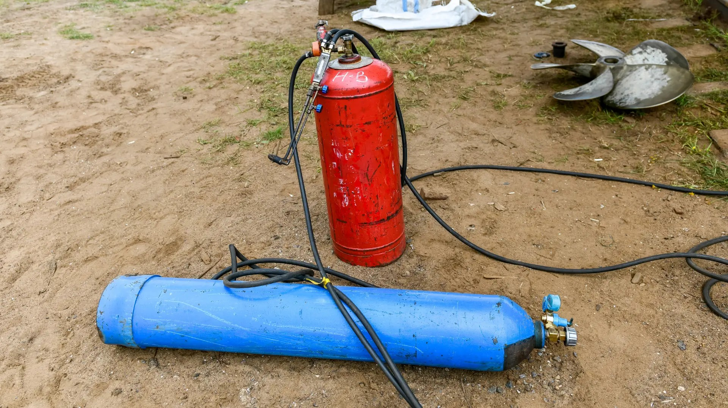
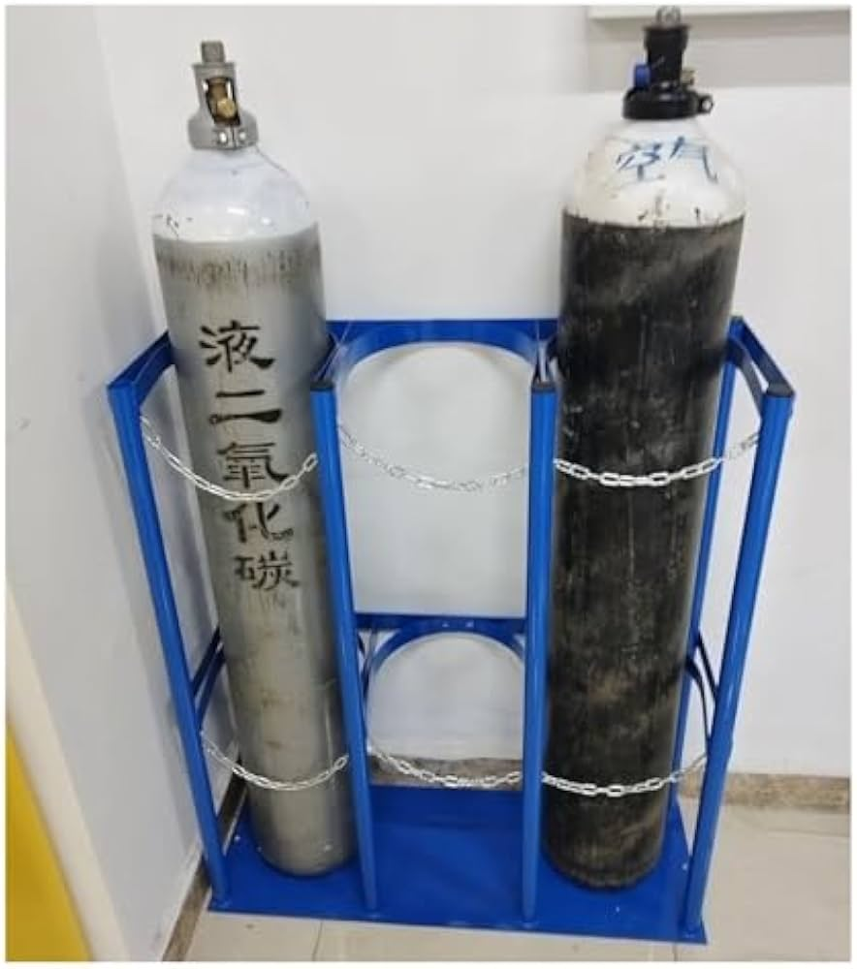
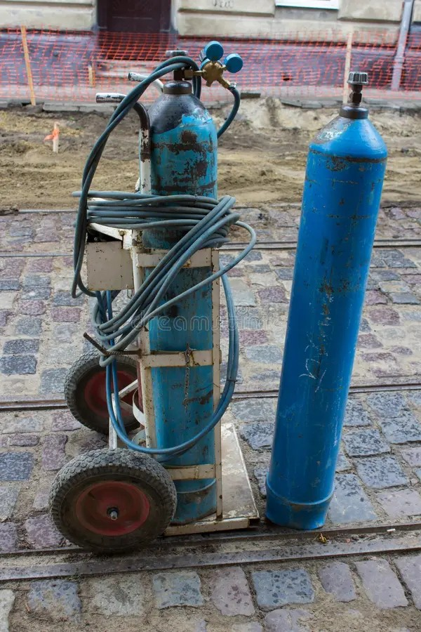
Detection examples on the development images
Reviewed GT
A real93
B Augmented
C Image edit
D LoRA T2I
(a) Fallen cylinders
new_test_set_0014
0.76
D output reserved
0.91
(b) Background false positive
new_test_set_0006
0.36
D output reserved
(c) Multiple predictions
new_test_set_0005
0.35
0.31
0.96
0.97
D output reserved
Dashed red boxes: reviewed GT. Solid coloured boxes: detections at confidence ≥ 0.25.
Hand-selected illustrations using deployment checkpoints on dev61. Their occurrence does not estimate error rates.
Notes:
Source: experiments/v4_protocol/qualitative_detections.json and reviewed GT labels, dev61 images0014/0006/0005. Deployment weights: A yolo26s epoch280, B yolo26s epoch200, C yolo26s epoch260, conf>=.25. These hand-selected cases are illustrative, not frequency estimates. Predictions here use deployment weights, while quantitative figures5/8 use held-out OOF. D blank. Image, each box and each confidence label are independent objects.

