Slide 1
Figure index
Figure
Title
Page
1
Study design and development evaluation
2
2
Qwen-Image-Edit synthesis workflow (arm C)
3
3
real93 LoRA training and text-to-image synthesis (arm D)
4
4
Training images and reviewed bounding boxes
5
5
Arm-level performance relative to the real93 baseline
6
6
Fixed-endpoint performance across six YOLO detectors
7
7
Effect of the image-edit training-set size
8
8
Missed objects and false positives across confidence thresholds
9
11
Detection examples on the development images
10

Slide 2
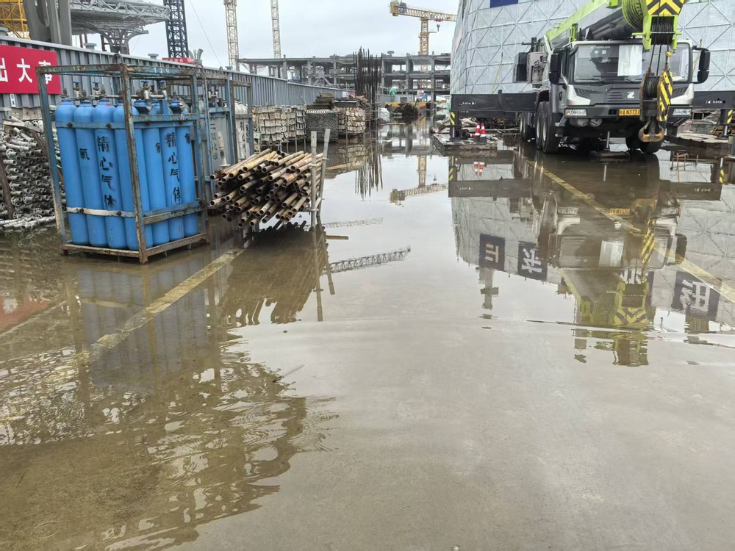
(a) Data construction
(b) Controlled training
(c) Development evaluation
A
Real-only baseline
93
Six detectors per arm
dev61
61 development images
Excluded from detector training
real93
Reviewed labels
Model family
s
m
B
Classical augmentation
1,085
YOLOv8
Fixed endpoint
Offline transformations
YOLO11
last.pt evaluated on dev61
C
Image editing
1,085
YOLO26
Five-fold cross-fitting
Reviewed synthetic images
Joint model + checkpoint; pooled OOF
93 real photographs
On-site and web sources
300 epochs per run
Paired bootstrap: 10,000 resamples
D
LoRA text-to-image
1,085*
Checkpoints every 10 epochs
and final last.pt
Deployment selection
1,308 candidates; screening pending
All dev61; development score
Notes:
Source: EXPERIMENTS.md, PROGRESS.md, docs/v5_prompts/full_generation_20261004.md. A=93; B/C=1085; D=1308 candidates generated, screening and reviewed annotations pending, target 1085. dev61 is development data, excluded from detector training. D is a later extension of the completed v4 A/B/C study.

Slide 3
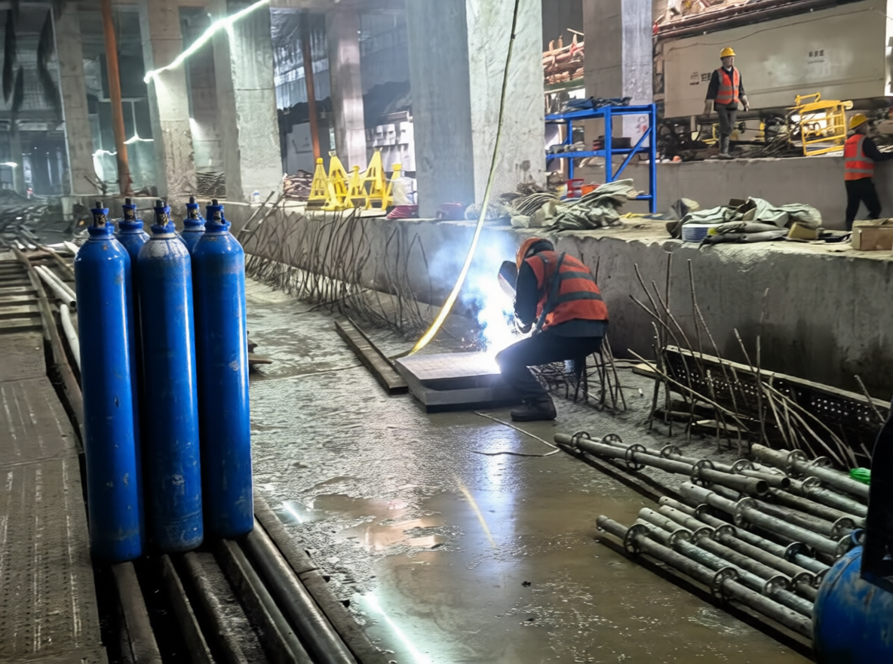
(a) Conditioning and model preparation
(b) Sampling and dataset assembly
Edit instruction
Noise latent
Target safety state
and scene description
Target size and random seed
Reference photograph
Denoising / KSampler
Image encoding
Multimodal encoding
Conditioned iterative sampling
Scale + Qwen VAE
Qwen2.5-VL 7B
FP8 text encoder
z
T
z
t
z
0
Image latent
Text conditioning
Qwen-Image-Edit-2509
VAE decode
FP8 diffusion model
Qwen image VAE
Standard path
Lightning LoRA
Optional four-step path
Generated edit
Model preparation: AuraFlow / CFGNorm
Scene content
Safety state
Image quality
Latent + conditioning + model
Human review and YOLO annotation
Prepared inputs enter the denoising process.
Arm C: 1,085 retained images
Notes:
Author workflow: reference in archive/drafts/fig1_pipeline.pptx. Exact models: qwen_image_edit_2509_fp8_e4m3fn.safetensors; qwen_2.5_vl_7b_fp8_scaled.safetensors; qwen_image_vae.safetensors; Qwen-Image-Edit-2509-Lightning-4steps-V1.0-bf16.safetensors. The standard/Lightning switch is available; the diagram does not assert all retained C images used four-step sampling. Source photographs and retained example are illustrative and unpaired. Exact per-image C sampling parameters and retained workflow provenance still need archival.

Slide 4
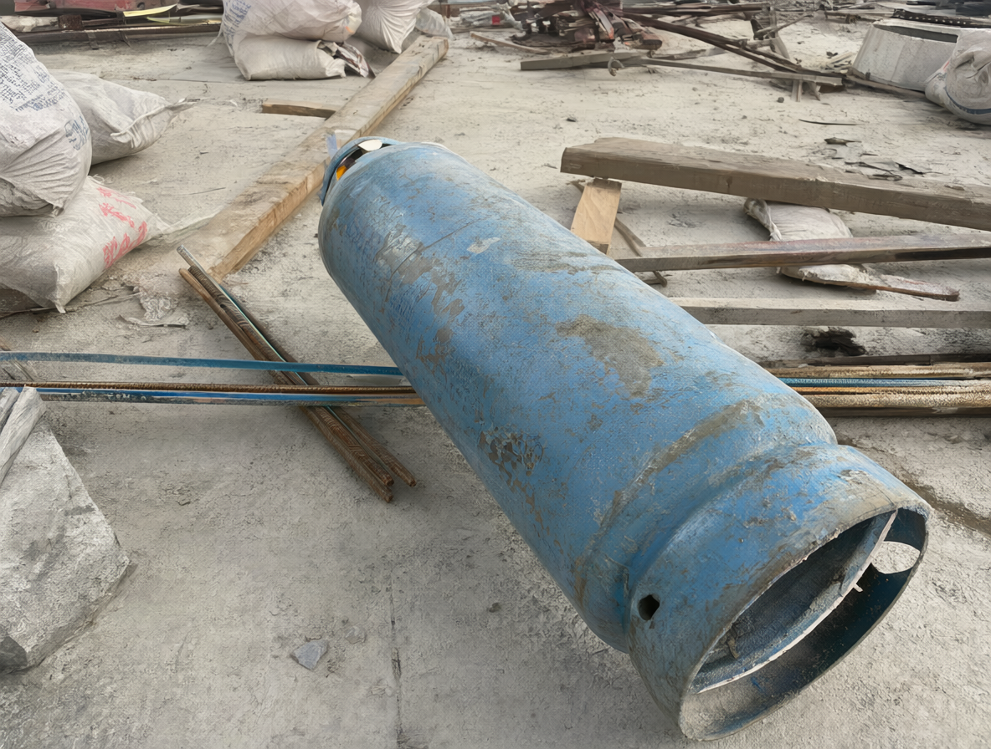
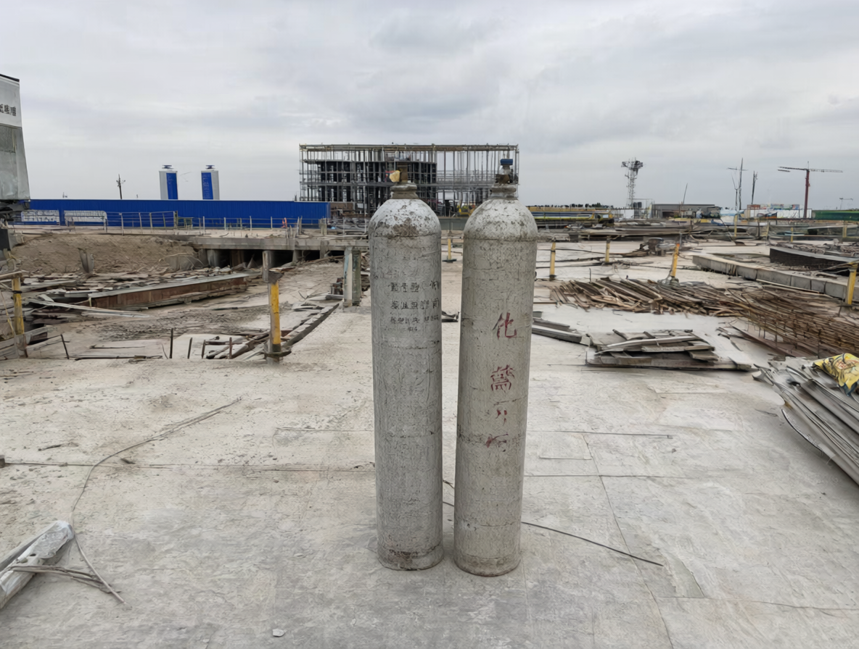
(a) LoRA fitting on real93
(b) Text-to-image generation
93 reviewed image–caption pairs
real93 prompts
new150 prompts
Source
real93
558
750
Trigger
cylsite93
93 prompts × 6
150 prompts × 5
Image VAE encoder
Text encoder
Text conditioning
Qwen3VL 8B (INT8)
Qwen-Image-2.1 DiT
Qwen-Image-2.1 + LoRA
Frozen base
Trainable adapter
Base / adapter
INT8 convrot / step-1860
W
+
×
A
rank 16
Generation settings
B
Adapter strength
0.8
Sampler / schedule
Euler / simple
Optimization settings
Steps / CFG
25 / 1
Framework
DiffSynth-Studio SFT
Seed / denoise
Random / 1
Loss
FlowMatchSFTLoss
Size / batch
1184 × 896 / 1
Optimizer
AdamW
Negative prompt
Empty
Learning rate
1e-4 (constant)
VAE decode → PNG with metadata
Batch / max pixels
1 / 1,048,576
Qwen-Image-2.1 VAE
Images × repeats × epochs
1,308
93 × 5 × 4 = 1,860 optimizer steps
Generated candidates
Unscreened examples
FINAL LORA CHECKPOINT
step-1860.safetensors
Review + annotation: target 465 + 620 = 1,085
Notes:
Sources: docs/v5_prompts/qwen21_lora_training_validation.md, full_generation_20261004.md, pilot_workflow_api.json. Actual compatible training: Qwen-Image-2.1 DiffSynth-Studio SFT DiT LoRA, rank16, LR1e-4, repeat5, epochs4, batch1, 1860 optimizer steps, max_pixels1048576, FlowMatchSFTLoss, AdamW / ConstantLR. 93 reviewed image-caption pairs; no held-out LoRA validation set. Earlier Liblib 2000-step/0.0004 LoRA is incompatible and is not the formal D weight. Inference: qwen_image_2.1_int8_convrot.safetensors, qwen3vl_8b_int8_convrot.safetensors, qwen_image_2.1_vae_bf16.safetensors, step-1860.safetensors at0.8, random seeds, 1184x896, Euler/simple25steps CFG1 denoise1 empty negative, batch1. 1308 candidates (558+750) completed 2026-10-04. Screening/labels pending, target465+620=1085. Displayed D pictures are unscreened candidates, not evidence of downstream benefit.

