Slide 1
Password GENERATOR
TEAM- (RS)^2DCYVP

Slide 2
INTRODUCTION
A password generator is a tool that automatically generates a password based on guidelines that you set to create strong and unpredictable passwords for each of your accounts.

Slide 3
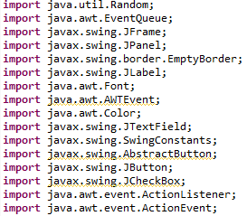
PROGRAM
Importing Required Packages

Slide 4
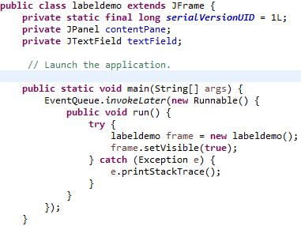
PROGRAM
Creating THE MAIN FUNC and class

Slide 5
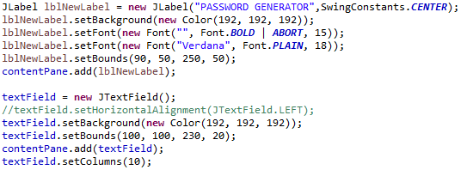
PROGRAM
CREATING LABEL AND TEXTFIELD

Slide 6
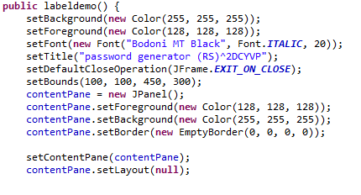
PROGRAM
CREATING BACKGROUND

Slide 7
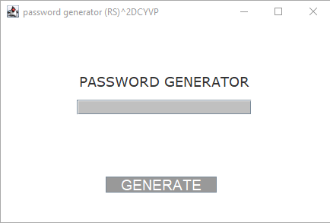
PROGRAM
OUTPUT

Slide 8
A PROJECT BY :
REEGAN R-21IT45
PRADEEPRAJ A-21IT38
RAGUNATH S-21IT41
YOUSUF-21IT33
SABARISH S-21IT47

