Slide 1

G2M insight for Cab Investment Firm
Virtual Internship Week 2
27th June 2021

Slide 2

Agenda
Executive Summary
Problem Statement
Approach
EDA
EDA Summary
Recommendations

Slide 3
Executive Summary
XYZ is a private firm in US. Due to remarkable growth in the Cab Industry in last few years and multiple key players in the market, it is planning for an investment in Cab industry and as per their Go-to-Market(G2M) strategy they want to understand the market before taking final decision.

Slide 4
Problem Statement
Cab Companies included:
Yellow Cab
Pink Cab
The task is to identify the right company to invest in.

Slide 5
Data Exploration
There are 4 datasets:
Cab_Data.csv
Customer_ID.csv
Transaction_ID. Csv
City.csv
TimeFrame of the Data: 2016-01-31 to 2018-12-31
Total Data Points: 355,032

Slide 6
Exploratory Data Analysis

Slide 7
Statistics of the Total Distance Travelled by Both Cabs
The mean, standard deviation, minimum, maximum and all the percentiles are the same for both the cabs. However, the overall distance travelled for Yellow Cab is greater than Pink Cab.
 | PinkCab | YellowCab
Count | 84711.000000 | 274681.000000
Mean | 22.559917 | 22.569517
Std. Dev. | 12.231092 | 12.234298
Min | 1.900000 | 1.900000
25% | 12.000000 | 11.990000
50% | 22.440000 | 22.440000
75% | 32.960000 | 32.960000
Max | 48.000000 | 48.000000

Slide 8
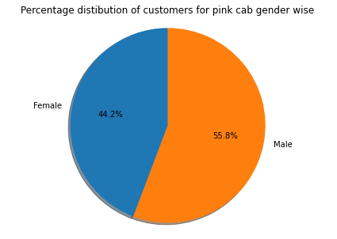
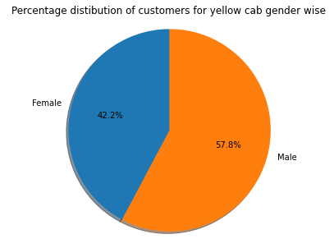
Gender Based Percentage Distribution
It can be seen that the overall percentage of females in Pink Cab is greater than in Yellow Cab.

Slide 9
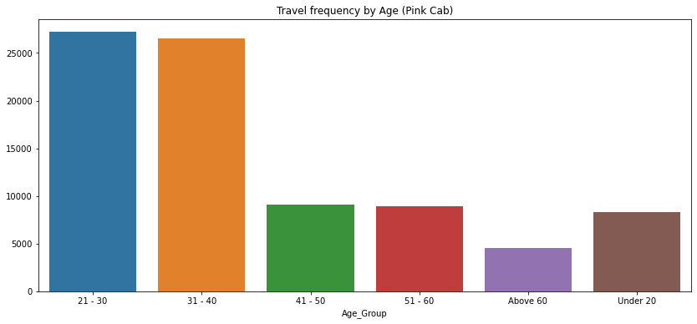
Age Based Travel Frequency

Slide 10
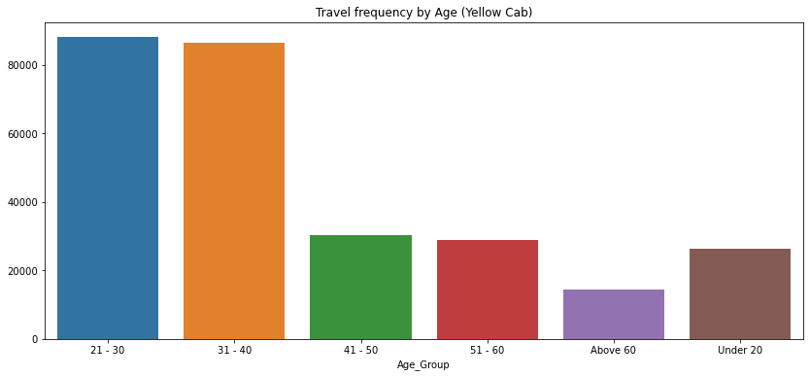
For both of the cabs, customers between the age of 21-40 use more cabs than any age group.

Slide 11
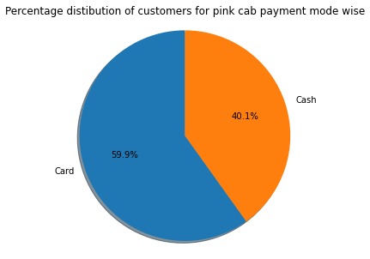

Payment Mode Based Customer Distribution
It can be seen that more of the customers prefer to use Card in Yellow Cab than in Pink Cab.

Slide 12
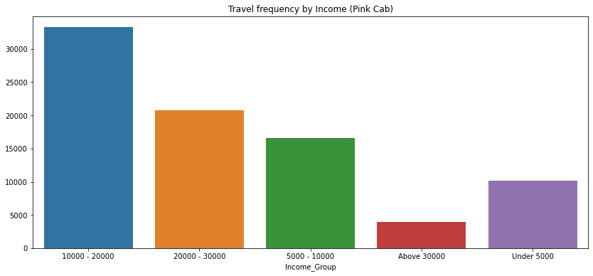
Income Based Travel Frequency

Slide 13
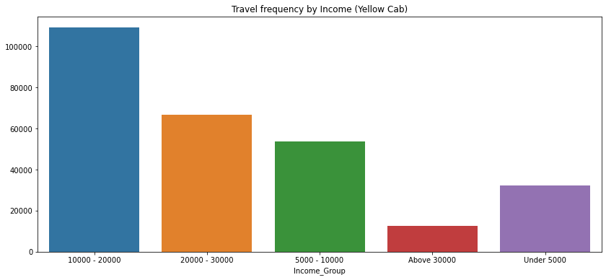
Customers with income between 10,000 and 20,000 prefer to use cabs the most.
However, for each income group the number of customers for Yellow Cab is significantly higher, showing that there are more customers for the Yellow Cab.

Slide 14
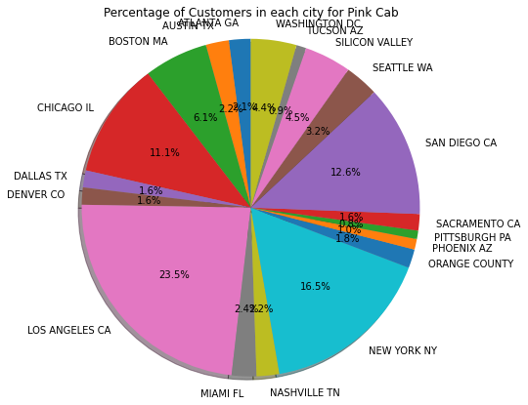
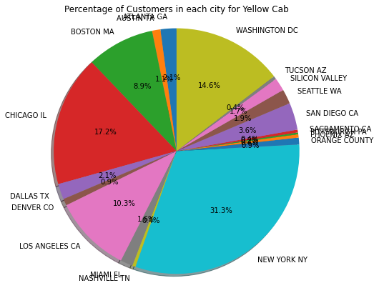
Customer Distribution in each city
In the major cities of New York, Chicago and Washington, more customers prefer to use the Yellow Cab. In Los Angeles, customers prefer Pink Cab.

Slide 15
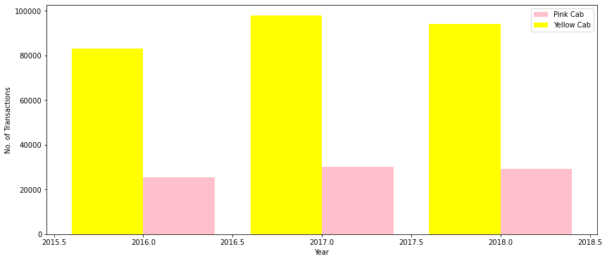
Number of Transaction per year
The overall number of transactions for all the years is almost 4 times higher for the Yellow Cab.
The customer reach has also increased more for the Yellow Cab in 2017.

Slide 16
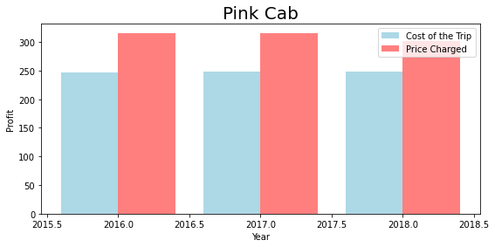
Profit Margin

Slide 17
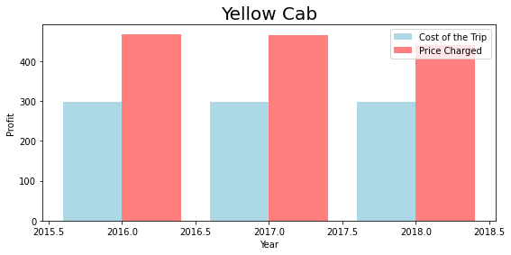
It can be easily seen that the Yellow Cab has kept more Profit Margin.

Slide 18
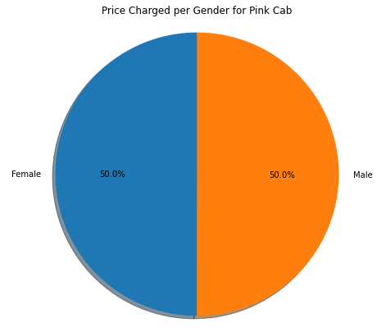

Price Charged per Gender
The price charged for the Pink Cab is the same for both genders, however, the Yellow Cab seems to give more discounts to the females.

Slide 19
Summary
 | Pink Cab | Yellow Cab
Distance Travelled | lesser | greater
No. Of Customers | lesser | greater
Female Customers Percentage | greater | lesser
Age Based Customers ratio | Same | Same
Income Based Customers ratio | Same | Same
Customers Percentage using Card for payment | lesser | greater
Customers Percentage in major cities | Los Angeles | New York, Chicago, Washington
Increase in Customer Reach | lesser | greater
Profit Margin | lesser | greater
Percentage Discounts to females | lesser | greater

Slide 20
Recommendation and Summary
Based on the points stated in the previous table, we suggest that it is better to invest in the Yellow Cab.
Yellow Cab has more customers, covered more distance, have gained more customers trust which can be seen by more customers using card and the customer reach increasing.
It is also very popular in most of the major cities. Yellow Cab provides discounts to females, but also has kept the profit margin high.

Slide 21
Thank You

