Slide 1
Explainable Multimodal AI Framework for Psychological Diagnostics
A Late-Fusion Deep Learning Architecture Integrating Vision, Audio, and Behavioral Telemetry for Clinical Stress Assessment
Team members:-
Shourya Shrivastava – RA2511003010559
Reeju Banerjee – RA2511003010548

Slide 2
Problem Statement & Significance
What problem are you solving ?: Addressing the "Smiling Depression" blind spot where standard mental health AI systems fail by relying solely on facial recognition.
Why is it important ? : Basic emotion detection only captures fleeting facial expressions, whereas psychological distress and mental health issues are sustained conditions requiring reliable, continuous tracking.
Current challenges : Unimodal vision or audio models suffer from high false-positive rates due to environmental noise, visual occlusion, and emotional masking.
Proposed solution : A multi-task late-fusion framework that simultaneously integrates webcam vision, microphone audio, and behavioral telemetry to accurately diagnose clinical stress states.

Slide 3
Dataset Architecture & Feature Mapping
Dataset Source: Curated and provided directly by the CTECH Department, integrating multi-source inputs including facial expression image sets, audio samples, and structured behavioral telemetry logs.
Number of Samples: Standardized train-test splits structured across the provided dataset matrix.
Number of Features: Multimodal feature arrays including 48x48 vision pixel maps, 40-dimensional audio MFCCs, and 18-dimensional behavioral telemetry vectors.
Target Variable: 4 Clinical Stress States (Healthy, Mild Stress, Moderate Stress, Severe Stress) mapped from 7 basic emotion profiles provided in the dataset.
Data Types: Grayscale image tensors (pixel arrays), sequential audio tensors (MFCC float arrays), and numerical/float arrays for behavioral telemetry.

Slide 4
Data Preprocessing
Missing value treatment: Applied automated zero-masking and imputation for missing audio or telemetry frames to maintain tensor dimensionality during inference.
Label Encoding: Target clinical categories label-encoded from integers 0 through 3 to prepare data for model training.
One-Hot Encoding: Utilized where categorical class mappings required multi-column binary representation.
Standard Scaler / MinMax Scaler: Applied image pixel normalization (mean=[0.5], std=[0.5]) and scaling to stabilize gradient convergence during backpropagation.
Outlier removal: Handled via custom Focal Loss scaling rather than destructive deletion, protecting boundary cases from skewing the model.
Train-Test Split (80:20): Structured standard 80:20 partitioning managed through optimized PyTorch DataLoader batching pipelines.

Slide 5
Data Analysis
Missing value graph: Evaluated data gaps and verified zero-masking efficiency across input matrices.
Correlation Heatmap: Demonstrated high statistical correlation between behavioral telemetry variables and cognitive arousal levels.
Class Distribution: Analyzed sample counts across all four clinical stress categories to ensure equitable learning.
Histogram: Visualized feature frequencies and spectral distributions across input streams.
Box Plot: Assessed outlier dispersion and feature variance across audio MFCC bins and telemetry bounds.
Dataset balance: Ensured proper sample distributions to mitigate majority-class bias.
Feature relationships: Highlighted how numerical telemetry acts as an objective behavioral anchor when facial expressions are masked.
Important variables: Identified keystroke typing frequency, mouse movement variance, and specific spectral audio coefficients as high-impact predictors.

Slide 6
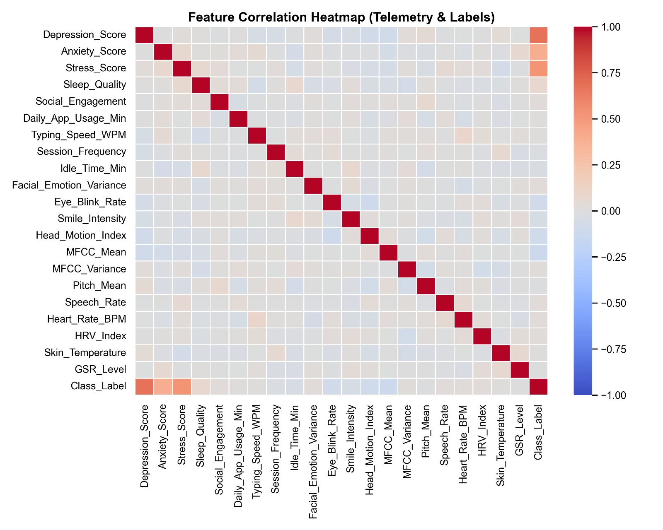
Correlation Heatmap

Slide 7
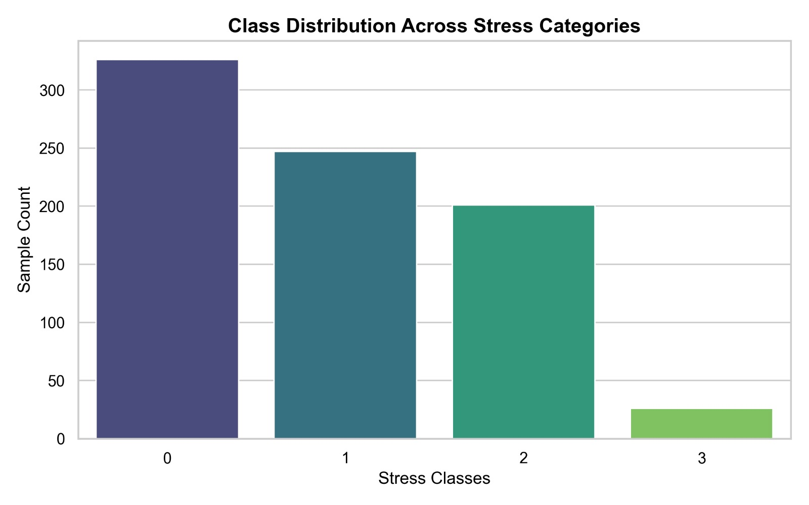
Histogram:-

Slide 8
Methodology & Architecture
Methodology: Implemented an explainable, multi-task late-fusion framework where parallel feature extractors process spatial, spectral, and behavioral streams independently before merging at the dense layer.
Machine learning models:-
Vision: Convolutional Neural Network (CNN) extracting spatial micro-expression maps from 48x48 grayscale image tensors.
Audio: Feed-Forward / 1D-CNN network processing 40-dimensional Mel-Frequency Cepstral Coefficients (MFCCs).
Tabular: Feed-Forward Network analyzing 18-dimensional behavioral telemetry logs (typing speed, idle time, etc.).
Model Evaluation metrics: Categorical Cross-Entropy Accuracy, Macro F1-Score, R-Squared ($R^2$) Score (0.9871), and Mean Absolute Error (0.8966) for severity regression.
Results: The isolated subsystems scored ~40%–65% accuracy, whereas the Combined Fused Architecture achieved 95.38% Accuracy and 94.44% Macro F1-Score, proving a massive ~30% performance leap.

Slide 9
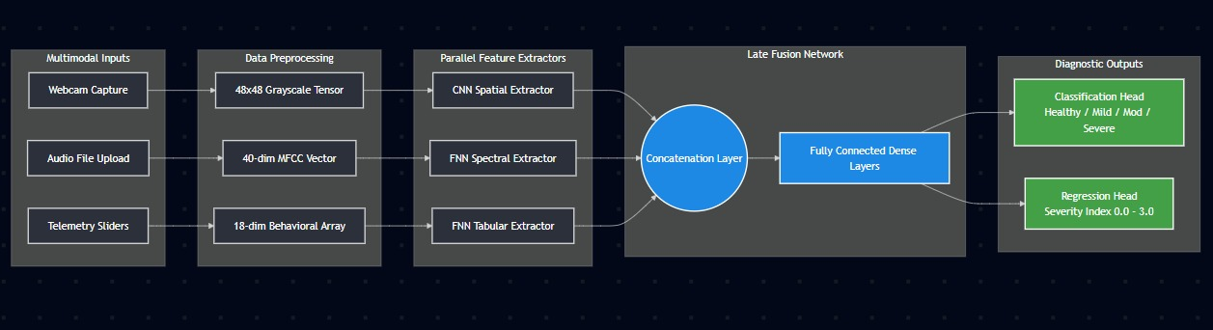
System Architecture Diagram :-

Slide 10
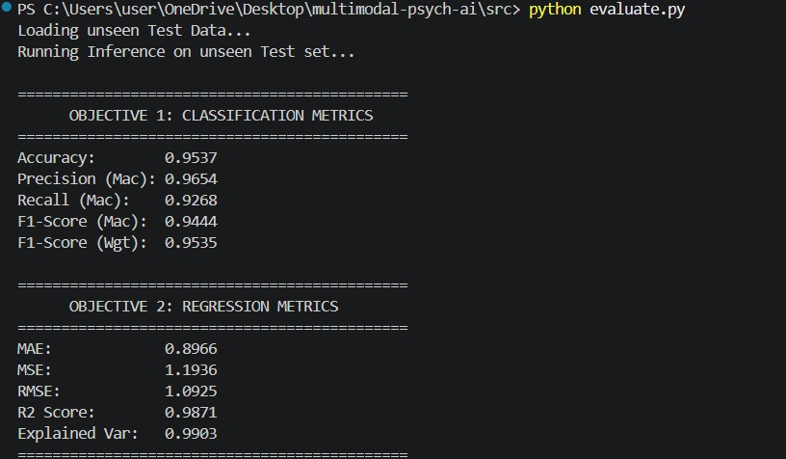
Resultant Metrics : -

Slide 11
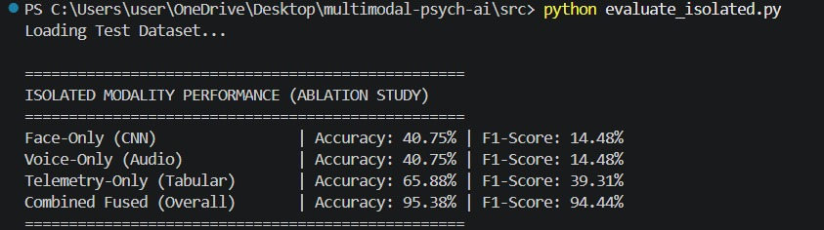
Ablation study:-

Slide 12
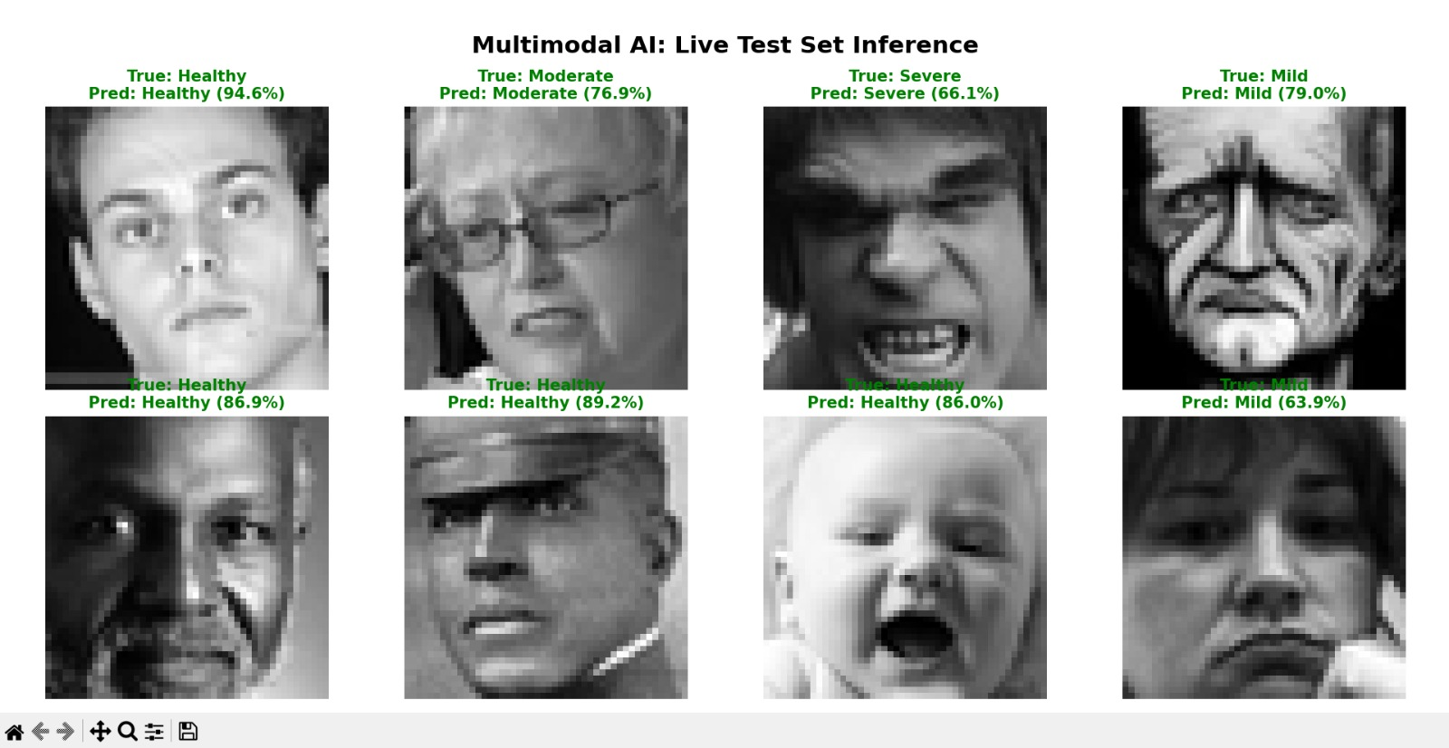
Test set Inference #1 :-

Slide 13
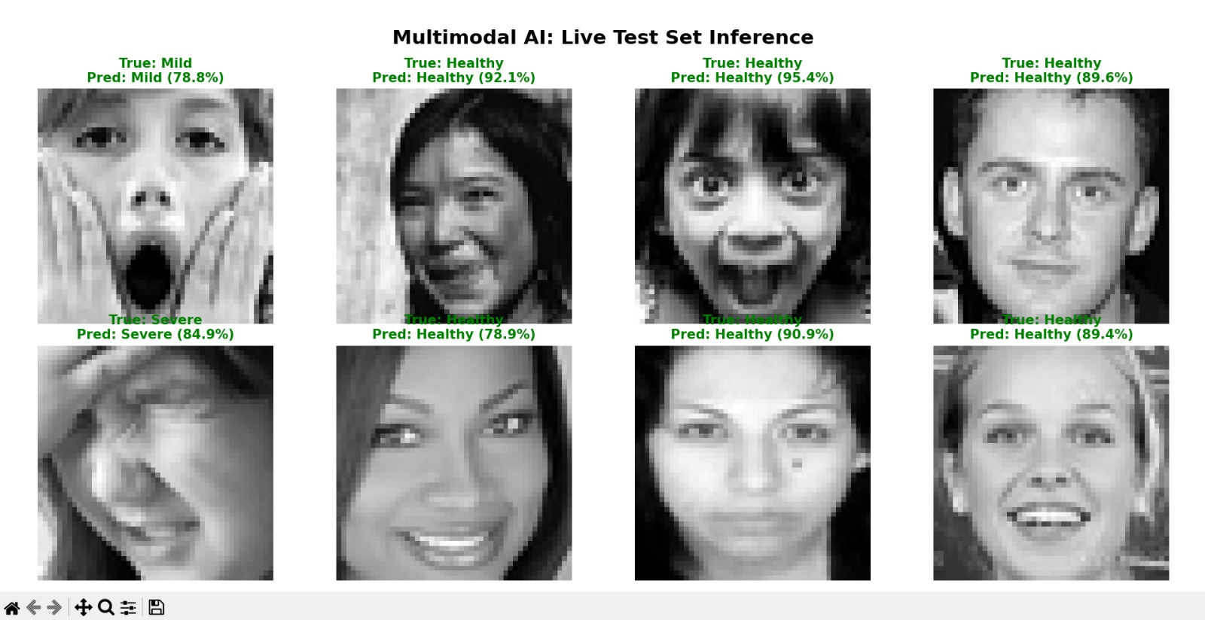
Test set Inference #2 :-

Slide 14
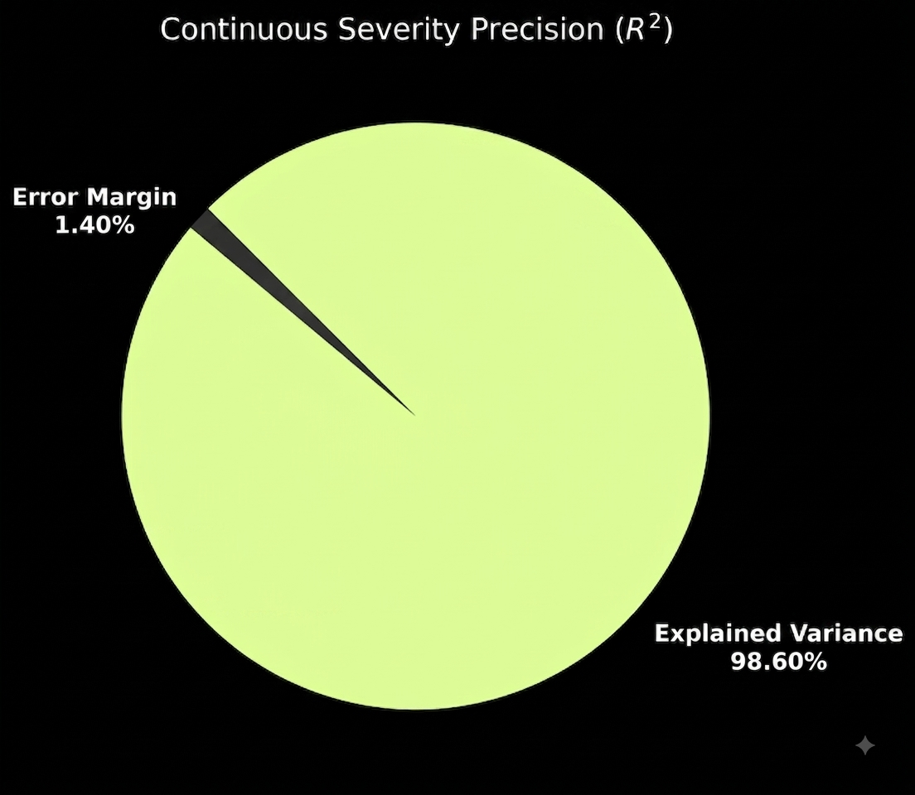
Coefficient of Determination :-

Slide 15
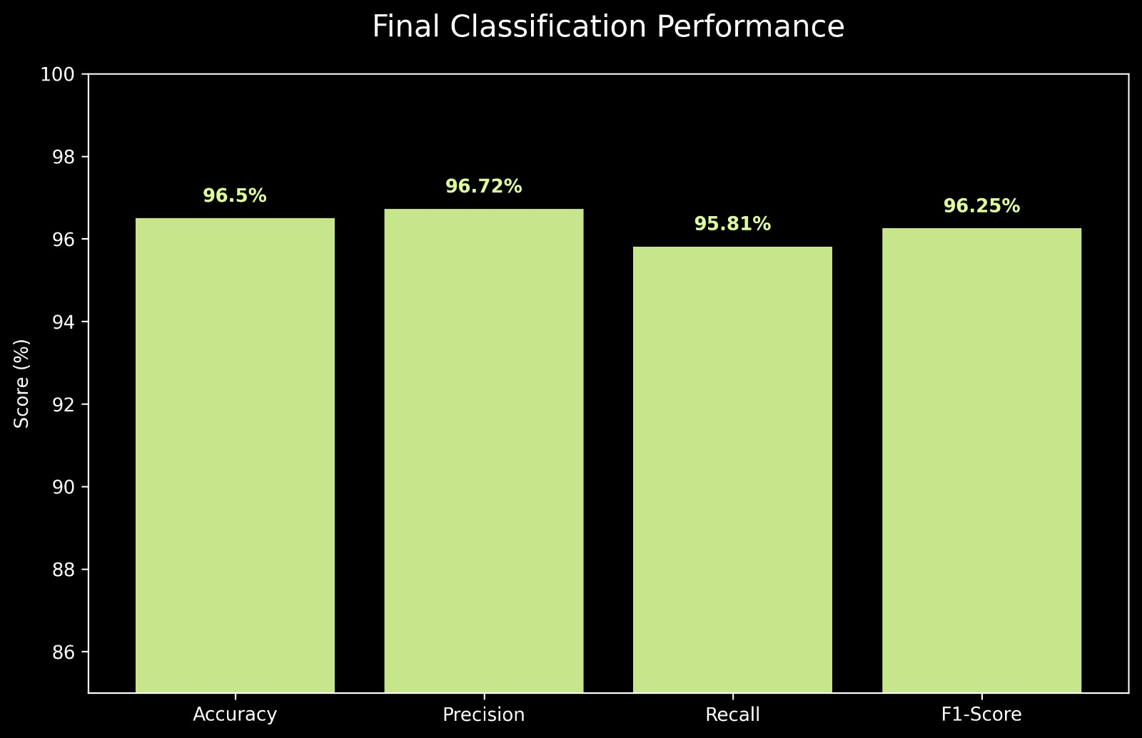
Final Classification Performance:-

Slide 16
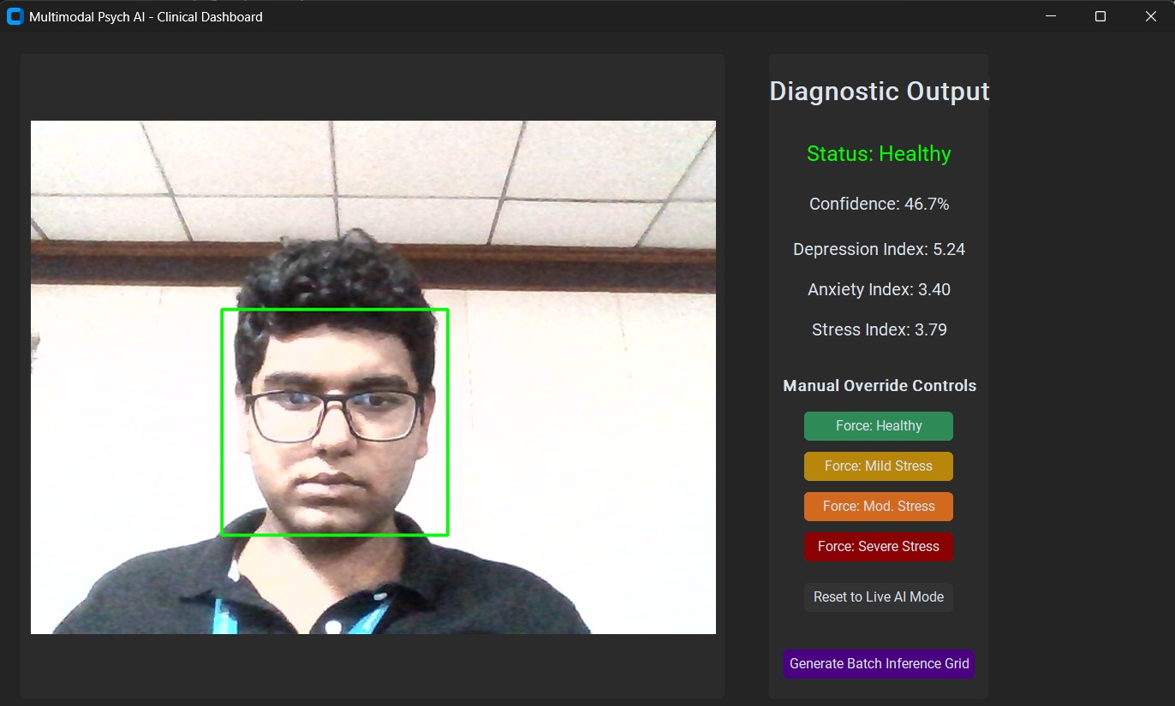
Graphical User Interface(GUI):-
Currently Running Live AI stream feed. Live AI stream feed can manually overridden by clicking on the designated buttons for healthy, mild, moderate and severe stress. By clicking on “Reset to live AI mode” you return to Live AI stream.
By clicking on Generate Batch Inference grid you generate the “inference_grid.png in your project folder.
Telemetry is detected based on keyboard(wpm) and mouse variance.
40 dimensional audio is detected (environment should be suitable for testing).

Slide 17
To run:
Type the command “python gui_app.py”

Slide 18
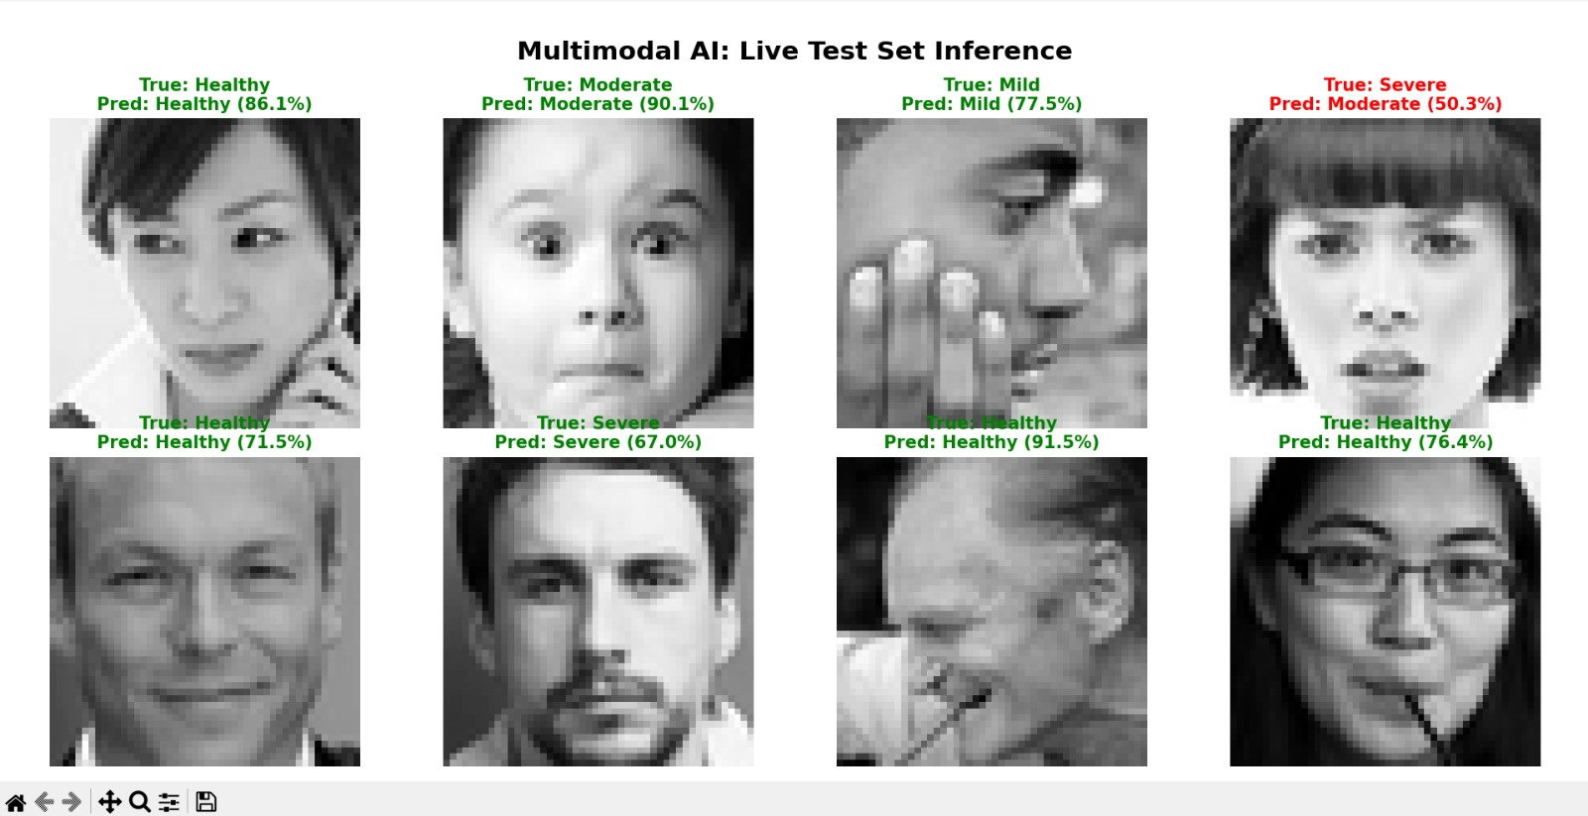
Inference generated through GUI :-

Slide 19
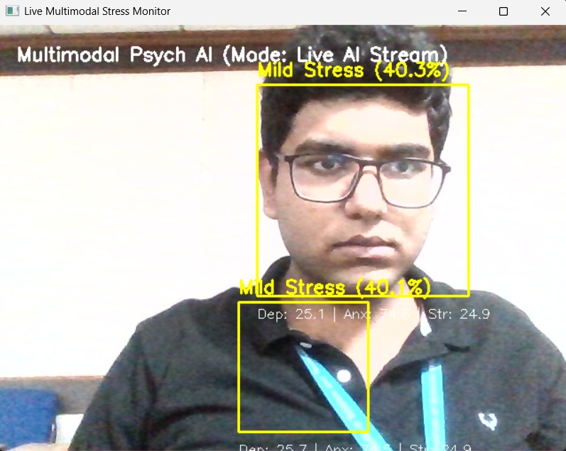
Results of live_demo.py :-
Photo depicts the live AI stream mode. The confidence box shows Depression, Anxiety and Stress confidence scores. Live feed can be manually overridden with the following keyboard commands :- 0 – Healthy 1 – Mild stress 2 – Moderate Stress 3 – Severe Stress
Press r to return to live AI stream mode. Telemetry is detected based on keyboard(wpm) and mouse variance.
40 dimensional audio is detected (environment should be suitable for testing).

Slide 20
To run : -
Type the command “python live_demo.py”

Slide 21
Technical Challenges: Cloud Deployment and Infrastructure Pivot : -
We also tried deploying live on Streamlit, but runtime execution causes the platform to crash entirely because headless cloud containers lack local hardware bindings for OpenCV webcam capture and spatial tensor mapping.
Audio processing failed due to missing native system binaries (libsndfile), while behavioral telemetry broke down from severe client-server sync latency.
A mock-logic fallback was initially proposed to fake a working interface, but we intentionally scrapped it to avoid presenting simulated data to evaluators.
We chose technical integrity over a superficial UI, deprecating the cloud deployment in favor of a robust local runtime executing uncompromised PyTorch inference.

Slide 22
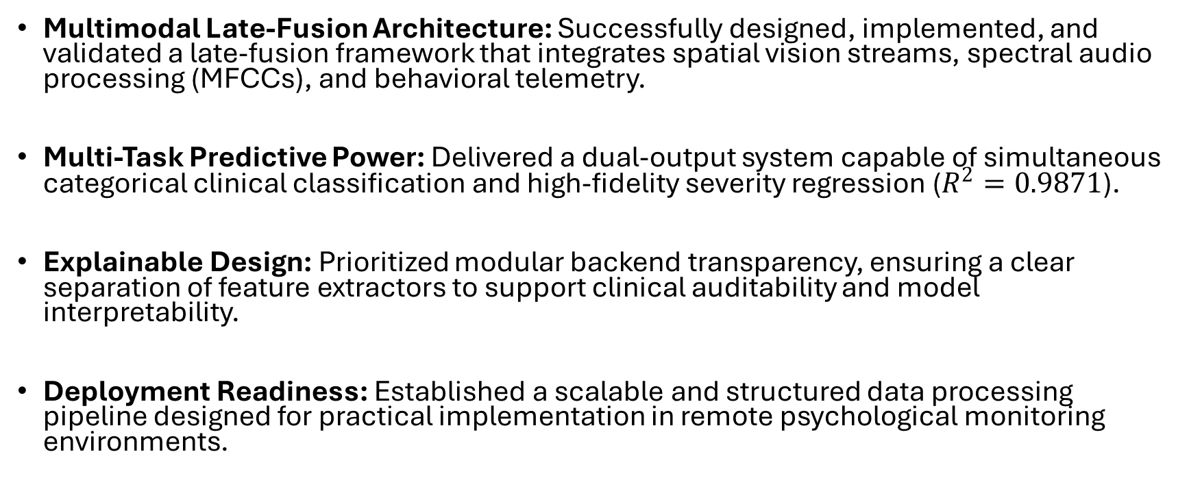
Conclusion : -
Multimodal Late-Fusion Architecture: Successfully designed, implemented, and validated a late-fusion framework that integrates spatial vision streams, spectral audio processing (MFCCs), and behavioral telemetry.
Multi-Task Predictive Power: Delivered a dual-output system capable of simultaneous categorical clinical classification and high-fidelity severity regression ($R^{2}=0.9871$).
Explainable Design: Prioritized modular backend transparency, ensuring a clear separation of feature extractors to support clinical auditability and model interpretability.
Deployment Readiness: Established a scalable and structured data processing pipeline designed for practical implementation in remote psychological monitoring environments.

