Slide 1
JDBC
JDBC is an alternative to ODBC and ADO that provides database access to programs written in Java.
JDBC is not an acronym — it doesn’t stand for anything!
  Do you believe that!? ;-)
JDBC drivers are available for most DBMS products:
  http://java.sun.com/products/jdbc

Slide 2
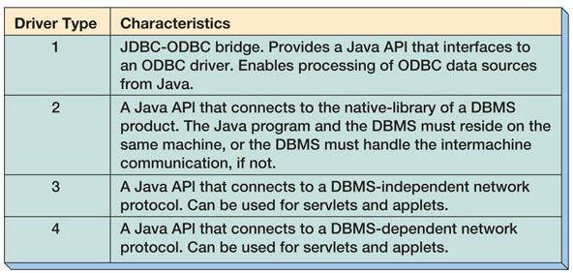
JDBC Driver Types

Slide 3
Java Servlets and Applets
Java programs are complied into an operating system independent bytecode.
Various operating systems use their own bytecode interpreters aka Java virtual machines.
An applet is transmitted to a browser via HTTP and is invoked on the client workstation using the HTTP protocol.
A servlet is a Java program that is invoked on the server to respond to HTTP requests.
Type 3 and Type 4 drivers can be used for both applets and servlets.
Type 2 drivers can be used only in servlets.

Slide 4
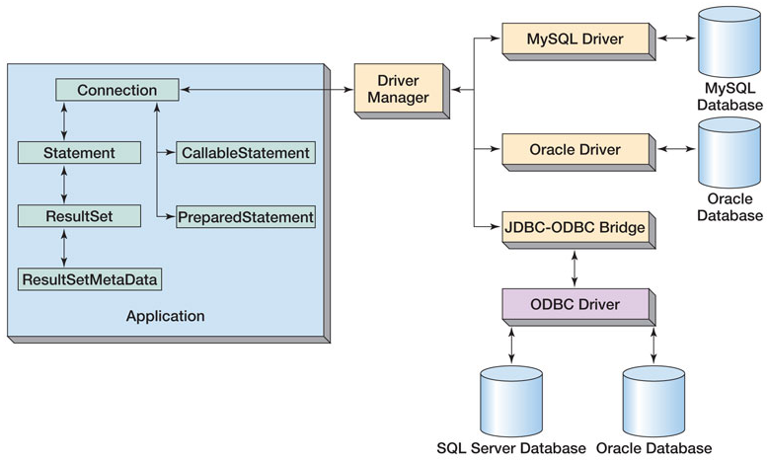
JDBC Components

Slide 5
Database Programming Steps
Establish a connection
Begin transaction
Create a statement object
Associate SQL with the statement object
Provide values for statement parameters
Execute the statement object
Process the results
End transaction
Release resources

Slide 6
Using JDBC
1a. Load the driver:
  The driver class libraries need to be in the CLASSPATH for the Java compiler and for the Java virtual machine.
  The most reliable way to load the driver into the program is:
  Class.forName(string).newInstance();
1b. Establish a connection to the database:
  A connection URL string includes the literal jdbc:, followed by the name of the driver and a URL to the database
  String url = "jdbc:oracle:thin:@reddwarf.cs.rit.edu:1521:csodb";
  jdbc “subprotocol”“subname” host port database
  Create a Connection object:
  Connection con = DriverManager.getConnection(url,
  dbUser, dbPassword);

Slide 7
Using JDBC (Continued)
2. Begin the transaction
con.setTransactionIsolation( Connection.TRANSACTION_SERIALIZABLE );
con.setAutoCommit( false );
3. Create a statement object
  Statement stmt = conn.createStatement();
4. Associate SQL with the statement object
  String queryString = "create table students "
  + "(name varchar(30), id int, phone char(9))";
6. Process the statement:
  Example statements:
  ResultSet rs = stmt.executeQuery(querystring);
  int result = stmt.executeUpdate(updatestring);
  ResultSetMetaData rsMeta = rs.getMetaData();
Compiled queries can be processed via a PreparedStatement object
Stored procedures can be processed via a CallableStatement object

Slide 8
Using JDBC (Continued)
8. End transaction
  con.commit();
  con.rollback();
9. Release resources
  con.close();

Slide 9
Using a PreparedStatement
// Once you have a connection, you can create a
// "prepared statement" object. A prepared statement is
// precompiled, and can be used repeatedly with new values
// for its parameters.
// Use question marks for parameter place-holders.
PreparedStatement prepStmt = con.prepareStatement(
"INSERT INTO Artist (ArtistID, Name, "
+ "Nationality, BirthDate, DeceasedDate)"
+ "VALUES (ArtistSeq.nextVal, ?, ?, ?, ? )" );
// Now supply values for the parameters
// Parameters are referenced in order starting with 1.
prepStmt.setString( 1, "Galvan" );
prepStmt.setString( 2, "French" );
prepStmt.setInt ( 3, 1910 );
prepStmt.setNull ( 4, Types.INTEGER );
// The PreparedStatement object methods:
// 1) executeUpdate -- statements that modify the database
// 2) executeQuery -- SELECT statements (reads)
prepStmt.executeUpdate();
System.out.println( "Prepared statement executed" );
// Now do it again
prepStmt.setString( 1, "Monet" );
prepStmt.setString( 2, "French" );
prepStmt.setInt ( 3, 1840 );
prepStmt.setInt ( 4, 1879 );
prepStmt.executeUpdate();
System.out.println( "Prepared statement executed again" );

Slide 10
Accessing a stored procedure
// Once you have a connection, you can create a
// "callable statement" object to access the stored procedure.
// Inside the curly braces, you call the procedure, and use
// question marks for parameter place-holders.
CallableStatement callStmt = con.prepareCall(
"{call Record_sale( ?, ?, ?, ?, ?, ?)}" );
// Now supply values for the parameters
// Parameters are referenced in order starting with 1.
callStmt.setString( 1, "Barry Goldwater" );
callStmt.setString( 2, "Tobey" );
callStmt.setString( 3, "Mystic Fabric" );
callStmt.setString( 4, "105/135" );
callStmt.setInt ( 5, 24000 );
// And register the OUT variable
// This variable returns information to this program
// from the stored procedure.
callStmt.registerOutParameter( 6, java.sql.Types.VARCHAR );
System.out.println( "Parameters set for CallableStatement" );
// The CallableStatement object has an additional method*
// for use when the stored procedure uses multiple SQL statements.
// 1) executeUpdate -- statements that modify the database
// 2) executeQuery -- SELECT statements (reads)
// *3) execute -- procedures with multiple SQL statements
callStmt.execute();
System.out.println( "Stored procedure executed" );
// Get the OUT variable contents (parameter 6)
String result = callStmt.getString( 6 );

Slide 11
Using ADO.NET
Establish a connection to the database:
  String connection_string =
  "Server=(local);UID=sa;PWD=;DATABASE=pubs;Connection Timeout=60";
  {Odbc|OleDb|SQL}Connection con =
  new {Odbc|OleDb|SQL}Connection( connection_string );
  Con.Open();
2. Begin the transaction
  {Odbc|OleDb|SQL}Transaction trans = con.BeginTransaction(
  [IsolationLevel.{Chaos|ReadCommitted|ReadUncommitted|
  RepeatableRead|Serializable|Unspecified}] );
3. Create a statement (Command) object
  {Odbc|OleDb|SQL}Command statement = con.CreateCommand();
  statement.Transaction = trans;

Slide 12
Using ADO.NET (cont.)
4. Associate SQL with the statement (Command) object
  statement.CommandText = “INSERT INTO authors …
6. Process the statement
  int rowsInserted = statement.ExecuteNonQuery();
  Also: statement.ExecuteReader() returns a DataReader
  statement.ExecuteScalar() returns a single value
8. End transaction
  trans.Commit();
  trans.Rollback();
9. Release resources
  conn.Close();

