Slide 1


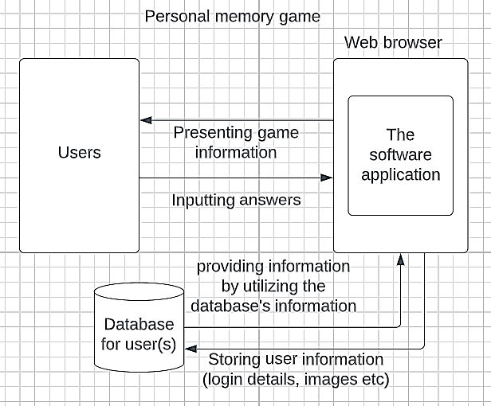
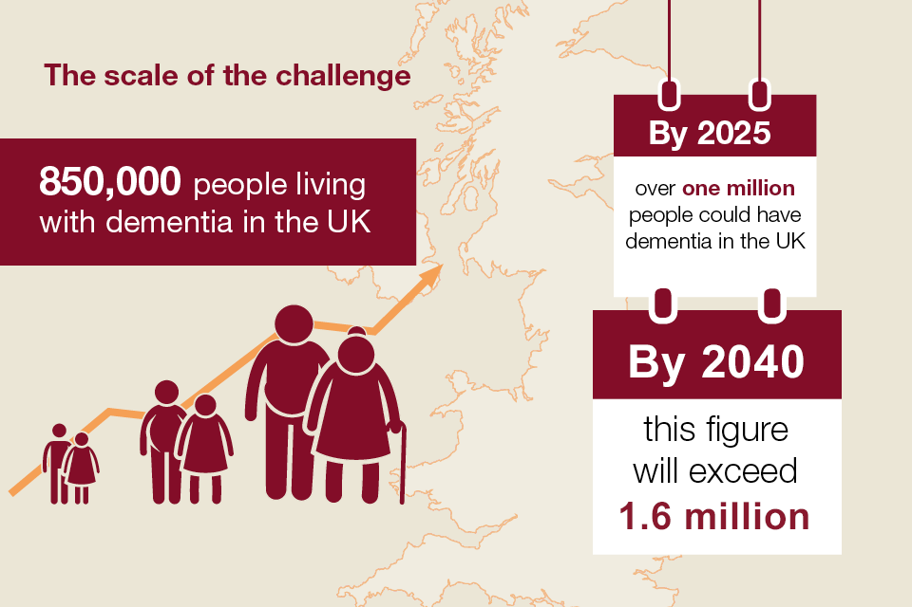
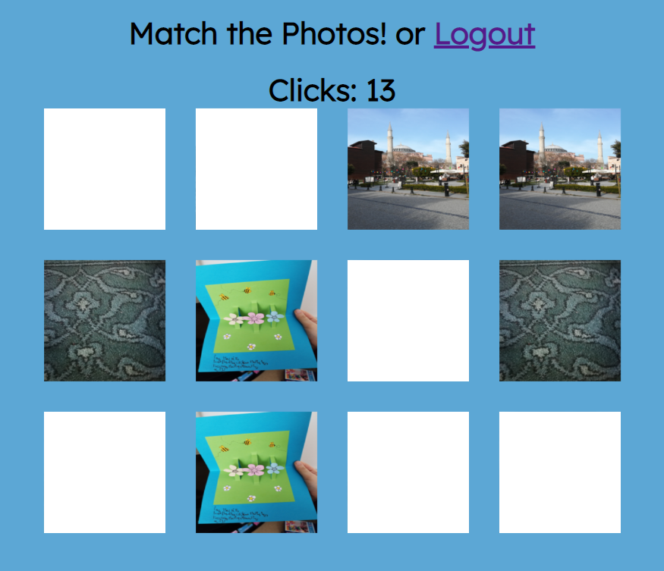
Personal Memory Game
By: Reem Khider Email: r.khider313@canterbury.ac.uk
Supervisor: Gareth Ward Email: gareth.ward@canterbury.ac.uk
Introduction: The aim of this project is to build a memory game as a cognitive activity that helps stimulating and maintaining users’ cognitive function and memory. The game would prompt users with potential diagnose of dementia to import personal photos to use in the game as it will not only keep the brain active, but also help them keep remembering family members and places.
Fig. 2: Game Framework
Requirements: Kitakoshi et al, 2015 described in their research the basic rules of the game which is based on the user memorizing several photos, and then trying to match them and find their pairs.
User to upload photos with a description of them.
Produce a tour/instructions to the user on how to play.
User to choose the number of photos to display (difficulty level).
Have n×n grid to display the masked photos.
User clicks on 2 photos at a time to find matching pairs.
Give feedback to the user by comparing their performance from previous times played.
Fig. 1: Dementia in the UK (gov.uk, 2022).
Motivation: Smith et al, 2009 described in their research how using a reminiscence tool in the form of multimodal life stories on DVDs helps people with Alzheimer to elicit good feelings. Furthermore, Kitakoshi et al, 2015 proposed a cognitive training system using a memory game with a software agent based on the concept of HAI and discussed the characteristics and effectiveness of its functions.
Thus, building a personal memory game as cognitive activity and encouraging the patients to remember their relatives, would have a huge benefit in reducing the risk of developing dementia.
Project Phases: The following phases would be performed during this project based on Zhunio et al, 2020 and Kitakoshi et al, 2015 studies:
Requirements: Investigating topics related to the development of the game and dementia to capture and classify the requirements, then verifying and validating them.
Design: Zhunio et al, 2020 proposed several accessibility and usability criteria for the elderly. Therefore, some criteria were considered such as ease of learning, efficiency and visualization.
Implementation: The game was developed by initializing a database using MySQL, and building the game using php, JavaScript and CSS to add functionality, features, and style.
Testing: This phase was carried out in two steps: 1) validating and verifying the game hence unexpected errors may be detected. 2) testing the application with the end user.
Fig. 3: Game Prototype
References:
Kitakoshi, D., et al, 2015. Cognitive training system for dementia prevention using memory game based on the concept of human-agent interaction. JACIII, 19(6), pp.727-737.
Koivisto, A., et al, 2016, December. Designing Working Memory Games for Elderly. In International Conference on Games and Learning Alliance (pp. 311-320). Springer, Cham.
Zhunio, C.S., et al, 2020, April. A Memory Game for Elderly People: Development and Evaluation. In 2020 Seventh International Conference on eDemocracy & eGovernment (ICEDEG) (pp. 248-252). IEEE.
Smith, K.L., et al, 2009. Multimedia biographies: a reminiscence and social stimulus tool for persons with cognitive impairment. JTHS, 27(4), pp.287-306.

