Slide 1

G2M Case Study
By Reem Aboelsoud
Virtual Internship
April 2023

Slide 2
Background –G2M(cab industry) case study
A company by the name of XYZ is considering investing in the burgeoning cab industry. Our actionable insights are expected to aid XYZ in identifying the ideal company for investment.
As per their Go-to-Market (G2M) strategy, they seek to gain a comprehensive understanding of the market before making a final decision. Our analysis includes two cab companies, namely Pink and Yellow, and each file provides distinct insights into the customer profile.
The following document presents an analysis conducted to evaluate the investment potential of either the Pink or Yellow cab company.
The data was prepared, analysed, and visualized using the Tableau platform. The resulting plots provide a detailed representation of the data and accompanying explanations offer insights into their implications from a business standpoint.
The analysis has been segmented into two components:
1- Data understanding and visualisation, which includes the following analysis: Profit analysis, City-wise profit analysis, Customer analysis and Number of rides analysis
2- Conclusion and Recommendation on the most profitable company.

Slide 3
1- Data understanding and visualisation
We have three data files:
Cab_data.csv (size 19.2 MB )
City.csv (size 612.0 bytes )
Customer.csv (size 1.5 MB )
Transiction_Id.csv (size 10.1 MB )
Assumption:
Profit was calculated as the difference between Price Charged and Cost of Trip while other factors were held constant.
The number of rides was calculated as the number of transactions.

Slide 4
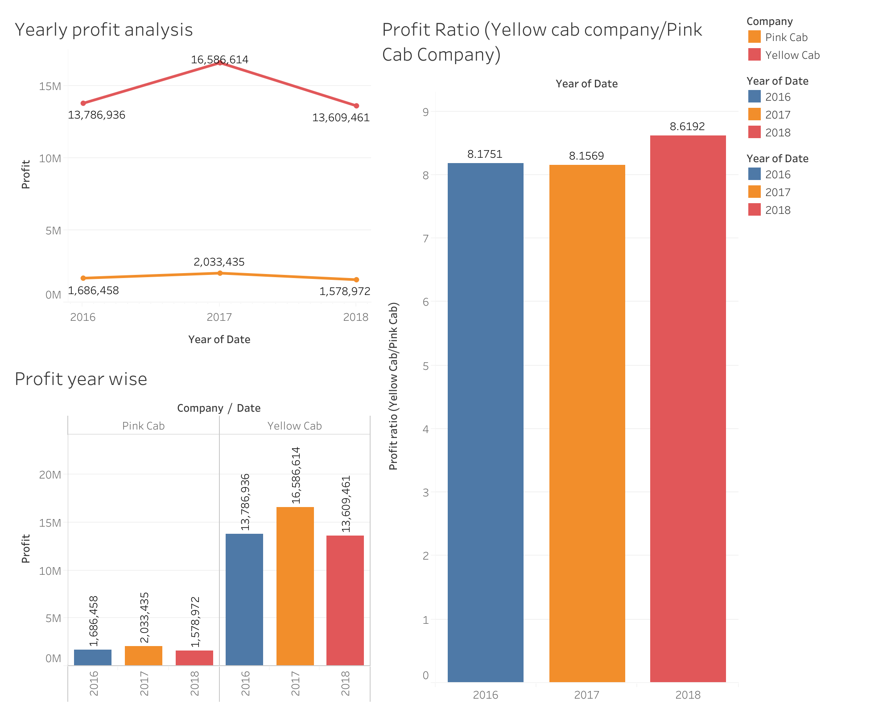
Profit Analysis
The yellow cab company’s profit was between 8 to 9 times the Pink cab company’s profit.

Slide 5
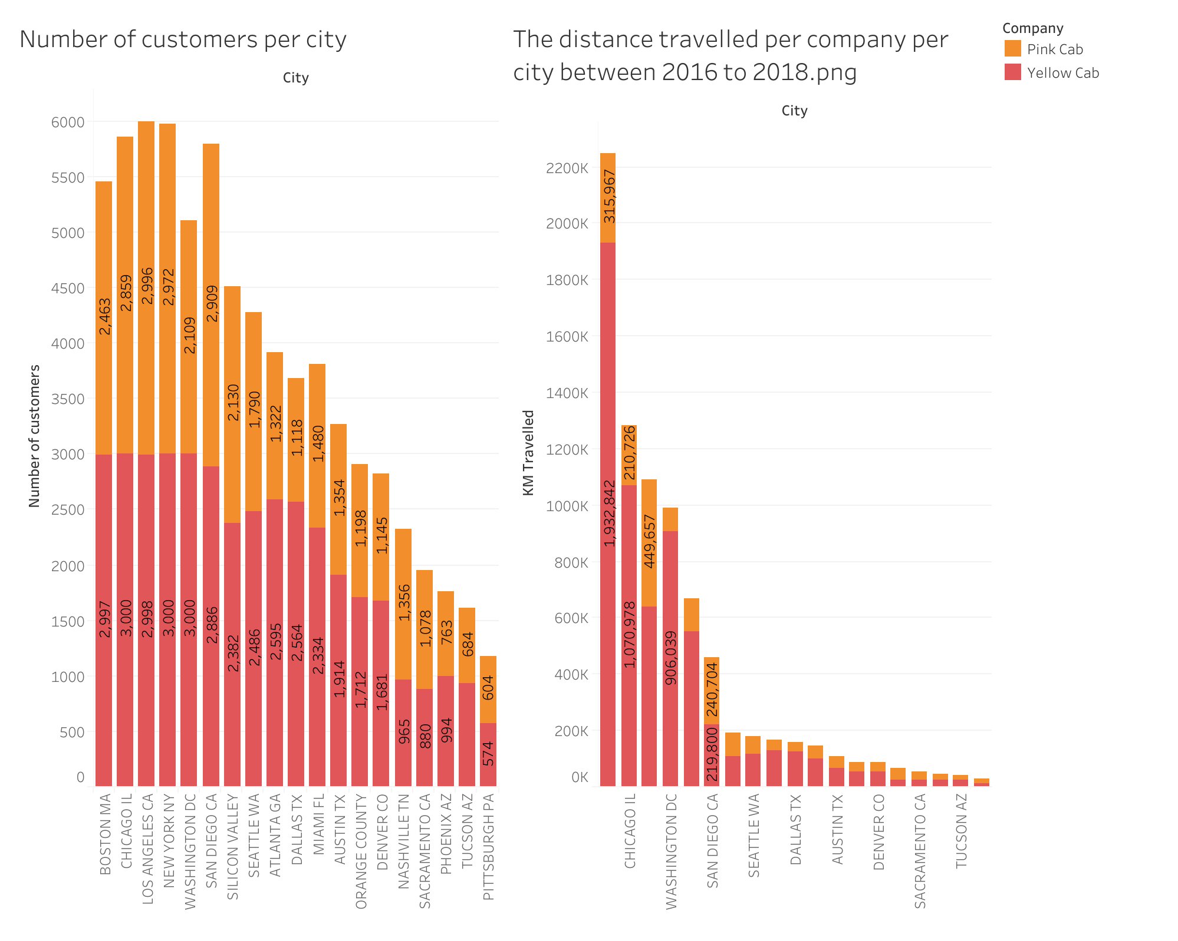
Profit Analysis

Slide 6
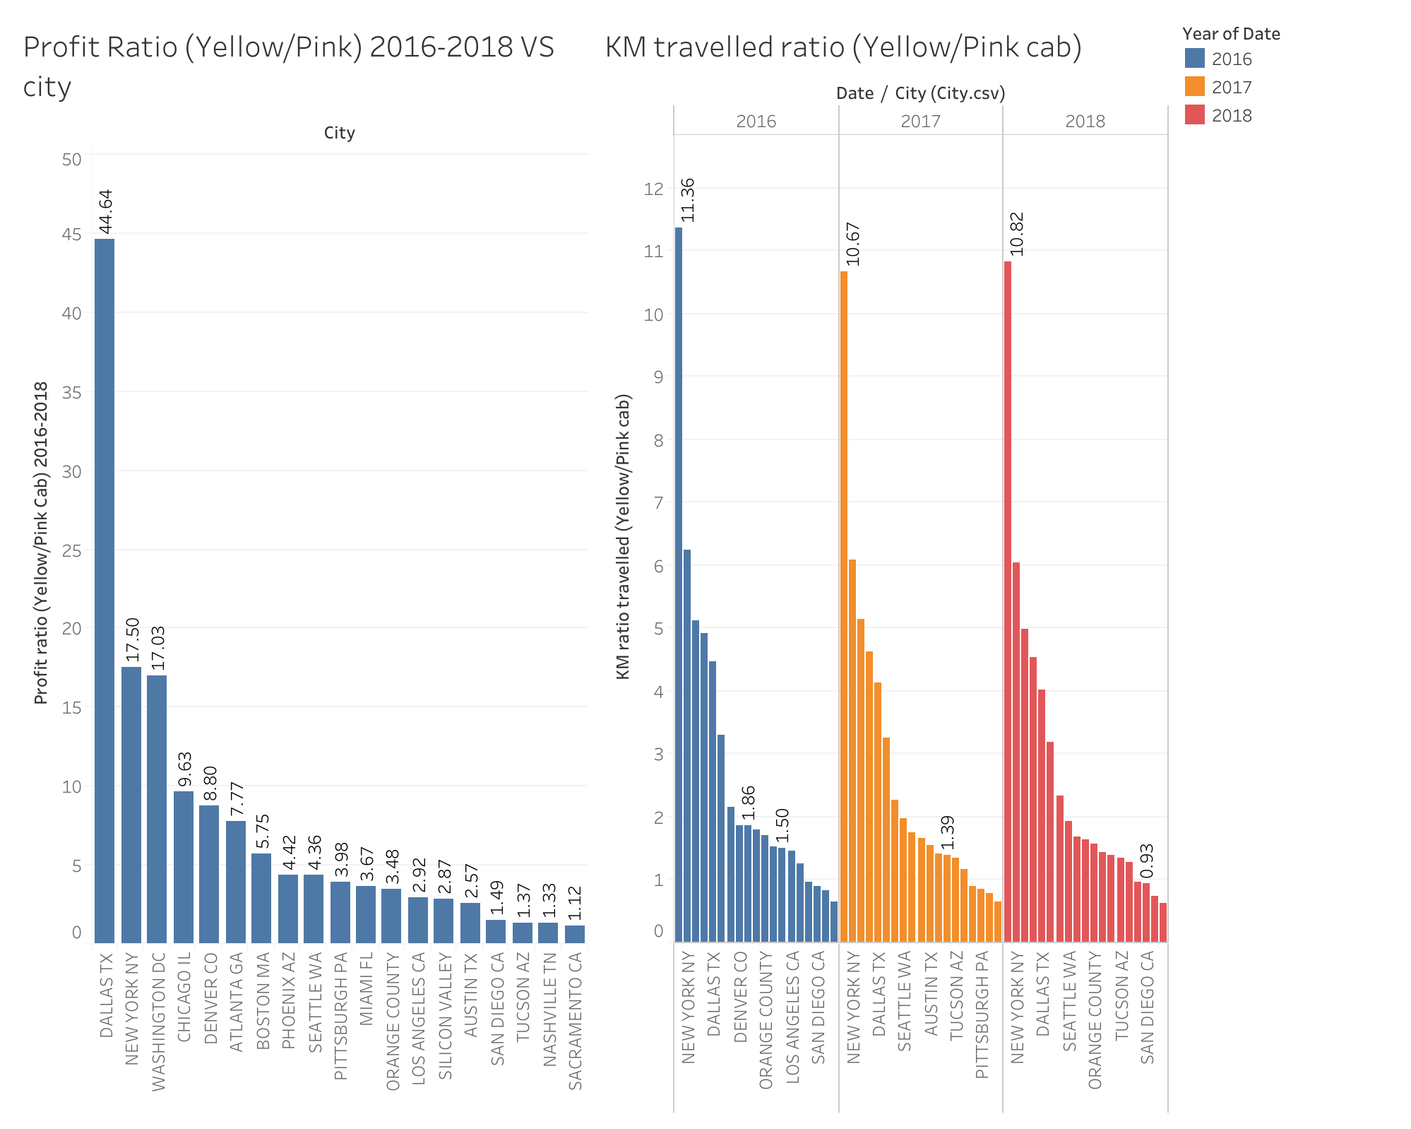
Profit Analysis

Slide 7
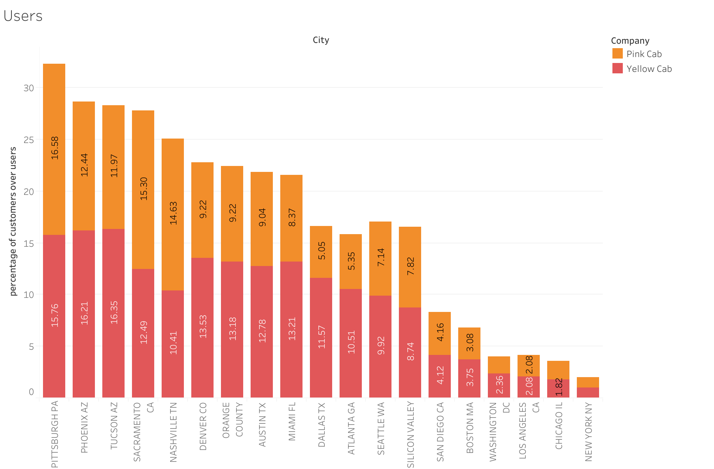
Profit Analysis

Slide 8
Customer analysis
The number of customers traveling a distance between 5 to 40 km is relatively similar between the two companies, but the numbers increase for distances less than five km and more than 40 km.
Both companies generate the highest profits from customers with a monthly income between 5000 USD and 25000 USD, while customers earning more than 25000 USD contribute the least to their profits.
Customers aged between 25 to 34 years old make the most significant contribution to the two companies' profits, while those over 65 years contribute the least. Additionally, male customers were found to be more numerous than female customers in both companies.

Slide 9
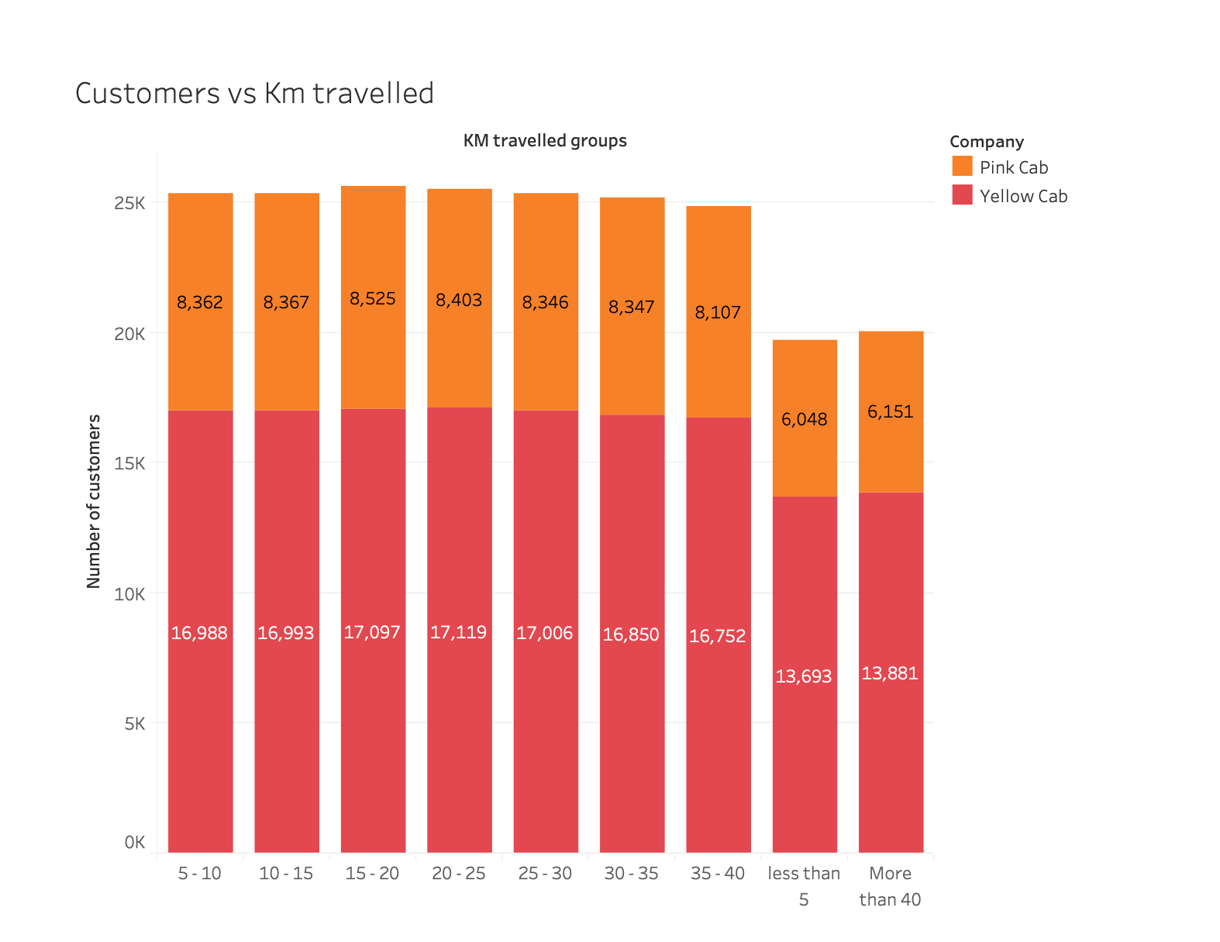
Customer analysis

Slide 10
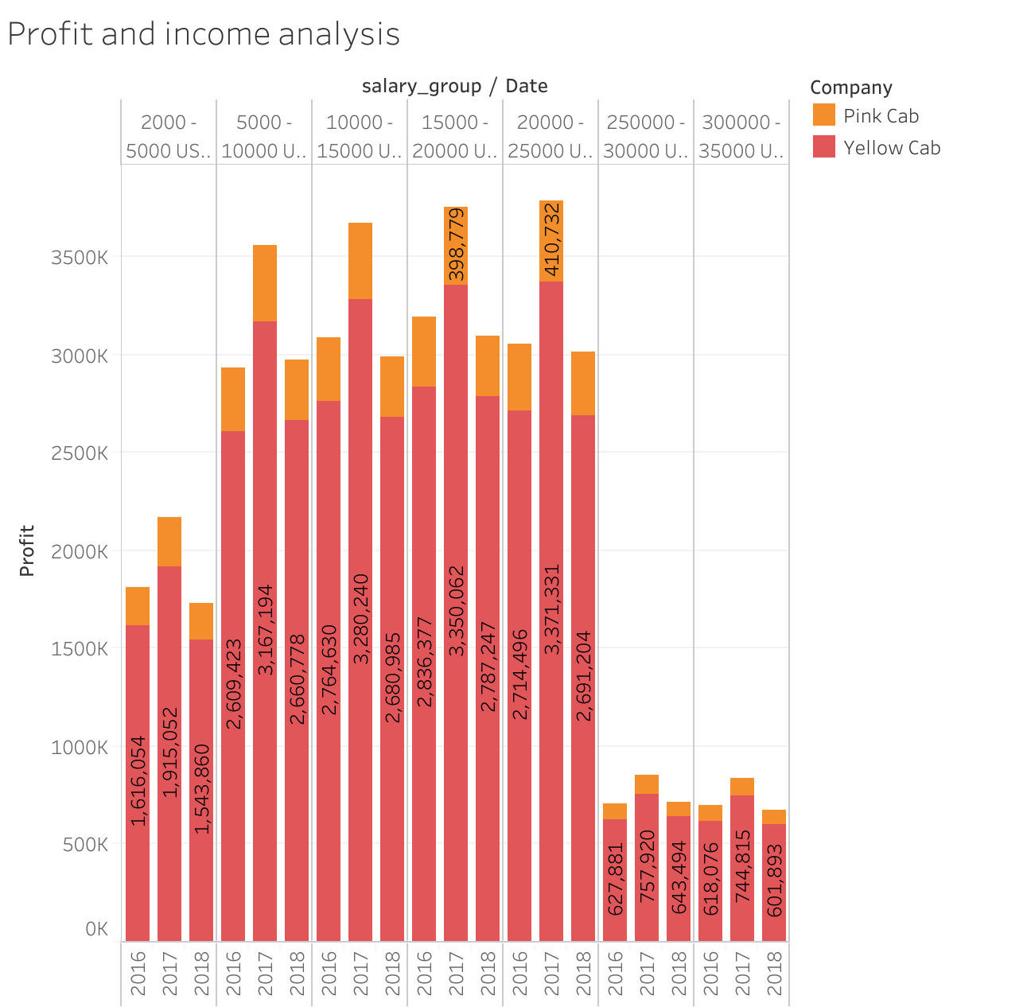
Customer analysis

Slide 11
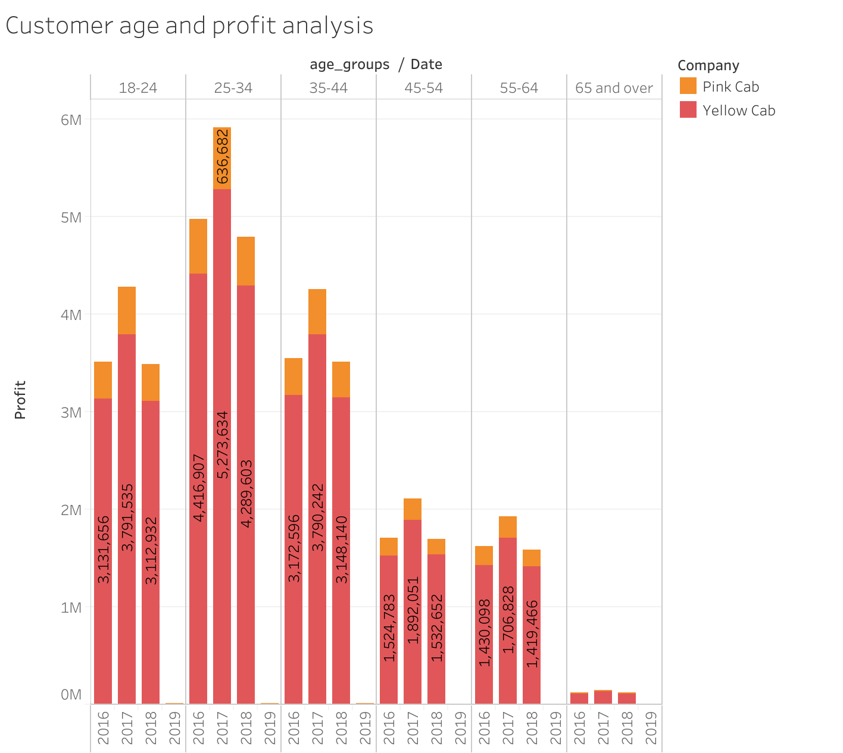
Customer analysis

Slide 12
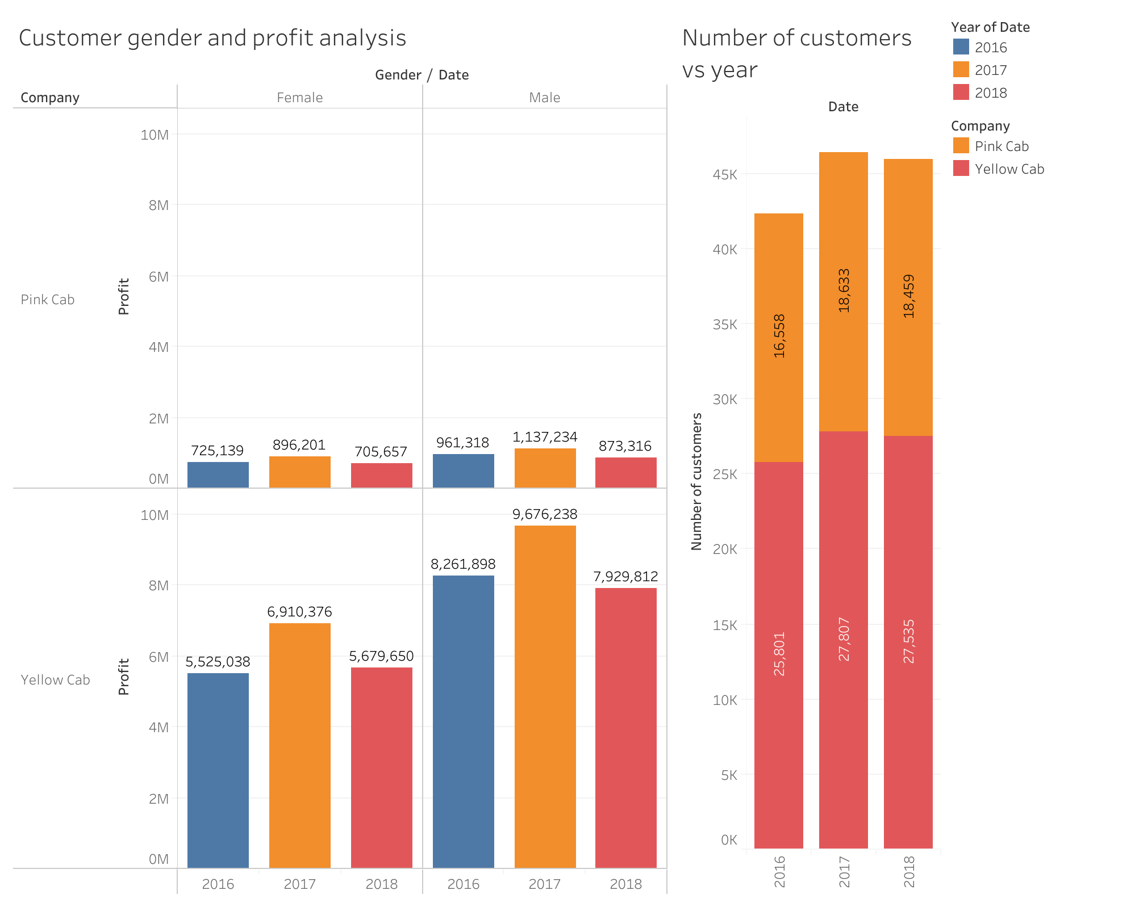
Customer analysis

Slide 13
Number of rides analysis
During the three-year period spanning from 2016 to 2018, the greatest frequency of rides occurred on Monday and Tuesday for both companies.
Moreover, the final quarter of the year witnessed the most considerable number of rides for both companies, with the month of December ranking highest in ride frequency across all three years.

Slide 14
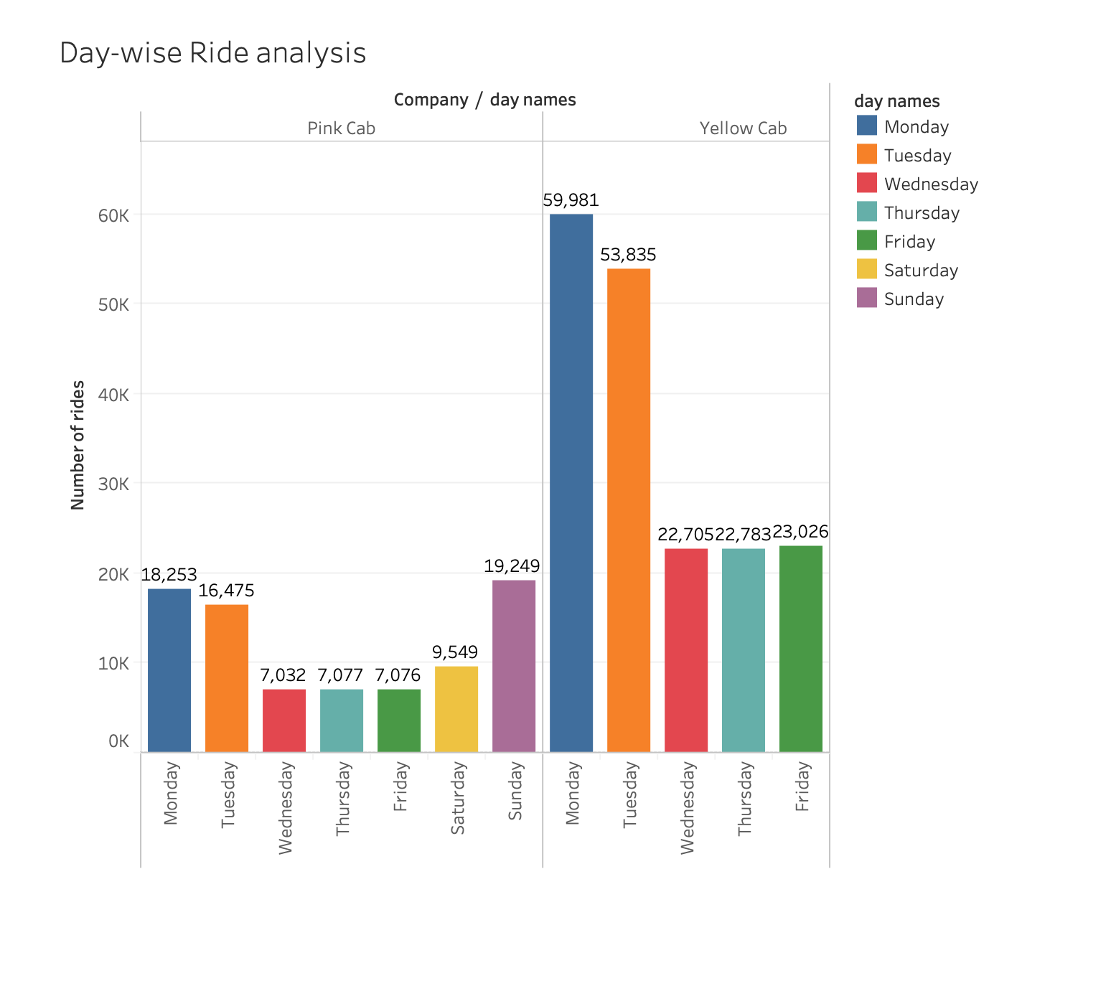
Number of rides analysis

Slide 15
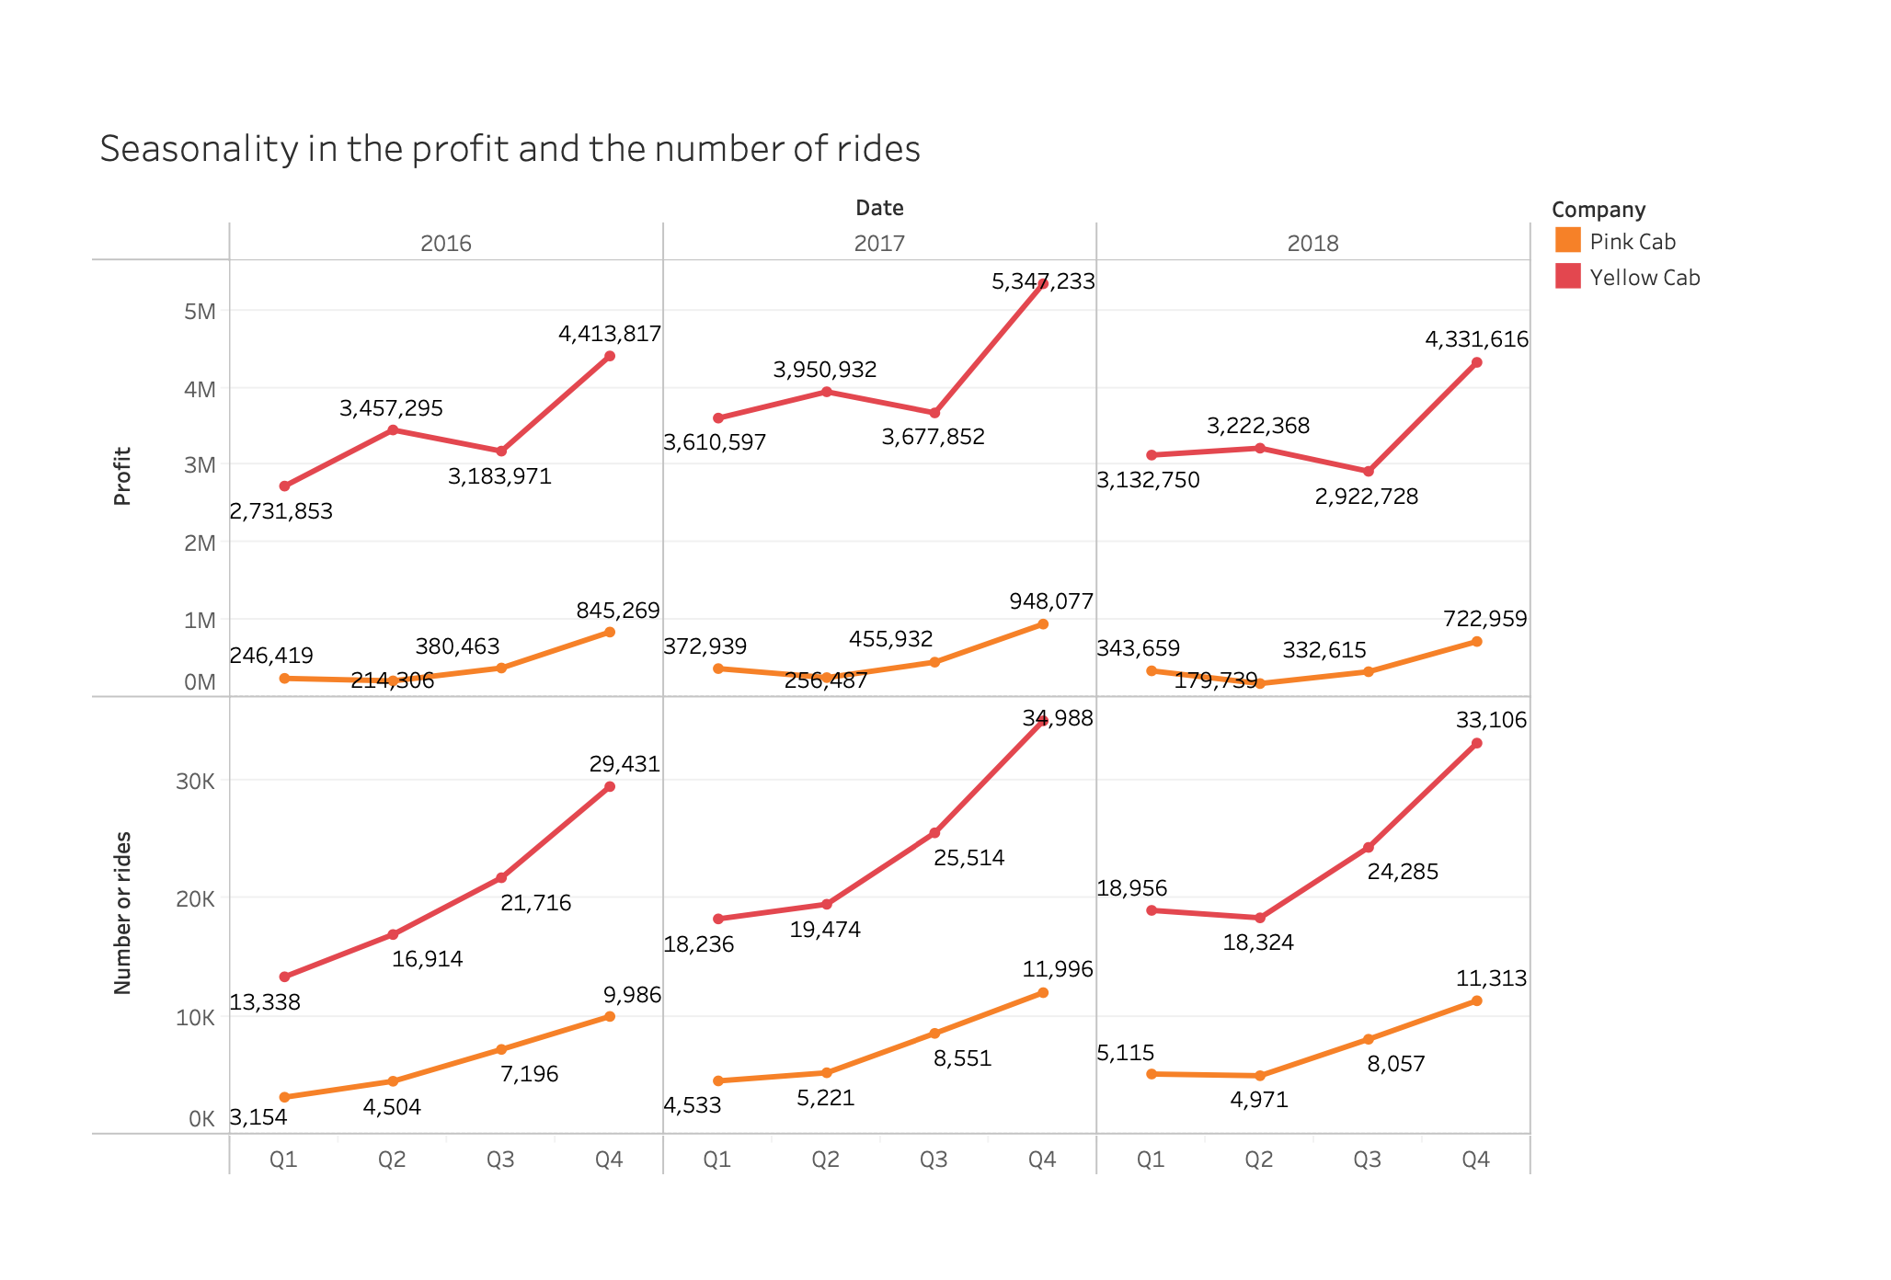
Number of rides analysis

Slide 16
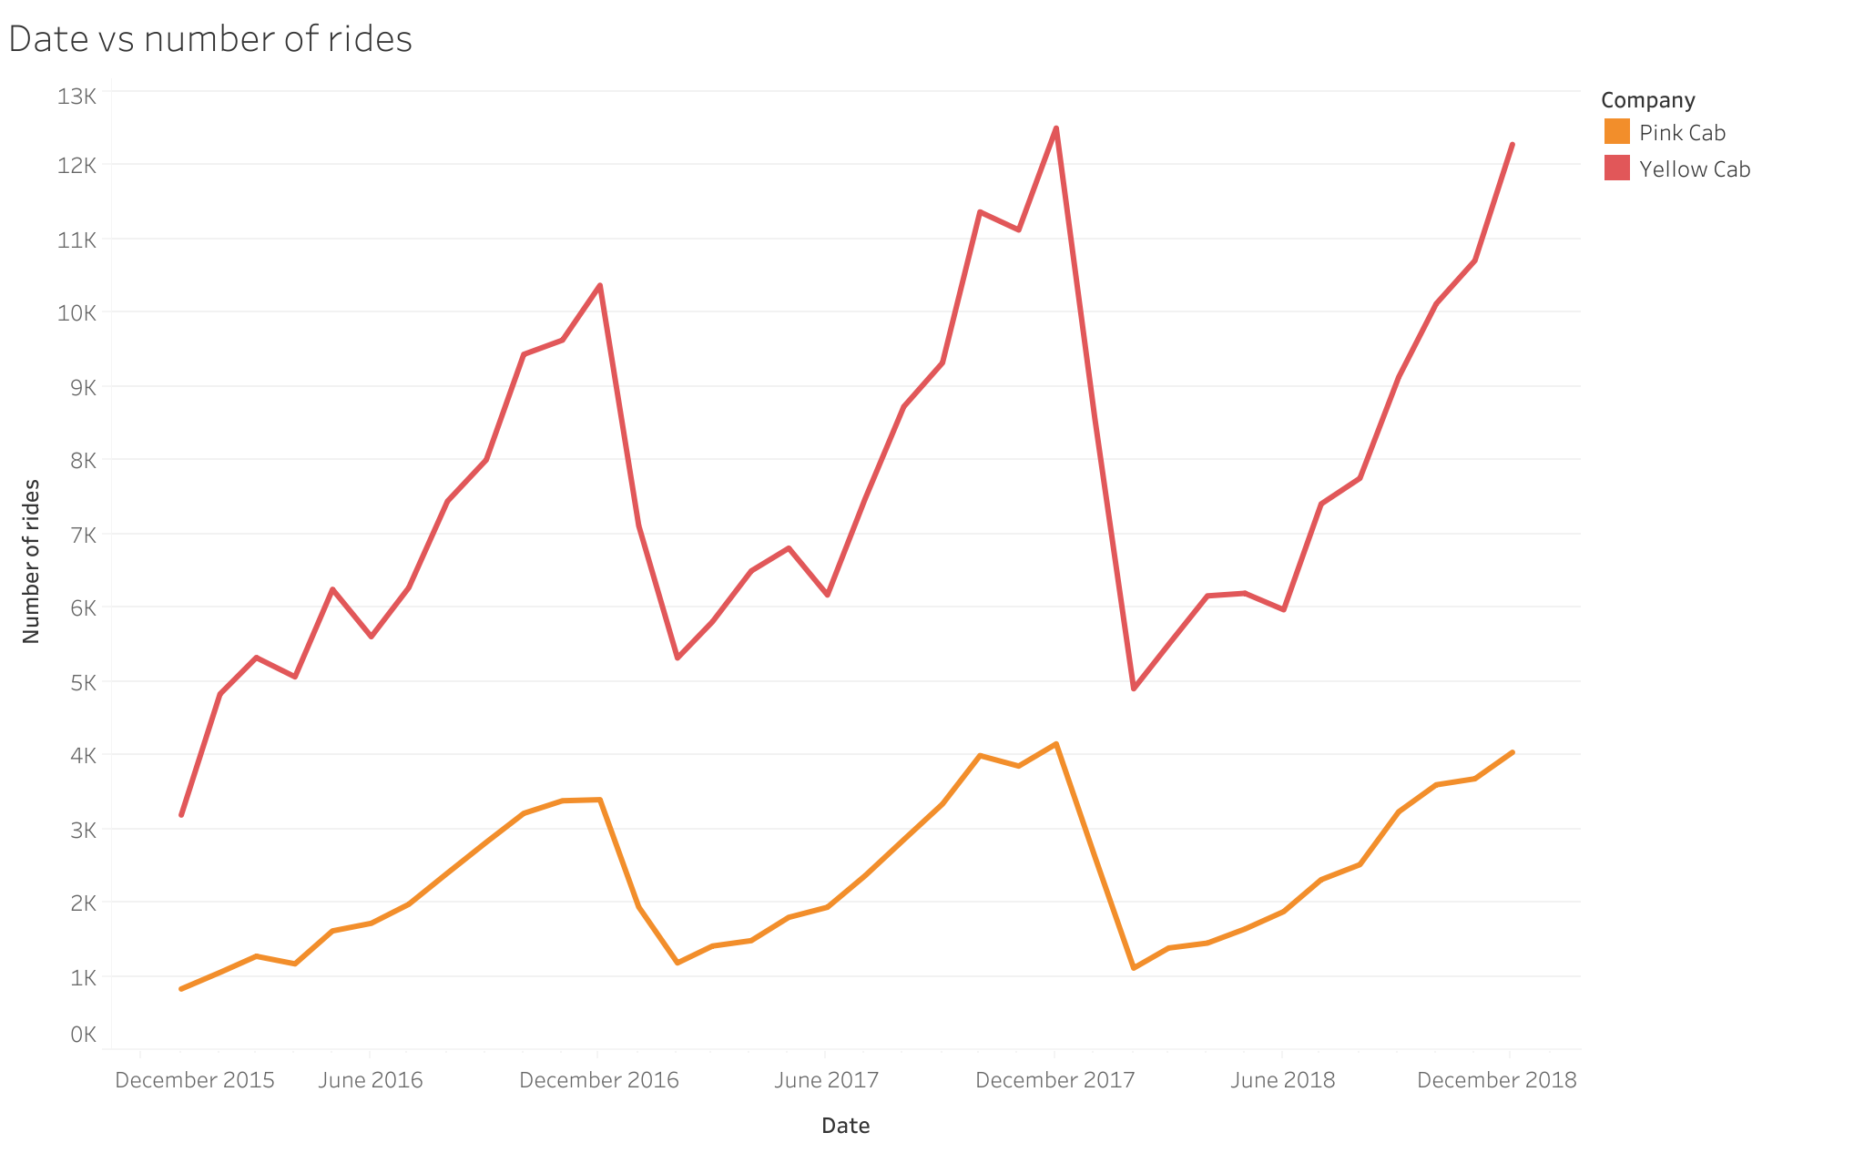
Number of rides analysis

Slide 17
2- Conclusion and Recommendation
Profit wise:
Yellow cab company's profit was between 8 to 9 times that of the Pink cab company for the three years analysed.
City wise:
In 17 cities out of 20 cities in the data set, the number of customer is higher for the yellow cab company than the pink cab company. In 16 cities, the number of KM travelled by the yellow company is higher than the pink company.
Customer wise:
The number of customers at all ages and all income groups is higher for the Yellow company than the Pink one.
Based on these analysis We recommend the Yellow Cab company for investment.

Slide 18
Thank You

