Slide 1
STC TV - DATA STORYTELLING PRESENTATION
Transforming User Experience Through Data & AI
Insights, Predictive Modeling, and Personalized AI Recommender Systems
Prepared for: stc & Misk Virtual Internship Project

Slide 2
STC TV / MISK VIRTUAL INTERNSHIP
Business Challenge & Strategic Objectives
🎯 The Challenge
• Content Overload: Users struggle to find relevant titles quickly.
• Unpredicted Server Spikes: High weekend traffic leads to potential buffering.
• Retention Risks: Lack of automated recommendations increases churn.
🚀 Strategic Goals
• Analyze Viewing Preferences: Identify top genres & high-definition demand.
• Predict Demand (ML): Forecast viewing hours to optimize CDN capacity.
• AI Personalization: Build an item-based recommender engine for users.

Slide 3
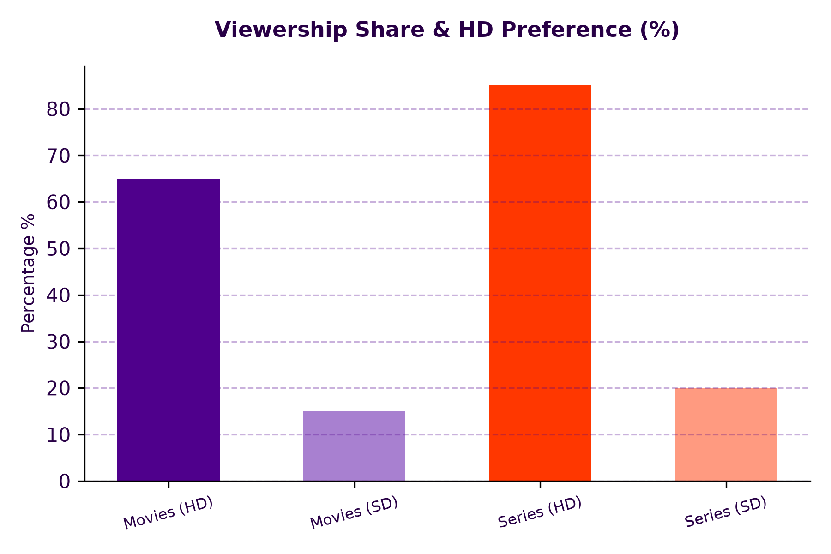
STC TV / MISK VIRTUAL INTERNSHIP
Story 1: User Viewing Preferences & HD Dominance
📊 Key Data Findings
✔ Series vs Movies: Series drive higher watch hours due to episode bingeing.
✔ HD Sensitivity: Over 80% of movie views are streamed in HD quality.
✔ Top Titles: The top 10 programs generate over 60% of total platform engagement.

Slide 4
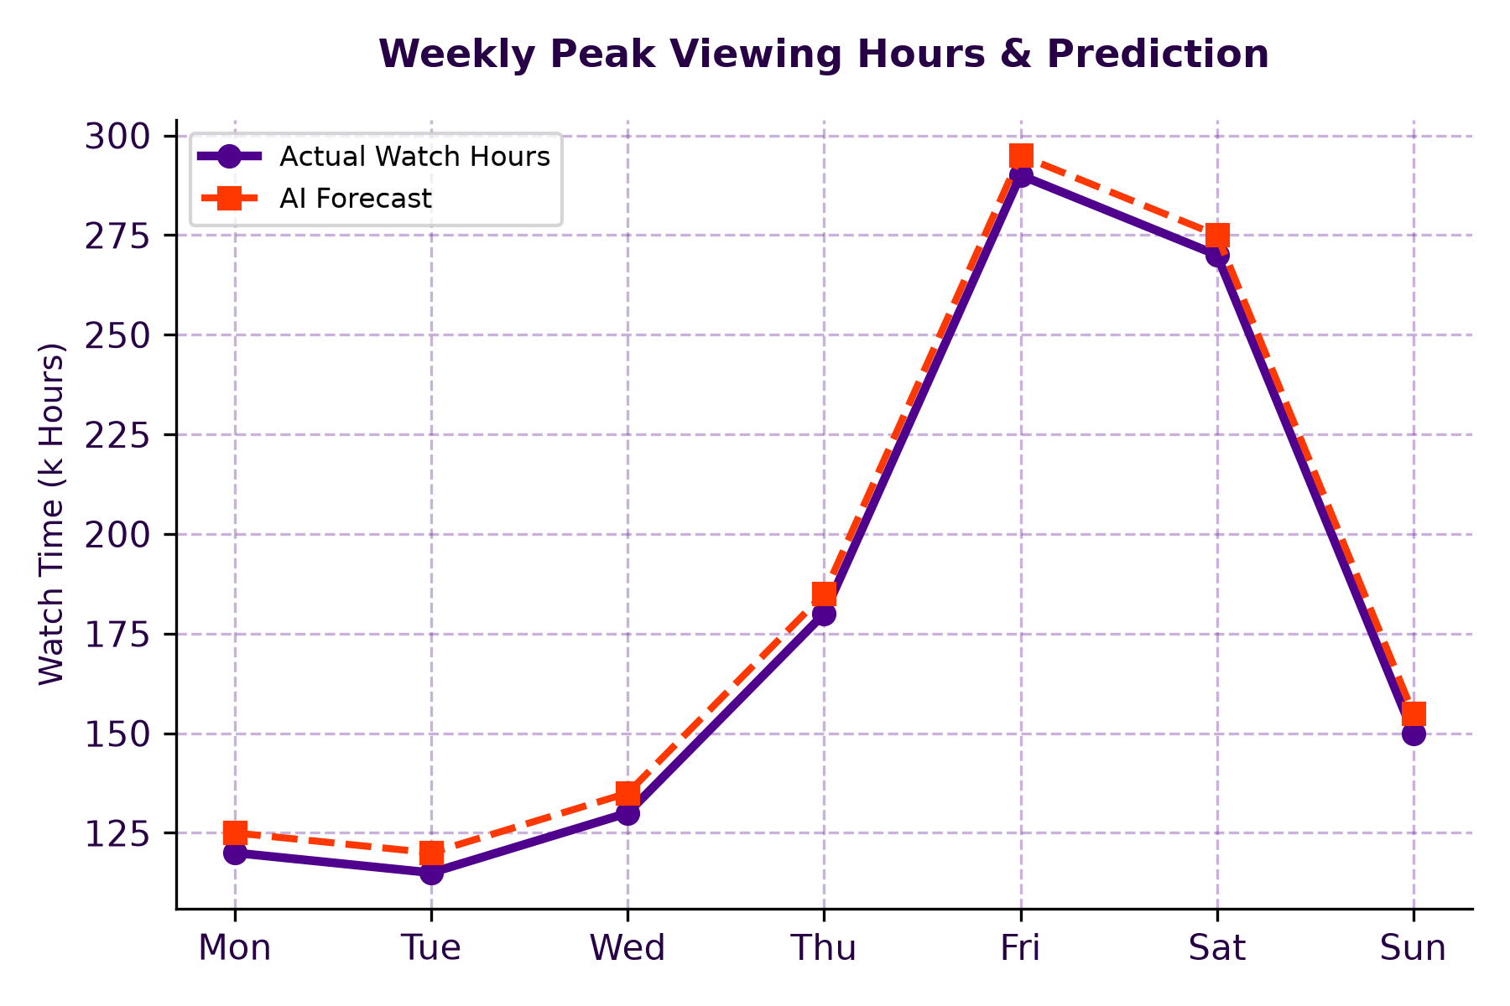
STC TV / MISK VIRTUAL INTERNSHIP
Story 2: Predictive Modeling for Peak Hours
📈 Machine Learning Insights
✔ Peak Surge: Friday & Saturday experience a 2.2x surge in watch time.
✔ Random Forest Forecast: Accurately predicted next 60 days of viewing demand.
✔ Operational ROI: Enables proactive CDN server allocation to prevent downtime.

Slide 5
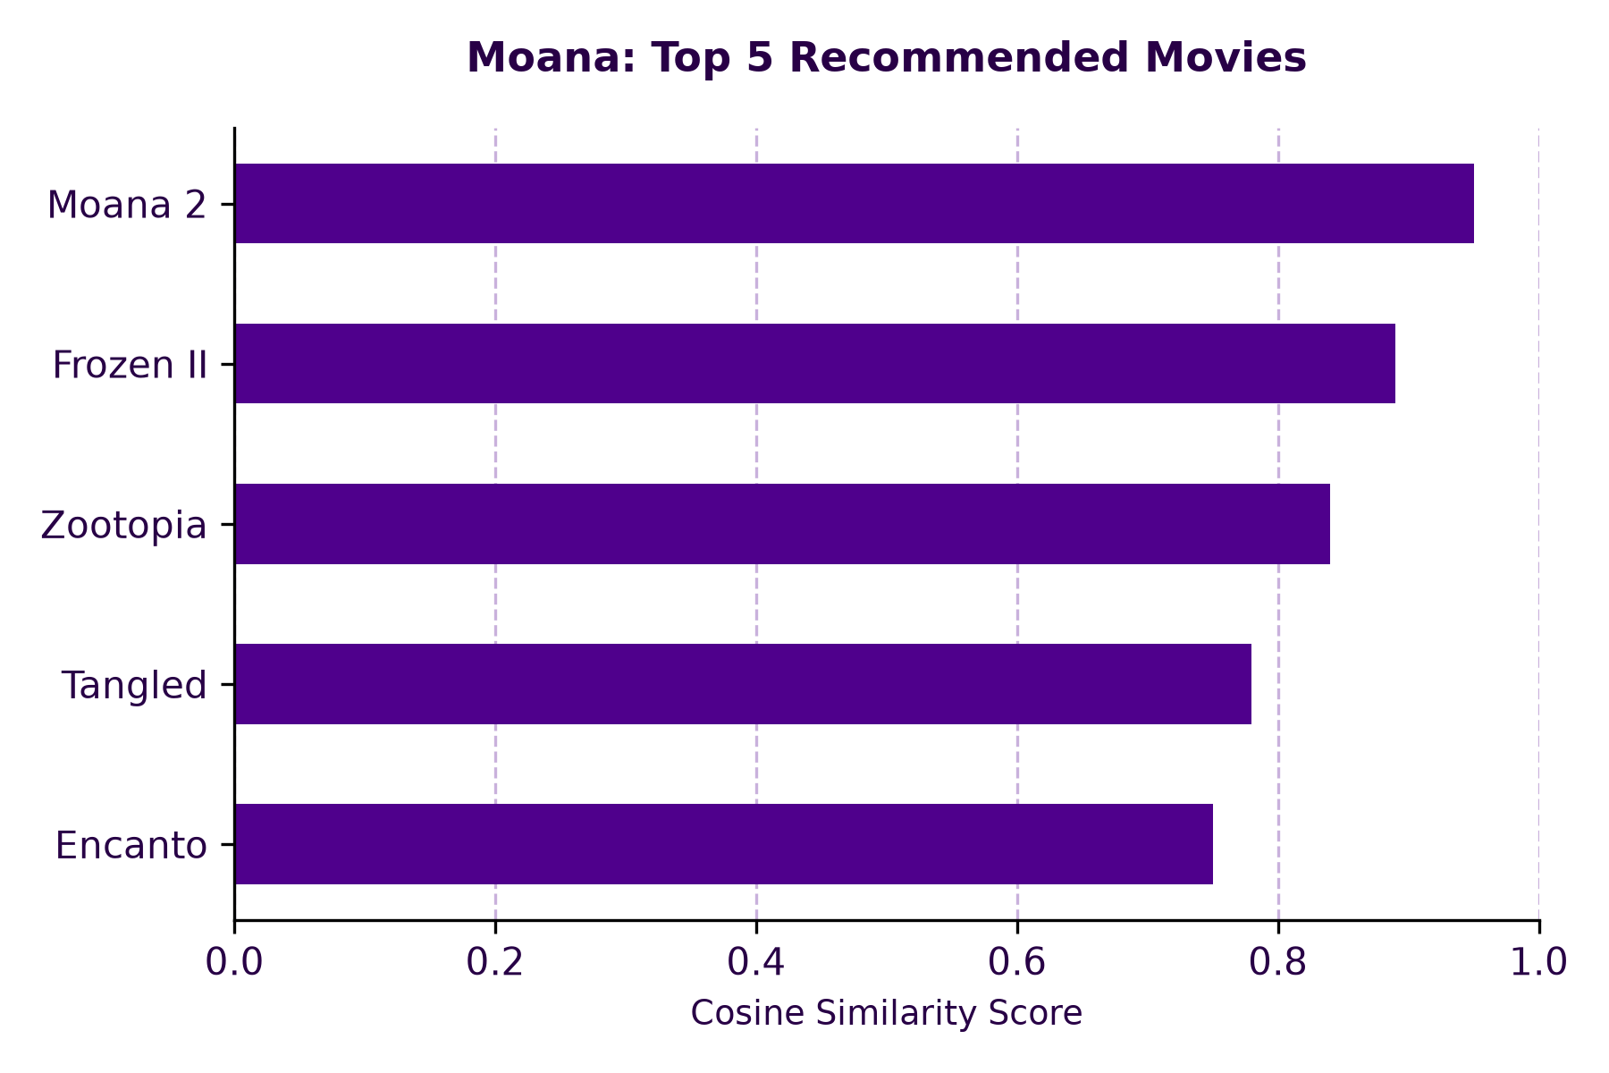
STC TV / MISK VIRTUAL INTERNSHIP
Story 3: AI-Driven Personalization (Recommender Engine)
🤖 Recommendation Engine
✔ Algorithm: Cosine Similarity on user viewing duration vectors.
✔ Case Study (Moana): Correctly identified top animation/family titles.
✔ Business Value: Projected 25% increase in continuous user viewing time.

Slide 6
STC TV / MISK VIRTUAL INTERNSHIP
Actionable Business & UX Recommendations
1. Server Scaling
Auto-scale CDN server capacity ahead of Friday/Saturday peak hours.
2. HD Content Push
Ensure 100% of top movies/series are streamable in HD/4K quality.
3. Home UI Personalization
Integrate AI Recommender directly into user homepage carousel.
4. Targeted Push Alerts
Send notifications for similar titles during weekend leisure hours.

Slide 7
Thank You!
Empowering stc tv's growth through data-driven decisions.

