Slide 1
Javascript

Slide 2
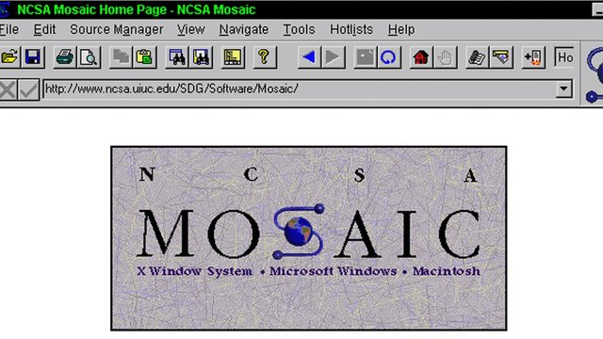
MosAic
Notes:
Mosaic was the first widely-distributed graphical browser or viewer for the World Wide Web. It is usually considered to have been the software that introduced the World Wide Web and the Internet to a wide general audience.
First web browser introduce the <img /> tag
The first alpha release (numbered 0.1a) was published in June 1993

Slide 3

NetScape
Notes:
Netscape is the first browser introduce HTML formatting tags

Slide 4

Brendan Eich
Notes:
Brendan Eich create javascript in 10 days in May 1995 then working at Netscape and now of Mozilla. JavaScript was not always known as JavaScript: the original name was Mocha, a name chosen by Marc Andreessen, founder of Netscape

Slide 5
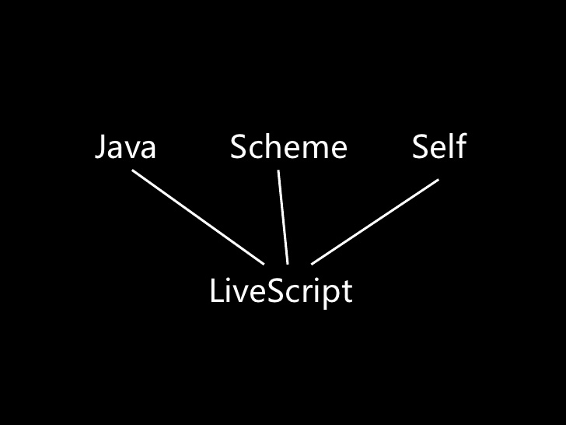

Slide 6
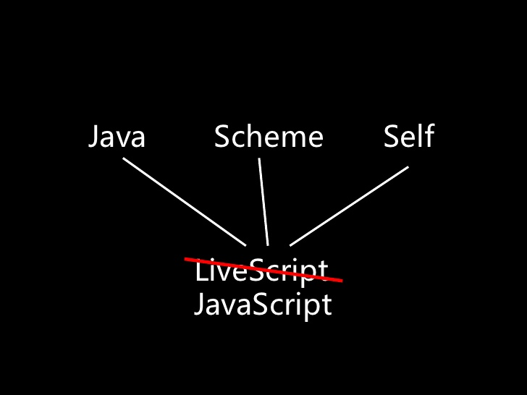

Slide 7
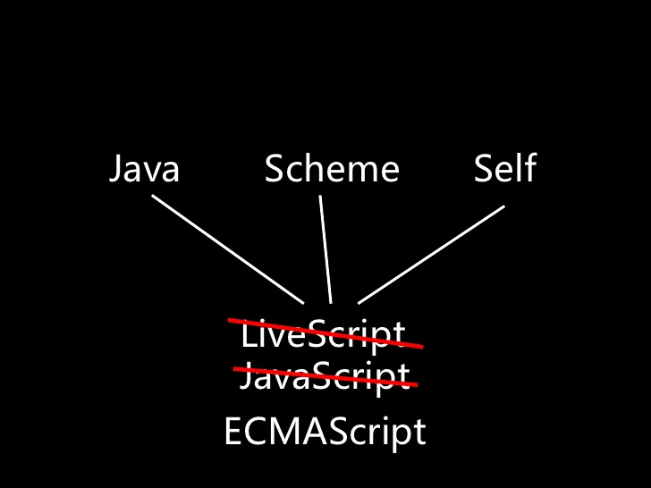

Slide 8
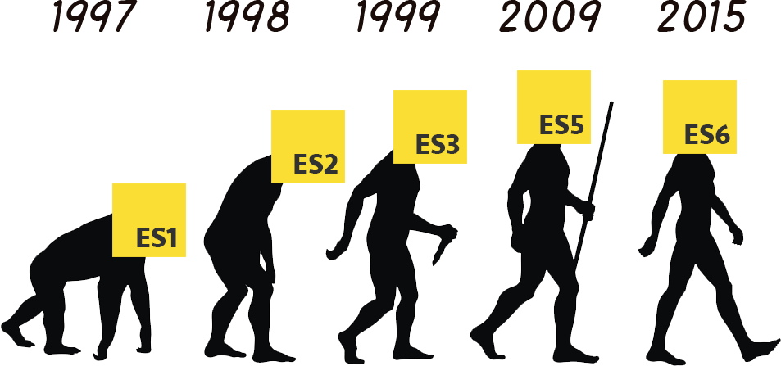

Slide 9
what is first class object
A first class object is an entity that can be dynamically created, destroyed, passed to a function, returned as a value, and have all the rights as other variables in the programming language have.
can be assigned to variable
Can be passed as parameter
Can be included as property from object
Can be returned from functions

Slide 10
Types
Type | Value example | Value category
Number | 1 , 5 , 6 | Primitive value
String | “ahmed” , “hi ”
Boolean | True , false
Null | Null
undefined | undefined
Object | [1,2,3,4] Function(){} {id:1} Regular expressions | Object values
Notes:
Onlye one number type
Numer need 64 bit

Slide 11
Nan
Special number : Not a number
Any arithmetic operation wit nan as input will have Nan as a result
NaN is not equal anything including NaN
NaN === NaN is false
NaN !== NaN is true
parseInt(‘ss’)===NaN !!
isNan( parseInt(‘ss’) )

Slide 12
String
Sequence of 0 or more 16-bit characters
No separate character type

Slide 13
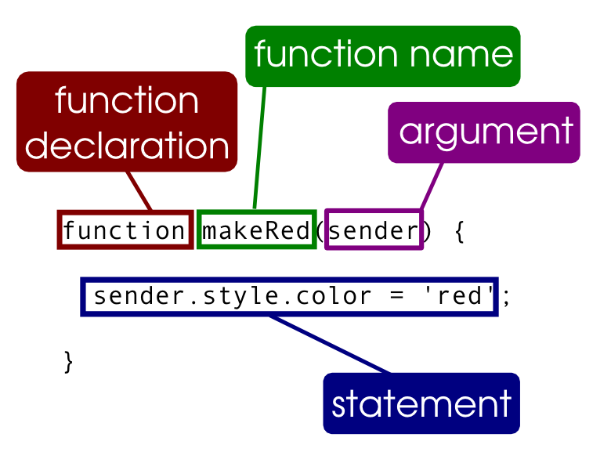
Functions

Slide 14
Functions
Functions are first class object
May be passed as an argument to a function
May be returned from a function
May be assigned to a variable
May be store in an object or array

