Slide 1
Global Coal Power Capacity: A Comparative Analysis

Slide 2
BACKGROUND
The goal of this project was to track changes in global coal-fired power plant projects overtime using datasets from 2017 and 2023.
To accomplish this goal, I began with processing the data, writing comments for documentation for each line of code, and then I moved on to visualizations.
I used R (R Studio) to complete this data science task. The libraries that I used are:
RColorBrewer
tidyverse
leaflet
leaflet.extras
ggmap
scales
data.table
openxlsx
readxl
H

Slide 3
VISUALIZATIONS & KEY FINDINGS
H

Slide 4
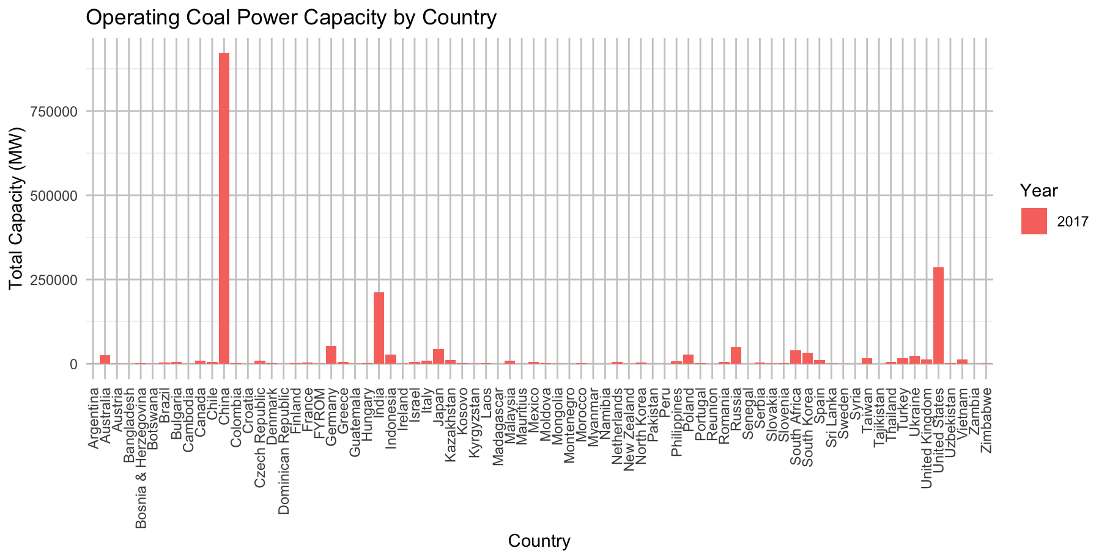
Global Coal Power Capacity by Country from 2017 Data
China: 921,227 MW
India: 212,562 MW
United States: 287,051 MW

Slide 5
Global Coal Power Capacity by Country from 2017 Findings
Initially, I began creating visualizations that would provide insights into coal plant capacity based on country and year from both data sets.
China, India, and the United States were leading in 2017 terms of largest total capacity overall for the operating coal power plants.
However, the scale of the Y-Axis is too large, so in subsequent graphs I used a logarithmic scale to ensure that large and small countries could be graphed and represented.

Slide 6
Using a Logarithmic Scale
Each tick mark on the Y-Axis represents an exponential increase (10¹, 10², 10³)
A Logarithmic scale is useful to use because the dataset is vast and spans several levels of magnitude with large and small values
The y-axis label indicates that the values are the total retired capacities in megawatts (MW)

Slide 7
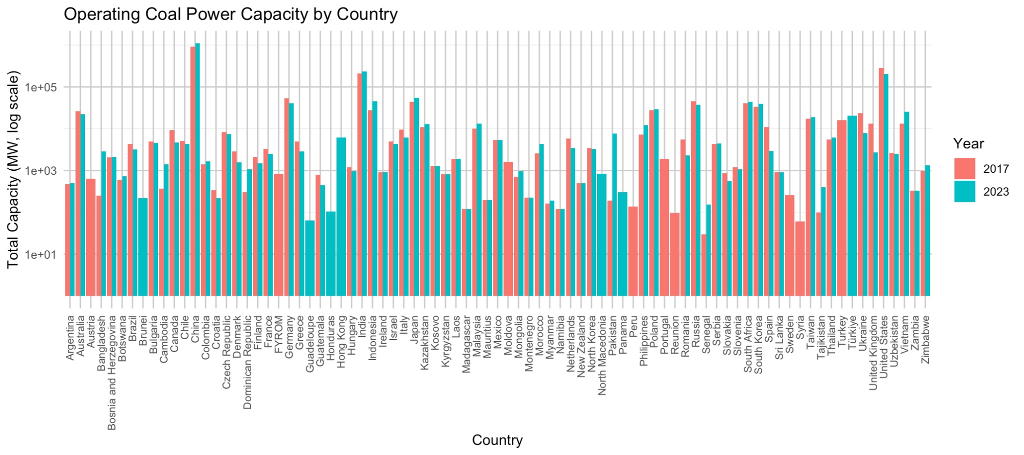
Global Coal Power Capacity by Country (Operating Plants)

Slide 8
Operating Plants Global Power Capacity ( Findings)
Comparing the 2023 dataset to the 2017 dataset, the countries that had an increase in coal plant capacity for operating plants were China and India.
The United States had a slight decrease, which indicates that there may be more plants that have been retired in the United States compared to China and India.
Bangladesh also saw a large increase in their coal plant capacity for operating plants from 2017 data to 2023 data.

Slide 9
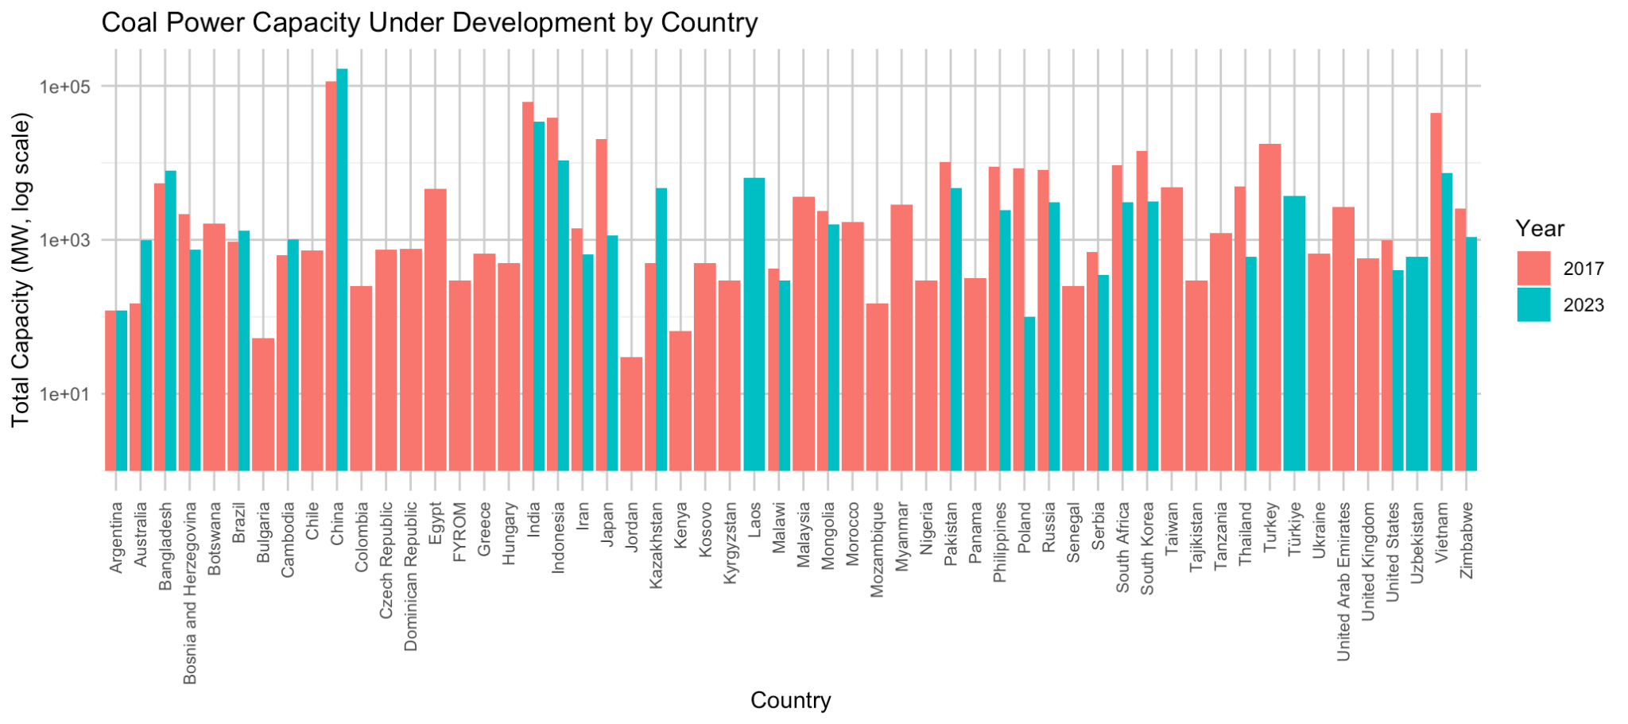

Slide 10
Plants Under Development (Findings)
Compared to 2017 data, the 2023 dataset shows China and Bangladesh having an increase in power capacity for plants under development.
The United States and Indonesia had a decrease in their total capacity for plants under development.
This may mean that plants in the US and Indonesia are operating at less than their normal capacity. They are not producing as many Megawatts of electricity.

Slide 11
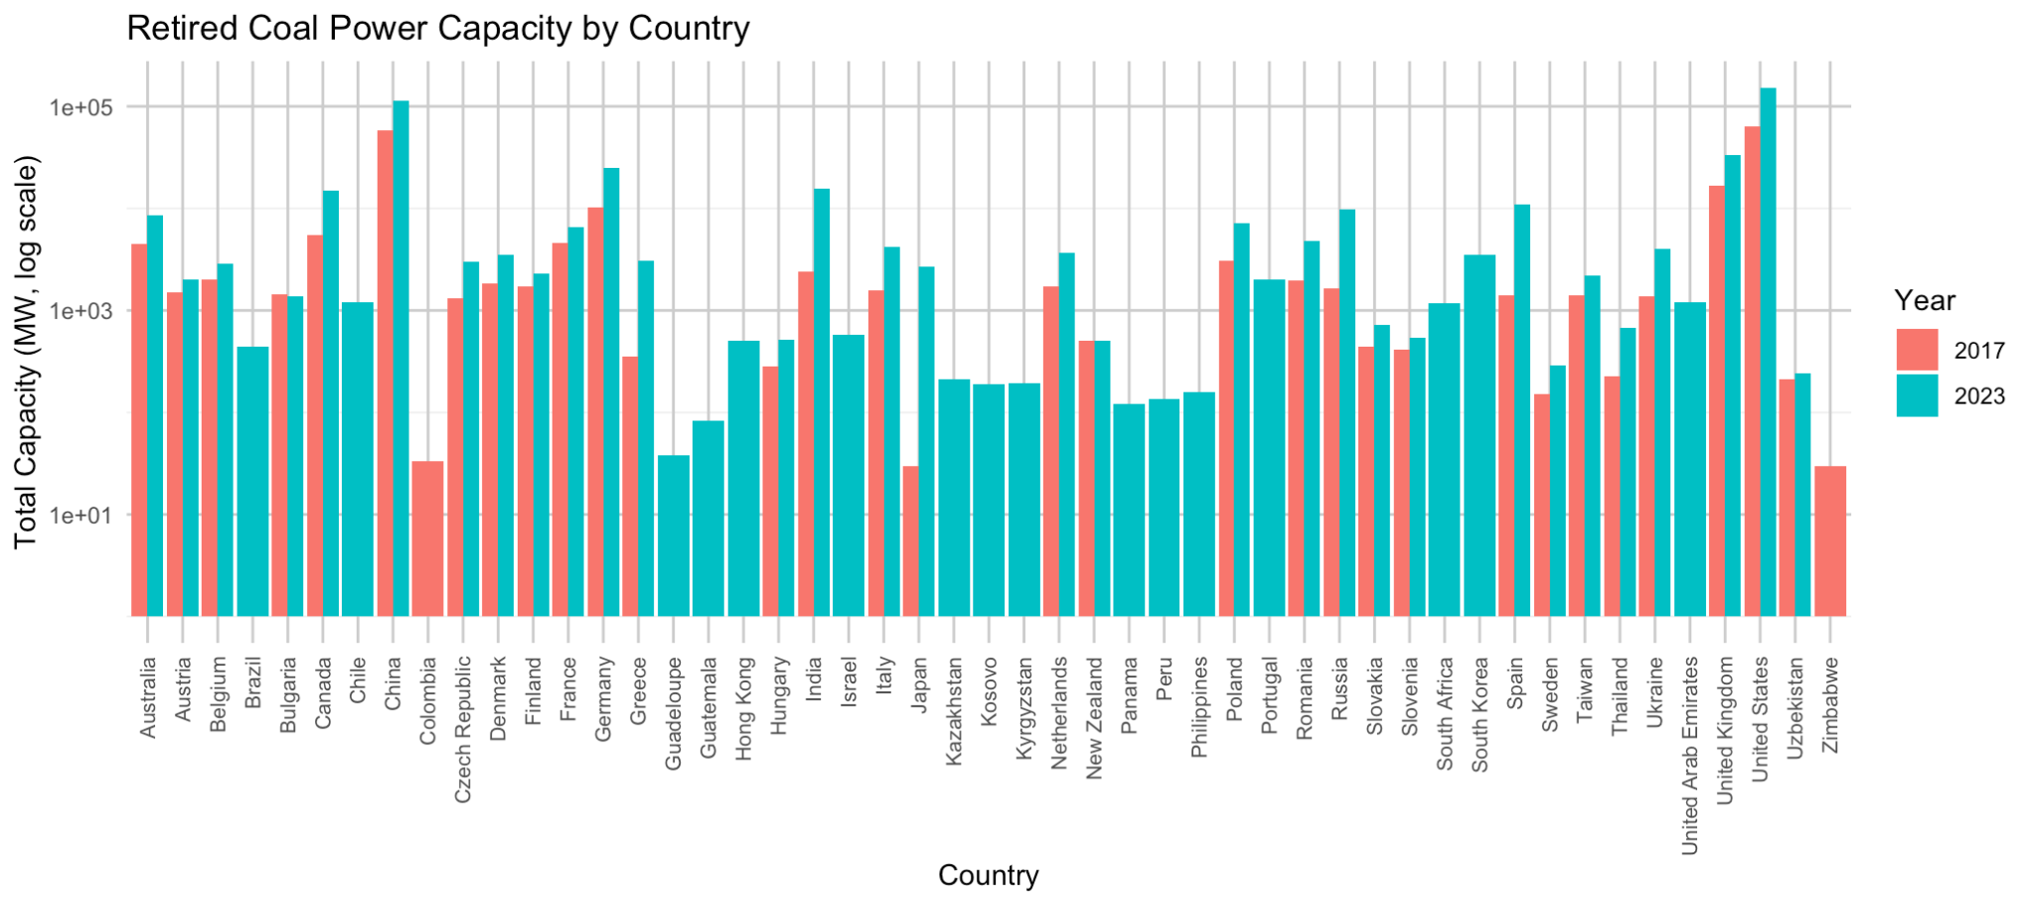

Slide 12
Retired Plants (Findings)
Compared to 2017 data, the 2023 dataset shows China and Bangladesh having an increase in power capacity for plants under development.
The United States and Indonesia had a decrease in their total capacity for plants under development.
These findings reflect all plants under development for the countries included in the dataset, and total capacity for plants overall.

Slide 13
Mapping the locations of the plants will allow us to visualize the areas that have the highest amount of coal plants, which will lead to further research on environmental and economic impacts of the coal plants in these particular countries.
The plants are mapped by operating and non-operating status, which are distinguished from each other, the plants are mapped from both datasets by their Plant name, Country it is located in, Status of the plant, Capacity in Megawatts of the plant, and the year the plant began operating/was started.
For example, a dot if clicked on, the popup would show this information:
Plant: Kostolac power station
Country: Serbia
Status: Operating
Capacity (MW): 350
Start Year: 1991

Slide 14
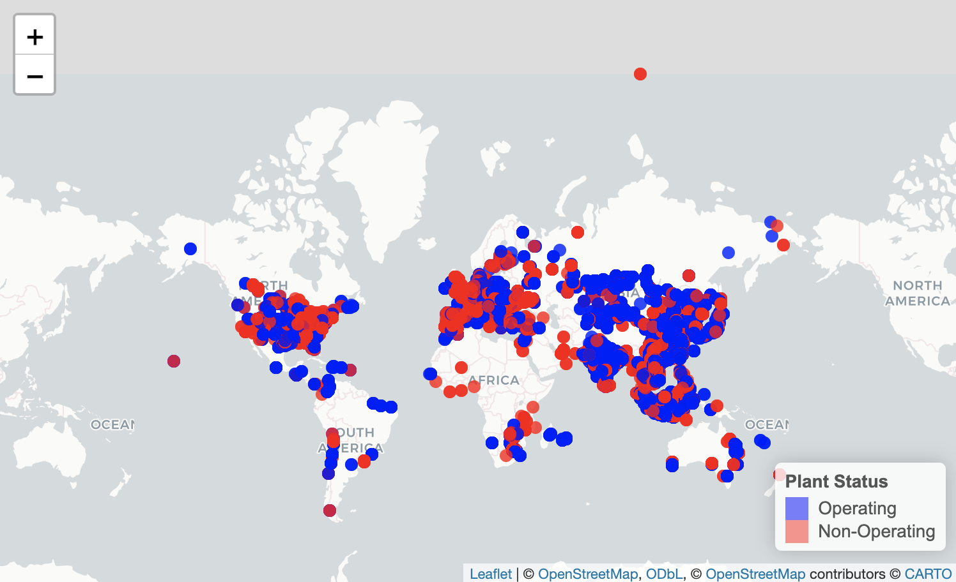
Coal Plant Mapped Locations

Slide 15
Future Directions
There are many directions I would like to go in for the future with this dataset. One thing I could do is create a heatmap based on heat rate of the different power plants because that will give an idea on how effective the power plants are at turning coal into electricity. The effectiveness of these plants has implications on the environment that are important to explore further.
Another direction would be to go into depth more on the bar graphs and choose different variables to visualize.
Equipped with more information on the environmental data, I will create more advanced visualizations and contribute more to data science projects and research in the environmental field.

Slide 16
Citations:
Kahle D, Wickham H (2013). “ggmap: Spatial Visualization with ggplot2.” The R Journal, 5(1), 144–161. https://journal.r-project.org/archive/2013-1/kahle-wickham.pdf.
“Global Coal Plant Tracker, Global Energy Monitor, January 2024 release.”

