Slide 1


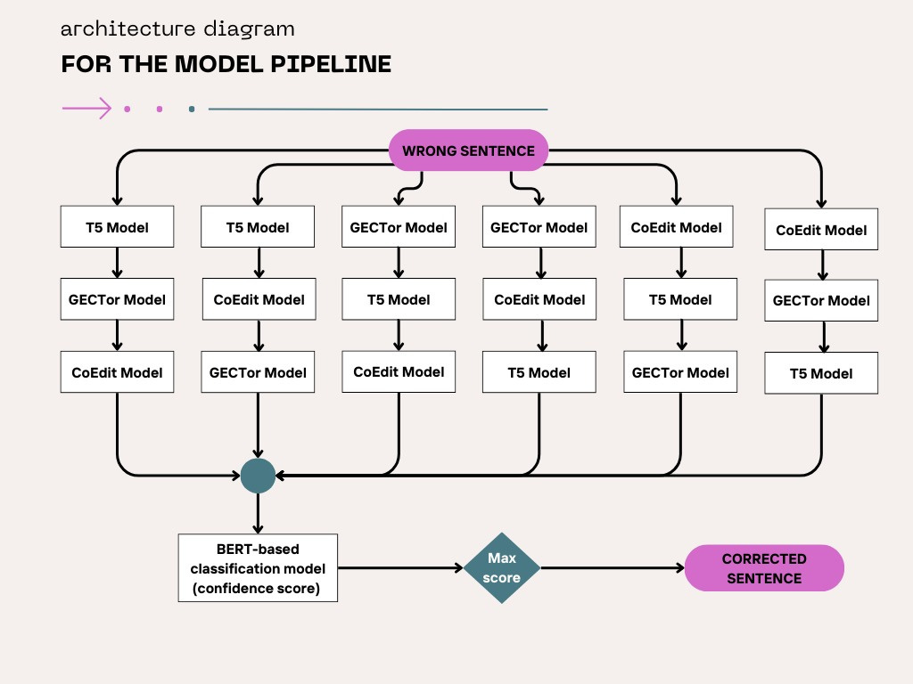
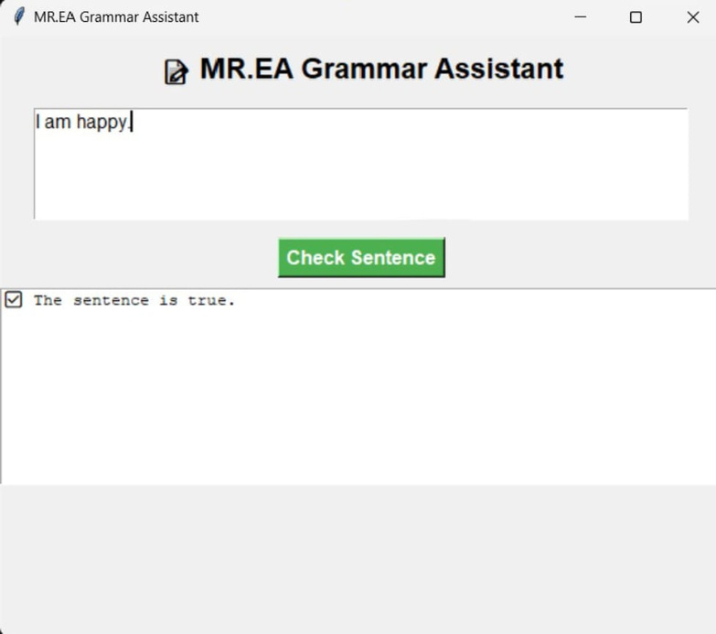
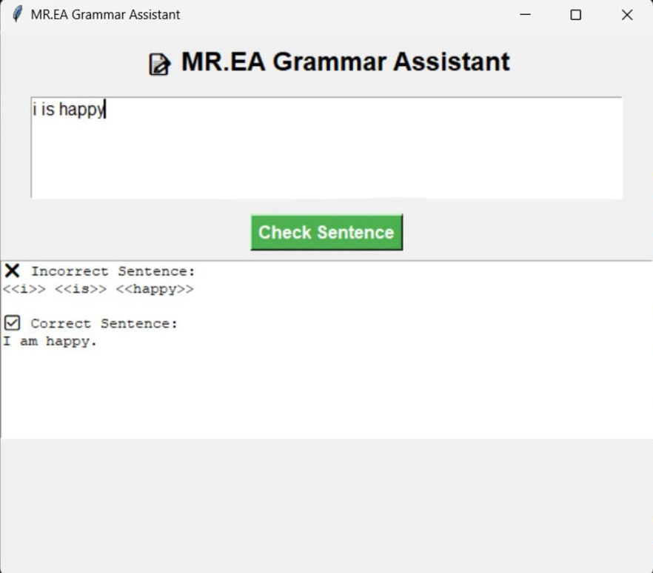
AIS301-7
Reem Hussin . Mohanned Mahmoud . Ibrahim Alaa . Mahmoud Essa . Abdelrahman Ahmed
Language Learning for Grammar Feedback
Abstract:
Architecture Diagram:
This project introduces a grammar correction system that improves writing proficiency with real-time feedback on grammatical errors. It integrates three seq2seq models—T5, GECToR, and Coedit—with a BERT-based classifier to validate corrections. An ensemble strategy selects the most reliable output by evaluating multiple predictions with classification confidence scores. Trained on a large dataset of incorrect and corrected sentences, the system effectively corrects subject-verb agreement, verb tense errors, and preposition misuse. Its user-friendly design delivers personalized feedback for efficient grammar learning. The project demonstrates scalable NLP solutions, with future enhancements including multilingual support, domain-specific fine-tuning, and data diversity expansion.
Introduction:
The Language Learning for Grammar Feedback project aims to develop an intelligent, real-time grammar correction system using state-of-the-art machine learning models. This solution addresses common grammar issues such as subject-verb agreement, verb tense errors, and preposition misuse. By combining three advanced sequence-to-sequence models—T5, GECToR, and Coedit—with a BERT-based classification model, the system delivers more accurate corrections through an ensemble strategy. This approach evaluates multiple corrections, assigns confidence scores using classification, and selects the most reliable output to ensure precise feedback.
The system was trained on a diverse dataset of incorrect and corrected sentences, combining the strengths of T5 for fluency, GECToR for explicit error correction, and Coedit for grammar refinement, while a BERT classifier validates the outputs for reliability.
Main Results:
The results of this project highlight the effectiveness of combining multiple models for grammar correction. The T5 model achieved 85% accuracy, excelling in fluent corrections. The GECToR model reached 72% accuracy, addressing grammar errors but struggling with sentence restructuring. Coedit showed 70% accuracy, maintaining fluency but performing less on complex issues. The BERT classification model excelled with 90% accuracy and a 92% F1 score in validating corrections. Using an ensemble strategy, the final system achieved a 96% accuracy by selecting the best correction from different model combinations. These results demonstrate the power of model integration for effective grammar correction.
Methodology:
This project developed a grammar correction system using an ensemble of three seq2seq models (T5, GECToR, and Coedit) and a BERT classification model. The dataset consisted of incorrect sentence-correction pairs, preprocessed for tokenization and labeling. Each seq2seq model was fine-tuned on the dataset to correct grammar errors, while the BERT model validated the corrections. An ensemble strategy combined model outputs in six sequences, and the best correction was chosen based on classification scores. This approach achieved a final accuracy of 96%, leveraging the strengths of each model for optimal performance.
Objectives:
The objective of this project is to create an advanced grammar correction system that improves sentence accuracy. By integrating three seq2seq models—T5, GECToR, and Coedit—with a BERT classification model, the system leverages their individual strengths. An ensemble strategy is employed to combine the outputs of these models, selecting the best correction based on classification scores. This approach aims to address common grammar issues like subject-verb agreement, sentence restructuring, and preposition misuse. The ultimate goal is to achieve high accuracy and fluency in the corrected sentences.
Conclusion:
This project successfully developed a high-accuracy grammar correction system by integrating multiple NLP models with an ensemble strategy. By combining T5, GECToR, Coedit, and BERT, the system achieved a 96% accuracy, improving sentence fluency and correctness. The results demonstrate the effectiveness of leveraging model diversity and validation layers to tackle complex grammar correction tasks. This approach provides a strong foundation for creating reliable, scalable grammar correction tools for real-world applications.
Technologies Used:
T5 (Text-to-Text Transfer Transformer): A seq2seq model for generating corrected sentences.
GECToR (Grammar Error Correction Transformer): A seq2seq model specifically designed for grammar error correction.
Coedit (Collaborative Editing Transformer): A seq2seq model for improving sentence fluency while correcting grammar.
BERT (Bidirectional Encoder Representations from Transformers): Used as a classifier to validate the grammatical correctness of the outputs.
HuggingFace Transformers: For fine-tuning and training the models.
Python: The primary programming language for implementation and model training.
Recommendations:
Expand Training Data: Use larger and more diverse datasets to improve model performance on complex sentences.
Domain-Specific Tuning: Fine-tune models for specific use cases like academic or business language.
Add Multilingual Support: Extend the system to handle multiple languages for broader applications.

