Slide 1
Book Cover
Project Report Template

Slide 2
Introduction
1.1 Overview
Romeo and Juliet is a play about the conflict between the main characters love, with its transformative power, and the darkness, hatred, and selfishness represented by their families feud.
1.2 Purpose
Shakespeare wrote Romeo and Juliet to explain the worst possible lovers can find themselves in. Romeo and Juliet both are form families that hate each other, they face the fact the Romeo kill Juliet’s cousin, and that they have know each other for no over a week.

Slide 3
2.Problem Definition & Design Thinking
2.1 Empathy Map :
They are designed to capture the needs and perspective of a specific audience, but may not capture the needs and perspectives of other stakeholders. For example, an empathy map created for customers may not capture the needs and perspectives of employees or suppliers.
2.2 Brainstorming Map :
• Can take too much time if the group is not properly controlled and is allowed to run for too long.
• Raising expectations of the brainstorming group by considering ideas that will never be implemented.

Slide 4
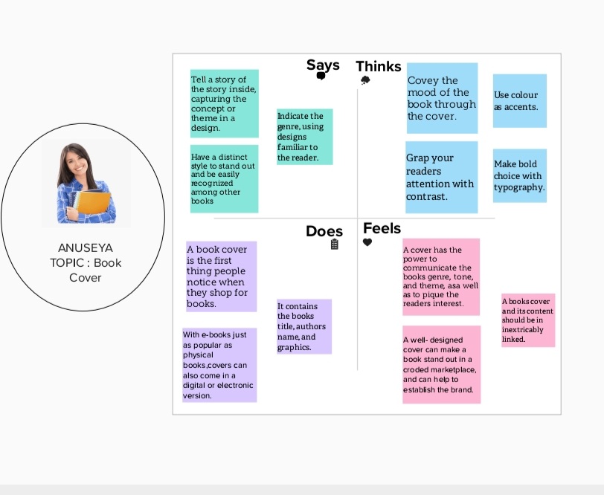
2.1 Empathy Map

Slide 5
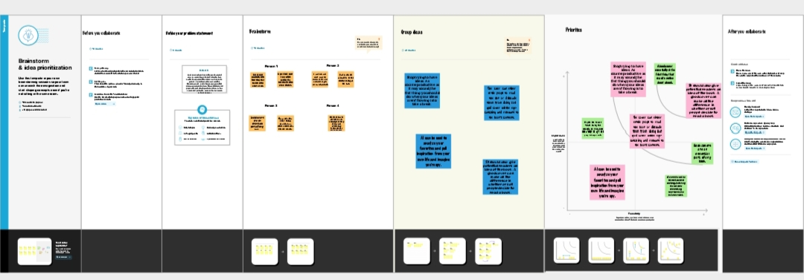
2.2 Brainstorming Map

Slide 6
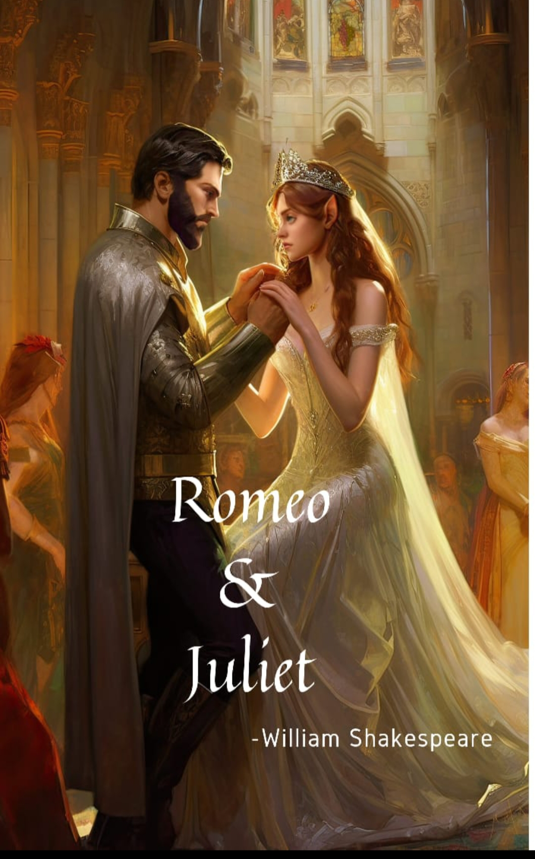
3.Result :

Slide 7
4.Advantages & Disadvantages
Advantages
The study of Romeo and Juliet consist of; students getting to learn about the way people spoke during shakespeare times, the theme of the play being the ones that play being the ones that students can relate to, and the useful life lessons that can be learned.
Disadvantages
Some find themselves trapped in regrets and can’t undo the damage they have done.

Slide 8
Application
Romeo and Juliet does not make a specific moral statement about the relationships between love and society, religion and family.
Portrays the choose and passion of being in love.
Combining images of love ,violence ,death , religion ,and family in an impressionistic rush leading to the play’s tragic conclusion.

Slide 9
Conclusion
That’s the best thing you can do, not only to deliver value to the reader, but also to make the book memorable.

