Slide 1
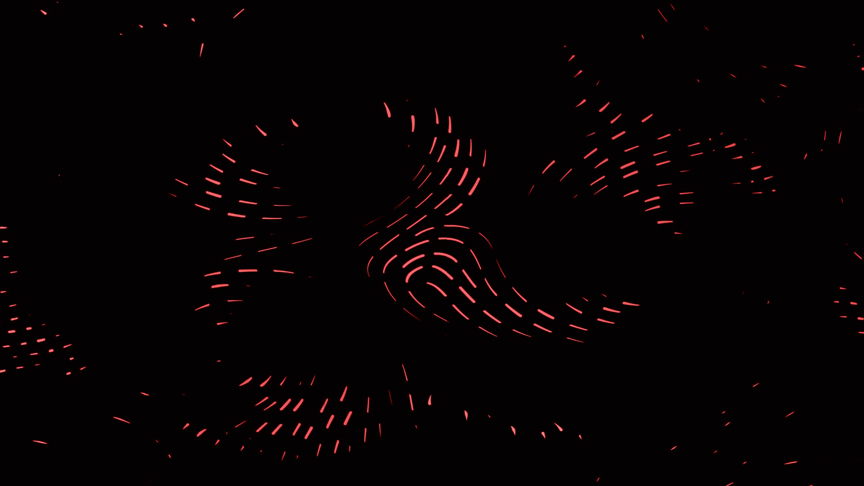
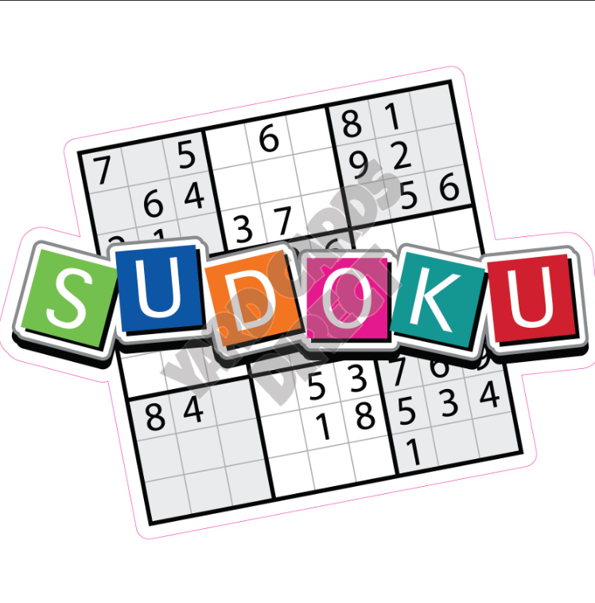
Sudoku Games in Python
Welcome to my presentation on my Sudoku game projects. I've created two versions, one using Pygame and the other using Tkinter, both in Python. We'll explore the design, features, and development process of each game.

Slide 2
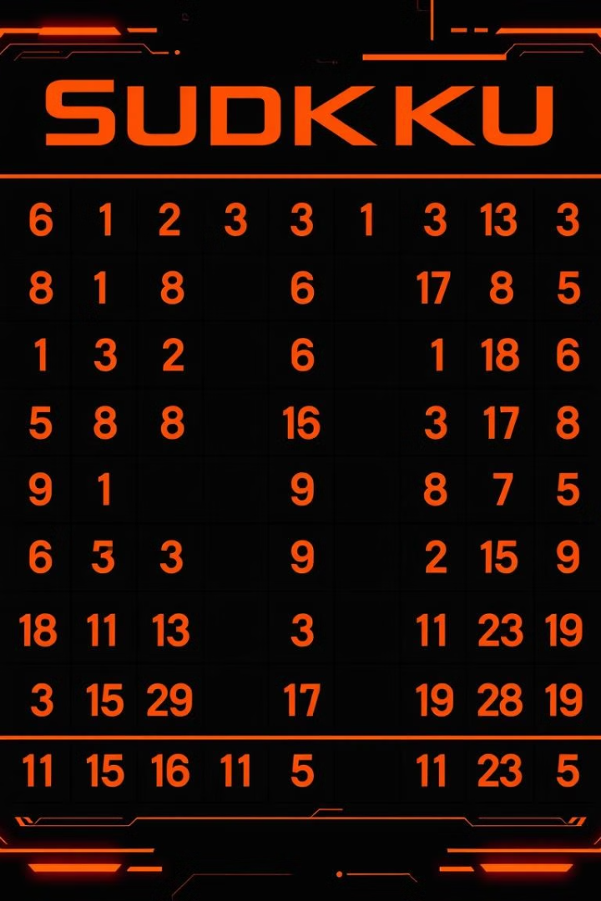
Sudoku Game Overview
Sudoku is a logic-based number-placement puzzle. The objective is to fill a 9x9 grid with digits so that each column, each row, and each of the nine 3x3 subgrids contains all of the digits from 1 to 9.
Rules
Difficulty
Each row, column, and 3x3 block must contain all digits 1 through 9.
Sudoku puzzles vary in difficulty, from easy to hard.
Logic
Players use logic and deduction to solve Sudoku puzzles.

Slide 3
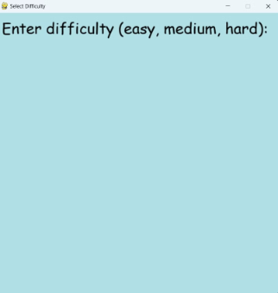
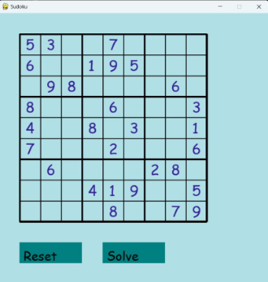
Sudoku Game using Pygame
The Pygame Sudoku game is a visually appealing and interactive experience. It utilizes Pygame's graphics and event handling capabilities to create a dynamic game interface.
Gameplay Screen
Menu Screen
The gameplay screen displays the Sudoku grid, allowing users to interact with cells, enter numbers.
The menu screen allows players to adjust difficulty.

Slide 4
Pygame Sudoku Game Features
The Pygame Sudoku game offers features that enhance user experience and provide game assistance.
1
Number Input
2
Error Checking
3
Difficulty Levels
Players can enter numbers by choosing the box he want to insert in it and click on number buttons.
The game identifies and highlights errors, such as duplicate numbers in a row, column, or block.
Players can select from various difficulty levels, ranging from easy to challenging.
4
Solver
The game also includes a solver feature that allows players to solve Sudoku puzzles using an algorithm that finds the correct solution. This feature can be used to completely solve the puzzle for the player.

Slide 5
Pygame Sudoku Game Development Process
Developing the Pygame Sudoku game involved several steps, from design to implementation.
Game Design
1
Planning the game interface, features, and gameplay mechanics.
2
Grid Implementation
Creating the Sudoku grid and implementing grid logic.
User Input Handling
3
Implementing user input for number entry and cell selection.
4
Game Logic
Developing the game logic for error checking, puzzle generation, and solving.
Graphical Interface
5
Designing and implementing the game's graphical interface using Pygame.
6
Testing and Refinement
Thoroughly testing the game, identifying and fixing bugs, and refining the user experience.

Slide 6
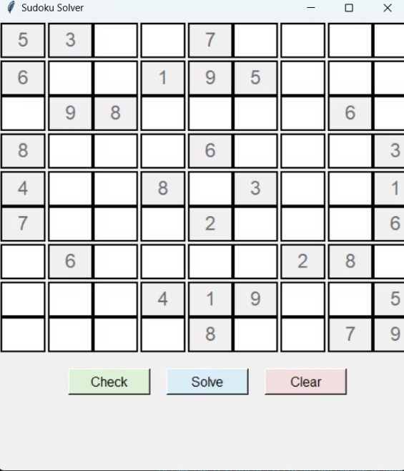
Sudoku Game using Tkinter
The Tkinter Sudoku game provides a more basic and straightforward user interface, relying on Tkinter's widgets and layout capabilities.
Gameplay Screen
The gameplay screen displays the Sudoku grid, allowing players to enter numbers using a small input area.
Game Controls
Adding game controls such as buttons for solving the puzzle, checking for errors, and resetting the grid.

Slide 7
Tkinter Sudoku Game Features
The Tkinter Sudoku game includes features that provide basic functionality and assistance.
1
Error Checking
2
Game Reset
3
Solve Suggestion:
The game checks for errors and highlights invalid entries.
The game allows players to reset the puzzle to its initial state.
The game includes a solve button that users can click to have the Sudoku puzzle solved automatically. This feature is useful for players who get stuck or simply want to see the solution.

Slide 8





Tkinter Sudoku Game Development Process
Building the Tkinter Sudoku game involved a similar development process, emphasizing simplicity and functionality.
Game Design
Conceptualizing the game interface, features, and gameplay logic.
Grid Implementation
Creating the Sudoku grid using Tkinter widgets.
User Input Handling
Implementing user input for entering numbers using entry widgets.
Game Logic
Developing the game logic for error checking and puzzle generation.
Testing and Refinement
Thoroughly testing the game, identifying and fixing any bugs, and refining the user experience.

Slide 9
Comparing the Pygame and Tkinter Sudoku Games
Both Pygame and Tkinter offer unique advantages and drawbacks for Sudoku game development.
Game
Features
Pros
Cons
GUIs
offers more flexibility and control over the game's graphical interface, allowing for more visually appealing designs.
Pygame
Visual appeal, user interface, game statistics, difficulty levels, solver
More engaging, visually appealing, interactive elements
More complex, potentially slower
Tkinter
Simple interface, basic functionality, error checking,solver
Simple and straightforward, easier to develop
Less visually appealing, fewer features
provides a simpler and more straightforward approach to GUI development, making it easier to create the game's graphical interface.

Slide 10


Conclusion and Future Improvements
My Sudoku game projects showcase the versatility of Python for game development. The Pygame version provides a richer and more interactive experience, while the Tkinter version offers a simpler and more accessible approach.
Future Plans
New Features
I plan to continue improving both games by adding new features and enhancing the user experience.
I'm considering adding a puzzle editor,Hint button, and more difficulty levels.

Slide 11
THANK YOU ☺
Any Questions?
Made by:
Reema Ehab El hariry
Jessica Boles
Nadia Talaat
Mohamed El Sharkawy
Amr Khaled

