Slide 1
Lending Club Case Study
Reema Rani

Slide 2
Problem Statement
Based on the given data, about past loan applicants and whether they ‘defaulted’ or not. Analyze consumer attributes and loan attributes and identify patterns which indicate if a person is likely to default.

Slide 3
Analysis Approach
Data Understanding
Data Cleaning and Manipulation
Univariate & Segmented Univariate Analysis
Bivariate Analysis
Heatmap understanding
Conclusion
Recommendations

Slide 4
Data Understanding

Slide 5
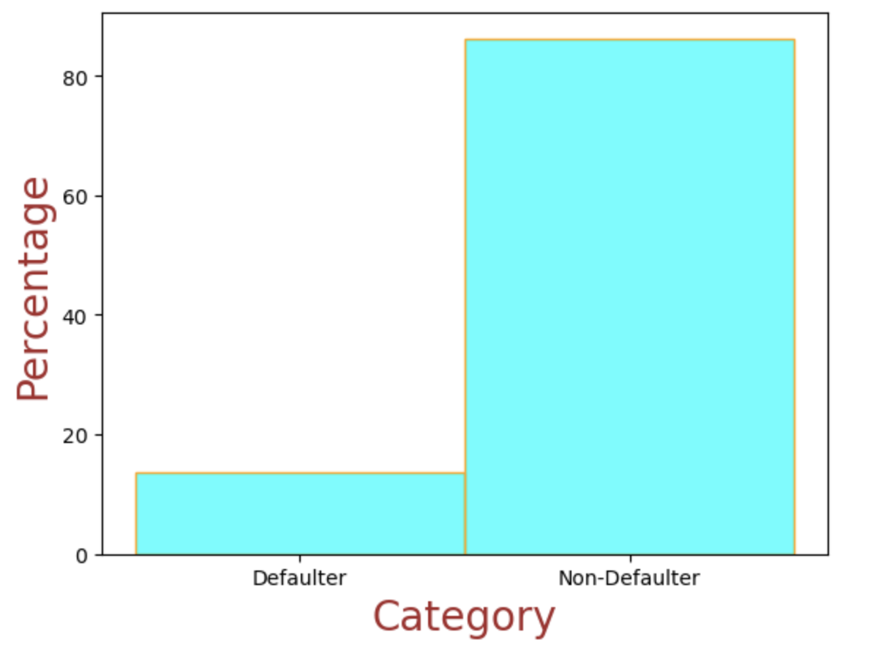
Default Rate is nearly 14%

Slide 6
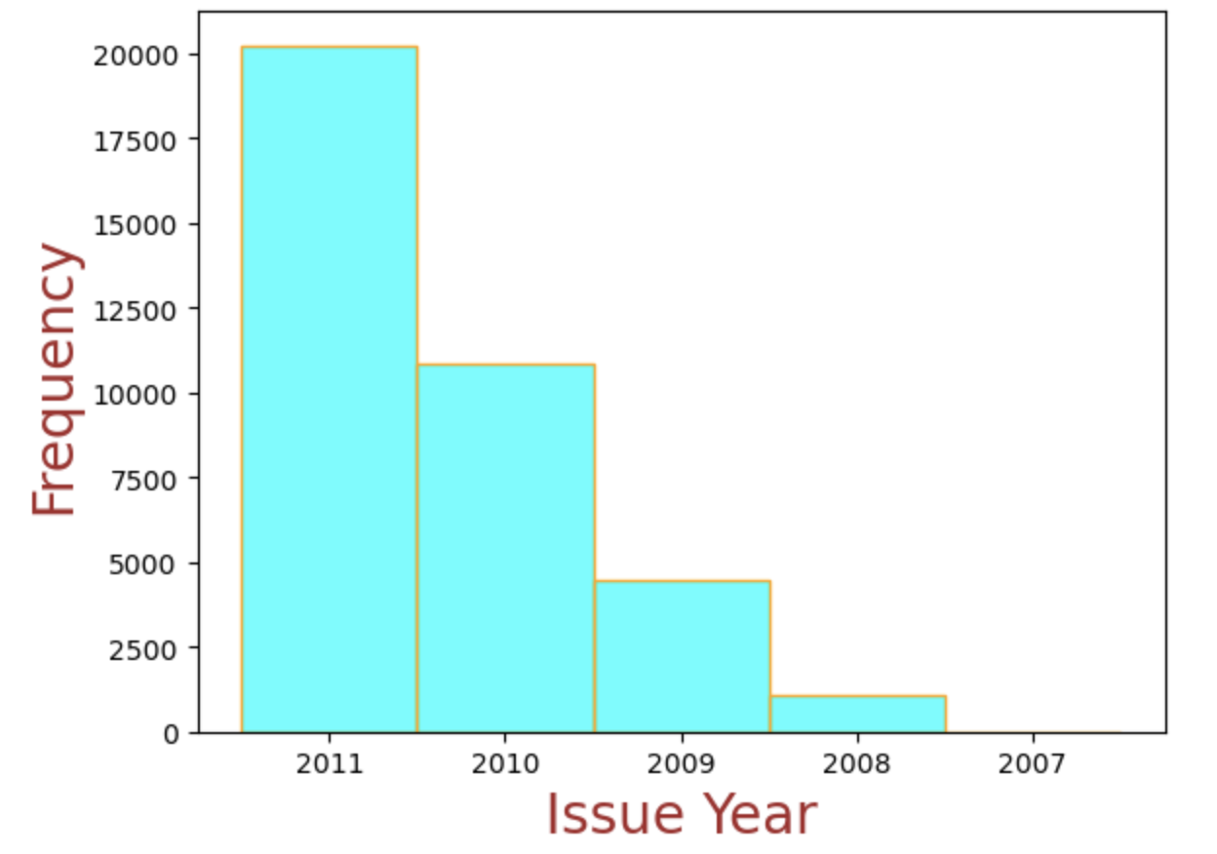
Time frame of the data “2007-2011”

Slide 7
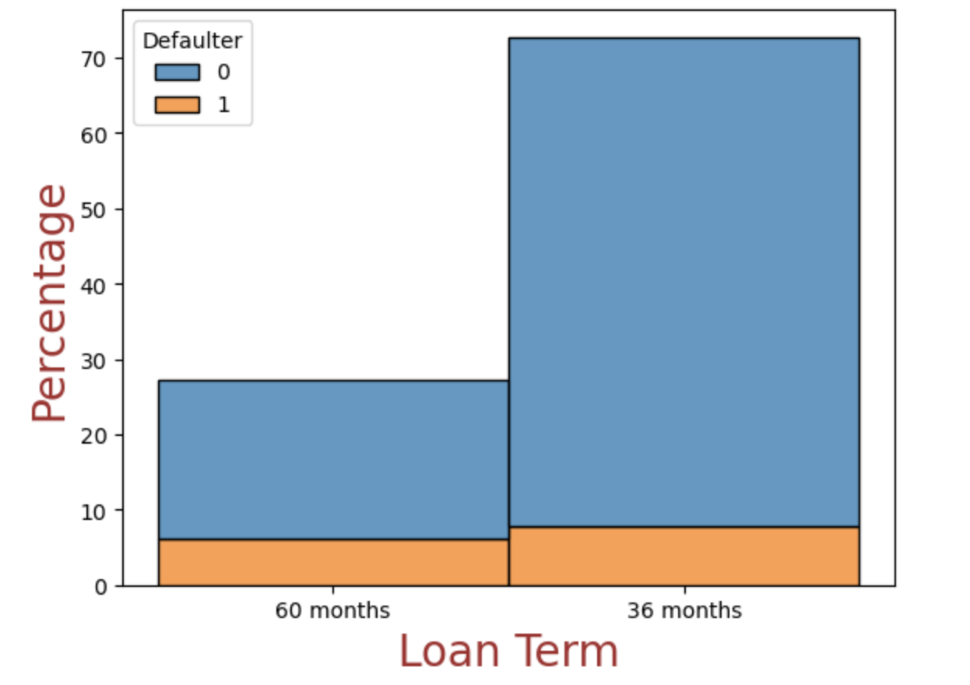
73% of Loan term is of 36 months
Notes:
Count or bar hue

Slide 8
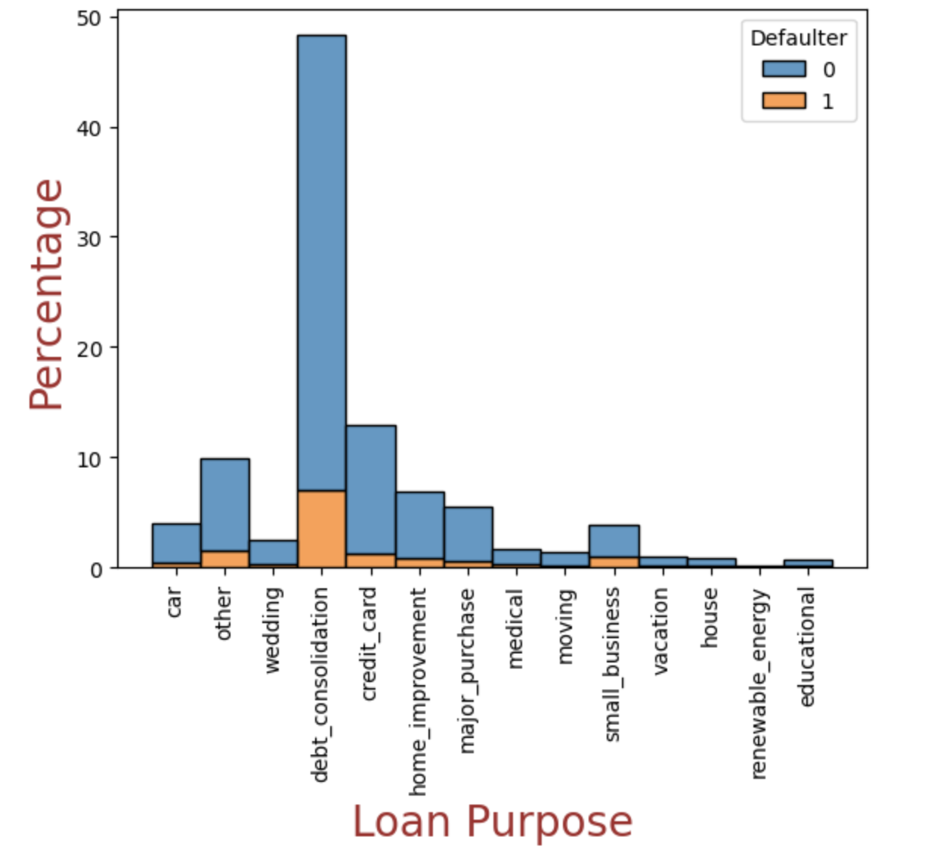
48% of loan were taken for Debt Consolidation

Slide 9
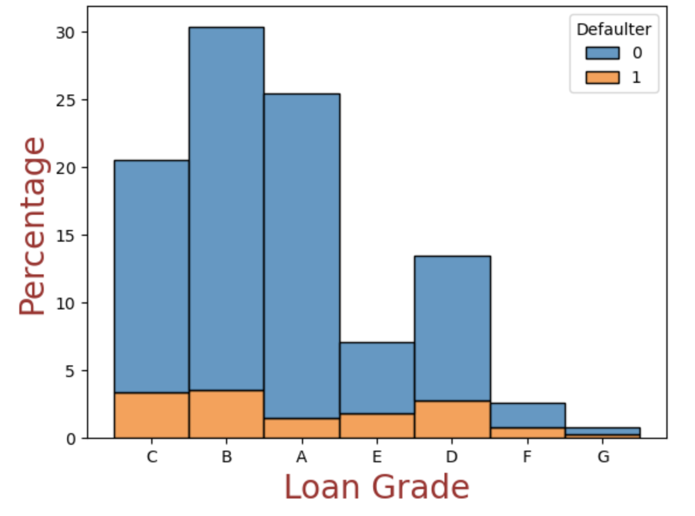
Loan percentage decreases as Grade decreases

Slide 10
Conclusion
Based on the data understanding below points can be concluded
Overall Default Rate of given loan data is 14%
Timeframe of given loan data is “2007-2011”
73% of loans are approved for 36 months term
There are different types of loan purpose given, in which 48% is of “Debt Consolidation”
Number of loans is directly proportional to Customer Grade

Slide 11
Univariate & Segmented Univariate Analysis

Slide 12
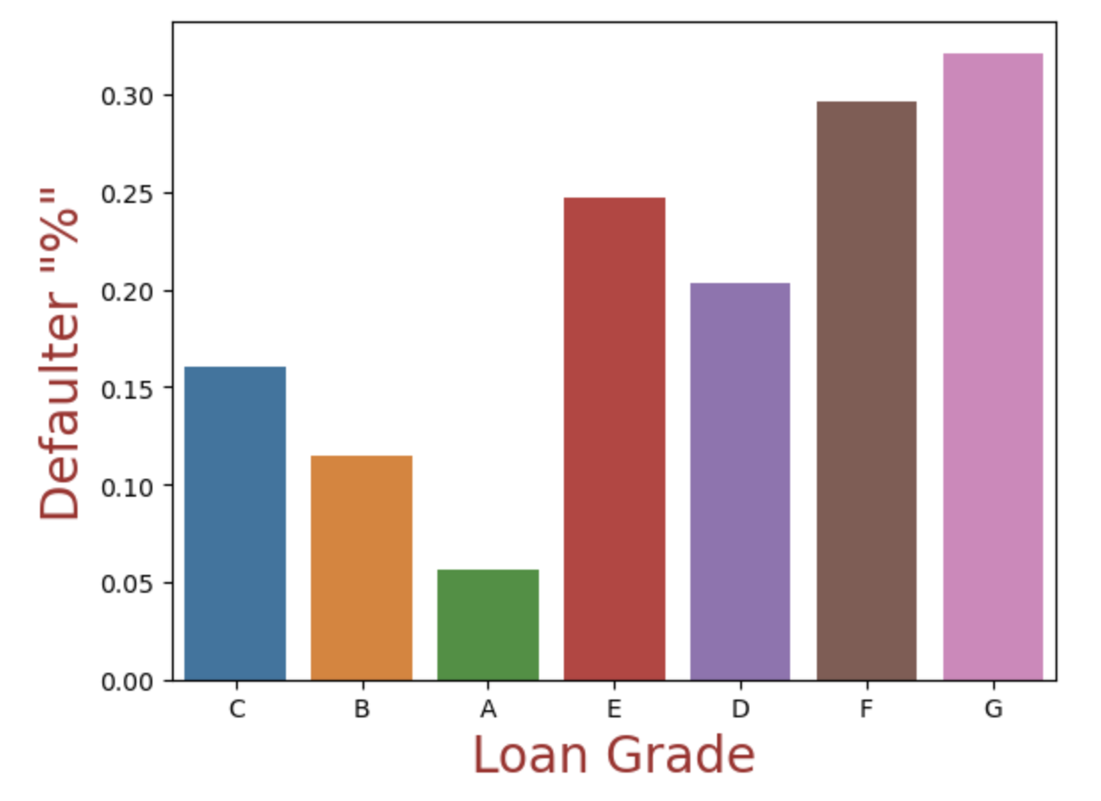
Defaulters % is ‘–’ vely correlated with Loan Grade

Slide 13
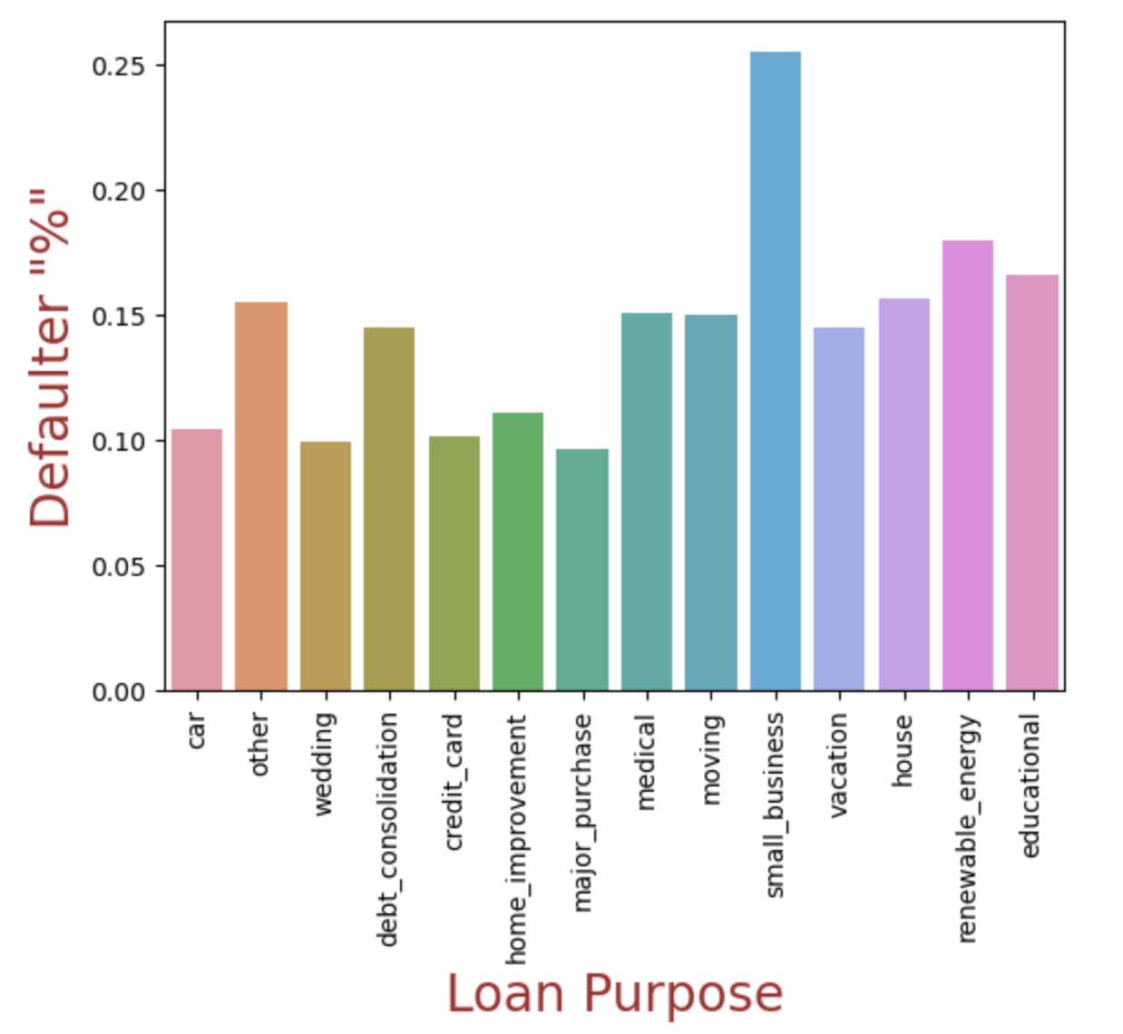
26% customer with purpose “small business” are Defaulters

Slide 14
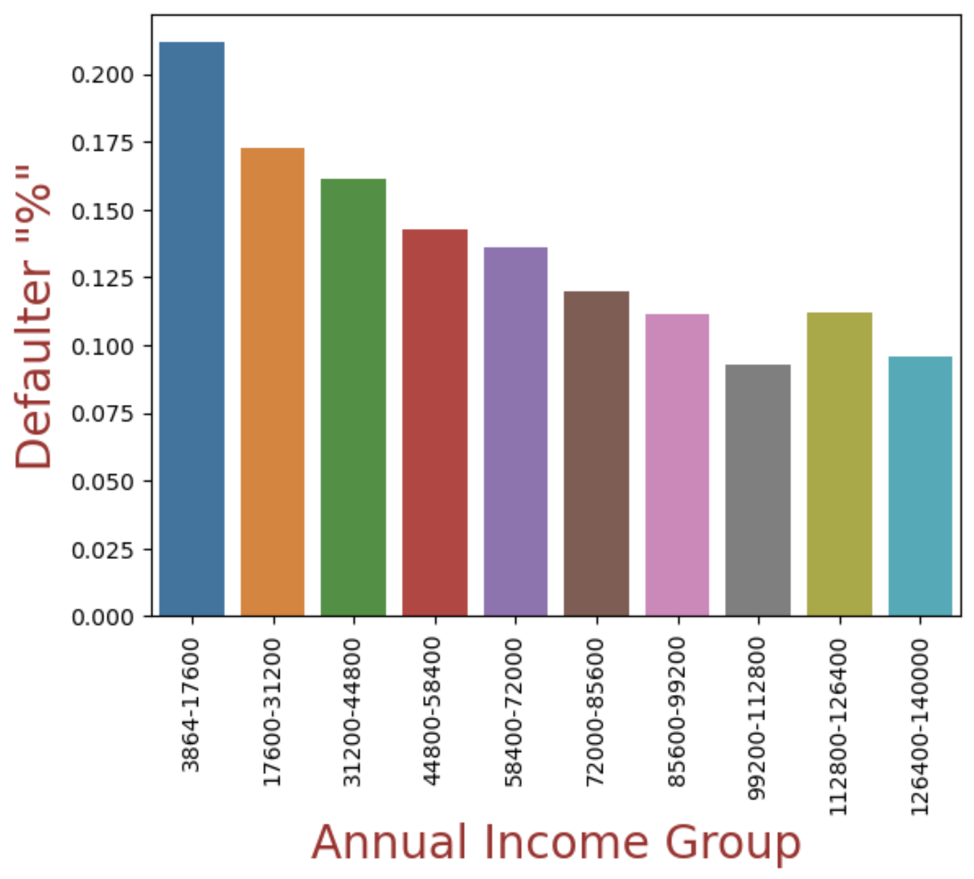
% Defaulter decreasing with Customer Annual Income

Slide 15
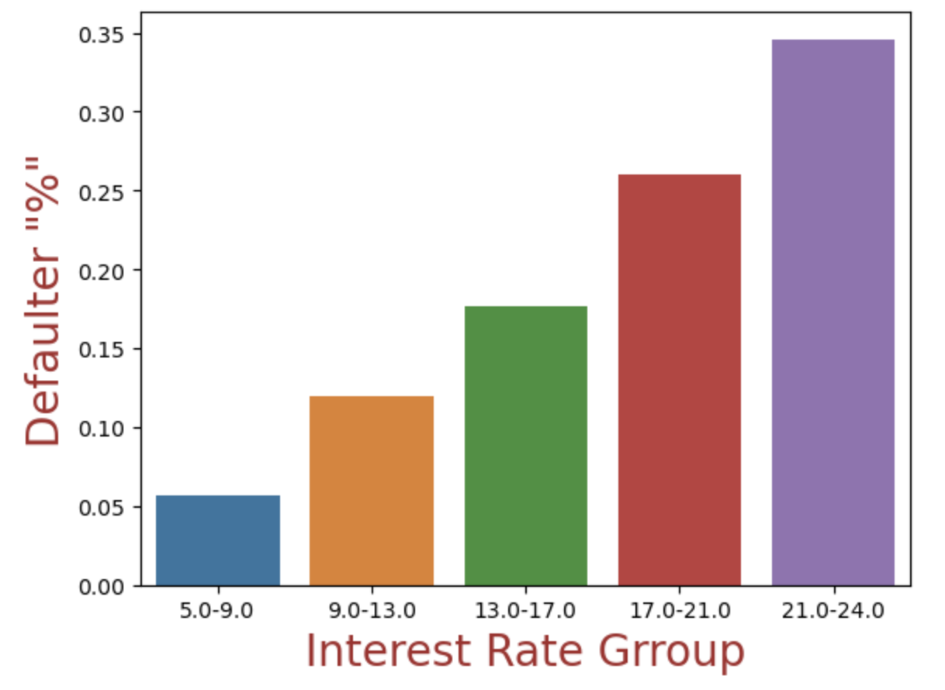
Loans with higher interest rate are more likely to default

Slide 16
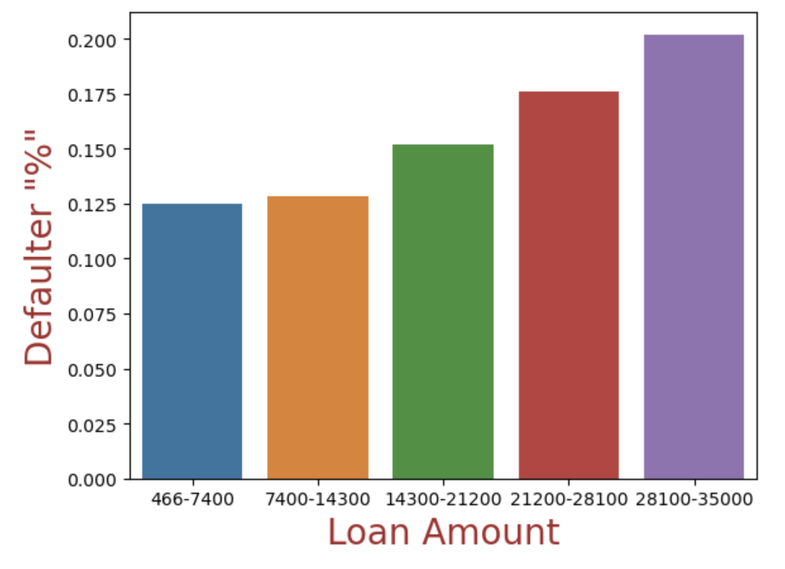
% Defaulters is increasing with Loan Amount

Slide 17
Conclusion
Defaulter percentage is negatively correlated with loan grade, as default rate increases with decreasing grade rank
26% of the customers with the purpose “small business” are defaulters, followed by “renewal energy” and “educational”
Lower income groups tend to default more as with increasing annual income of customers default rate is decreasing
Loans with higher interest rates are more likely to default
Loans with higher loan amounts are more likely to default
27% of loans with long-term (60 months) defaulted

Slide 18
Bivariate Analysis Result

Slide 19
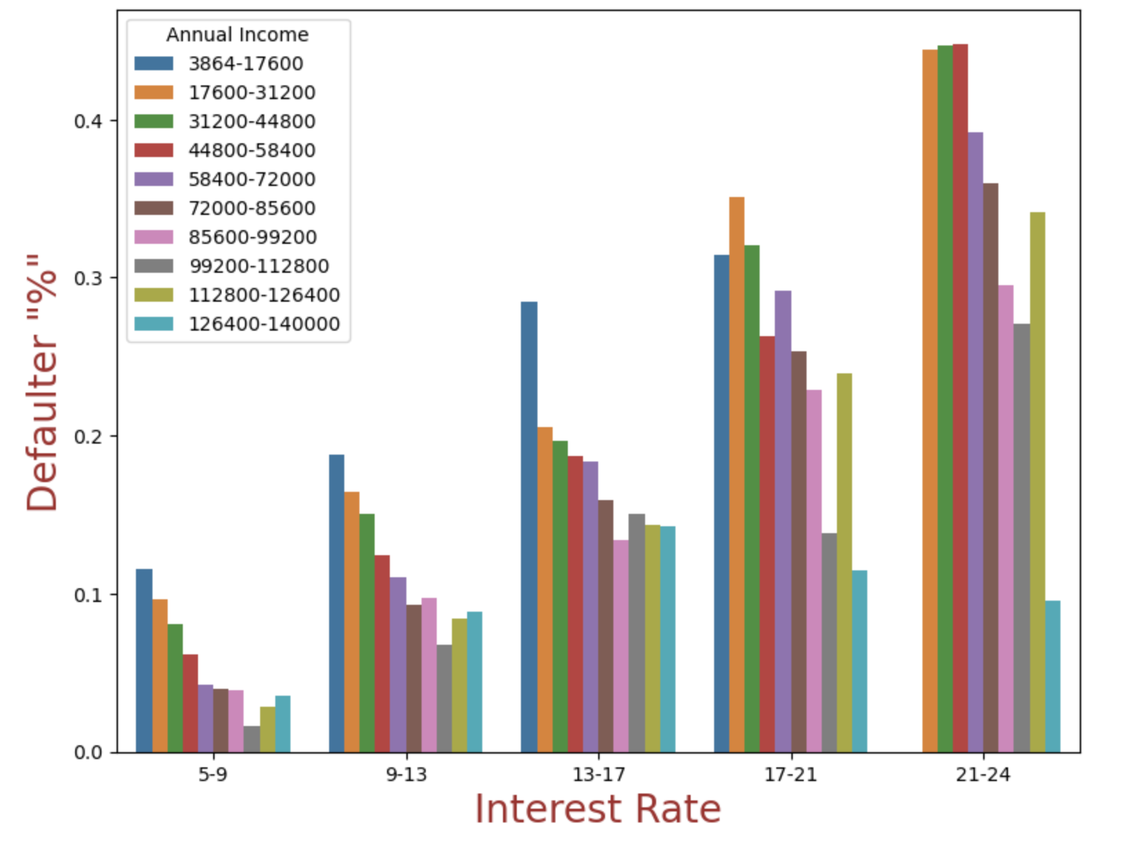
Analysis of Defaulters based on Interest Rate and Annual Income
Conclusion: With increasing interest rate, loans are defaulting more in case of lower income group customers
Notes:
Give with lower interest rate to lower income group customer

Slide 20
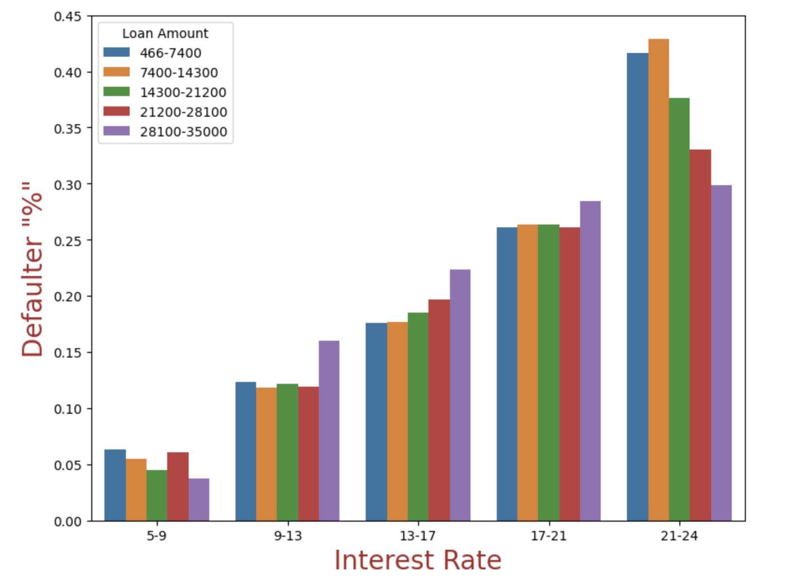
Analysis of Defaulters based on Loan Amount and Interest Rate
Conclusion: For higher interest rate, defaulter percentage is increasing in all the loam amount group

Slide 21
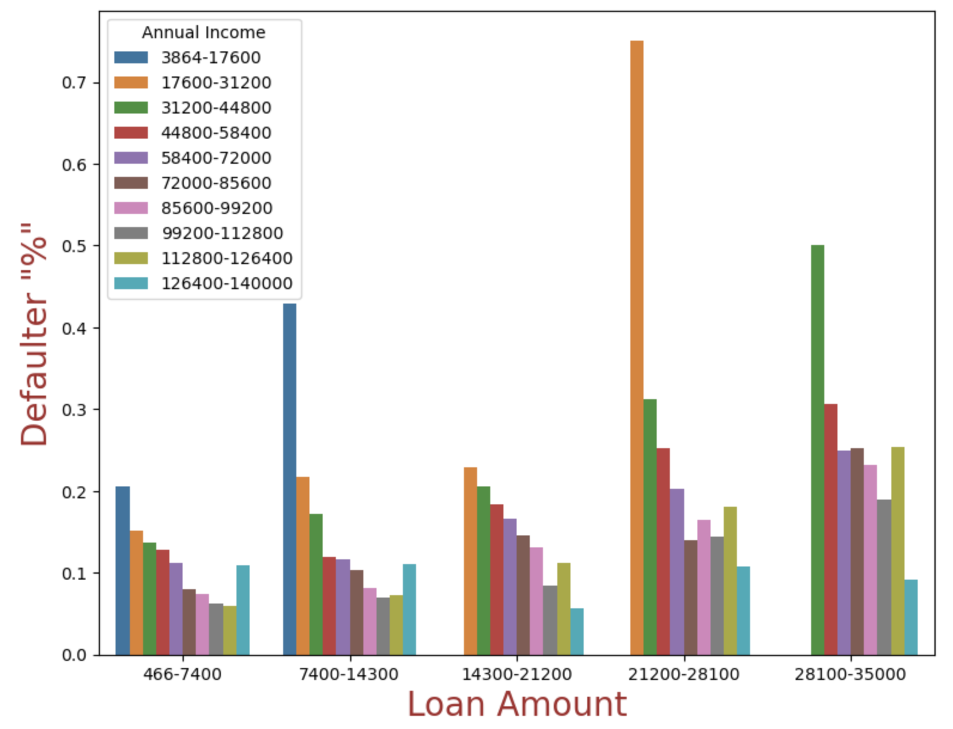
Analysis of Defaulters based on Loan Amount and Annual Income
Conclusion: With increasing loan amount, loans are defaulting more in case of lower income group customers

Slide 22
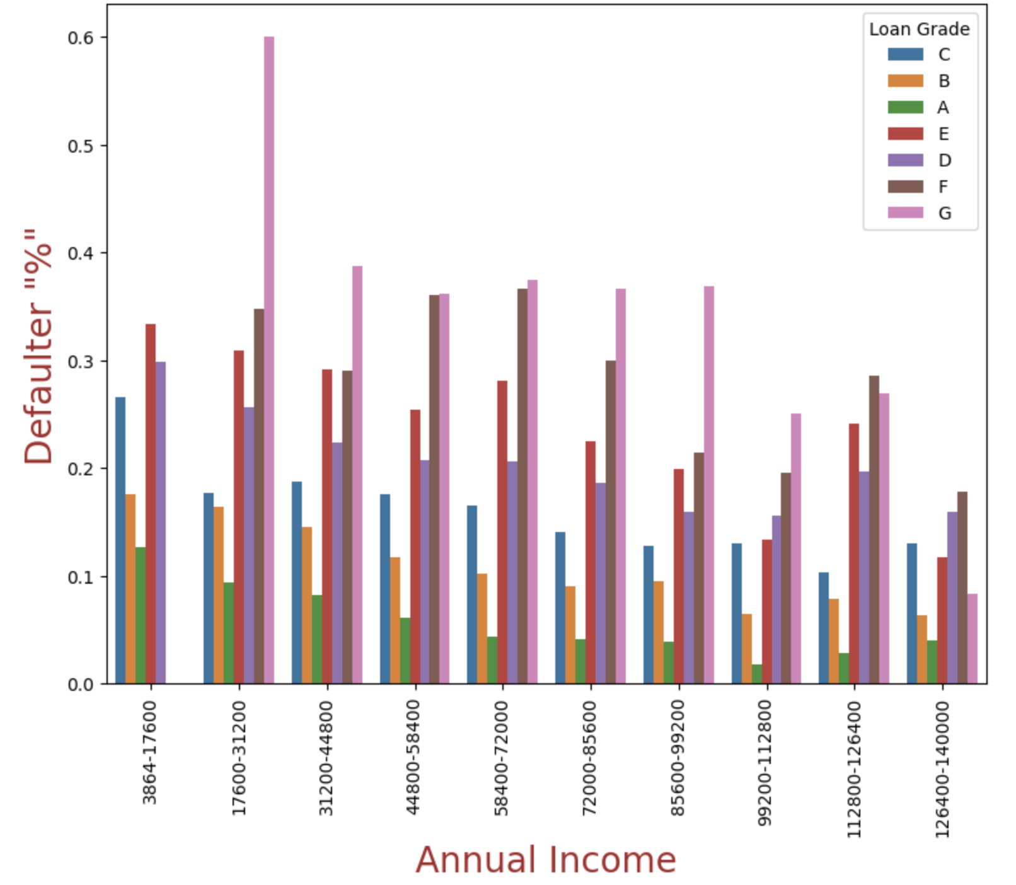
Analysis of Defaulters based on Loan Amount and Grade
Conclusion: For lower annual income group, loans are defaulting more in-case of poor grade
customers

Slide 23
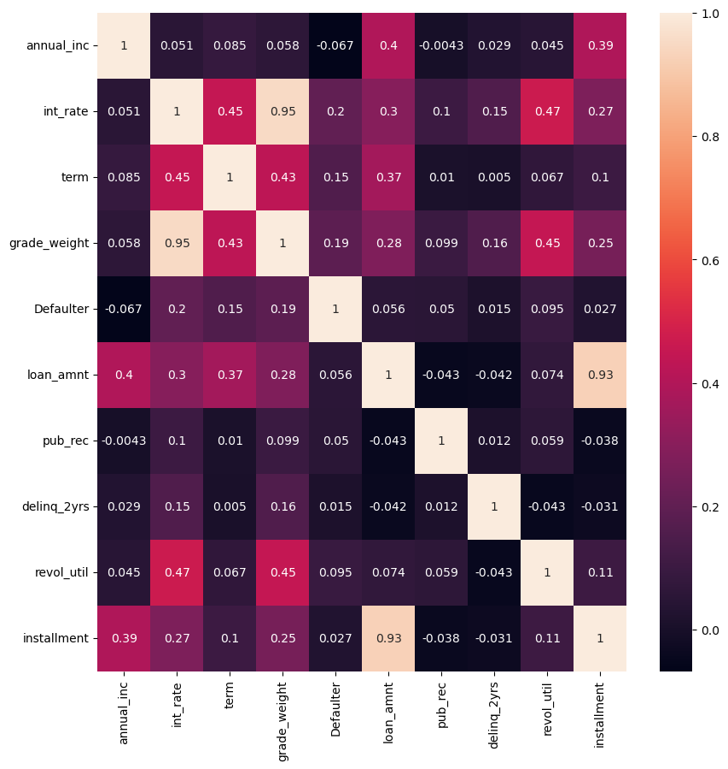
Correlation of continuous variables

Slide 24
Conclusion
With increasing interest rate loans are defaulting more in case of lower income group customers
For higher interest rate, defaulter percentage is increasing in all the loam amount group
With increasing loan amount, loans are defaulting more in case of lower income group customers
For lower annual income group, loans are defaulting more in-case of poor grade customers
With descending Grade rank, “Other” type of home ownership are defaulting more
Driving factors behind loan defaults are: Lower annual income, high loan amount, high interest rate, poor grade of customer, long term plan, higher revolving line utilization
Heatmap Correlation:
Defaulters are negatively correlated with annual income and positively correlated with other attributes
Defaulters are highly correlated with Interest Rate, Term, Grade

Slide 25
Recommendations:
For lower annual income group with bad grade rank reduce the loan amount as increasing percentage will not help in defaulter percentage reduction.
Higher loan amount should be approved for higher income salary group having good grade rank.
Keep loan term lesser as there is more chances of loans getting defaulted for long terms.
Driving factors behind loan defaults are: Lower annual income, high loan amount, high interest rate, poor letter of credit loan grade of customer, long term plan, higher revolving line utilization ask correct data from customer and analyze before loan approval to keep business in profit.

