Slide 1



Looking for somewhere to go?
your AI-Powered Riyadh Place Recommendation Assistant
Reema Almutawa
Fatimah Alqahtani
Alanoud Alotaibi
Find. choose. Explore.
Notes:
Welcome everyone. WAIN — “where to?” in Gulf Arabic — is our final project for the Generative AI course. It turns a single sentence and a budget into the right places in Riyadh.

Slide 2


Agenda
01
Problem & solution
04
Future development
02
How it works
05
The demo
03
Tools & technology
Notes:
Here is what we will cover: the problem and our solution, how it works, the tools and technology we used, a live demo, and finally how we can develop WAIN further.

Slide 3







The problem & our solution
THE PROBLEM
Choosing a place in Riyadh takes too much effort
OUR SOLUTION
Say what you want. Find the right place.
Too many filters
Sidebars and sliders turn a simple question into a form.
WAIN is an AI agent that understands a normal sentence your budget, the kind of place, the time and finds places in Riyadh that fit.
Budget gets ignored
Many apps rank by rating, not by what you want to spend.
Italian dinner, 100 per person
Repetitive results
Repeat a search and the list barely changes.
Notes:
The problem: with so many places in Riyadh, choosing one is tiring. Most apps make you fight with filters, budget per person is rarely the main signal, and repeated searches feel the same. Our solution: an AI agent that understands a normal sentence and finds places that fit.

Slide 4




How it works
STEP 01
STEP 02
STEP 03
STEP 04
Ask
Understand
Search
Recommend
Type one sentence: budget per person, place type, area, rating.
An AI agent turns your sentence into structured intent.
Exact filters on the places database find matches for budget, type and rating
WAIN picks the places that truly match your Preferences.
Notes:
Four steps. One: the user types a sentence. Two: the AI agent extracts the intent. Three: exact filters on our places database find matching places. Four: WAIN recommends the places that truly match the person's budget and taste.

Slide 5






Tools & technology
AI
BUILD
COLLABORATE
OpenAI API
Python
Git
The LLM that understands your sentence
The language behind the whole project
Version control for every change
Streamlit
GitHub
The web app users search in
Shared repository for the team
PostgreSQL
Stores places and runs the filters
Notes:
Our tools: the OpenAI API and LangChain power the AI agent; Python is the language behind the project; Streamlit is the user interface; PostgreSQL stores the places and runs the filters; Git and GitHub let us collaborate on the code.

Slide 6


Future development
What we can build next to make WAIN even better.
Expand WAIN to other Saudi cities
Arabic language support
Notes:
Future development: more cities beyond Riyadh, maps and directions, Arabic language support, and personal profiles that remember budgets and tastes.

Slide 7
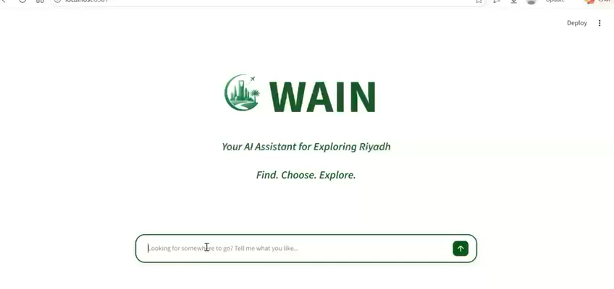
DEMO
Let’s try it.
Notes:
Live demo. Type a sentence like “I want sushi” or “I want shawarma” to show cuisine-specific results, tap a result’s neighborhood to open it directly in Google Maps, then search again to show that fresh options appear.

Slide 8


Thank you
Meet The Team
Any Questions?
Notes:
Thank you for listening. We are happy to take questions.

