Slide 1
Data for Good Hackathon
Team 19
Ting Xu, Reema Yadav, Yutong Wu, Michael Wieck-Sosa, Lavanya Velagala
Notes:
Hi everyone, my name is and I am from team 19.

Slide 2
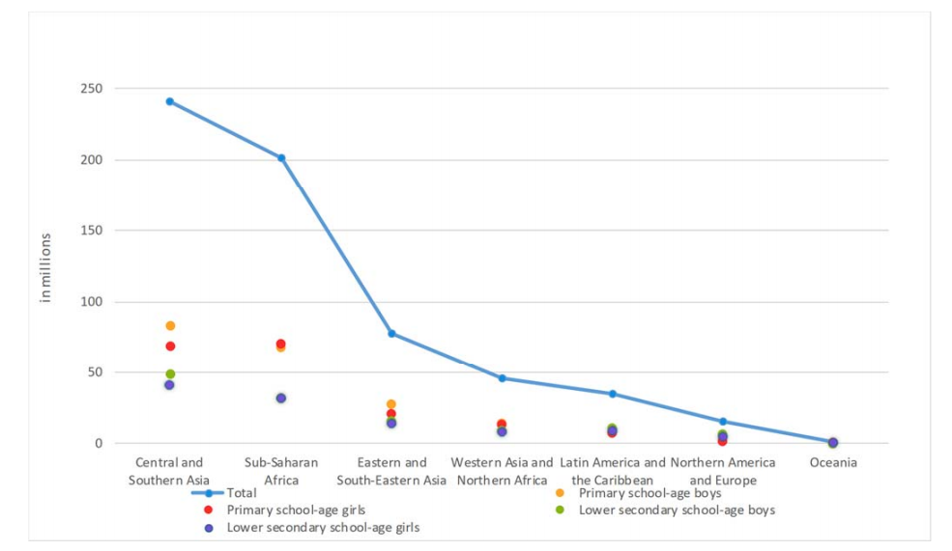
Inclusive & equitable quality education is still a
globally problem
Age group
Region
Sex
UNESCO. More Than One-Half of Children and Adolescents Are Not Learning Worldwide. UNESCO Inst. Stat. 2017, 67 (46), 25.
Notes:
Our team was assigned challenge one, which focus on the sustainable development goal 4.Currently, more than 617 million young people do not receive minimum proficiency levels (MPLs) education.This figure shows the global number such people are influenced by age group, region and sex

Slide 3
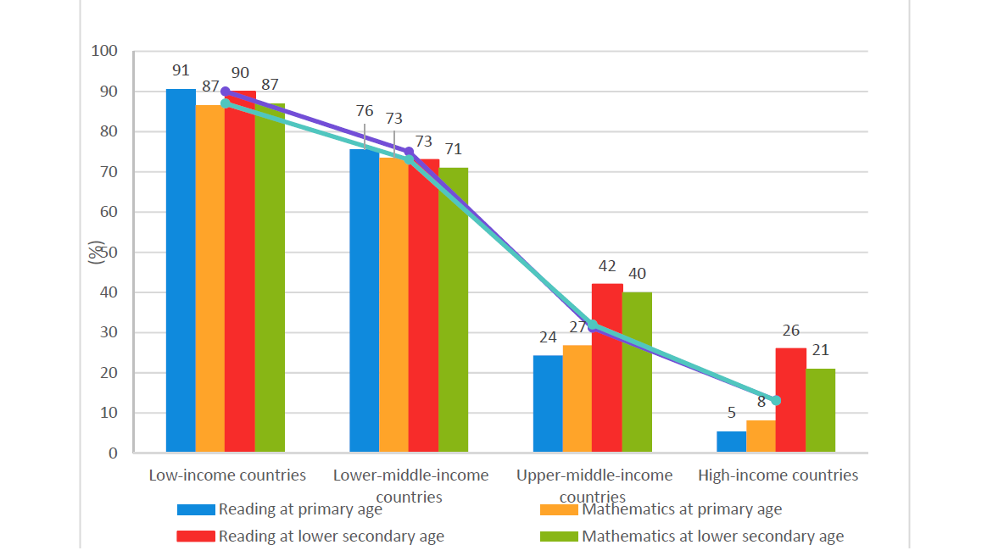
Wealth can also influence knowledge levels
UNESCO. More Than One-Half of Children and Adolescents Are Not Learning Worldwide. UNESCO Inst. Stat. 2017, 67 (46), 25.
Notes:
This figure shows the proportion of young people not achieving MPLs by region and country income. It’s obvious that counties with less income have more children not receiving MPLs. So combining all these information, we realize the demands on promoting inclusive and equitable quality education

Slide 4
Goal: To better understand the current status and predict the inclusive and equitable quality education
Step 1: Data Wrangling
Step 2: Statistical Modeling
Step 3: Prediction
Data cleaning (irrelevant, duplicate,
missing)
Category and format the data structure for next step
Data analysis
Choose input and prediction features
Choose proper models
Train and validate models
Get training and validation results
Make predictions based on the results
Code reference at: https://github.com/dfg2021/team-19
Notes:
We finish the project in three steps. First we did the data wrangling. We clean our data by dropping the irrelevant and duplicate data and fill in the missing data. We then category and format the data structure for next step. Finally we did some data analysis. In step 2, we train and validate the statistical modeling on the data after choosing input and prediction features, proper models. In step 3 we make predictions based on training and validation results.

Slide 5
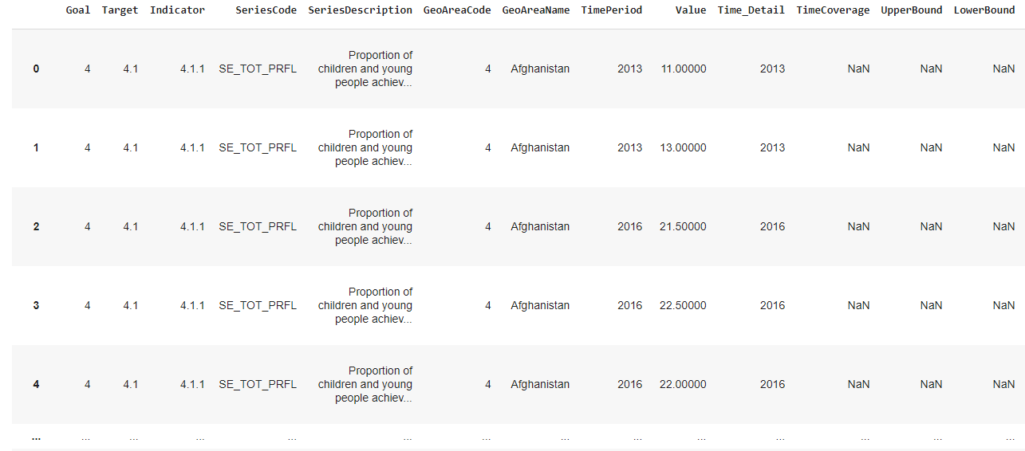
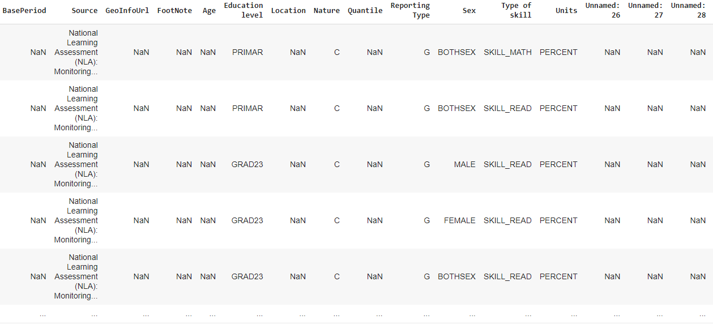
Step 1: Data Wrangling: deleting useless data
Notes:
So real quick to go through our data wrangling process, we find that there are columns with the name of unnamed are all NaN values, so we drop these columns. We also drop columns such as Footnote since they are either all NaN or all the same which is irrelevant to predicition

Slide 6
Step 1: Data Wrangling: select useful data
Notes:
After dropping the irrelevant data, we are able to select all the columns we need. Michael will go through the data cleaning part soon

Slide 7
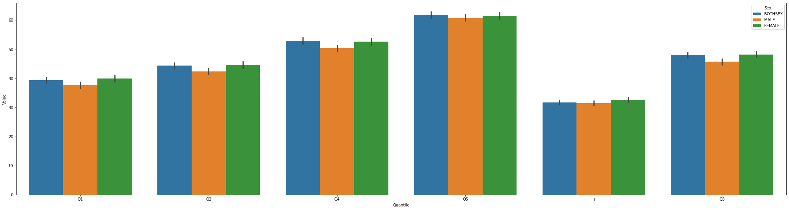

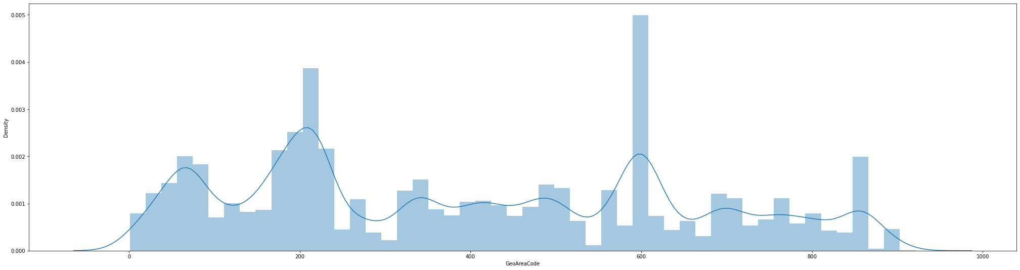
Step 1: Exploratory Data Analysis about Wealth & Location
Value
Quantile (Wealth)
Density
GeoArea Code
Notes:
Then we visualize some of the key features for analysis. The top figure shows the value based on wealth and sex group. We can find that wealth has an obvious influence on the value, however, the sex group has less. The bottom figure shows that the value from different region varies a lot Both of the figures correlate well with the background info.

Slide 8
Step 1: Preliminary imputation of missing data
Impute [Age] based on the education level using an assumption about the ages in school
For countries with mostly the same values for [Location], [Sex], and [Education Level], we did a preliminary imputation by using the mode based on the country and indicator features…
This assumption may not hold without knowing more about the data collection process, so we did not include this in our model
Notes:
MICHAEL

Slide 9
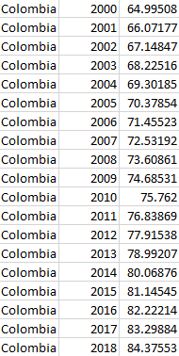
Step 1: Structuring data
Tricky thing about this dataset, different rows of “value” column mean different things (different distributions) and have different units (ratio vs. percentage units)
New structure (see image): Each country, each year (2000-2019), and constructed 20 features with combinations of sex, type of skill, and education level (if we had more time, use external data so not to violate OLS assumption of no perfect multi-collinearity which we tried to avoid by only looking at male and female instead of both sexes, etc)
+19 other features, combinations of sex, type of skill, education level
Notes:
MICHAEL
'BOTHSEX.SKILL_READ.GRAD23', 'BOTHSEX.SKILL_READ.LOWSEC',
'FEMALE.SKILL_MATH.GRAD23', 'FEMALE.SKILL_MATH.LOWSEC',
'MALE.SKILL_MATH.GRAD23', 'BOTHSEX.SKILL_MATH.PRIMAR',
'MALE.SKILL_READ.GRAD23', 'MALE.SKILL_MATH.LOWSEC',
'FEMALE.SKILL_READ.LOWSEC', 'BOTHSEX.SKILL_READ.PRIMAR',
'FEMALE.SKILL_READ.GRAD23', 'BOTHSEX.SKILL_MATH.LOWSEC',
'MALE.SKILL_READ.PRIMAR', 'FEMALE.SKILL_READ.PRIMAR',
'BOTHSEX.SKILL_MATH.GRAD23', 'MALE.SKILL_MATH.PRIMAR',
'MALE.SKILL_READ.LOWSEC', 'FEMALE.SKILL_MATH.PRIMAR'

Slide 10
Step 1: Structuring data
Multivariate Imputation
Used KNN with k = 2 for imputation of missing values in structured data
Linear Interpolation
Some countries only had 2 observations (e.g. 2006, 2013)
Used linear interpolation to get the average change to impute the values for each year 2000-2018
Notes:
MICHAEL
'BOTHSEX.SKILL_READ.GRAD23', 'BOTHSEX.SKILL_READ.LOWSEC',
'FEMALE.SKILL_MATH.GRAD23', 'FEMALE.SKILL_MATH.LOWSEC',
'MALE.SKILL_MATH.GRAD23', 'BOTHSEX.SKILL_MATH.PRIMAR',
'MALE.SKILL_READ.GRAD23', 'MALE.SKILL_MATH.LOWSEC',
'FEMALE.SKILL_READ.LOWSEC', 'BOTHSEX.SKILL_READ.PRIMAR',
'FEMALE.SKILL_READ.GRAD23', 'BOTHSEX.SKILL_MATH.LOWSEC',
'MALE.SKILL_READ.PRIMAR', 'FEMALE.SKILL_READ.PRIMAR',
'BOTHSEX.SKILL_MATH.GRAD23', 'MALE.SKILL_MATH.PRIMAR',
'MALE.SKILL_READ.LOWSEC', 'FEMALE.SKILL_MATH.PRIMAR'

Slide 11
Step 2: Statistical Time-Series Modeling
Input features
Model selection
The combination of all 5 original feature subjects (sex, location, education level, skill type, and quantile) results in 10,000+ combinations for features, this is way too high given our time, and some features would violate the assumption of OLS of no perfect multi-colinearity.
Solution: choose combinations of Sex, skill, Education level so there are only 20 features
Vector autoregression VAR(1), “minimized” AIC and BIC for model selection (though not comprehensively because of time limit)
Reason: Uses lags of features, an interpretable model, multiple target features, able to use AIC and BIC (+ penalty for complexity - likelihood), autocorrelation functions, impulse response, etc
Time series analysis and time series cross validation and metrics
Notes:
MICHAEL - Considering all combinations of sex, type of skill, education level, quantile, location results in 10,000+ features
We are considering the combinations of sex, type of skill, education level to simplify our analysis, resulting on 20 features
Add stuff on time series analysis and time series cross validation and metrics and we will put in the results later

Slide 12
Can make models for each country, but in the interest of time… we will give an example of our forecasts for Colombia.

Slide 13
VAR(1) Model for Colombia
No. of Equations: 17.0000 BIC: -1063.63
Nobs: 18.0000 HQIC: -1076.27
Log likelihood: 10096.7 AIC: -1078.84
Notes:
MICHAEL

Slide 14
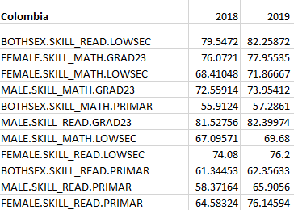
2019 Forecasts for Colombia (features in percentage unit) using data from 2000-2018
Notes:
MICHAEL

Slide 15
Future Steps
Add external data sets such as the World Factsheet (socioeconomic data each country/year)
Do more comprehensive imputation
Use spline instead of linear interpolation
Possibly choose a better predictor regression model (though not as interpretable, which we think is essential for socioeconomic data)
Optimize parameters with time-series cross-validation instead of just AIC, BIC
How should the COVID-19 regime shift / anomaly year affect our forecasts?

Slide 16
Summary:
We did the data cleaning based on the features we will use in our model, and fill in the missing data based on KNN imputation.
We structured the data to have each country, each year (2000-2018), with 20 features
VAR(1) was selected to fit the data and for the time series analysis
We conclude that all of the features across sex, type of skill, and education level will increase in 2019 (see previous slides for forecasts)
Notes:
MICHAEL

