Slide 1

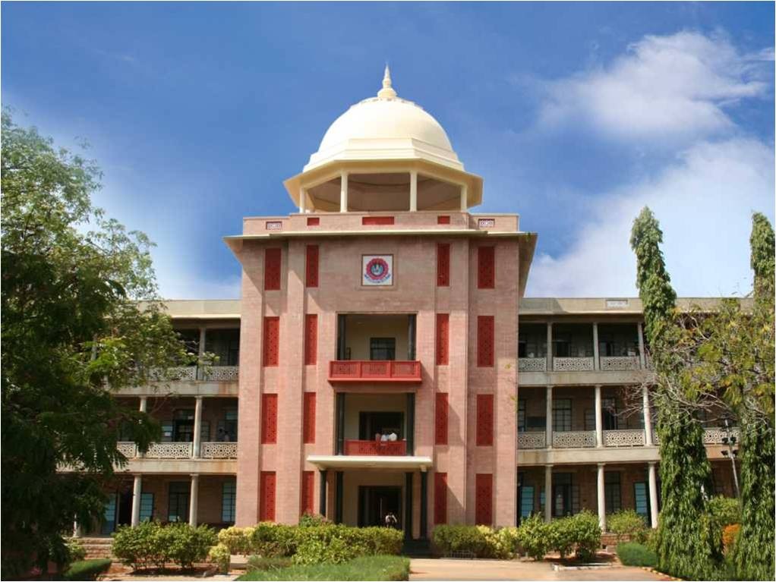
A Federated Learning Framework for Explainable and Privacy-Preserving Intrusion Detection in Battery Management Systems
THIAGARAJAR COLLEGE OF ENGINEERING, MADURAI-15
(A Govt. Aided Autonomous Institution affiliated to Anna University)
- where quality and ethics matter
Reema Afrin N (2503917762222026)
Lakshitha A (2503917762222019)
Type of the project: Research
Department of Computer Applications
1

Slide 2
Research area identified
Research area: Cybersecurity – Federated Learning for IoT/BLE(Bluetooth Low Energy)-based device security
BMS Security + Federated Learning + Privacy Protection + Explainable AI
Specific research area: Privacy-preserving intrusion detection for Battery Management Systems(BMS), motivated by recent unauthorized-access incidents on Bluetooth-enabled EV battery packs in India
Department of Computer Applications
2
Notes:
2

Slide 3
Problem Statement
Some BLE(Bluetooth Low Energy)-enabled BMS(Battery Management systems) used in low-cost Electric Vehicles have been reported with weak or default authentication, allowing unauthorized users within Bluetooth range to access critical functions, letting anyone nearby disable or hijack the battery, as seen in recent e-rickshaw hacking incidents in India. Centralized intrusion detection would require fleet operators to share raw data, which conflicts with the DPDP(Digital Personal Data Protection Act) Act and GDPR(General Data Protection Regulation). Fleet operators and e-vehicle manufacturers need a way to detect such unauthorized access collaboratively, without exposing their raw operational data.
Department of Computer Applications
3

Slide 4
Objectives
To design a federated learning architecture that simulates multiple decentralized fleet-operator clients for BMS intrusion detection.
To implement a lightweight intrusion-detection model for identifying anomalous network behaviour relevant to BLE-enabled BMS environments.
To evaluate centralized, local and federated models using accuracy, precision, recall and F1-score while analyzing data-locality and privacy trade-offs.
To integrate Explainable AI using SHAP to identify the features contributing to intrusion-detection decisions and improve operator understanding.
Department of Computer Applications
4

Slide 5
Tools and Technologies used
Python (Pandas, Scikit-learn) – dataset preprocessing and the local intrusion-detection classifier
Flower (flwr) framework – simulating federated clients and FedAvg aggregation
MERN Stack (MongoDB, Express.js, React.js, Node.js) – web dashboard to display fleet-wise intrusion alerts
Public IoT intrusion datasets – CICIoT2023 / N-BaIoT (used as a proxy for BMS network traffic)
SHAP – Explainable AI and feature contribution analysis
GitHub – version control and collaboration between team members
Department of Computer Applications
5

Slide 6
Literature survey (5 Recent Papers)
Title of the paper | Journal name and year of publication | Q1/Q2/Q3/Q4 | Inference of the paper (bulleted points)
FL-IDS: Federated Learning-Based Intrusion Detection in IoT Networks — Performance Evaluation and Data Scaling Study | Journal of Sensor and Actuator Networks (JSAN), 2025, 14(4), 78 | Q2 | Used Federated Learning for intrusion detection in IoT networks. Tested DNN, CNN and BiLSTM models. Used the CICIoT2023 dataset with many FL clients. Studied how increasing the number of clients and data size affects performance. Found that CNN gives a good balance between accuracy and computation. Shows that FL can be used for large-scale IoT intrusion detection. Relation to our project: We also use CICIoT2023 and multiple simulated fleet clients..
Privacy-Preserving Federated Learning for Intrusion Detection in IoT Environments: A Survey | Journal: IEEE Access, Volume 12, 2024, pages 127018–127050 | Q1 | Studied how Federated Learning can protect IoT data privacy. Explained that raw data does not need to be shared with a central server. Discussed privacy techniques such as Differential Privacy and Secure Aggregation. I dentified privacy and security challenges in FL-based IDS. Shows that FL is useful for privacy-preserving intrusion detection. Relation to our project: Our project also keeps BMS/fleet data locally and shares model information instead.
Department of Computer Applications
6

Slide 7
Title of the paper | Journal name and year of publication | Q1/Q2/Q3/Q4 | Inference of the paper (bulleted points)
Robust Intrusion Detection Based on Personalized Federated Learning for IoT Environment | Journal: Computers & Security, Volume 154, July 2025, Article 104442 | Q1 | Focused on the problem of different data distributions among clients. Explained that every IoT client may have different types of network data. Used Personalized Federated Learning to improve detection for different clients. Helps handle Non-IID data between clients. Improves the ability of the IDS to work with different types of IoT devices. Relation to our project: Different EV fleets may produce different BMS data, so this approach can help handle fleet differences.
FD-IDS: Federated Learning with Knowledge Distillation for Intrusion Detection in Non-IID IoT Environments | Journal: Sensors, 2025, 25(14), 4309 | Q2 | Proposed an FL-based IDS for Non-IID IoT data. Combined Federated Learning with Knowledge Distillation. Used FedProx to reduce differences between local and global models. Used N-BaIoT and Edge-IIoT datasets for evaluation. Knowledge Distillation helps local models learn useful information from the global model. Improves intrusion detection when clients have different data. Relation to our project: We use N-BaIoT and multiple fleet clients, so this approach could be useful for improving our model in future.
A Review of Federated Learning Applications in Intrusion Detection Systems(IDS) | Journal: Computer Networks Volume 258 Article 111023 Published February 2025 | Q1 | Reviewed existing research on Federated Learning for Intrusion Detection Systems. Studied different FL architectures, IDS models and datasets. Identified common challenges such as Non-IID data, privacy, communication cost and scalability. Shows that FL can reduce the need to share raw data. Helps identify research gaps in FL-based IDS. Relation to our project: This review helps us identify the gap of applying privacy-preserving FL specifically to EV Battery Management System security.

Slide 8
Module description
Module 1 — Data Preprocessing
Clean CICIoT2023 / N-BaIoT data
Handle missing/duplicate values
Encode attack labels
Feature selection/scaling
Partition data among clients
Module 2 — Client Simulation
Simulate multiple EV fleet clients
Each client gets its own local dataset
Create different/Non-IID data distributions
Module 3 — Local IDS Training
Train Random Forest locally at each client
Raw data stays at the client
Generate local intrusion predictions
Module 4 — Federated Aggregation
Send model parameters/updates instead of raw data
Use FedAvg
Generate the global IDS model
Repeat for multiple communication rounds
Department of Computer Applications
8

Slide 9
Module 5 — Privacy Protection
Keep raw client data local
Apply update clipping
Add Differential Privacy (DP) noise to model updates
Prevent unnecessary exposure of client information
Analyze the privacy–accuracy trade-off
Module 6 — Explainable AI
Use SHAP
Explain individual intrusion predictions
Identify important network features
Generate global feature-importance summaries
Module 7 — Evaluation & Dashboard
Centralized vs Local vs Federated comparison
Accuracy
Precision
Recall
F1-score
Privacy/utility analysis
SHAP explanations
MERN-based intrusion dashboard

Slide 10
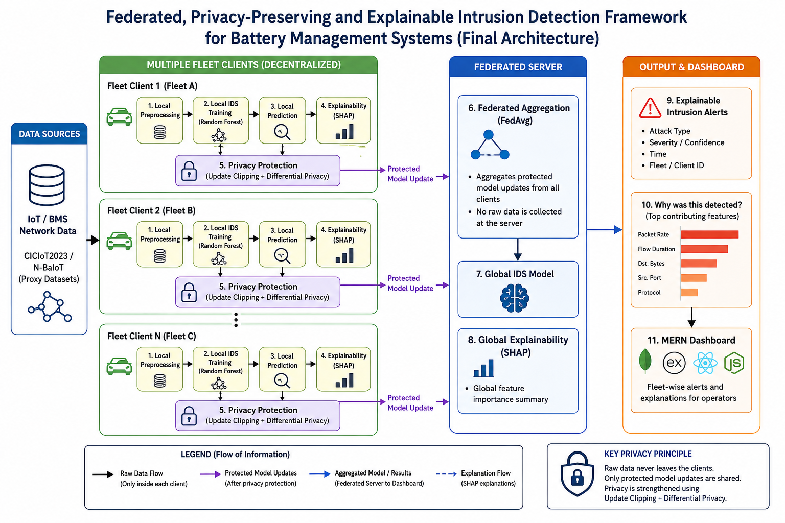
BLOCK DIAGRAM

Slide 11
Expected Outcome
Working Federated IDS Prototype for detecting intrusion in BMS/IoT network traffic.
Privacy-Preserving Training by keeping raw client data local and protecting model updates using update clipping and Differential Privacy.
Explainable Intrusion Detection using SHAP to identify the important features behind each prediction.
Performance Comparison of centralized, local, federated, and privacy-preserving federated models.
Privacy–Utility Analysis to study the effect of privacy protection on detection performance.
Improved Intrusion Detection Transparency by showing why a particular network activity was classified as an attack.
MERN-Based Dashboard displaying fleet-wise intrusion alerts, attack details, and SHAP-based explanations.
Research Findings on the effectiveness, privacy, explainability, and limitations of FL-based IDS for BMS environments.
Department of Computer Applications
11

