Slide 1
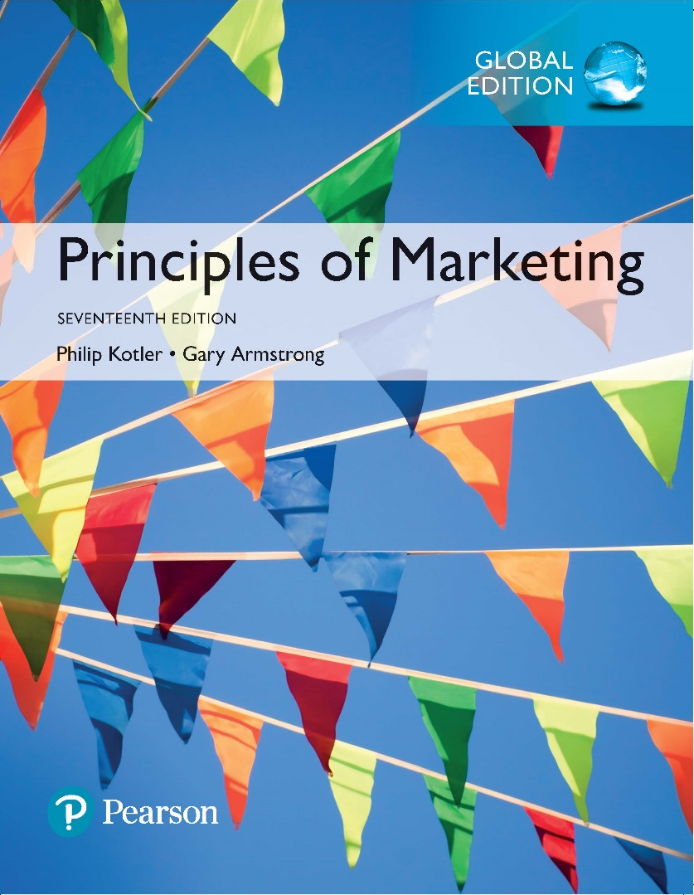
Principles of Marketing Seventeenth Edition
Chapter 12
Marketing Channels: Delivering Customer Value
Copyright © 2018 Pearson Education Ltd. All Rights Reserved.

Slide 2
Learning Objectives
12-1 Explain why companies use marketing channels and discuss the functions these channels perform.
12-2 Discuss how channel members interact and how they organize to perform the work of the channel.
12-3 Identify the major channel alternatives open to a company.
12-4 Explain how companies select, motivate, and evaluate channel members.
12-5 Discuss the nature and importance of marketing logistics and integrated supply chain management.

Slide 3
Learning Objective 1
Explain why companies use marketing channels and discuss the functions these channels perform.
In creating customer value, a company can’t go it alone. It must work within an entire network of partners—a value delivery network—to accomplish this task. Individual companies and brands don’t compete, their entire value delivery networks do. Most producers use intermediaries to bring their products to market.
They forge a marketing channel (or distribution channel)— a set of interdependent organizations involved in the process of making a product or service available for use or consumption by the consumer or business user. Through their contacts, experience, specialization, and scale of operation, intermediaries usually offer the firm more than it can achieve on its own.
Marketing channels perform many key functions. Some help complete transactions by gathering and distributing information needed for planning and aiding exchange, developing and spreading persuasive communications about an offer, performing contact work (finding and communicating with prospective buyers), matching (shaping and fitting the offer to the buyer’s needs), and entering into negotiation to reach an agreement on price and other terms of the offer so that ownership can be transferred. Other functions help to fulfill the completed transactions by offering physical distribution (transporting and storing goods), financing (acquiring and using funds to cover the costs of the channel work), and risk taking (assuming the risks of carrying out the channel work).
Notes:
Discussion Question
Describe how marketing channel members add value in the channel of distribution between manufacturers and consumers.
Learning Objective 1 Summary
In creating customer value, a company can’t go it alone. It must work within an entire network of partners—a value delivery network—to accomplish this task. Individual companies and brands don’t compete, their entire value delivery networks do. Most producers use intermediaries to bring their products to market.
They forge a marketing channel (or distribution channel)— a set of interdependent organizations involved in the process of making a product or service available for use or consumption by the consumer or business user. Through their contacts, experience, specialization, and scale of operation, intermediaries usually offer the firm more than it can achieve on its own.
Marketing channels perform many key functions. Some help complete transactions by gathering and distributing information needed for planning and aiding exchange, developing and spreading persuasive communications about an offer, performing contact work (finding and communicating with prospective buyers), matching (shaping and fitting the offer to the buyer’s needs), and entering into negotiation to reach an agreement on price and other terms of the offer so that ownership can be transferred. Other functions help to fulfill the completed transactions by offering physical distribution (transporting and storing goods), financing (acquiring and using funds to cover the costs of the channel work), and risk taking (assuming the risks of carrying out the channel work).

Slide 4
Supply Chains and Value Delivery Networks
Upstream partners are firms that supply raw materials, components, parts, information, finances, and expertise needed to create a product or service.
Downstream partners include the marketing channels or distribution channels that look toward the customer, including retailers and wholesalers.
Producing a product or service and making it available to buyers requires building relationships not only with customers but also with key suppliers and resellers in the company’s supply chain. This supply chain consists of upstream and downstream partners.
Marketers have traditionally focused on the downstream marketing channel partners, such as wholesalers and retailers, who form a vital link between the firm and its customers.
Notes:
Producing a product or service and making it available to buyers requires building relationships not only with customers but also with key suppliers and resellers in the company’s supply chain. This supply chain consists of upstream and downstream partners.
Marketers have traditionally focused on the downstream marketing channel partners, such as wholesalers and retailers, who form a vital link between the firm and its customers.

Slide 5
Supply Chains and Value Delivery Networks
Supply chain “make and sell” view includes the firm’s raw materials, productive inputs, and factory capacity.
Demand chain “sense and respond” view suggests that planning starts with the needs of the target customer.
The term supply chain may be too limited; a better term would be demand chain because it suggests a sense-and-respond view of the market.
Under this view, planning starts by identifying the needs of target customers, to which the company responds by organizing a chain of resources and activities with the goal of creating customer value.
Notes:
The term supply chain may be too limited; a better term would be demand chain because it suggests a sense-and-respond view of the market.
Under this view, planning starts by identifying the needs of target customers, to which the company responds by organizing a chain of resources and activities with the goal of creating customer value.

Slide 6

Supply Chains and Value Delivery Networks
Value delivery network is composed of the company, suppliers, distributors, and, ultimately, customers who partner with each other to improve the performance of the entire system.
Yet, even a demand chain view of a business may be too limited because it takes a step-by-step, linear view of purchase-production-consumption activities. Instead, most large companies today are engaged in building and managing a complex, continuously evolving value delivery network.
Value delivery network: In making and marketing even just its classic colas, Pepsi manages a huge network of people within the
company plus thousands of outside suppliers, bottlers, retailers, and marketing service firms that must work together to create customer
value and establish the brand’s “Pepsi: Live for Now” positioning.
Notes:
Yet, even a demand chain view of a business may be too limited because it takes a step-by-step, linear view of purchase-production-consumption activities. Instead, most large companies today are engaged in building and managing a complex, continuously evolving value delivery network.
Value delivery network: In making and marketing even just its classic colas, Pepsi manages a huge network of people within the
company plus thousands of outside suppliers, bottlers, retailers, and marketing service firms that must work together to create customer
value and establish the brand’s “Pepsi: Live for Now” positioning.

Slide 7
The Nature and Importance of Marketing Channels
Marketing channel (distribution channel) is a set of interdependent organizations that help make a product or service available for use or consumption by the consumer or business user.
Few producers sell their goods directly to final users. Instead, most use intermediaries to bring their products to market. They try to forge a marketing channel (or distribution channel)—a set of interdependent organizations that help make a product or service available for use or consumption by the consumer or business user.
A company’s channel decisions directly affect every other marketing decision. Pricing depends on whether the company works with national discount chains, uses high-quality specialty stores, or sells directly to consumers online.. Whether a company develops or acquires certain new products may depend on how well those products fit the capabilities of its channel members.
Many companies have used imaginative distribution systems to gain a competitive advantage. Examples include: Enterprise Rent-A-Car revolutionized the car-rental business, Apple selling music for the iPod via the Internet on iTunes and Amazon.com forever changed the face of retailing and became the Walmart of the Internet.
Distribution channel decisions often involve long-term commitments to other firms. Therefore, management must design its channels carefully, with an eye on both today’s likely selling environment and tomorrow’s as well.
Notes:
Few producers sell their goods directly to final users. Instead, most use intermediaries to bring their products to market. They try to forge a marketing channel (or distribution channel)—a set of interdependent organizations that help make a product or service available for use or consumption by the consumer or business user.
A company’s channel decisions directly affect every other marketing decision. Pricing depends on whether the company works with national discount chains, uses high-quality specialty stores, or sells directly to consumers online.. Whether a company develops or acquires certain new products may depend on how well those products fit the capabilities of its channel members.
Many companies have used imaginative distribution systems to gain a competitive advantage. Examples include: Enterprise Rent-A-Car revolutionized the car-rental business, Apple selling music for the iPod via the Internet on iTunes and Amazon.com forever changed the face of retailing and became the Walmart of the Internet.
Distribution channel decisions often involve long-term commitments to other firms. Therefore, management must design its channels carefully, with an eye on both today’s likely selling environment and tomorrow’s as well.

Slide 8
The Nature and Importance of Marketing Channels
How Channel Members Add Value
Transform the assortment of products into assortments wanted by consumers.
Bridge the major time, place, and possession gaps that separate goods and services from users.
Why do producers give some of the selling job to channel partners? After all, doing so means giving up some control over how and to whom they sell their products.
Producers use intermediaries because they create greater efficiency in making goods available to target markets. Through their contacts, experience, specialization, and scale of operation, intermediaries usually offer the firm more than it can achieve on its own.
Notes:
Why do producers give some of the selling job to channel partners? After all, doing so means giving up some control over how and to whom they sell their products.
Producers use intermediaries because they create greater efficiency in making goods available to target markets. Through their contacts, experience, specialization, and scale of operation, intermediaries usually offer the firm more than it can achieve on its own.

Slide 9
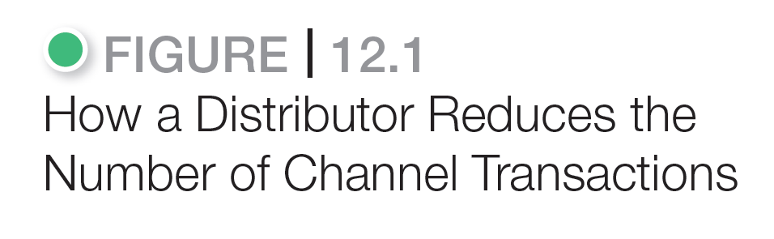
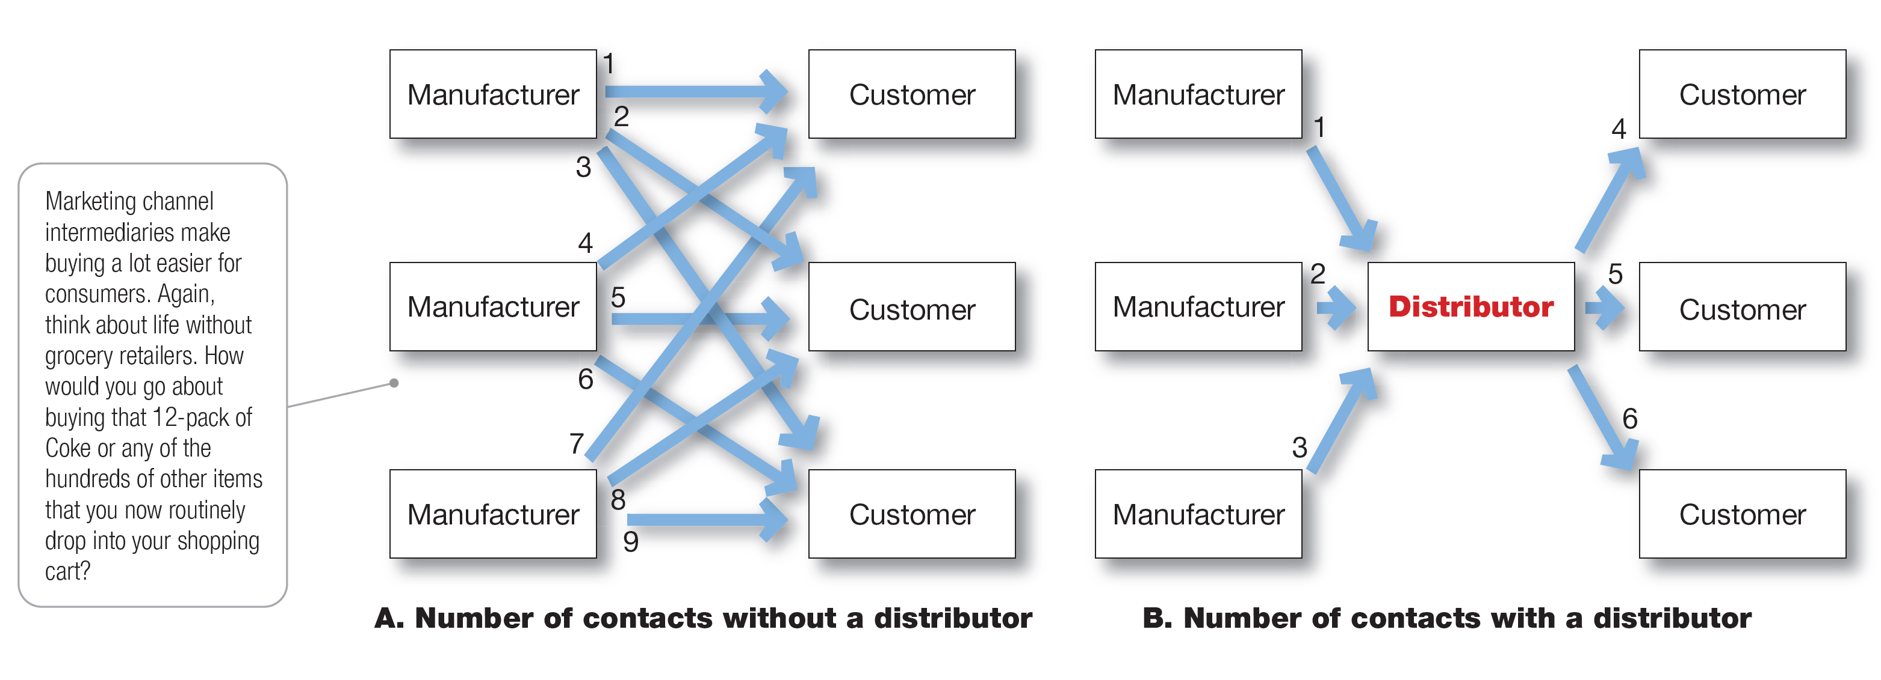
The Nature and Importance of Marketing Channels
Notes:
Figure 12.1 shows how using intermediaries can provide economies. Figure 12.1A shows three manufacturers, each using direct marketing to reach three customers. This system requires nine different contacts. Figure 12.1B shows the three manufacturers working through one distributor, which contacts the three customers. This system requires only six contacts. In this way, intermediaries reduce the amount of work that must be done by both producers and consumers.
From the economic system’s point of view, the role of marketing intermediaries is to transform the assortments of products made by producers into the assortments wanted by consumers. Producers make narrow assortments of products in large quantities, but consumers want broad assortments of products in small quantities. Marketing channel members buy large quantities from many producers and break them down into the smaller quantities and broader assortments desired by consumers.

Slide 10
Figure 12.1 shows how using intermediaries can provide economies. Figure 12.1A shows three manufacturers, each using direct marketing to reach three customers. This system requires nine different contacts. Figure 12.1B shows the three manufacturers working through one distributor, which contacts the three customers. This system requires only six contacts. In this way, intermediaries reduce the amount of work that must be done by both producers and consumers.
From the economic system’s point of view, the role of marketing intermediaries is to transform the assortments of products made by producers into the assortments wanted by consumers. Producers make narrow assortments of products in large quantities, but consumers want broad assortments of products in small quantities. Marketing channel members buy large quantities from many producers and break them down into the smaller quantities and broader assortments desired by consumers.

Slide 11
The Nature and Importance of Marketing Channels
How Channel Members Add Value
Information
Promotion
Contact
Matching
Negotiation
Physical distribution
Financing
Risk taking
Notes:
In making products and services available to consumers, channel members add value by bridging the major time, place, and possession gaps that separate goods and services from those who use them. Members of the marketing channel perform many key functions.
Information: Gathering and distributing marketing research and intelligence information about actors and forces in the marketing environment needed for planning and aiding exchange.
Promotion: Developing and spreading persuasive communications about an offer.
Contact: Finding and communicating with prospective buyers.
Matching: Shaping and fitting the offer to the buyer’s needs, including activities such as manufacturing, grading, assembling, and packaging.
Negotiation: Reaching an agreement on price and other terms of the offer so that ownership or possession can be transferred.
Physical distribution: Transporting and storing goods.
Financing: Acquiring and using funds to cover the costs of the channel work.
Risk taking: Assuming the risks of carrying out the channel work
The question is not whether these functions need to be performed—they must be—but rather who will perform them. To the extent that the manufacturer performs these functions, its costs go up; therefore, its prices must be higher. When some of these functions are shifted to intermediaries, the producer’s costs and prices may be lower, but the intermediaries must charge more to cover the costs of their work. In dividing the work of the channel, the various functions should be assigned to the channel members who can add the most value for the cost.

Slide 12
In making products and services available to consumers, channel members add value by bridging the major time, place, and possession gaps that separate goods and services from those who use them. Members of the marketing channel perform many key functions.
Information: Gathering and distributing marketing research and intelligence information about actors and forces in the marketing environment needed for planning and aiding exchange.
Promotion: Developing and spreading persuasive communications about an offer.
Contact: Finding and communicating with prospective buyers.
Matching: Shaping and fitting the offer to the buyer’s needs, including activities such as manufacturing, grading, assembling, and packaging.
Negotiation: Reaching an agreement on price and other terms of the offer so that ownership or possession can be transferred.
Physical distribution: Transporting and storing goods.
Financing: Acquiring and using funds to cover the costs of the channel work.
Risk taking: Assuming the risks of carrying out the channel work
The question is not whether these functions need to be performed—they must be—but rather who will perform them. To the extent that the manufacturer performs these functions, its costs go up; therefore, its prices must be higher. When some of these functions are shifted to intermediaries, the producer’s costs and prices may be lower, but the intermediaries must charge more to cover the costs of their work. In dividing the work of the channel, the various functions should be assigned to the channel members who can add the most value for the cost.

Slide 13
The Nature and Importance of Marketing Channels
Number of Channel Levels
Channel level is a layer of intermediaries that performs some work in bringing the product and its ownership closer to the final buyer.
Direct marketing channel is a marketing channel that has no intermediary levels.
Indirect marketing channel is a marketing channel containing one or more intermediary levels.
The definitions of each term here can be explained in conjunction with the illustration in Figure 12.2, Consumer and Business Marketing Channels.
Notes:
The definitions of each term here can be explained in conjunction with the illustration in Figure 12.2, Consumer and Business Marketing Channels.

Slide 14
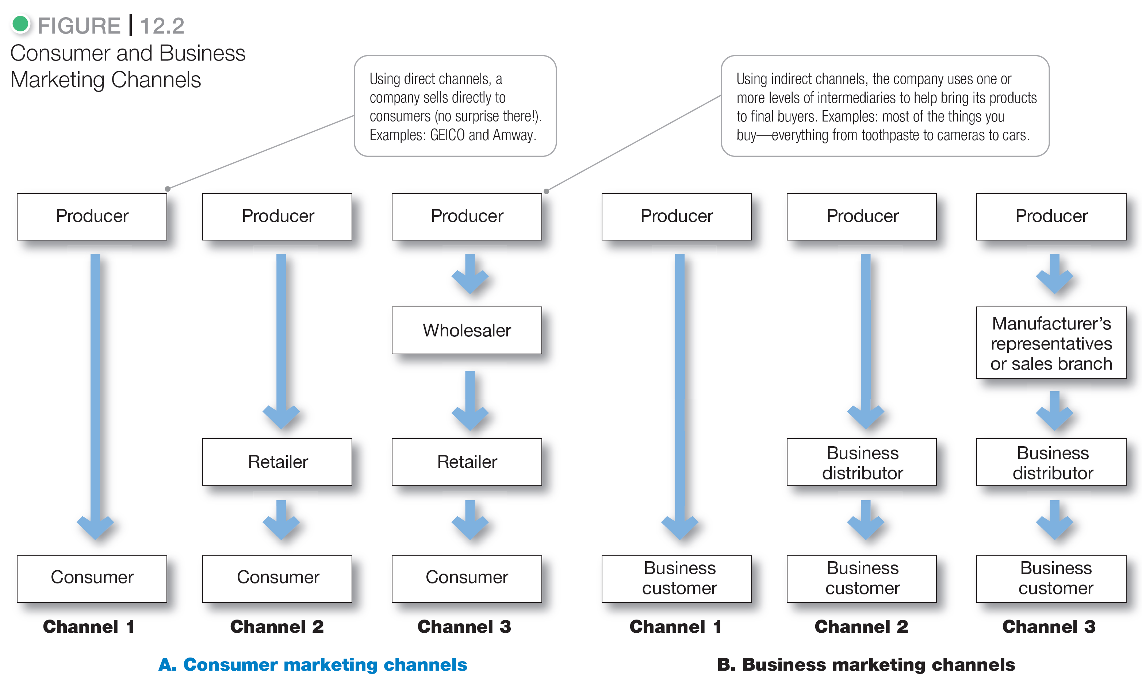
The Nature and Importance of Marketing Channels
Notes:
Companies can design their distribution channels to make products and services available to customers in different ways. Each layer of marketing intermediaries that performs some work in bringing the product and its ownership closer to the final buyer is a channel level. Because both the producer and the final consumer perform some work, they are part of every channel.
The number of intermediary levels indicates the length of a channel. Figure 12.2 shows both consumer and business channels of different lengths. Figure 12.2A shows several common consumer distribution channels. Channel 1, called a direct marketing channel, has no intermediary levels. The remaining channels in Figure 12.2A are indirect marketing channels, containing one or more intermediaries.
Figure 12.2B shows some common business distribution channels. The business marketer can use its own sales force to sell directly to business customers. Or it can sell to various types of intermediaries, who in turn sell to these customers.
Although consumer and business marketing channels with even more levels can sometimes be found, these are less common. From the producer’s point of view, a greater number of levels means less control and greater channel complexity.

Slide 15
Companies can design their distribution channels to make products and services available to customers in different ways. Each layer of marketing intermediaries that performs some work in bringing the product and its ownership closer to the final buyer is a channel level. Because both the producer and the final consumer perform some work, they are part of every channel.
The number of intermediary levels indicates the length of a channel. Figure 12.2 shows both consumer and business channels of different lengths. Figure 12.2A shows several common consumer distribution channels. Channel 1, called a direct marketing channel, has no intermediary levels. The remaining channels in Figure 12.2A are indirect marketing channels, containing one or more intermediaries.
Figure 12.2B shows some common business distribution channels. The business marketer can use its own sales force to sell directly to business customers. Or it can sell to various types of intermediaries, who in turn sell to these customers.
Although consumer and business marketing channels with even more levels can sometimes be found, these are less common. From the producer’s point of view, a greater number of levels means less control and greater channel complexity.

Slide 16
The Nature and Importance of Marketing Channels
Number of Channel Levels
Channel members are connected by several types of flows:
Physical flow of products
Flow of ownership
Payment flow
Information flow
Promotion flow
All the institutions in the channel are connected by several types of flows. These flows can make even channels with only one or a few levels very complex.
Notes:
All the institutions in the channel are connected by several types of flows. These flows can make even channels with only one or a few levels very complex.

Slide 17
Learning Objective 3
Identify the major channel alternatives open to a company.
Channel alternatives vary from direct selling to using one, two, three, or more intermediary channel levels. Marketing channels face continuous and sometimes dramatic change. Three of the most important trends are the growth of vertical, horizontal, and multichannel marketing systems. These trends affect channel cooperation, conflict, and competition. Channel design begins with assessing customer channel service needs and company channel objectives and constraints. The company then identifies the major channel alternatives in terms of the types of intermediaries, the number of intermediaries, and the channel responsibilities of each. Each channel alternative must be evaluated according to economic, control, and adaptive criteria. Channel management calls for selecting qualified intermediaries and motivating them. Individual channel members must be evaluated regularly.
Notes:
Discussion Question
Provide an example of a vertical, horizontal, or multichannel marketing system.
Learning Objective 3 Summary
Channel alternatives vary from direct selling to using one, two, three, or more intermediary channel levels. Marketing channels face continuous and sometimes dramatic change. Three of the most important trends are the growth of vertical, horizontal, and multichannel marketing systems. These trends affect channel cooperation, conflict, and competition. Channel design begins with assessing customer channel service needs and company channel objectives and constraints. The company then identifies the major channel alternatives in terms of the types of intermediaries, the number of intermediaries, and the channel responsibilities of each. Each channel alternative must be evaluated according to economic, control, and adaptive criteria. Channel management calls for selecting qualified intermediaries and motivating them. Individual channel members must be evaluated regularly.

Slide 18
Channel Design Decisions
Marketing channel design
Designing effective marketing channels by analyzing customer needs, setting channel objectives, identifying major channel alternatives, and evaluating those alternatives.
For maximum effectiveness, channel analysis and decision making should be purposeful. This requires marketing channel design.
Notes:
For maximum effectiveness, channel analysis and decision making should be purposeful. This requires marketing channel design.

Slide 19
Channel Design Decisions
We now look at several channel design decisions manufacturers face. In designing marketing channels, manufacturers struggle between what is ideal and what is practical.
A new firm with limited capital usually starts by selling in a limited market area. In this case, the problem is not deciding on the best channels but how to convince one or a few good intermediaries to handle the line.
If successful, the new firm can branch out to new markets through existing intermediaries. In smaller markets, the firm might sell directly to retailers; in larger markets, it might sell through distributors. In one part of the country, it might grant exclusive franchises; in another, it might sell through all available outlets. Then it might add an Internet store that sells directly to hard-to-reach customers. In this way, channel systems often evolve to meet market opportunities and conditions.
Analyzing consumer needs
Setting channel objectives
Identifying channel alternatives
Evaluating channel alternatives
Notes:
We now look at several channel design decisions manufacturers face. In designing marketing channels, manufacturers struggle between what is ideal and what is practical.
A new firm with limited capital usually starts by selling in a limited market area. In this case, the problem is not deciding on the best channels but how to convince one or a few good intermediaries to handle the line.
If successful, the new firm can branch out to new markets through existing intermediaries. In smaller markets, the firm might sell directly to retailers; in larger markets, it might sell through distributors. In one part of the country, it might grant exclusive franchises; in another, it might sell through all available outlets. Then it might add an Internet store that sells directly to hard-to-reach customers. In this way, channel systems often evolve to meet market opportunities and conditions.

Slide 20
Channel Design Decisions
Analyzing Consumer Needs
Find out what target consumers want from the channel
Identify market segments
Determine the best channels to use
Minimize the cost of meeting customer service requirements
Usually, a company can identify several segments wanting different levels of service. The company should decide which segments to serve and the best channels to use in each case. In each segment, the company wants to minimize the total channel cost of meeting customer service requirements.
Providing the fastest delivery, the greatest assortment, and the most services may not be possible, practical, or desired. The company and its channel members may not have the resources or skills needed to provide all the desired services. Also, providing higher levels of service results in higher costs for the channel and higher prices for consumers. The success of modern discount retailing shows that consumers will often accept lower service levels in exchange for lower prices.
Notes:
Usually, a company can identify several segments wanting different levels of service. The company should decide which segments to serve and the best channels to use in each case. In each segment, the company wants to minimize the total channel cost of meeting customer service requirements.
Providing the fastest delivery, the greatest assortment, and the most services may not be possible, practical, or desired. The company and its channel members may not have the resources or skills needed to provide all the desired services. Also, providing higher levels of service results in higher costs for the channel and higher prices for consumers. The success of modern discount retailing shows that consumers will often accept lower service levels in exchange for lower prices.

Slide 21
Channel Design Decisions
Setting Channel Objectives
Determine targeted levels of customer service
Balance consumer needs against costs and customer price preferences
The company’s channel objectives are influenced by the nature of the company, its products, its marketing intermediaries, its competitors, and the environment.
To determine targeted levels of customer service, companies must answer the following questions: Do consumers want to buy from nearby locations or are they willing to travel to more distant and centralized locations? Would customers rather buy in person, by phone, or online? Do they value breadth of assortment or do they prefer specialization? Do consumers want many add-on services (delivery, installation, repairs), or will they obtain these services elsewhere?
For example, the company’s size and financial situation determine which marketing functions it can handle itself and which it must give to intermediaries. In some cases, a company may want to compete in or near the same outlets that carry competitors’ products.
Finally, environmental factors such as economic conditions and legal constraints may affect channel objectives and design. For example, in a depressed economy, producers will want to distribute their goods in the most economical way, using shorter channels and dropping unneeded services that add to the final price of the goods. The bjective is to consumer needs against costs and customer price preferences.
Notes:
The company’s channel objectives are influenced by the nature of the company, its products, its marketing intermediaries, its competitors, and the environment.
To determine targeted levels of customer service, companies must answer the following questions: Do consumers want to buy from nearby locations or are they willing to travel to more distant and centralized locations? Would customers rather buy in person, by phone, or online? Do they value breadth of assortment or do they prefer specialization? Do consumers want many add-on services (delivery, installation, repairs), or will they obtain these services elsewhere?
For example, the company’s size and financial situation determine which marketing functions it can handle itself and which it must give to intermediaries. In some cases, a company may want to compete in or near the same outlets that carry competitors’ products.
Finally, environmental factors such as economic conditions and legal constraints may affect channel objectives and design. For example, in a depressed economy, producers will want to distribute their goods in the most economical way, using shorter channels and dropping unneeded services that add to the final price of the goods. The bjective is to consumer needs against costs and customer price preferences.

Slide 22
Channel Design Decision
Identifying Major Alternatives
Types of intermediaries refers to channel members available to carry out channel work. Most companies face many channel member choices.
Notes:
Types of intermediaries refers to channel members available to carry out channel work. Most companies face many channel member choices.

Slide 23
Channel Design Decision
Identifying Major Alternatives
Number of Marketing Intermediaries
Number of Marketing Intermediaries
Companies must determine the number of channel members to use at each level. Three strategies are available:
Producers of convenience products and common raw materials typically seek intensive distribution— a strategy in which they stock their products in as many outlets as possible.
Some producers purposely limit the number of intermediaries through exclusive distribution, in which the producer gives only a limited number of dealers the exclusive right to distribute its products in their territories. Exclusive distribution is often found in the distribution of luxury brands.
Between intensive and exclusive distribution lies selective distribution—the use of more than one but fewer than all of the intermediaries who are willing to carry a company’s products. Most consumer electronics, furniture, and home appliance brands are distributed in this manner.
Intensive distribution
Exclusive distribution
Selective distribution
Notes:
Number of Marketing Intermediaries
Companies must determine the number of channel members to use at each level. Three strategies are available:
Producers of convenience products and common raw materials typically seek intensive distribution— a strategy in which they stock their products in as many outlets as possible.
Some producers purposely limit the number of intermediaries through exclusive distribution, in which the producer gives only a limited number of dealers the exclusive right to distribute its products in their territories. Exclusive distribution is often found in the distribution of luxury brands.
Between intensive and exclusive distribution lies selective distribution—the use of more than one but fewer than all of the intermediaries who are willing to carry a company’s products. Most consumer electronics, furniture, and home appliance brands are distributed in this manner.

Slide 24
Channel Design Decision
Identifying Major Alternatives
Responsibilities of Channel Members
A producer and the intermediaries need to agree on
Price policies
Conditions of sale
Territory rights
Specific services
In addition, the producer should establish a list price and a fair set of discounts for the intermediaries. It must define each channel member’s territory, and it should be careful about where it places new resellers.
Mutual services and duties need to be spelled out carefully, especially in franchise and exclusive distribution channels.
Notes:
In addition, the producer should establish a list price and a fair set of discounts for the intermediaries. It must define each channel member’s territory, and it should be careful about where it places new resellers.
Mutual services and duties need to be spelled out carefully, especially in franchise and exclusive distribution channels.

Slide 25
Channel Design Decisions
Evaluating Major Alternatives
Economic criteria
Control issues
Adaptability criteria
Using economic criteria, a company compares the likely sales, costs, and profitability of different channel alternatives. What will be the investment required by each channel alternative, and what returns will result?
The company must also consider control issues. Using intermediaries usually means giving them some control over the marketing of the product, and some intermediaries take more control than others. Other things being equal, the company prefers to keep as much control as possible.
Finally, the company must apply adaptability criteria. Channels often involve long-term commitments, yet the company wants to keep the channel flexible so that it can adapt to environmental changes. Thus, to be considered, a channel involving long-term commitments should be greatly superior on economic and control grounds.
Notes:
Using economic criteria, a company compares the likely sales, costs, and profitability of different channel alternatives. What will be the investment required by each channel alternative, and what returns will result?
The company must also consider control issues. Using intermediaries usually means giving them some control over the marketing of the product, and some intermediaries take more control than others. Other things being equal, the company prefers to keep as much control as possible.
Finally, the company must apply adaptability criteria. Channels often involve long-term commitments, yet the company wants to keep the channel flexible so that it can adapt to environmental changes. Thus, to be considered, a channel involving long-term commitments should be greatly superior on economic and control grounds.

Slide 26
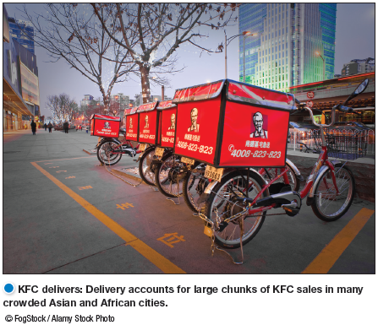
Channel Design Decisions
Designing International Distribution Channels
Channel systems can vary from country to country.
Marketers must be able to adapt channel strategies to structures within each country.
KFC delivers: Delivery accounts for large chunks of KFC sales in many crowded Asian and African cities.
International marketers face many additional complexities in designing their channels. Each country has its own unique distribution system that has evolved over time and changes very slowly. These channel systems can vary widely from country to country. Thus, global marketers must usually adapt their channel strategies to the existing structures within each country.
In some markets, the distribution system is complex and hard to penetrate, consisting of many layers and large numbers of intermediaries. For example, many Western companies find Japan’s distribution system difficult to navigate. It’s steeped in tradition and very complex, with many distributors touching the product before it arrives on the store shelf.
Notes:
KFC delivers: Delivery accounts for large chunks of KFC sales in many crowded Asian and African cities.
International marketers face many additional complexities in designing their channels. Each country has its own unique distribution system that has evolved over time and changes very slowly. These channel systems can vary widely from country to country. Thus, global marketers must usually adapt their channel strategies to the existing structures within each country.
In some markets, the distribution system is complex and hard to penetrate, consisting of many layers and large numbers of intermediaries. For example, many Western companies find Japan’s distribution system difficult to navigate. It’s steeped in tradition and very complex, with many distributors touching the product before it arrives on the store shelf.
At the other extreme, distribution systems in developing countries may be scattered, inefficient, or altogether lacking. For example, China and India are huge, however, because of inadequate distribution systems, most companies can profitably access only a small portion of the population located in each country’s most affluent cities.
After years of effort, even Walmart executives admit that they have been unable to assemble an efficient supply chain in China.

Slide 27
Learning Objective 4
At the other extreme, distribution systems in developing countries may be scattered, inefficient, or altogether lacking. For example, China and India are huge, however, because of inadequate distribution systems, most companies can profitably access only a small portion of the population located in each country’s most affluent cities.
After years of effort, even Walmart executives admit that they have been unable to assemble an efficient supply chain in China.
Explain how companies select, motivate, and evaluate channel members.
Notes:
Discussion Question
What types of exclusive arrangements do manufacturers develop with resellers? Are these arrangements legal?
Learning Objective 4 Summary
Producers vary in their ability to attract qualified marketing intermediaries. Some producers have no trouble signing up channel members, whereas others have to work hard to line up enough qualified intermediaries. When selecting intermediaries, the company should evaluate each channel member’s qualifications and select those that best fit its channel objectives.
Once selected, channel members must be continuously motivated to do their best. The company must sell not only through the intermediaries but also with them. It should forge strong partnerships with channel members to create a marketing system that meets the needs of both the manufacturer and the partners.

Slide 28
Channel Management Decision
Selecting channel members
Managing channel members
Motivating channel members
Evaluating channel members
Once the company has reviewed its channel alternatives and determined the best channel design, it must implement and manage the chosen channel. Marketing channel management calls for selecting, managing, and motivating individual channel members and evaluating their performance over time.
Selecting Channel Members
Producers vary in their ability to attract qualified marketing intermediaries. Some producers have no trouble signing up channel members and others have to work hard to line up enough qualified intermediaries.
For example, when Timex first tried to sell its inexpensive watches through regular jewelry stores, most jewelry stores refused to carry them. The company then managed to get its watches into mass-merchandise outlets.
Notes:
Once the company has reviewed its channel alternatives and determined the best channel design, it must implement and manage the chosen channel. Marketing channel management calls for selecting, managing, and motivating individual channel members and evaluating their performance over time.
Discussion Question
If you were a manufacturer, how would you select channel members?
Most likely students will look at years in business, profitability, and other products served.
Selecting Channel Members
Producers vary in their ability to attract qualified marketing intermediaries. Some producers have no trouble signing up channel members and others have to work hard to line up enough qualified intermediaries.
For example, when Timex first tried to sell its inexpensive watches through regular jewelry stores, most jewelry stores refused to carry them. The company then managed to get its watches into mass-merchandise outlets.
Even established brands may have difficulty gaining and keeping their desired distribution, especially when dealing with powerful resellers. For example, you won’t find P&G’s Pampers diapers in a Costco store. After P&G declined to manufacture Costco’s Kirkland store brand diapers a few years ago, Costco gave Pampers the boot.
When selecting intermediaries, the company should determine what characteristics distinguish the better ones. It will want to evaluate each channel member’s years in business, other lines carried, location, growth and profit record, cooperativeness, and reputation.
Discussion Question
How do you motivate and evaluate channel members?
Some students might have worked in stores where the salespeople were given rewards for excellent sales or service
Managing and Motivating Channel Members
Once selected, channel members must be continuously managed and motivated to do their best. The company must sell not only through the intermediaries but also to and with them.. In managing channel members, companies practice partner relationship management (PRM) and supply chain management (SCM) to develop long term relationships.
Evaluating Channel Members
The company must regularly check channel member performance against standards such as sales quotas, average inventory levels, customer delivery time, treatment of damaged and lost goods, cooperation in company promotion and training programs, and services to the customer. The company should recognize and reward intermediaries who are performing well, assist those performing poorly or, as a last resort, replace them.
Finally, companies need to be sensitive to the needs of their channel partners. Those who treat their partners poorly risk not only losing their support but also causing some legal problems. The next section describes various rights and duties pertaining to companies and other channel members.

Slide 29
Even established brands may have difficulty gaining and keeping their desired distribution, especially when dealing with powerful resellers. For example, you won’t find P&G’s Pampers diapers in a Costco store. After P&G declined to manufacture Costco’s Kirkland store brand diapers a few years ago, Costco gave Pampers the boot.
When selecting intermediaries, the company should determine what characteristics distinguish the better ones. It will want to evaluate each channel member’s years in business, other lines carried, location, growth and profit record, cooperativeness, and reputation.
Managing and Motivating Channel Members
Once selected, channel members must be continuously managed and motivated to do their best. The company must sell not only through the intermediaries but also to and with them.. In managing channel members, companies practice partner relationship management (PRM) and supply chain management (SCM) to develop long term relationships.
Evaluating Channel Members
The company must regularly check channel member performance against standards such as sales quotas, average inventory levels, customer delivery time, treatment of damaged and lost goods, cooperation in company promotion and training programs, and services to the customer. The company should recognize and reward intermediaries who are performing well, assist those performing poorly or, as a last resort, replace them.
Finally, companies need to be sensitive to the needs of their channel partners. Those who treat their partners poorly risk not only losing their support but also causing some legal problems. The next section describes various rights and duties pertaining to companies and other channel members.

Slide 30
Public Policy and Distribution Decisions
Exclusive distribution is when the producer gives only a limited number of dealers the exclusive right to distribute its products in their territories.
Exclusive dealing is when the seller requires that the exclusive distribution sellers not handle competitor’s products.
Exclusive territorial agreements are where producer or seller limit territory.
Tying agreements are agreements where the dealer must take most or all of the line.
For the most part, companies are legally free to develop whatever channel arrangements suit them. In fact, the laws affecting channels seek to prevent the exclusionary tactics of some companies that might keep another company from using a desired channel. Most channel law deals with the mutual rights and duties of channel members once they have formed a relationship.
Producers are free to select their dealers, but their right to terminate dealers is somewhat restricted. In general, sellers can drop dealers “for cause.” However, they cannot drop dealers if, for example, the dealers refuse to cooperate in a doubtful legal arrangement, such as exclusive dealing or tying agreements.
Notes:
For the most part, companies are legally free to develop whatever channel arrangements suit them. In fact, the laws affecting channels seek to prevent the exclusionary tactics of some companies that might keep another company from using a desired channel. Most channel law deals with the mutual rights and duties of channel members once they have formed a relationship.
Producers are free to select their dealers, but their right to terminate dealers is somewhat restricted. In general, sellers can drop dealers “for cause.” However, they cannot drop dealers if, for example, the dealers refuse to cooperate in a doubtful legal arrangement, such as exclusive dealing or tying agreements.

