Slide 1
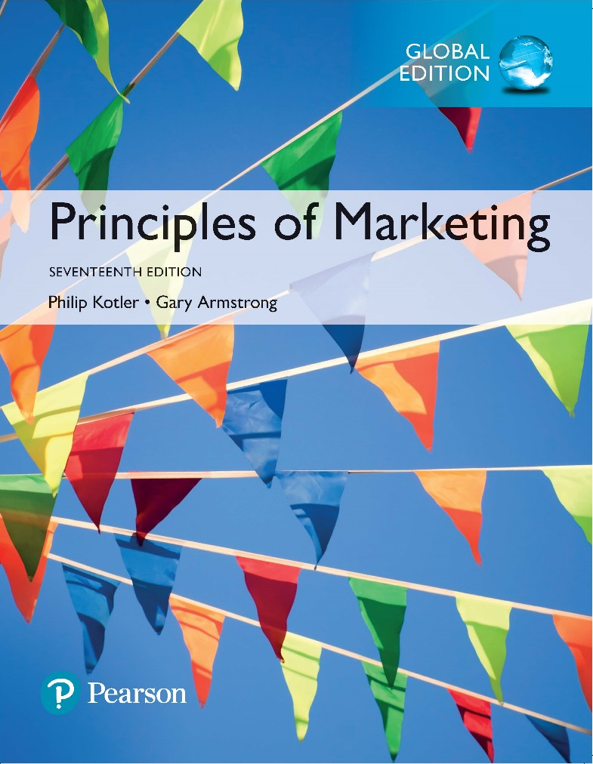
Principles of Marketing Seventeenth Edition
Chapter 8
Products, Services, and Brands:
Building Customer Value
Copyright © 2018 Pearson Education Ltd. All Rights Reserved.

Slide 2
Learning Objectives
8-1 Define product and describe the major classifications of products and services.
8-2 Describe the decisions companies make regarding their individual products and services, product lines, and product mixes.
8-3 Identify the four characteristics that affect the marketing of services and the additional marketing considerations that services require.
8-4 Discuss branding strategy—the decisions companies make in building and managing their brands.

Slide 3
Learning Objective 1
Define product and describe the major classifications of products and services.

Slide 4
What is a Product?
Product is anything that can be offered in a market for attention, acquisition, use, or consumption that might satisfy a need or want.
Products include more than just tangible objects, such as cars, computers, or mobile phones.
Broadly defined, products also include services, events, persons, places, organizations, ideas, or a mixture of these.
Products also include other marketable entities such as experiences, organizations, persons, places, and ideas.
Service is a product that consists of activities, benefits, or satisfactions and that is essentially intangible and does not result in the ownership of anything.
Because of their importance in the world economy, we will look at services more closely later in this chapter. Examples include banking, hotel services, airline travel, retail, wireless communication, and home-repair services.
Notes:
Products include more than just tangible objects, such as cars, computers, or mobile phones. Broadly defined, products also include services, events, persons, places, organizations, ideas, or a mixture of these.
Because of their importance in the world economy, we will look at services more closely later in this chapter. Examples include banking, hotel services, airline travel, retail, wireless communication, and home-repair services.

Slide 5
What Is a Product?
Products, Services, and Experiences
Products and services are becoming more commoditized.
Companies are now creating and managing customer experiences with their brands or company.
Today, all kings of firms are recasting their traditional goods and services to create experiences.
Products are a key element in the overall market offering. Marketing mix planning begins with building an offering that brings value to target customers. This offering becomes the basis on which the company builds profitable customer relationships.
A company’s market offering often includes both tangible goods and services. At one extreme, the market offer may consist of a pure tangible good, such as soap; no services accompany the product. At the other extreme are pure services, for which the market offer consists primarily of a service. Examples include a doctor’s exam and financial services. Between these two extremes, however, many goods-and-services combinations are possible.
Experiences have always been an important part of marketing for some companies. Disney has long manufactured dreams and memories through its movies and theme parks.
Notes:
Products are a key element in the overall market offering. Marketing mix planning begins with building an offering that brings value to target customers. This offering becomes the basis on which the company builds profitable customer relationships.
A company’s market offering often includes both tangible goods and services. At one extreme, the market offer may consist of a pure tangible good, such as soap; no services accompany the product. At the other extreme are pure services, for which the market offer consists primarily of a service. Examples include a doctor’s exam and financial services. Between these two extremes, however, many goods-and-services combinations are possible.
Experiences have always been an important part of marketing for some companies. Disney has long manufactured dreams and memories through its movies and theme parks.

Slide 6
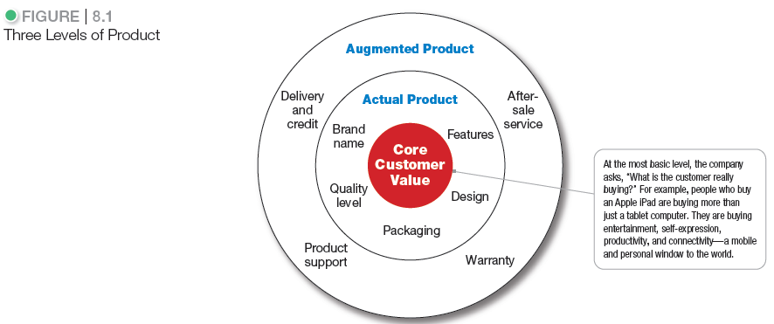
What Is a Product?
Product planners need to think about products and services on three levels (see Figure 8.1). Each level adds more customer value. The most basic level is the core customer value, which addresses the question: What is the buyer really buying?
At the second level, product planners must turn the core benefit into an actual product. They need to develop product and service features, a design, a quality level, a brand name, and packaging.
Finally, product planners must build an augmented product around the core benefit and actual product by offering additional consumer services and benefits.
Notes:
Product planners need to think about products and services on three levels (see Figure 8.1). Each level adds more customer value. The most basic level is the core customer value, which addresses the question: What is the buyer really buying?
At the second level, product planners must turn the core benefit into an actual product. They need to develop product and service features, a design, a quality level, a brand name, and packaging.
Finally, product planners must build an augmented product around the core benefit and actual product by offering additional consumer services and benefits.
Discussion Question
It is a good idea for the students to bring in some products so the class can discuss the levels of product and services. Products including Gatorade, toothpaste, facial moisturizer, or cosmetics work well in this discussion. You can often find augmented product features on product websites including games, features, and support.

Slide 7
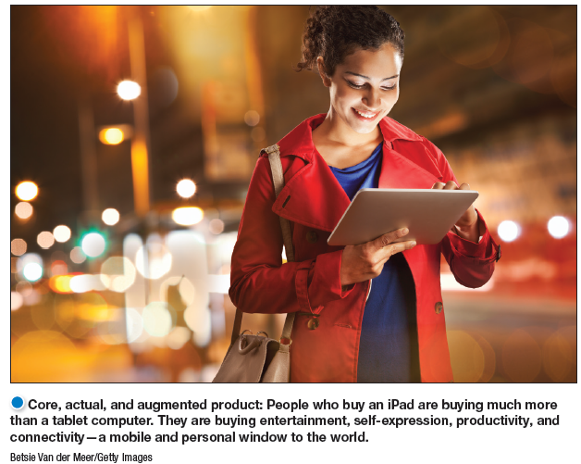
What Is a Product?
Product and Service Classifications
Core, actual, and augmented product: People who buy an iPad are buying much more
than a tablet computer. They are buying entertainment, self-expression, productivity, and
connectivity—a mobile and personal window to the world.
Notes:
Core, actual, and augmented product: People who buy an iPad are buying much more
than a tablet computer. They are buying entertainment, self-expression, productivity, and
connectivity—a mobile and personal window to the world.

Slide 8
What Is a Product?
Product and Service Classifications
Consumer products
Industrial products
Two broad classes of products are based on the types of consumers that use them.
Broadly defined, products also include other marketable entities such as experiences, organizations, persons, places, and ideas.
Products also include other marketable entities such as experiences, organizations, persons, places, and ideas.
Notes:
Two broad classes of products are based on the types of consumers that use them.
Broadly defined, products also include other marketable entities such as experiences, organizations, persons, places, and ideas.

Slide 9
What is a Product?
Product and Service Classifications
Consumer products are products and services bought by final consumers for personal consumption.
Convenience products
Shopping products
Specialty products
Unsought products
Consumer products differ in the ways consumers buy them and, therefore, in how they are marketed (see Table 8.1).
Notes:
Consumer products differ in the ways consumers buy them and, therefore, in how they are marketed (see Table 8.1).

Slide 10
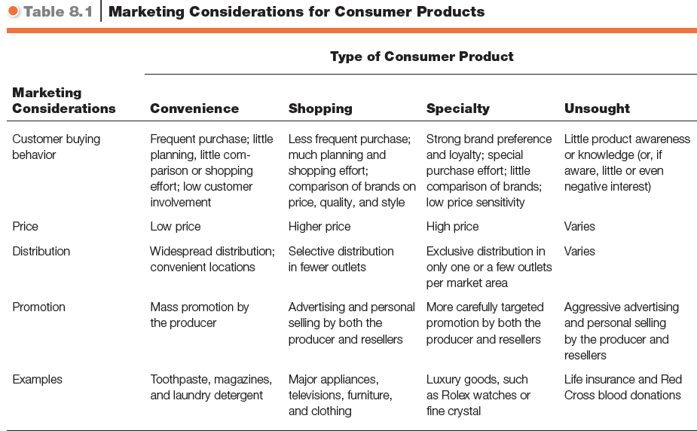
What is a Product?

Slide 11
What Is a Product?
Product and Service Classifications
Convenience products are consumer products and services that the customer usually buys frequently, immediately, and with a minimum comparison and buying effort.
Newspapers
Candy
Fast food
Convenience products are usually low priced, and marketers place them in many locations to make them readily available when customers need or want them.
Notes:
Convenience products are usually low priced, and marketers place them in many locations to make them readily available when customers need or want them.
Discussion Question
What is a convenience product that you buy?

Slide 12
What Is a Product?
Product and Service Classifications
Shopping products are less frequently purchased consumer products and services that the customer compares carefully on suitability, quality, price, and style.
Furniture
Cars
Appliances
Shopping products are usually distributed through fewer outlets but provide deeper sales support to help customers in their comparison efforts.
Notes:
Shopping products are usually distributed through fewer outlets but provide deeper sales support to help customers in their comparison efforts.
Discussion Question
What is a shopping product that you buy?

Slide 13
What Is a Product?
Product and Service Classifications
Specialty products are consumer products and services with unique characteristics or brand identification for which a significant group of buyers is willing to make a special purchase effort.
Medical services
Designer clothes
High-end electronics
Buyers normally do not compare specialty products. They invest only the time needed to reach dealers carrying the wanted products.
Notes:
Buyers normally do not compare specialty products. They invest only the time needed to reach dealers carrying the wanted products.
Discussion Questions
What is a specialty product that you buy?
What is a product that could be convenience, shopping, and specialty?
This is a bit of a puzzle. Students might realize that a camera could fall into several categories depending on the buyer and the situation. Certainly, if you are on vacation and you forgot your camera, you would pick one up at a convenience store, pharmacy, or maybe the hotel store. If you were a professional photographer, a camera purchase could easily be specialty if you were buying a $5,000 camera. Other examples might include mats for the floor of an automobile, tires, or a fan.

Slide 14
What Is a Product?
Product and Service Classifications
Unsought products are consumer products that the consumer does not know about or knows about but does not normally think of buying.
Life insurance
Funeral services
Blood donations
Most major new innovations are unsought until the consumer becomes aware of them through advertising. By their very nature, unsought products require a lot of advertising, personal selling, and other marketing efforts
Notes:
Most major new innovations are unsought until the consumer becomes aware of them through advertising. By their very nature, unsought products require a lot of advertising, personal selling, and other marketing efforts.

Slide 15
What Is a Product?
Product and Service Classifications
Industrial products are those products purchased for further processing or for use in conducting a business.
Materials and parts
Capital items
Supplies and services
The distinction between a consumer product and an industrial product is based on the purpose for which the product is purchased.
If a consumer buys a lawn mower for use around home, the lawn mower is a consumer product. If the same consumer buys the same lawn mower for use in a landscaping business, the lawn mower is an industrial product.
Notes:
The distinction between a consumer product and an industrial product is based on the purpose for which the product is purchased. If a consumer buys a lawn mower for use around home, the lawn mower is a consumer product. If the same consumer buys the same lawn mower for use in a landscaping business, the lawn mower is an industrial product.

Slide 16
What Is a Product?
Product and Service Classifications
Materials and parts include raw materials and manufactured materials and parts.
Capital items are industrial products that aid in the buyer’s production or operations.
Supplies and services include operating supplies, repair and maintenance items, and business services.
Notes:
The three groups of industrial products and services are materials and parts, capital items, and supplies and services.
Materials and parts: Raw materials consist of farm products and natural products. Manufactured materials and parts consist of component materials and component parts. Most manufactured materials and parts are sold directly to industrial users. Price and service are the major marketing factors; branding and advertising tend to be less important.
Capital items are industrial products that aid in the buyer’s production or operations, including installations and accessory equipment. Installations consist of major purchases such as buildings and fixed equipment. Accessory equipment includes portable factory equipment and tools and office equipment. They have a shorter life than installations and simply aid in the production process.
The final group of industrial products is supplies and services. Supplies include operating supplies and repair and maintenance items. Supplies are the convenience products of the industrial field because they are usually purchased with a minimum of effort or comparison. Business services include maintenance and repair services and business advisory services usually supplied under contract.

Slide 17
What Is a Product?
Product and Service Classifications
The three groups of industrial products and services are materials and parts, capital items, and supplies and services.
Materials and parts: Raw materials consist of farm products and natural products. Manufactured materials and parts consist of component materials and component parts. Most manufactured materials and parts are sold directly to industrial users. Price and service are the major marketing factors; branding and advertising tend to be less important.
Capital items are industrial products that aid in the buyer’s production or operations, including installations and accessory equipment. Installations consist of major purchases such as buildings and fixed equipment. Accessory equipment includes portable factory equipment and tools and office equipment. They have a shorter life than installations and simply aid in the production process.
The final group of industrial products is supplies and services. Supplies include operating supplies and repair and maintenance items. Supplies are the convenience products of the industrial field because they are usually purchased with a minimum of effort or comparison. Business services include maintenance and repair services and business advisory services usually supplied under contract.

Slide 18

What Is a Product?
Product and Service Classifications
Organizations, Persons,
Places, and Ideas
Organization marketing
Person marketing
Place marketing
Social marketing
Organization marketing: Kaiser Permanente’s “Thrive” campaign markets the organization as a total health advocate that helps its members get healthy, stay healthy, and thrive.
Notes:
Organization marketing: Kaiser Permanente’s “Thrive” campaign markets the organization as a total health advocate that helps its members get healthy, stay healthy, and thrive.

Slide 19
What Is a Product?
Product and Service Classifications
Organization marketing consists of activities undertaken to create, maintain, or change the attitudes and behavior of target consumers toward an organization.
Organizations often carry out activities to “sell” the organization itself. Both profit and not-for-profit organizations practice organization marketing. Business firms sponsor public relations or corporate image marketing campaigns to market themselves and polish their images.
For example, Kaiser Permanente’s long-running “Thrive” campaign markets the health maintenance organization (HMO) not just as a health-care company, but as a total health advocate. Whereas “competitors [stand] for health care,” says the company, “Kaiser Permanente [stands] for health” as shown in the ad on the previous slide. Still other ads show how Kaiser Permanente accomplishes major health-care breakthroughs behind the scenes so that its members can thrive and enjoy the everyday moments of their lives to the fullest.
Notes:
Organizations often carry out activities to “sell” the organization itself. Both profit and not-for-profit organizations practice organization marketing. Business firms sponsor public relations or corporate image marketing campaigns to market themselves and polish their images.
For example, Kaiser Permanente’s long-running “Thrive” campaign markets the health maintenance organization (HMO) not just as a health-care company, but as a total health advocate. Whereas “competitors [stand] for health care,” says the company, “Kaiser Permanente [stands] for health” as shown in the ad on the previous slide. Still other ads show how Kaiser Permanente accomplishes major health-care breakthroughs behind the scenes so that its members can thrive and enjoy the everyday moments of their lives to the fullest.

Slide 20
What Is a Product?
Product and Service Classifications
Person marketing consists of activities undertaken to create, maintain, or change the attitudes or behavior of target consumers toward particular people.
People can also be thought of as products. People ranging from presidents, entertainers, and sports figures to professionals such as doctors, lawyers, and architects use person marketing to build their reputations. Businesses, charities, and other organizations use well-known personalities to help sell their products or causes.
Notes:
People can also be thought of as products. People ranging from presidents, entertainers, and sports figures to professionals such as doctors, lawyers, and architects use person marketing to build their reputations. Businesses, charities, and other organizations use well-known personalities to help sell their products or causes.

Slide 21
What Is a Product?
Product and Service Classifications
Place marketing consists of activities undertaken to create, maintain, or change attitudes and behavior toward particular places.
Place marketing: Cities, states, regions, and even entire nations compete to attract tourists, new residents, conventions, and company offices and factories. The New Orleans city web site shouts “Go NOLA” and markets annual events such as Mardi Gras festivities and the New Orleans Jazz and Heritage Festival.
Brand USA, a public–private marketing partnership created by a recent act of Congress, promotes the United States as a tourist destination to international travelers. Its mission is to “represent the true greatness of America—from sea to shining sea” through country-by-country ads and promotions and a DiscoverAmerica.com web site that features destinations, U.S. travel information and tips, and travel planning tools.
Social marketing uses commercial marketing concepts to influence individuals’ behavior to improve their well-being and that of society.
Social marketing: Ideas can also be marketed. In one sense, all marketing is the marketing of an idea, whether it is the general idea of brushing your teeth or the specific idea that Crest toothpastes create “healthy, beautiful smiles for life.” Here, however, we narrow our focus to the marketing of social ideas. This area has been called social marketing.
Notes:
Place marketing: Cities, states, regions, and even entire nations compete to attract tourists, new residents, conventions, and company offices and factories. The New Orleans city web site shouts “Go NOLA” and markets annual events such as Mardi Gras festivities and the New Orleans Jazz and Heritage Festival.
Brand USA, a public–private marketing partnership created by a recent act of Congress, promotes the United States as a tourist destination to international travelers. Its mission is to “represent the true greatness of America—from sea to shining sea” through country-by-country ads and promotions and a DiscoverAmerica.com web site that features destinations, U.S. travel information and tips, and travel planning tools.
Social marketing: Ideas can also be marketed. In one sense, all marketing is the marketing of an idea, whether it is the general idea of brushing your teeth or the specific idea that Crest toothpastes create “healthy, beautiful smiles for life.” Here, however, we narrow our focus to the marketing of social ideas. This area has been called social marketing.

Slide 22
Learning Objective 2
Describe the decisions companies make regarding their individual products and services, product lines, and product mixes.

Slide 23
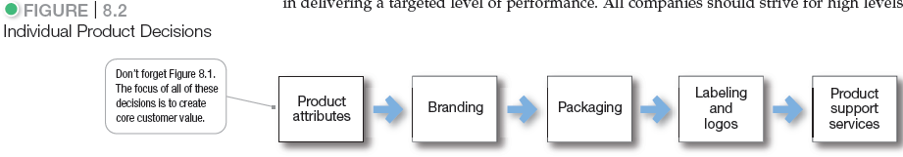
Product and Service Decisions
Figure 8.2 Individual Product Decisions
Figure 8.2 shows the important decisions in the development and marketing of individual products and services. We will examine decisions about product attributes, branding, packaging, labeling, and product support services.
Notes:
Figure 8.2 shows the important decisions in the development and marketing of individual products and services. We will examine decisions about product attributes, branding, packaging, labeling, and product support services.

Slide 24
Product and Service Decisions
Individual Product and Service Decisions
Communicate and deliver benefits by product and service attributes.
Quality
Features
Style and design
Developing a product or service involves defining the benefits that it will offer.
Notes:
Developing a product or service involves defining the benefits that it will offer.

Slide 25
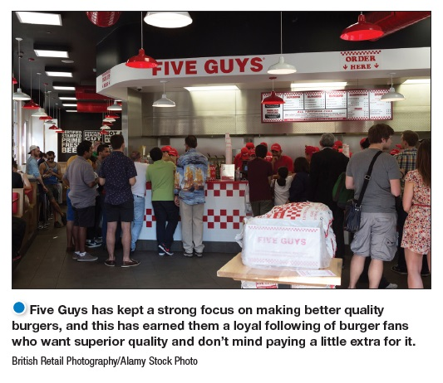
Product and Service Decisions
Individual Product and Service Decisions
Product quality refers to the characteristics of a product or service that bear on its ability to satisfy stated or implied customer needs.
Total quality management
Return-on-quality
Quality level
Performance quality
Conformance quality
Notes:
Product quality is one of the marketer’s major positioning tools. Quality affects product or service performance; thus, it is closely linked to customer value and satisfaction. In the narrowest sense, quality can be defined as “freedom from defects.” But most marketers go beyond this narrow definition. Instead, they define quality in terms of creating customer value and satisfaction.
Total quality management (TQM) is an approach in which all of the company’s people are involved in constantly improving the quality of products, services, and business processes..
Today, companies are taking a return-on-quality approach, viewing quality as an investment and holding quality efforts accountable for bottom-line results.
Product quality has two dimensions: level and consistency. In developing a product, the marketer must first choose a quality level that will support the product’s positioning. Here, product quality means performance quality—the product’s ability to perform its functions.
Beyond quality level, high quality also can mean high levels of quality consistency. Here, product quality means conformance quality—freedom from defects and consistency in delivering a targeted level of performance. All companies should strive for high levels of conformance quality.

Slide 26
Individual Product and Service Decisions
Product quality is one of the marketer’s major positioning tools. Quality affects product or service performance; thus, it is closely linked to customer value and satisfaction. In the narrowest sense, quality can be defined as “freedom from defects.” But most marketers go beyond this narrow definition. Instead, they define quality in terms of creating customer value and satisfaction.
Total quality management (TQM) is an approach in which all of the company’s people are involved in constantly improving the quality of products, services, and business processes..
Today, companies are taking a return-on-quality approach, viewing quality as an investment and holding quality efforts accountable for bottom-line results.
Product quality has two dimensions: level and consistency. In developing a product, the marketer must first choose a quality level that will support the product’s positioning. Here, product quality means performance quality—the product’s ability to perform its functions.
Beyond quality level, high quality also can mean high levels of quality consistency. Here, product quality means conformance quality—freedom from defects and consistency in delivering a targeted level of performance. All companies should strive for high levels of conformance quality.

Slide 27
Product and Service Decisions
Individual Product and Service Decisions
Product Features
Competitive tool for differentiating a product from competitors’ products
Assessed based on the value to the customer versus its cost to the company
A product can be offered with varying product features. A stripped-down model, one without any extras, is the starting point. The company can then create higher-level models by adding more features. Being the first producer to introduce a valued new feature is one of the most effective ways to compete.
How can a company identify new features and decide which ones to add to its product? It should periodically survey buyers who have used the product and ask these questions: How do you like the product? Which specific features of the product do you like most? Which features could we add to improve the product? The answers to these questions provide the company with a rich list of feature ideas.
The company can then assess each feature’s value to customers versus its cost to the company. Features that customers value highly in relation to costs should be added.
Notes:
A product can be offered with varying product features. A stripped-down model, one without any extras, is the starting point. The company can then create higher-level models by adding more features. Being the first producer to introduce a valued new feature is one of the most effective ways to compete.
How can a company identify new features and decide which ones to add to its product? It should periodically survey buyers who have used the product and ask these questions: How do you like the product? Which specific features of the product do you like most? Which features could we add to improve the product? The answers to these questions provide the company with a rich list of feature ideas.
The company can then assess each feature’s value to customers versus its cost to the company. Features that customers value highly in relation to costs should be added.

Slide 28
Product and Service Decisions
Individual Product and Service Decisions
Style describes the appearance of the product.
Design contributes to a product’s usefulness as well as to its looks.
Good design doesn’t start with brainstorming new ideas and making prototypes.
Design begins with observing customers, understanding their needs, and shaping their product-use experience.
Product designers should think less about technical product specifications and more about how customers will use and benefit from the product.
For example, using smart design based on consumer needs, Sonos created a wireless, internet-enabled speaker system that’s easy to use and fills a whole house with great sound.
Another way to add customer value is through distinctive product style and design. Design is a larger concept than style.
Good design doesn’t start with brainstorming new ideas and making prototypes. Design begins with observing customers, deeply understanding their needs, and shaping their product-use experience. Product designers should think less about technical product specifications and more about how customers will use and benefit from the product.
Notes:
Good design doesn’t start with brainstorming new ideas and making prototypes.
Design begins with observing customers, understanding their needs, and shaping their
product-use experience. Product designers should think less about technical product
specifications and more about how customers will use and benefit from the product. For
example, using smart design based on consumer needs, Sonos created a wireless, internet-enabled
speaker system that’s easy to use and fills a whole house with great sound.
Another way to add customer value is through distinctive product style and design. Design is a larger concept than style.
Good design doesn’t start with brainstorming new ideas and making prototypes. Design begins with observing customers, deeply understanding their needs, and shaping their product-use experience. Product designers should think less about technical product specifications and more about how customers will use and benefit from the product.

Slide 29
Product and Service Decisions
Individual Product and Service Decisions
Brand is the name, term, sign, or design or a combination of these, that identifies the maker or seller of a product or service.
Consumers view a brand as an important part of a product, and branding can add value to a consumer’s purchase. Customers attach meanings to brands and develop brand relationships. Branding has become so strong that today hardly anything goes unbranded. Brand names help consumers identify products that might benefit them and say something about product quality and consistency.
Branding also gives the seller several advantages. The seller’s brand name and trademark provide legal protection for unique product features that otherwise might be copied by competitors. Branding helps the seller to segment markets.
Notes:
Discussion Questions
What brands do you tend to purchase consistently? Why?
This discussion should lead to the consumer benefits of brands including quality and consistency. It is interesting to now ask students what the benefits might be for the seller of a strong brand. This will include segmentation, positioning, and the ability to communicate product features.
Consumers view a brand as an important part of a product, and branding can add value to a consumer’s purchase. Customers attach meanings to brands and develop brand relationships. Branding has become so strong that today hardly anything goes unbranded. Brand names help consumers identify products that might benefit them and say something about product quality and consistency.
Branding also gives the seller several advantages. The seller’s brand name and trademark provide legal protection for unique product features that otherwise might be copied by competitors. Branding helps the seller to segment markets.

Slide 30
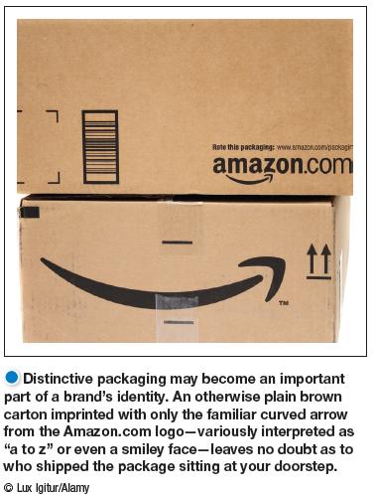
Product and Service Decisions
Individual Product and Service Decisions
Packaging involves designing and producing the container or wrapper for a product.
Labels identify the product or brand, describe attributes, and provide promotion.
Notes:
Product quality is one of the marketer’s major positioning tools. Quality affects product or service performance; thus, it is closely linked to customer value and satisfaction. In the narrowest sense, quality can be defined as “freedom from defects.” But most marketers go beyond this narrow definition. Instead, they define quality in terms of creating customer value and satisfaction.
Total quality management (TQM) is an approach in which all of the company’s people are involved in constantly improving the quality of products, services, and business processes..
Today, companies are taking a return-on-quality approach, viewing quality as an investment and holding quality efforts accountable for bottom-line results.
Product quality has two dimensions: level and consistency. In developing a product, the marketer must first choose a quality level that will support the product’s positioning. Here, product quality means performance quality—the product’s ability to perform its functions.
Beyond quality level, high quality also can mean high levels of quality consistency. Here, product quality means conformance quality—freedom from defects and consistency in delivering a targeted level of performance. All companies should strive for high levels of conformance quality.

Slide 31
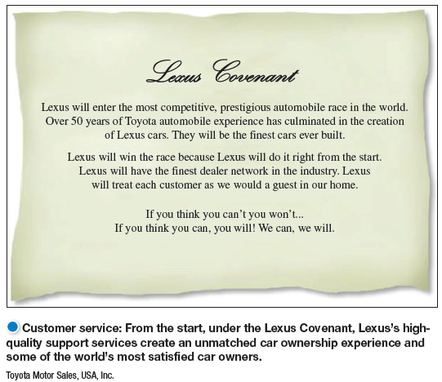
Product and Service Decisions
Individual Product and Service Decisions
Product support services augment actual products.
Customer service: Customer service is another element of product strategy. A company’s offer usually includes some product support services, which can be a minor part or a major part of the total offering. Support services are an important part of the customer’s overall brand experience. Keeping customers happy after the sale is the key to building lasting relationships.
Many companies now use a sophisticated mix of phone, e-mail, online, social media, mobile, and interactive voice and data technologies to provide support services that were not possible before. For example, Lowe’s has equipped employees with 42,000 iPhones filled with custom apps and add-on hardware, letting them perform service tasks such as checking inventory at nearby stores, looking up specific customer purchase histories, sharing how-to videos, and checking competitor prices—all without leaving the customer’s side.
Notes:
Customer service: Customer service is another element of product strategy. A company’s offer usually includes some product support services, which can be a minor part or a major part of the total offering. Support services are an important part of the customer’s overall brand experience. Keeping customers happy after the sale is the key to building lasting relationships.
Many companies now use a sophisticated mix of phone, e-mail, online, social media, mobile, and interactive voice and data technologies to provide support services that were not possible before. For example, Lowe’s has equipped employees with 42,000 iPhones filled with custom apps and add-on hardware, letting them perform service tasks such as checking inventory at nearby stores, looking up specific customer purchase histories, sharing how-to videos, and checking competitor prices—all without leaving the customer’s side.

Slide 32
Product and Service Decisions
Product Line Decisions
Product line is a group of products that are closely related because they function in a similar manner, are sold to the same customer groups, are marketed through the same types of outlets, or fall within given price ranges.
The major product line decision involves product line length—the number of items in the product line. The line is too short if the manager can increase profits by adding items; the line is too long if the manager can increase profits by dropping items. Managers need to analyze their product lines periodically to assess each item’s sales and profits and understand how each item contributes to the line’s overall performance.
Notes:
The major product line decision involves product line length—the number of items in the product line. The line is too short if the manager can increase profits by adding items; the line is too long if the manager can increase profits by dropping items. Managers need to analyze their product lines periodically to assess each item’s sales and profits and understand how each item contributes to the line’s overall performance.

Slide 33
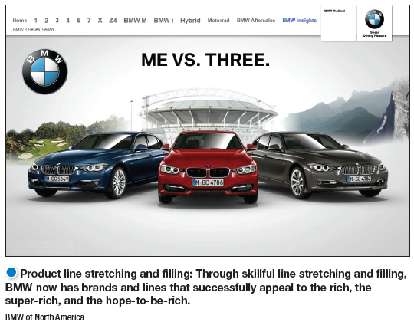
Product and Service Decisions
Product Line Decisions
Product line length is the number of items in the product line.
Line stretching
occurs when a company lengthens its product line beyond its current range − downward, upward, or both ways.
Line filling
involves adding more items within the present range of the line for earning extra profits, satisfying dealers.
Notes:
Product line stretching and filling: Samsung’s bulging Galaxy mobile devices line now offers a size for any need or preference, including smartphones, “phablets,” tablets, and even a wristwatch-like wearable smartphone, the Galaxy Gear.
A company can expand its product line in two ways: by line filling or line stretching. Product line filling involves adding more items within the present range of the line for earning extra profits, satisfying dealers, using excess capacity, being the leading full-line company, and plugging holes to keep out competitors. However, line filling is overdone if it results in cannibalization and customer confusion. The company should ensure that new items are noticeably different from existing ones.
Product line stretching occurs when a company lengthens its product line beyond its current range − downward, upward, or both ways.
Companies located at the upper end of the market can stretch their lines downward. A company may stretch downward to plug a market hole that otherwise would attract a new competitor or respond to a competitor’s attack on the upper end. Or it may add low-end products because it finds faster growth taking place in the low-end segments.
Companies can also stretch their product lines upward. Sometimes, companies stretch upward to add prestige to their current products. Or they may be attracted by a faster growth rate or higher margins at the higher end.

Slide 34
Product Line Decisions
Product line stretching and filling: Samsung’s bulging Galaxy mobile devices line now offers a size for any need or preference, including smartphones, “phablets,” tablets, and even a wristwatch-like wearable smartphone, the Galaxy Gear.
A company can expand its product line in two ways: by line filling or line stretching. Product line filling involves adding more items within the present range of the line for earning extra profits, satisfying dealers, using excess capacity, being the leading full-line company, and plugging holes to keep out competitors. However, line filling is overdone if it results in cannibalization and customer confusion. The company should ensure that new items are noticeably different from existing ones.
Product line stretching occurs when a company lengthens its product line beyond its current range − downward, upward, or both ways.
Companies located at the upper end of the market can stretch their lines downward. A company may stretch downward to plug a market hole that otherwise would attract a new competitor or respond to a competitor’s attack on the upper end. Or it may add low-end products because it finds faster growth taking place in the low-end segments.
Companies can also stretch their product lines upward. Sometimes, companies stretch upward to add prestige to their current products. Or they may be attracted by a faster growth rate or higher margins at the higher end.

Slide 35
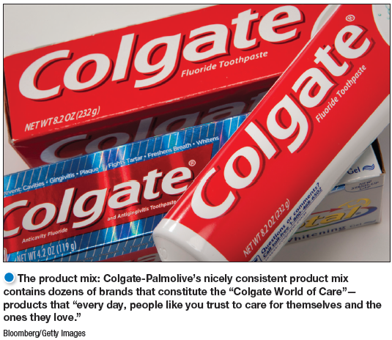
Product and Service Decisions
Product Mix Decisions
Product mix consists of all the product lines and items that a particular seller offers for sale.
Width: number of different product lines
Length: total number of items the company carries within its product line
Depth: number of versions offered of each product in the line.
Consistency: how closely the various product lines are in end use, production requirements, or distribution channels.
Notes:
The product mix: The Clorox Company has a nicely contained product mix consistent with its mission to “make everyday life better every day.”
Product mix width is the number of different product lines the company carries.
Product mix length is the total number of items the company carries within its product lines.
Product mix depth is the number of versions offered of each product in the line.
Consistency is how closely the various product lines are in end use, production requirements, or distribution channels.
These product mix dimensions provide the handles for defining the company’s product strategy and increasing business.
From time to time, a company may also have to streamline its product mix to pare out marginally performing lines and models and to regain its focus.

Slide 36
Learning Objective 3
Identify the four characteristics that affect the marketing of services and the additional marketing considerations that services require.
The firm now has to decide how many and which segments it can serve best. We now look at how companies evaluate and select target segments.
Notes:
After dividing the market into segments, it’s time to answer that first seemingly simple marketing strategy question we raised in Figure 7.1: Which customers will the company serve?
The firm now has to decide how many and which segments it can serve best. We now look at how companies evaluate and select target segments.

Slide 37
Services Marketing
Types of Service Industries
Government
Private not-for-profit organizations
Business organizations
Services have grown dramatically in recent years. The service industry is growing and now accounts for 80 percent of the U.S. gross domestic product (GDP). Services are growing even faster in the world economy, making up 64 percent of the gross world product.
Service industries vary greatly:
Governments offer services through courts, employment services, hospitals, military services, police and fire departments, the postal service, and schools.
Private not-for-profit organizations offer services through museums, charities, churches, colleges, foundations, and hospitals.
Business organizations offer services such as airlines, banks, hotels, insurance companies, consulting firms, medical and legal practices, entertainment and telecommunications companies, real estate firms, retailers, and others.
Notes:
Services have grown dramatically in recent years. The service industry is growing and now accounts for 80 percent of the U.S. gross domestic product (GDP). Services are growing even faster in the world economy, making up 64 percent of the gross world product.
Service industries vary greatly:
Governments offer services through courts, employment services, hospitals, military services, police and fire departments, the postal service, and schools.
Private not-for-profit organizations offer services through museums, charities, churches, colleges, foundations, and hospitals.
Business organizations offer services such as airlines, banks, hotels, insurance companies, consulting firms, medical and legal practices, entertainment and telecommunications companies, real estate firms, retailers, and others.

Slide 38
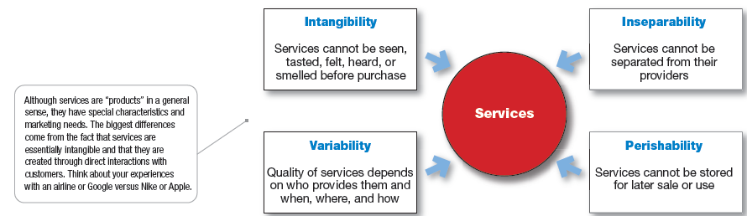
Services Marketing
Figure 8.3 Four Service Characteristics
Intangibility refers to the fact that services cannot be seen, tasted, felt, heard, or smelled before they are purchased.
Inseparability refers to the fact that services cannot be separated from their providers.
Variability refers to the fact that service quality depends on who provides the services as well as when, where, and how the services are provided.
Perishability refers to the fact that services cannot be stored for later sale or use.
Notes:
Intangibility refers to the fact that services cannot be seen, tasted, felt, heard, or smelled before they are purchased.
Inseparability refers to the fact that services cannot be separated from their providers.
Variability refers to the fact that service quality depends on who provides the services as well as when, where, and how the services are provided.
Perishability refers to the fact that services cannot be stored for later sale or use.

Slide 39
Services Marketing
Marketing Strategies for Service Firms
In addition to traditional marketing strategies, service firms often require additional strategies.
Service-profit chain
Internal marketing
Interactive marketing
In a service business, the customer and the front-line service employee interact to co-create the service. Effective interaction, in turn, depends on the skills of front-line service employees and on the support processes backing these employees.
Thus, successful service companies focus their attention on both their customers and their employees. They understand the service profit chain, which links service firm profits with employee and customer satisfaction.
Notes:
In a service business, the customer and the front-line service employee interact to co-create the service. Effective interaction, in turn, depends on the skills of front-line service employees and on the support processes backing these employees.
Thus, successful service companies focus their attention on both their customers and their employees. They understand the service profit chain, which links service firm profits with employee and customer satisfaction.

Slide 40
Services Marketing
Marketing Strategies for Service Firms
Service-profit chain links service firm profits with employee and customer satisfaction.
Internal service quality
Satisfied and productive service employees
Greater service value
Satisfied and loyal customers
Healthy service profits and growth
Notes:
Good service firms use marketing to position themselves strongly in chosen target markets. FedEx promises to take your packages “faster, farther”; Angie’s List offers “reviews you can trust.” At Hampton, “We love having you here.” In addition to traditional marketing mix activities, services require additional marketing approaches.
Internal service quality requires superior employee selection and training, a quality work environment, and strong support for those dealing with customers.
Satisfied and productive service employees are more satisfied, loyal, and hardworking employees.
Greater service value relates to more effective and efficient customer value creation and service delivery.
Satisfied and loyal customers make repeat purchases and refer other customers.
Healthy service profits and growth relate to superior service firm performance.

Slide 41
Marketing Strategies for Service Firms
Good service firms use marketing to position themselves strongly in chosen target markets. FedEx promises to take your packages “faster, farther”; Angie’s List offers “reviews you can trust.” At Hampton, “We love having you here.” In addition to traditional marketing mix activities, services require additional marketing approaches.
Internal service quality requires superior employee selection and training, a quality work environment, and strong support for those dealing with customers.
Satisfied and productive service employees are more satisfied, loyal, and hardworking employees.
Greater service value relates to more effective and efficient customer value creation and service delivery.
Satisfied and loyal customers make repeat purchases and refer other customers.
Healthy service profits and growth relate to superior service firm performance.

Slide 42
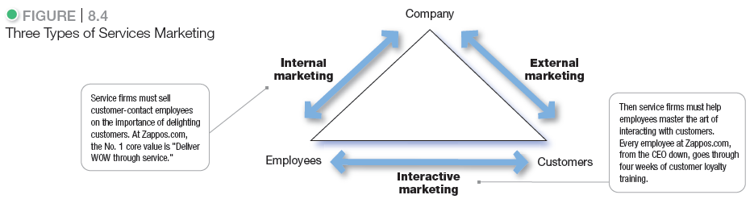
Services Marketing
Services marketing requires more than just traditional external marketing using the four Ps. Figure 8.4 shows that services marketing also requires internal marketing and interactive marketing.
Notes:
Services marketing requires more than just traditional external marketing using the
four Ps. Figure 8.4 shows that services marketing also requires internal marketing and
interactive marketing.

Slide 43
Services Marketing
Marketing Strategies for Service Firms
Internal marketing means that the service firm must orient and motivate its customer-contact employees and supporting service people to work as a team to provide customer satisfaction.
With internal marketing, marketers must get everyone in the organization to be customer centered. In fact, internal marketing must precede external marketing.
Notes:
With internal marketing, marketers must get everyone in the organization to be customer centered. In fact, internal marketing must precede external marketing.

Slide 44
Services Marketing
Marketing Strategies for Service Firms
Interactive marketing means that service quality depends heavily on the quality of the buyer-seller interaction during the service encounter.
Service differentiation
Service quality
Service productivity
Interactive marketing: In services marketing, service quality depends on both the service deliverer and the quality of delivery. Service marketers have to master interactive marketing skills. Thus, Four Seasons selects only people with an innate “passion to serve” and provides three months of training to instruct them carefully in the fine art of interacting with customers to satisfy their every need.
Notes:
Interactive marketing: In services marketing, service quality depends on both the service deliverer and the quality of delivery. Service marketers have to master interactive marketing skills. Thus, Four Seasons selects only people with an innate “passion to serve” and provides three months of training to instruct them carefully in the fine art of interacting with customers to satisfy their every need.

Slide 45
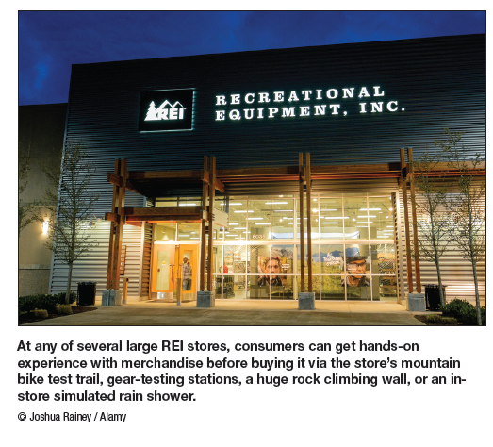
Services Marketing
Marketing Strategies for Service Firms
Managing service differentiation creates a competitive advantage.
Offer
Delivery
Image
In these days of intense price competition, service marketers must develop a differentiated offer, delivery, and image.
The offer can include innovative features that set one company’s offer apart from competitors’ offers. For example, some retailers differentiate themselves by offerings that take you well beyond the products they stock.
At Dick’s Sporting Goods customers can sample shoes on Dick’s indoor footwear track, test golf clubs with an on-site golf swing analyzer and putting green, shoot bows in its archery range, and receive personalized fitness product guidance from an in-store team of fitness trainers. Such differentiated services help make Dick’s “the ultimate sporting goods destination store for core athletes and outdoor enthusiasts.”
Service companies can differentiate their service delivery by having more able and reliable customer-contact people, developing a superior physical environment in which the service product is delivered, or designing a superior delivery process. For example, many grocery chains now offer online shopping and home delivery.
Notes:
In these days of intense price competition, service marketers must develop a differentiated offer, delivery, and image.
The offer can include innovative features that set one company’s offer apart from competitors’ offers. For example, some retailers differentiate themselves by offerings that take you well beyond the products they stock.
At Dick’s Sporting Goods customers can sample shoes on Dick’s indoor footwear track, test golf clubs with an on-site golf swing analyzer and putting green, shoot bows in its archery range, and receive personalized fitness product guidance from an in-store team of fitness trainers. Such differentiated services help make Dick’s “the ultimate sporting goods destination store for core athletes and outdoor enthusiasts.”
Service companies can differentiate their service delivery by having more able and reliable customer-contact people, developing a superior physical environment in which the service product is delivered, or designing a superior delivery process. For example, many grocery chains now offer online shopping and home delivery.

Slide 46
Marketing Strategies for Service Firms
Managing service quality enables a service firm to differentiate itself by delivering consistently higher quality than its competitors provide.
The customer-driven quality movement requires service providers to identify what target customers expect in regard to service quality. Service quality is harder to define and judge than product quality. Customer retention is perhaps the best measure of quality.
Top service companies set high service-quality standards. They watch service performance closely, both their own and that of competitors. They do not settle for merely good service—they strive for 100 percent defect-free service. A 98 percent performance standard may sound good, but using this standard, the U.S. Postal Service would lose or misdirect 440,000 pieces of mail each hour, and U.S. pharmacists would misfill more than 75.3 million prescriptions each week.
Service quality will always vary, depending on the interactions between employees and customers, yet even the best companies will occasionally deliver services which fall short of customer expectations. However, good service recovery can turn angry customers into loyal ones and can win more customer purchasing and loyalty than if things had gone well in the first place.
For example, Southwest airlines has a proactive customer communications team whose job is to find the situations in which something went wrong. The team’s communications to passengers have three basic components: a sincere apology, a brief explanation of what happened, and a gift to make it up, usually a voucher in dollars that can be used on their next Southwest flight. Surveys show that when Southwest handles a delay situation well, customer service quality rankings score 14 to 16 points higher than on regular on-time flights.
These days, social media such as Facebook and Twitter can help companies root out and remedy customer dissatisfaction with service.
Notes:
The customer-driven quality movement requires service providers to identify what target customers expect in regard to service quality. Service quality is harder to define and judge than product quality. Customer retention is perhaps the best measure of quality.
Top service companies set high service-quality standards. They watch service performance closely, both their own and that of competitors. They do not settle for merely good service—they strive for 100 percent defect-free service. A 98 percent performance standard may sound good, but using this standard, the U.S. Postal Service would lose or misdirect 440,000 pieces of mail each hour, and U.S. pharmacists would misfill more than 75.3 million prescriptions each week.
Service quality will always vary, depending on the interactions between employees and customers, yet even the best companies will occasionally deliver services which fall short of customer expectations. However, good service recovery can turn angry customers into loyal ones and can win more customer purchasing and loyalty than if things had gone well in the first place.
For example, Southwest airlines has a proactive customer communications team whose job is to find the situations in which something went wrong. The team’s communications to passengers have three basic components: a sincere apology, a brief explanation of what happened, and a gift to make it up, usually a voucher in dollars that can be used on their next Southwest flight. Surveys show that when Southwest handles a delay situation well, customer service quality rankings score 14 to 16 points higher than on regular on-time flights.
These days, social media such as Facebook and Twitter can help companies root out and remedy customer dissatisfaction with service.

Slide 47
Services Marketing
Marketing Strategies for Service Firms
Managing service productivity refers to the cost side of marketing strategies for service firms.
Employee hiring and training
Service quantity and quality
With their costs rising rapidly, service firms are under great pressure to increase service productivity. A service provider can harness the power of technology to make service workers more productive.
However, companies must avoid pushing productivity so hard that doing so reduces quality. Attempts to streamline a service or cut costs can make a service company more efficient in the short run. But that can also reduce its longer-run ability to innovate, maintain service quality, or respond to consumer needs and desires. For example, some airlines have learned this lesson the hard way as they attempt to economize by cutting back personal counter service, eliminating free snacks, and charging extra for everything from luggage to aisle seats. The result is a plane full of resentful customers. In their attempts to improve productivity, these airlines have mangled customer service.
Thus, in attempting to improve service productivity, companies must be mindful of how they create and deliver customer value. They should be careful not to take service out of the service. In fact, a company may purposely lower service productivity in order to improve service quality, in turn allowing it to maintain higher prices and profit margins.
Notes:
With their costs rising rapidly, service firms are under great pressure to increase service productivity. A service provider can harness the power of technology to make service workers more productive.
However, companies must avoid pushing productivity so hard that doing so reduces quality. Attempts to streamline a service or cut costs can make a service company more efficient in the short run. But that can also reduce its longer-run ability to innovate, maintain service quality, or respond to consumer needs and desires. For example, some airlines have learned this lesson the hard way as they attempt to economize by cutting back personal counter service, eliminating free snacks, and charging extra for everything from luggage to aisle seats. The result is a plane full of resentful customers. In their attempts to improve productivity, these airlines have mangled customer service.
Thus, in attempting to improve service productivity, companies must be mindful of how they create and deliver customer value. They should be careful not to take service out of the service. In fact, a company may purposely lower service productivity in order to improve service quality, in turn allowing it to maintain higher prices and profit margins.

Slide 48
Learning Objective 4
Discuss branding strategy—the decisions companies make in building and managing their brands.

Slide 49
Brand Strategy: Building Strong Brands
Brand Equity and Brand Value
Brand equity is the differential effect that knowing the brand name has on customer response to the product or its marketing.
Brand value is the total financial value of a brand.
Brands are more than just names and symbols. They are a key element in the company’s relationships with consumers. Brands represent consumers’ perceptions and feelings about a product and its performance—everything that the product or the service means to consumers.
A powerful brand has high brand equity. It’s a measure of the brand’s ability to capture consumer preference and loyalty. A brand has positive brand equity when consumers react more favorably to it than to generic or unbranded products.
Ad agency Young & Rubicam’s BrandAsset Valuator measures brand strength along four consumer perception dimensions: differentiation, relevance, knowledge, and esteem. Brands with strong brand equity rate high on all four dimensions.
Notes:
Brands are more than just names and symbols. They are a key element in the company’s relationships with consumers. Brands represent consumers’ perceptions and feelings about a product and its performance—everything that the product or the service means to consumers.
A powerful brand has high brand equity. It’s a measure of the brand’s ability to capture consumer preference and loyalty. A brand has positive brand equity when consumers react more favorably to it than to generic or unbranded products.
Ad agency Young & Rubicam’s BrandAsset Valuator measures brand strength along four consumer perception dimensions: differentiation, relevance, knowledge, and esteem. Brands with strong brand equity rate high on all four dimensions.
Positive brand equity derives from consumer feelings about and connections with a brand. Strong brands are built around an ideal of improving consumers’ lives in some relevant way.
A brand with high brand equity is a very valuable asset. Brand valuation is the process of estimating the total financial value of a brand. Measuring such value is difficult. However, according to one estimate, the brand value of Apple is a whopping $185 billion, with Google at $113.6 billion, IBM at $112.5 billion, McDonald’s at $90 billion, Microsoft at $70 billion, and Coca-Cola at $78.4 billion
High brand equity provides a company with many competitive advantages:
high level of consumer brand awareness and loyalty
more leverage in bargaining with resellers
easier launch of line and brand extensions
defense against fierce price competition
A powerful brand forms the basis for building strong and profitable customer relationships. The fundamental asset underlying brand equity is customer equity—the value of customer relationships that the brand creates. Companies need to think of themselves not as portfolios of brands but as portfolios of customers.

Slide 50
Brand Equity and Brand Value
Positive brand equity derives from consumer feelings about and connections with a brand. Strong brands are built around an ideal of improving consumers’ lives in some relevant way.
A brand with high brand equity is a very valuable asset. Brand valuation is the process of estimating the total financial value of a brand. Measuring such value is difficult. However, according to one estimate, the brand value of Apple is a whopping $185 billion, with Google at $113.6 billion, IBM at $112.5 billion, McDonald’s at $90 billion, Microsoft at $70 billion, and Coca-Cola at $78.4 billion
High brand equity provides a company with many competitive advantages:
high level of consumer brand awareness and loyalty
more leverage in bargaining with resellers
easier launch of line and brand extensions
defense against fierce price competition
A powerful brand forms the basis for building strong and profitable customer relationships. The fundamental asset underlying brand equity is customer equity—the value of customer relationships that the brand creates. Companies need to think of themselves not as portfolios of brands but as portfolios of customers.

Slide 51
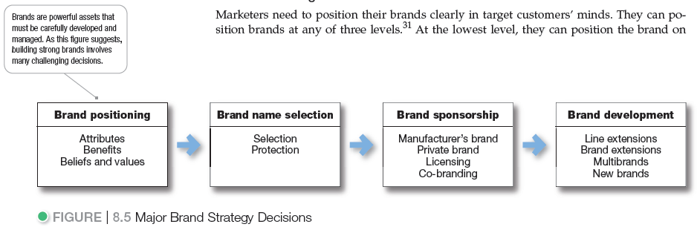
Brand Strategy: Building Strong Brands
Branding poses challenging decisions to the marketer. Figure 8.5 shows that the major brand strategy decisions involve brand positioning, brand name selection, brand sponsorship, and brand development.
Notes:
Branding poses challenging decisions to the marketer. Figure 8.5 shows that the major brand strategy decisions involve brand positioning, brand name selection, brand sponsorship, and brand development.

Slide 52
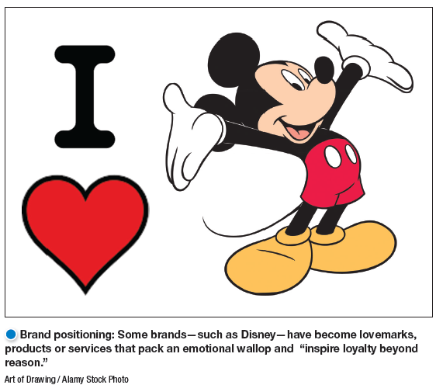
Brand Strategy: Building Strong Brands
Building Strong Brands
Brand Positioning
Marketers can position brands at any of three levels.
Attributes
Benefits
Beliefs and values
Marketers need to position their brands clearly in target customers’ minds. They can position brands at any of three levels.
At the lowest level, they can position the brand on product attributes. For example, P&G’s Pampers’ early marketing focused on attributes such as fluid absorption, fit, and disposability. Attributes are the least desirable level for brand positioning because competitors can easily copy attributes. Customers are not interested in what the attributes are—they are interested in what the attributes will do for them.
Notes:
Marketers need to position their brands clearly in target customers’ minds. They can position brands at any of three levels.
At the lowest level, they can position the brand on product attributes. For example, P&G’s Pampers’ early marketing focused on attributes such as fluid absorption, fit, and disposability. Attributes are the least desirable level for brand positioning because competitors can easily copy attributes. Customers are not interested in what the attributes are—they are interested in what the attributes will do for them.
A brand can be better positioned by associating its name with a desirable benefit. Thus, Pampers can go beyond technical product attributes and talk about the resulting containment and skin-health benefits from dryness.
The strongest brands are positioned on strong beliefs and values, engaging customers on a deep, emotional level. For example ,Pampers is positioned as a “love, sleep, and play brand where we grow together” that’s concerned about happy babies, parent-child relationships, and total baby care.
Successful brands engage customers on a deep, emotional level. Brands ranging from Apple, Google, Disney, and Coca-Cola to Google and Pinterest have achieved this status with many of their customers. Customers don’t just like these brands, they have strong emotional connections with them and love them unconditionally.
When positioning a brand, the marketer should establish a mission for the brand and a vision of what the brand must be and do. A brand is the company’s promise to deliver a specific set of features, benefits, services, and experiences consistently to buyers. The brand promise must be simple and honest

Slide 53
Building Strong Brands
A brand can be better positioned by associating its name with a desirable benefit. Thus, Pampers can go beyond technical product attributes and talk about the resulting containment and skin-health benefits from dryness.
The strongest brands are positioned on strong beliefs and values, engaging customers on a deep, emotional level. For example ,Pampers is positioned as a “love, sleep, and play brand where we grow together” that’s concerned about happy babies, parent-child relationships, and total baby care.
Successful brands engage customers on a deep, emotional level. Brands ranging from Apple, Google, Disney, and Coca-Cola to Google and Pinterest have achieved this status with many of their customers. Customers don’t just like these brands; they have strong emotional connections with them and love them unconditionally.
When positioning a brand, the marketer should establish a mission for the brand and a vision of what the brand must be and do. A brand is the company’s promise to deliver a specific set of features, benefits, services, and experiences consistently to buyers. The brand promise must be simple and honest

Slide 54
Brand Strategy: Building Strong Brands
Building Strong Brands
Brand Name Selection
Suggests benefits and qualities
Easy to pronounce, recognize, and remember
Distinctive
Extendable
Translatable for the global economy
Capable of registration and legal protection
Desirable qualities for a brand name include the following.
It should suggest something about the product’s benefits and qualities: Beautyrest, Lean Cuisine, Snapchat, Pinterest.
It should be easy to pronounce, recognize, and remember: iPad, Tide, Jelly Belly, Twitter, JetBlue.
The brand name should be distinctive: Panera, Swiffer, Zappos, Nest.
It should be extendable—Amazon.com began as an online bookseller but chose a name that would allow expansion into other categories.
The name should translate easily into foreign languages. Before changing its name to Exxon, Standard Oil of New Jersey rejected the name Enco, which it learned meant a stalled engine when pronounced in Japanese.
It should be capable of registration and legal protection. A brand name cannot be registered if it infringes on existing brand names.
Notes:
Desirable qualities for a brand name include the following.
(1) It should suggest something about the product’s benefits and qualities: Beautyrest, Lean Cuisine, Snapchat, Pinterest.
(2) It should be easy to pronounce, recognize, and remember: iPad, Tide, Jelly Belly, Twitter, JetBlue.
(3) The brand name should be distinctive: Panera, Swiffer, Zappos, Nest.
(4) It should be extendable—Amazon.com began as an online bookseller but chose a name that would allow expansion into other categories.
(5) The name should translate easily into foreign languages. Before changing its name to Exxon, Standard Oil of New Jersey rejected the name Enco, which it learned meant a stalled engine when pronounced in Japanese.
(6) It should be capable of registration and legal protection. A brand name cannot be registered if it infringes on existing brand names.

Slide 55
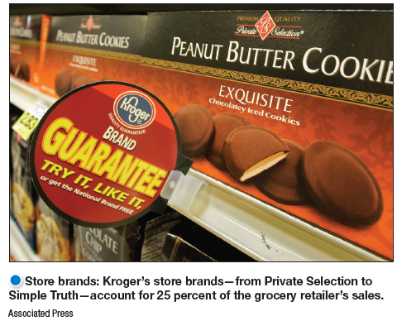
Brand Strategy: Building Strong Brands
Brand Sponsorship
Manufacturer’s brand
Private brand
Licensed brand
Co-brand
The popularity of store brands has soared recently. Kroger store brands account for a whopping 25 percent of its sales.
A manufacturer has four brand sponsorship options. The product may be launched as a national brand or a private brand (also called a store brand or distributor brand). Other alternatives include a licensed brand and co-branding.
National brands (or manufacturers’ brands) have long dominated the retail scene. In recent times, however, an increasing number of retailers and wholesalers have created their own store brands (or private brands). Store brands have been gaining strength for more than two decades, but recent tighter economic times have created a store-brand boom.
Notes:
The popularity of store brands has soared recently. Kroger store brands account for a whopping 25 percent of its sales.
A manufacturer has four brand sponsorship options. The product may be launched as a national brand or a private brand (also called a store brand or distributor brand). Other alternatives include a licensed brand and co-branding.
National brands (or manufacturers’ brands) have long dominated the retail scene. In recent times, however, an increasing number of retailers and wholesalers have created their own store brands (or private brands). Store brands have been gaining strength for more than two decades, but recent tighter economic times have created a store-brand boom.
For example, Walmart’s private brands—Great Value food products; Sam’s Choice beverages; Equate pharmacy, health, and beauty products; White Cloud toilet tissue and diapers; Simple Elegance laundry products; and Canopy outdoor home products— account for a whopping 20 percent of its sales. Its private-label brands alone generate more sales than all P&G brands combined, and Walmart’s Great Value is the nation’s largest single food brand.
At the other end of the grocery spectrum, upscale Whole Foods Market offers an array of store-brand products. Target and Trader Joe’s are out-innovating many of their national-brand competitors. As a result, consumers are becoming loyal to store brands for reasons besides price. Recent research showed that 80 percent of all shoppers believe store brand quality is equal to or better than that of national brands. In some cases, consumers are even willing to pay more for store brands that have been positioned as gourmet or premium items.
Licensing: Some companies license names or symbols previously created by other manufacturers, names of well-known celebrities, or characters from popular movies and books. For a fee, any of these can provide an instant and proven brand name.
Co-branding occurs when two established brand names of different companies are used on the same product. Co-branding offers many advantages. Because each brand operates in a different category, the combined brands create broader consumer appeal and greater brand equity. Examples include Benjamin Moore and Pottery Barn, Taco Bell and Doritos.
Co-branding can take advantage of the complementary strengths of two brands. It also allows a company to expand its existing brand into a category it might otherwise have difficulty entering alone.
Co-branding has limitations and usually involves complex legal contracts and licenses. Co-branding partners must carefully coordinate their marketing mix, and each partner must trust that the other will take good care of its brand. If something damages the reputation of one brand, it can tarnish the co-brand as well.

Slide 56
For example, Walmart’s private brands—Great Value food products; Sam’s Choice beverages; Equate pharmacy, health, and beauty products; White Cloud toilet tissue and diapers; Simple Elegance laundry products; and Canopy outdoor home products— account for a whopping 20 percent of its sales. Its private-label brands alone generate more sales than all P&G brands combined, and Walmart’s Great Value is the nation’s largest single food brand.
At the other end of the grocery spectrum, upscale Whole Foods Market offers an array of store-brand products. Target and Trader Joe’s are out-innovating many of their national-brand competitors. As a result, consumers are becoming loyal to store brands for reasons besides price. Recent research showed that 80 percent of all shoppers believe store brand quality is equal to or better than that of national brands. In some cases, consumers are even willing to pay more for store brands that have been positioned as gourmet or premium items.
Licensing: Some companies license names or symbols previously created by other manufacturers, names of well-known celebrities, or characters from popular movies and books. For a fee, any of these can provide an instant and proven brand name.
Co-branding occurs when two established brand names of different companies are used on the same product. Co-branding offers many advantages. Because each brand operates in a different category, the combined brands create broader consumer appeal and greater brand equity. Examples include Benjamin Moore and Pottery Barn, Taco Bell and Doritos.
Co-branding can take advantage of the complementary strengths of two brands. It also allows a company to expand its existing brand into a category it might otherwise have difficulty entering alone.
Co-branding has limitations and usually involves complex legal contracts and licenses. Co-branding partners must carefully coordinate their marketing mix, and each partner must trust that the other will take good care of its brand. If something damages the reputation of one brand, it can tarnish the co-brand as well.

Slide 57
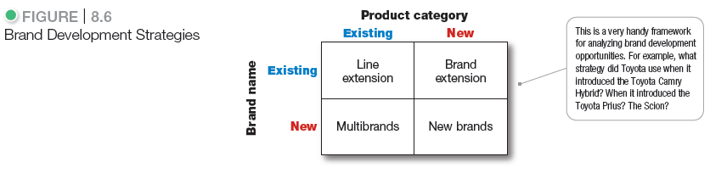
Brand Strategy: Building Strong Brands
A company has four choices when it comes to brand development (see Figure 8.6). It can introduce line extensions, brand extensions, multibrands, or new brands.
Line extensions occur when a company extends existing brand names to new forms, colors, sizes, ingredients, or flavors of an existing product category. For example, over the years, KFC has extended its “finger lickin’ good” chicken lineup well beyond original recipe and now offers grilled chicken, boneless fried chicken, chicken tenders, hot wings, and chicken bites. A line extension works best when it takes sales away from competing brands, not when it “cannibalizes” the company’s other items.
Brand extension extends a current brand name to new or modified products in a new category. For example, Starbucks has extended its retail coffee shops by adding packaged supermarket coffees, a chain of teahouses (Teavana Fine Teas + Tea Bar), and even a single-serve home coffee, espresso, and latte machine—the Verismo. And P&G has leveraged the strength of its Mr. Clean household cleaner brand to launch several new lines: cleaning pads (Magic Eraser), bathroom cleaning tools (Magic Reach), and home auto cleaning kits (Mr. Clean AutoDry).
Notes:
A company has four choices when it comes to brand development (see Figure 8.6). It can introduce line extensions, brand extensions, multibrands, or new brands.
Line extensions occur when a company extends existing brand names to new forms, colors, sizes, ingredients, or flavors of an existing product category. For example, over the years, KFC has extended its “finger lickin’ good” chicken lineup well beyond original recipe and now offers grilled chicken, boneless fried chicken, chicken tenders, hot wings, and chicken bites. A line extension works best when it takes sales away from competing brands, not when it “cannibalizes” the company’s other items.
Brand extension extends a current brand name to new or modified products in a new category. For example, Starbucks has extended its retail coffee shops by adding packaged supermarket coffees, a chain of teahouses (Teavana Fine Teas + Tea Bar), and even a single-serve home coffee, espresso, and latte machine—the Verismo. And P&G has leveraged the strength of its Mr. Clean household cleaner brand to launch several new lines: cleaning pads (Magic Eraser), bathroom cleaning tools (Magic Reach), and home auto cleaning kits (Mr. Clean AutoDry).
Multibrands: Companies often market many different brands in a given product category. For example, in the United States, PepsiCo markets at least eight brands of soft drinks (Pepsi, Sierra Mist, Mountain Dew, Manzanita Sol, Mirinda, IZZE, Tropicana Twister, and Mug root beer), three brands of sports and energy drinks (Gatorade, AMP Energy, and Starbucks Refreshers), four brands of bottled teas and coffees (Lipton, SoBe, Starbucks, and Tazo), three brands of bottled waters (Aquafina, H2OH!, and SoBe), and nine brands of fruit drinks (Tropicana, Dole, IZZE, Lipton, Looza, Ocean Spray, and others). Each brand includes a long list of sub-brands.
New brands: A company might believe that the power of its existing brand name is waning, so a new brand name is needed. Or it may create a new brand name when it enters a new product category for which none of its current brand names are appropriate. For example, Toyota created the separate Lexus brand aimed at luxury car consumers and the Scion brand, targeted toward Millennial consumers.
As with multibranding, offering too many new brands can result in a company spreading its resources too thin. And in some industries, such as consumer packaged goods, consumers and retailers have become concerned that there are already too many brands, with too few differences between them.
Thus, P&G, PepsiCo, Kraft, and other large consumer-product marketers are now pursuing megabrand strategies—weeding out weaker or slower-growing brands and focusing their marketing dollars on brands that can achieve the number-one or number-two market share positions with good growth prospects in their categories.

Slide 58
Multibrands: Companies often market many different brands in a given product category. For example, in the United States, PepsiCo markets at least eight brands of soft drinks (Pepsi, Sierra Mist, Mountain Dew, Manzanita Sol, Mirinda, IZZE, Tropicana Twister, and Mug root beer), three brands of sports and energy drinks (Gatorade, AMP Energy, and Starbucks Refreshers), four brands of bottled teas and coffees (Lipton, SoBe, Starbucks, and Tazo), three brands of bottled waters (Aquafina, H2OH!, and SoBe), and nine brands of fruit drinks (Tropicana, Dole, IZZE, Lipton, Looza, Ocean Spray, and others). Each brand includes a long list of sub-brands.
New brands: A company might believe that the power of its existing brand name is waning, so a new brand name is needed. Or it may create a new brand name when it enters a new product category for which none of its current brand names are appropriate. For example, Toyota created the separate Lexus brand aimed at luxury car consumers and the Scion brand, targeted toward Millennial consumers.
As with multibranding, offering too many new brands can result in a company spreading its resources too thin. And in some industries, such as consumer packaged goods, consumers and retailers have become concerned that there are already too many brands, with too few differences between them.
Thus, P&G, PepsiCo, Kraft, and other large consumer-product marketers are now pursuing megabrand strategies—weeding out weaker or slower-growing brands and focusing their marketing dollars on brands that can achieve the number-one or number-two market share positions with good growth prospects in their categories.

