Slide 1







The Stack overflow developer survey
Reema Gangwani
26th June 2024

Slide 2



OUTLINE
Executive Summary
Introduction
Methodology
Results
Visualization – Charts
Dashboard
Discussion
Findings & Implications
Conclusion
Appendix

Slide 3

EXECUTIVE SUMMARY
This report highlights various aspects of the developer survey basis the demographics and data technologies.
The trends and indepth analysis of the following factors were carried out -
Current technology usage,
Future Technology Trends,
Demographics
Technological gaps in various countries were also studied

Slide 4

INTRODUCTION
This project highlights the trends in software development
This will help the HR and IT department to –
Identify skill requirement in the future,
Understand the top programming languages in demand,
The Popular IDE’s in the market,
Understand the top skills preferred by skilled professionals

Slide 5

METHODOLOGY
Data Exploration
Data Cleaning
Data Visualizations using various software
Dashboarding for better communication and understanding of data
Presentation

Slide 6
RESULTS
JavaScript is the most commonly used programming language, but Python has risen in the ranks,
About one-quarter of respondents are enrolled in a formal college or university program full-time or part-time,
jQuery is the most broadly used of these web frameworks,
Men have more preferences towards coding vs any other gender,
The project also gives a very good understanding of the programs , webframes and languages desired in the future.

Slide 7
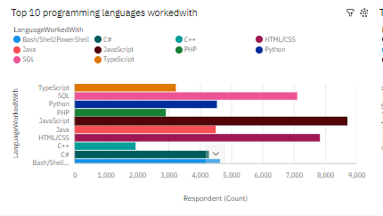
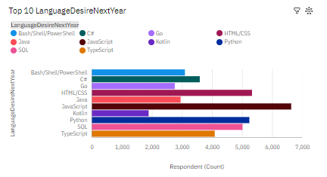
PROGRAMMING LANGUAGE TRENDS
Current Year
Next Year

Slide 8
PROGRAMMING LANGUAGE TRENDS - FINDINGS & IMPLICATIONS
Findings
Java script , SQL, HTML/CSS are top 3 this year
Python and typescript becoming popular for next year
PowerShell edged out in the upcoming year
Implications
Web development are still in high demand
Big data technology in companies still need
With AI and ML in rising demand, python is the best choice

Slide 9
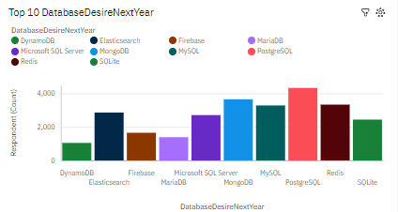
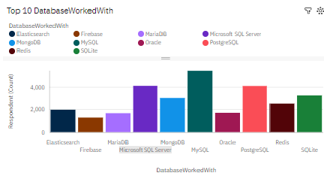
DATABASE TRENDS
Current Year
Next Year

Slide 10
DATABASE TRENDS - FINDINGS & IMPLICATIONS
Findings
MYSQL is the most popular database followed by Microsoft SQL
Mongo DB and Redis are upcoming favorites
Elastisearch seems to be getting highlighted in the future
Implications
Opensource databases are still preferred by firms
NoSQL databases will make an impact for storing non relational data
Redis support abstract data types hence getting popular

Slide 11

DASHBOARD
https://github.com/Reemasadhwani/Final-Assignments/blob/main/Last%20assignment%20-%20IBM%20COGNOS.pdf

Slide 12
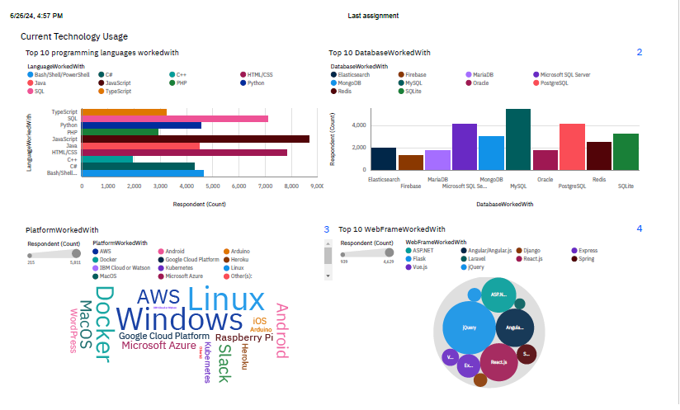
DASHBOARD TAB 1

Slide 13
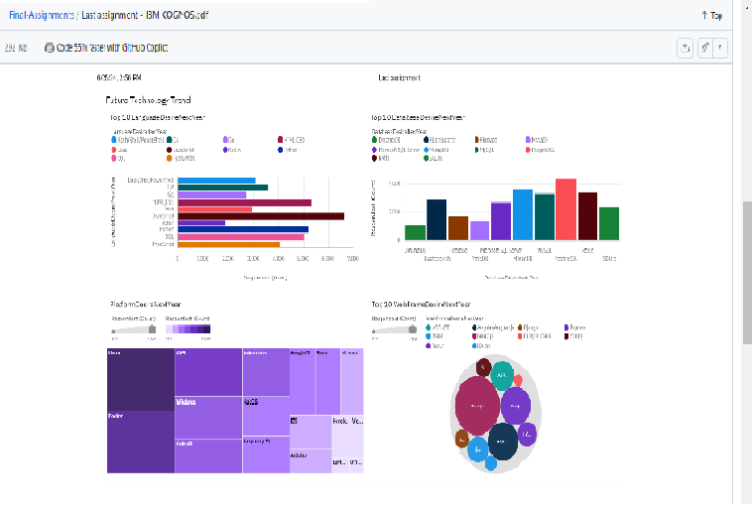
DASHBOARD TAB 2

Slide 14
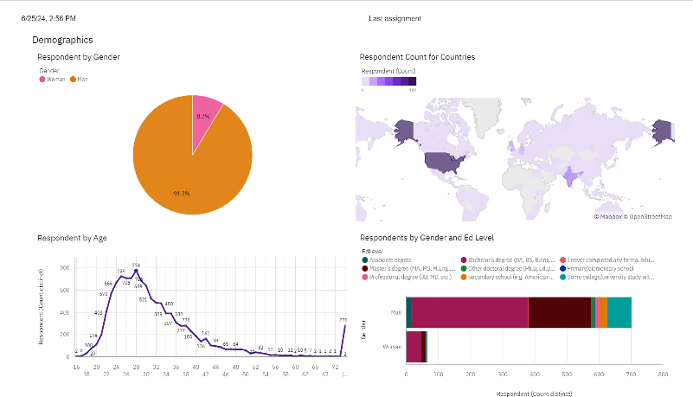
DASHBOARD TAB 3

Slide 15
DISCUSSION
Technology trends then vs now
Women and other Gender inclusion and interest in technology field
Elimination of gaps in technology and ways to introduce in various sectors

Slide 16
OVERALL FINDINGS & IMPLICATIONS
Findings
The technology is chnaged at a very fast pace
There is a massive concentration in coutries like India and USA
Major gaps in Gender based jobs requirements
Platforms like AWS are growing
Implications
High need for companies to be flexible and adaptive
Need introduce techologies in developing countries
Impact in Job Demands
Shift to better and faster technologies for better and faster deployments

Slide 17

CONCLUSION
Technology is rapidly being accepted and changing
Demographics have to be worked up including gender, countries and age
Various actions can be taken to cope with the changing needs and also the demands for technological education
Machine learnings can be incorporated in the future to predict trends and salaries

Slide 18
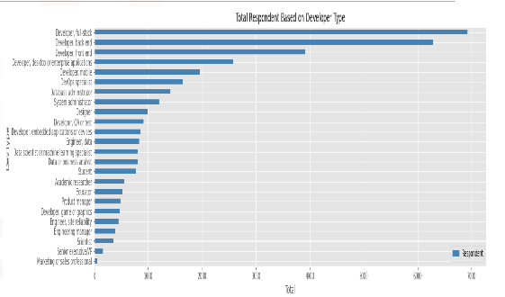

APPENDIX

Slide 19
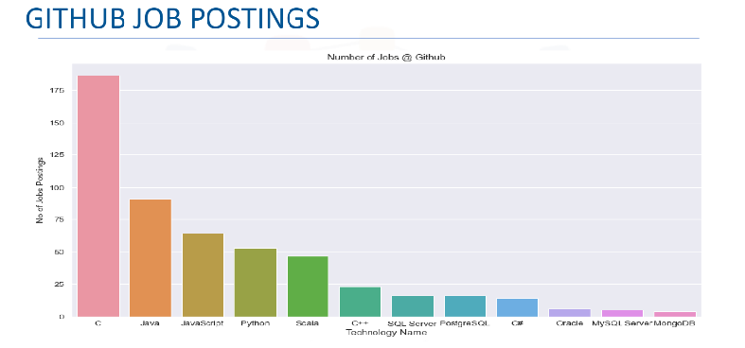
JOB POSTINGS

Slide 20
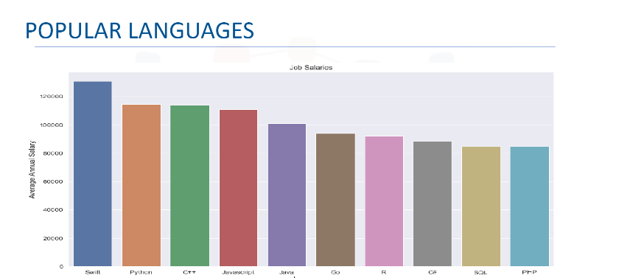
POPULAR LANGUAGES

