Slide 1
تحليل الثغرات الأمنية وتطوير الآليات الدفاعية في الشبكات السيارة VANET
Security Vulnerability Analysis and Defensive Mechanisms Development in
VANET
Prepared by: ريم بعاج & عدنان صبري
Supervised by: د.وسيم الجنيدي م. محمد يامن

Slide 2
Introduction to VANET
-Vehicular Ad Hoc Network used in Intelligent Transportation Systems
-Supports V2V, V2I, and V2X communication
-Enhances road safety and traffic efficiency
-Uses wireless ad hoc communication
VANET Security Project

Slide 3
Problem Statement
-Open wireless communication introduces vulnerabilities
-High mobility creates dynamic topology challenges
-Identity spoofing may spread false information
-Security mechanisms may affect latency and performance
VANET Security Project

Slide 4
Research Objectives
-Build realistic VANET simulation
-Implement Identity Spoofing attack
-Develop detection and mitigation mechanisms
-Evaluate network and security performance
VANET Security Project

Slide 5
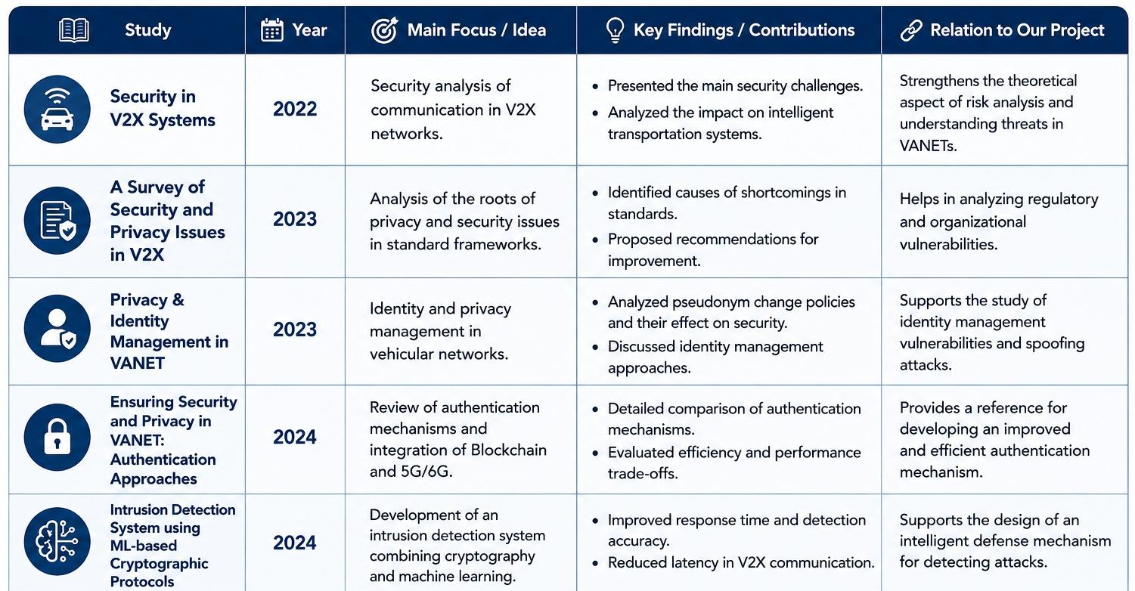
State of the Art

Slide 6
Simulation Environment
-NS-3 for network simulation
-SUMO for realistic traffic mobility
-Python + TraCI for visualization
-40 vehicles and 2 RSUs
VANET Security Project

Slide 7
Network Configuration
-IEEE 802.11 Wi-Fi Ad Hoc
-AODV routing protocol
-UDP communication
-Supports V2V and V2I communication
VANET Security Project

Slide 8
Identity Spoofing Attack
-Attacker node: vehicle19
-Uses fake identities dynamically
-Injects fake warning and traffic messages
-Sender ≠ claimedId
VANET Security Project

Slide 9
Detection & Mitigation
-Compare sender with claimed identity
-Detect malicious messages in real time
-Drop spoofed packets
-Mark attacker as suspicious
VANET Security Project

Slide 10
Performance Metrics
-Packet Delivery Ratio (PDR)
-Packet Loss
-Throughput
-Detection Accuracy
-Mitigation Rate
VANET Security Project

Slide 11
Results
-Before protection: lower reliability and higher packet loss
-After protection: improved PDR and stable throughput
-Spoofed packets detected successfully
-Improved VANET security performance
VANET Security Project

Slide 12
Strengths and Limitations
Strengths: lightweight, fast, low overhead
Real-time spoofing detection
Limitation: focused mainly on spoofing attacks
No machine learning integration
VANET Security Project

Slide 13
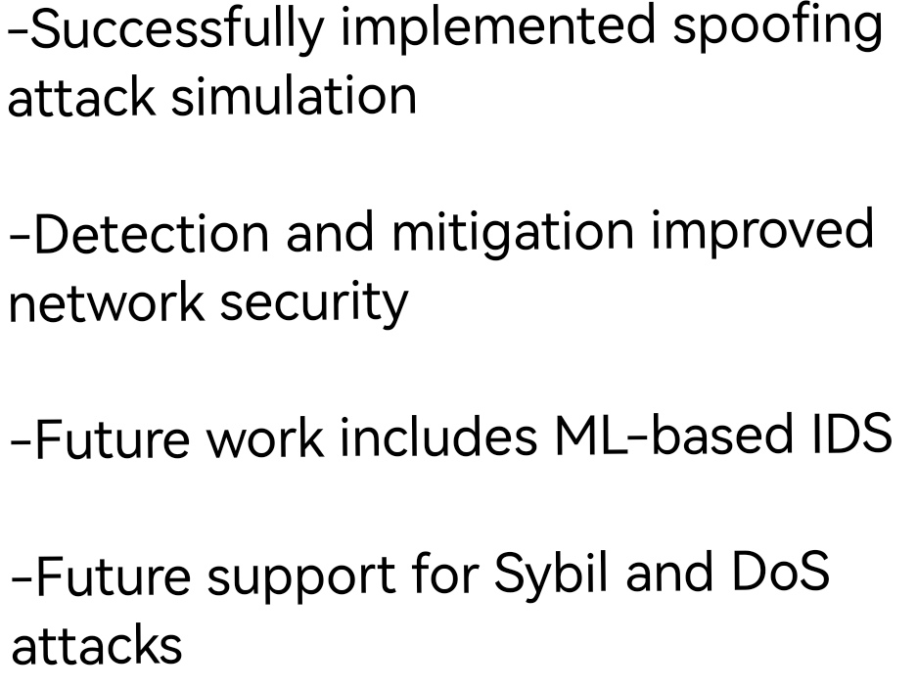
Conclusion & Future Work
VANET Security Project

