Slide 1
Superstore
File created on: 2/19/2023 11:18:19 AM

Slide 2
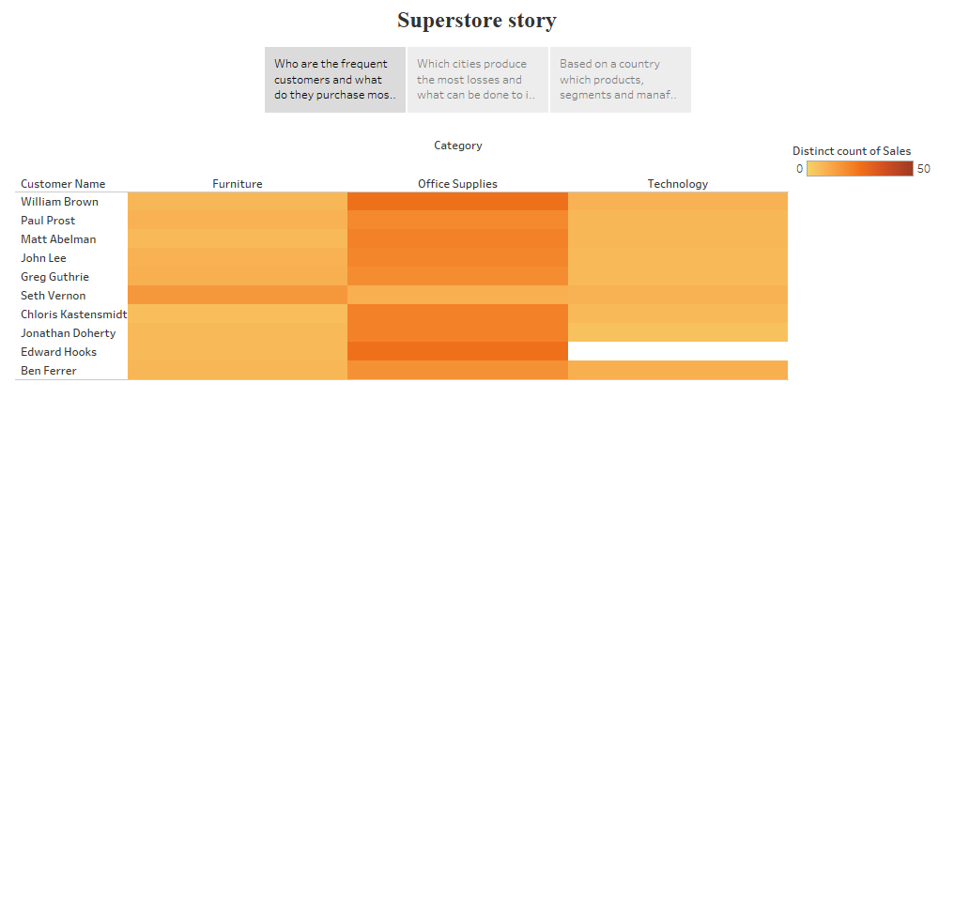

Slide 3
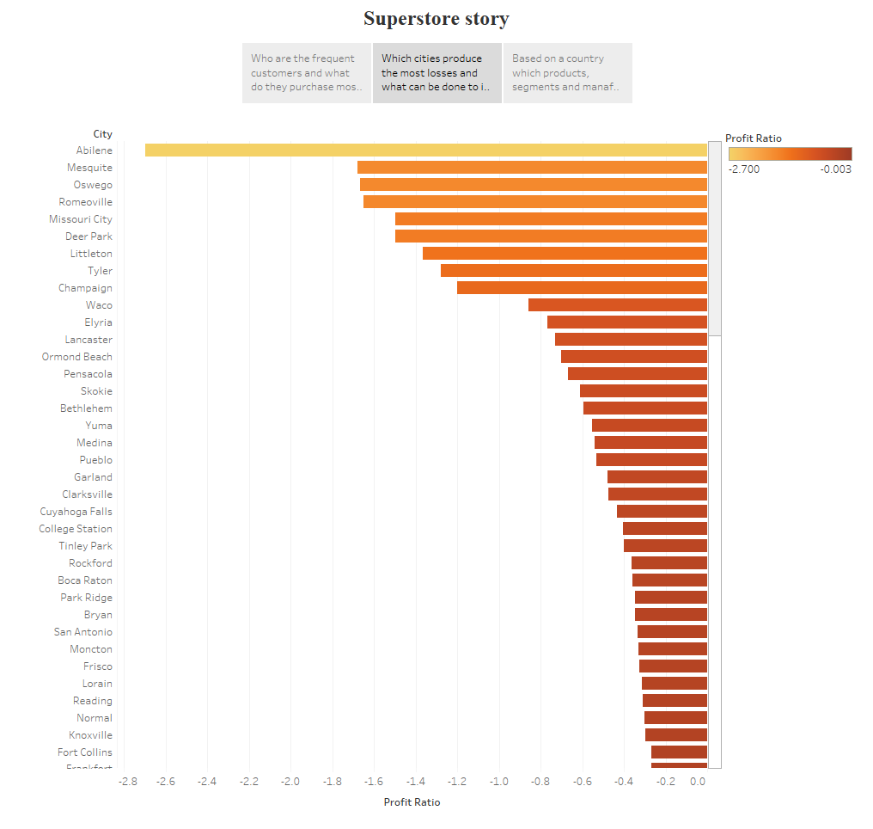

Slide 4
