Slide 1


DYNAMIC ROUTING AND POWER CONTROL IN WSNs WITH K-MEANS AND Q-LEARNING
Domain: Artificial Intelligence

Slide 2
GUIDE NAME
Mrs. P. UMA MAHESHWARI, M.E.
Assistant Professor,
Department of CSBS,
K.Ramakrishnan College of Engineering (Autonomous)
BATCH 3
TEAM MEMBERS
REENA S (8115U22CB044)
SHREE HARINI S (8115U22CB050)
SOUNDARYA A L (8115U22CB052)

Slide 3
LIST OF SLIDE
Introduction
Abstract
Literature Survey
Existing System
Disadvantages
Problem Statement
Proposed System
Advantages
List of Modules
Modules Explanation
Future Enhancement
Conclusion
References

Slide 4
INTRODUCTION
Wireless Sensor Networks (WSNs) consist of multiple low-power sensor nodes used to sense, process, and transmit data.
These nodes have limited battery power and processing capability, making energy efficiency a major challenge.
This project introduces an AI-based model that combines K-Means clustering and Q-Learning to improve routing and power control in WSNs.
K-Means reduces intra-cluster distance, and Q-Learning selects the most energy-efficient routes dynamically.

Slide 5
ABSTRACT
Wireless Sensor Networks (WSNs) suffer from limited battery power and high energy consumption due to inefficient routing. This project proposes an intelligent energy-efficient communication model using K-Means clustering and Q-Learning. Sensor nodes are grouped into clusters, and cluster heads are selected based on distance and residual energy. Q-Learning dynamically determines the optimal routing path to the base station. Power control and sleep scheduling further reduce unnecessary energy usage. The proposed approach improves energy efficiency and extends overall network lifetime.

Slide 6
LITERATURE SURVEY
Title | AUTHOR | ALGORITHM
Q-Learning-Based Energy-Efficient Routing (2021) | Wan-Kyu Yun & Sang-Jo Yoo | Q-Learning-Based Data Aggregation & Energy-Efficient Routing
EEMLCR using LEACH protocols (2025) | Muhammad Akram, Sibghat Ullah Bazai, Muhammad Imran | LEACH Protocol Algorithms
AI in Sensor Networks (2024) | Salim El Khediri & Awatef Benfradj | ML & RL techniques for WSN optimization

Slide 7
Title | AUTHOR | ALGORITHM
Energy-Efficient Q-Learning Routing (2025) | Huda Salih Abd & Asaad S. Daghul | Dynamic K-Means + Q-Learning + Sleep Scheduling
Reinforcement Learning for WSN Optimization (2024) | Yan Wang, Ke Deng, Yongli Ren, Jeffrey Chan | Reinforcement Learning–Enhanced Cluster-Based Routing

Slide 8
EXISTING SYSTEM
Existing WSN routing methods like LEACH, DMHT-LEACH, EDMHT-LEACH use static or probabilistic models.
They suffer from:
No dynamic routing decisions
Poor scalability in large networks
Uneven energy distribution
High packet loss in long-distance communication
Early node death due to inefficient cluster head selection

Slide 9
DISADVANTAGES OF EXISTING SYSTEM
Static cluster head selection
No learning-based optimization
High energy consumption
Poor adaptability to network changes
Limited lifetime of sensor nodes
No intelligent multi-hop routing

Slide 10
PROBLEM STATEMENT
Sensor nodes in WSNs have limited battery power.
Traditional static routing methods cause high energy consumption and early node failure.
An intelligent, adaptive routing and clustering mechanism is required to optimize energy usage and improve network lifetime.

Slide 11
PROPOSED SYSTEM
✔ K-Means Clustering
Groups nodes based on location, creates balanced clusters, and reduces communication distance.
✔ Q-Learning Routing
Learns optimal multi-hop routes using rewards based on energy, hop count, and successful delivery.
✔ Energy Model
Tracks transmission, reception, and aggregation energy.
✔ Performance Evaluation
Compares with LEACH, DMHT-LEACH, and modern methods like EECDA.

Slide 12
ADVANTAGES OF PROPOSED SYSTEM
Increased network lifetime
Reduced energy consumption
Balanced load distribution
Better packet delivery rate
Adaptive routing with learning behavior
Supports large-scale WSN deployments
Minimal packet loss
Optimized energy usage across nodes

Slide 13
LIST OF MODULES
Data Collection & Initialization
K-Means Clustering
Q-Learning-Based Routing
Results Visualization & Analysis
Performance Evaluation
Energy Consumption Analysis

Slide 14
MODULES EXPLANATION
1. Data Collection & Initialization
Data Collection & Initialization
Deploy sensor nodes in the network area
Initialize system before communication
Prepare nodes for clustering and routing
Define environment for simulation
This module is the starting stage of our system. Here, sensor nodes are deployed in the network area, and the entire environment is initialized for further processing like clustering and routing.

Slide 15
Node Deployment & Energy Initialization
Nodes are randomly distributed in sensing area
Each node is assigned initial energy
Energy is limited and non-rechargeable
Energy used for sensing, processing, transmission
In this step, sensor nodes are randomly placed in the sensing field. Each node is given an initial energy value, which is limited. This energy is used for sensing, processing, and communication.

Slide 16
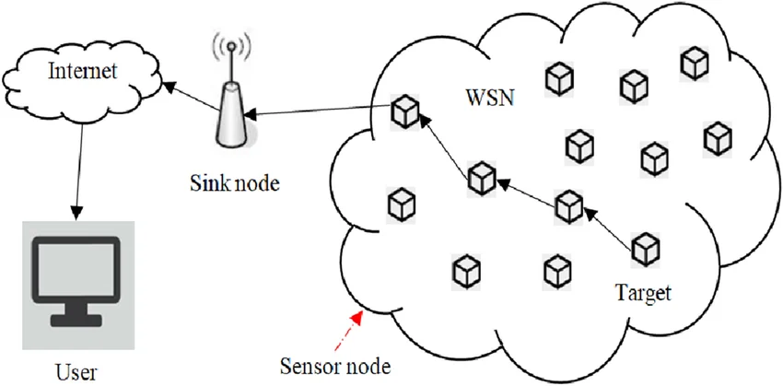
Simulation Parameters & Base Station
Define number of nodes
Set area size and communication range
Set number of rounds
Place base station inside/outside network
Here, we define simulation parameters such as number of nodes, area size, and communication rounds. The base station is also placed, which collects all data from sensor nodes.

Slide 17
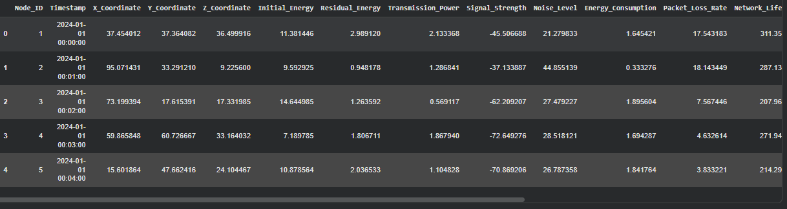
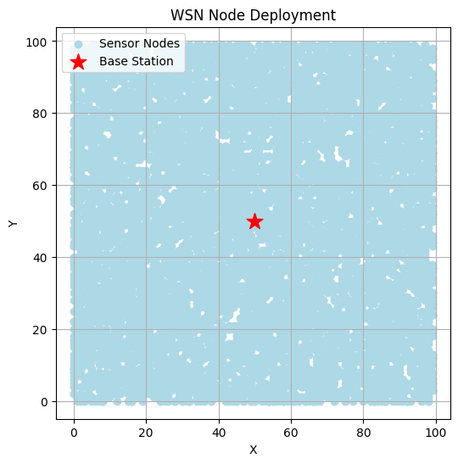

Slide 18
2. K-Means Clustering
K-Means Clustering
Groups sensor nodes into clusters
Based on node location (distance)
Reduces communication complexity
Improves energy efficiency
In this module, K-Means clustering is used to group sensor nodes based on their location. This helps reduce communication distance and improves overall energy efficiency of the network.

Slide 19
.
Cluster Formation
Calculates cluster centers (centroids)
Assigns nodes to nearest centroid
Forms multiple clusters
Repeats until stable clusters are formed
K-Means first calculates the centroid, which is the center of a group of nodes. Then, each node is assigned to the nearest centroid. This process repeats until clusters are stable.

Slide 20
Cluster Head Selection
Select node near centroid
Consider residual energy
Cluster Head manages communication
Reduces intra-cluster energy usage
After forming clusters, a cluster head is selected. The node closest to the centroid with higher energy is chosen as the cluster head. It collects data from nodes and forwards it efficiently.

Slide 21
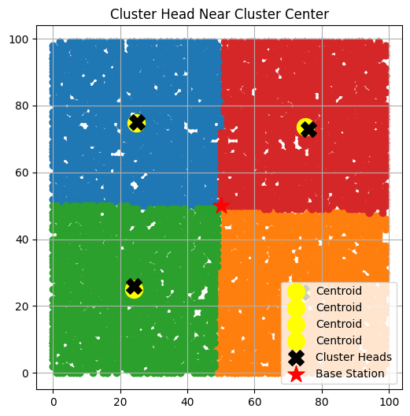
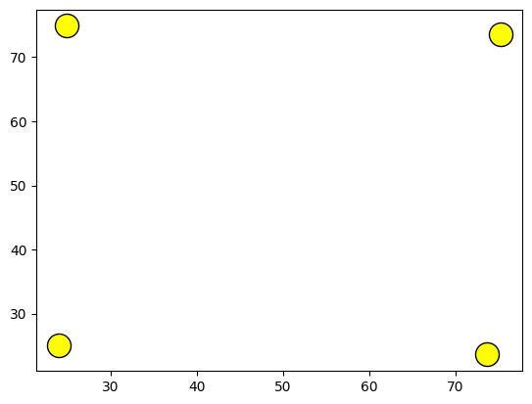

Slide 22
3. Q-Learning Routing
Q-Learning Overview
Reinforcement learning technique
Finds optimal routing path
Adapts to network conditions
Improves energy efficiency
Q-Learning is used to find the best routing path from cluster heads to the base station. It learns and improves routing decisions based on network conditions.

Slide 23
States, Actions, Reward
States: distance, energy, neighbors
Action: select next-hop node
Reward: energy saving + successful transmission
In Q-Learning, the state includes distance, energy, and neighboring nodes. The action is selecting the next hop, and the reward is based on energy efficiency and successful data delivery.

Slide 24
Optimal Path Selection
Updates Q-table continuously
Learns best path over time
Avoids low-energy nodes
Ensures reliable communication
The Q-table is updated continuously, and the algorithm learns the best routing path. It avoids nodes with low energy and ensures efficient communication.

Slide 25
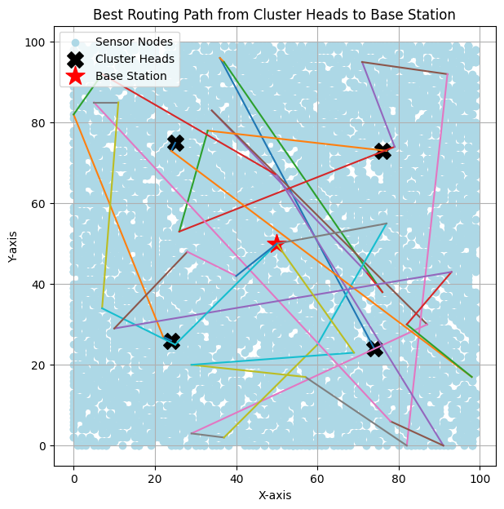

Slide 26
4.Energy Consumption Analysis
Energy Model Overview
Calculates energy usage in communication
Important for network lifetime
Tracks battery usage
This module calculates how much energy is consumed during communication and helps in evaluating network performance.

Slide 27
Energy Components
Transmission energy
Reception energy
Data aggregation cost
Energy is consumed during transmission, reception, and data aggregation at the cluster head.

Slide 28
Energy Update
Updates node energy after transmission
Reduces battery level
Detects dead nodes
After each transmission, node energy is reduced. If energy reaches zero, the node becomes dead.

Slide 29
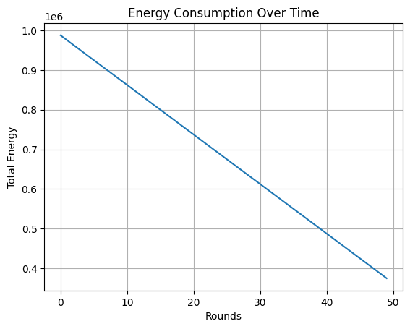

Slide 30
5. Performance Evaluation
Evaluation Overview
Measures system performance
Evaluates efficiency
Validates proposed method
This module evaluates how well the proposed system performs in terms of energy and network lifetime.

Slide 31
Performance Metrics
Alive nodes
Average energy
Network lifetime
Packet delivery ratio
The system performance is measured using metrics such as alive nodes, energy levels, and packet delivery ratio.

Slide 32
.
Comparison
Compared with existing protocols
LEACH
DMHT-LEACH
EDMHT-LEACH
The proposed method is compared with existing protocols like LEACH and its variants to show improved performance.

Slide 33
.

Slide 34
6.Results Visualization & Analysis
Visualization Overview
Converts results into graphs
Easy to analyze performance
Supports conclusion
This module presents the results using graphs to make analysis easier and clearer.

Slide 35
Graphs Generated
Alive nodes vs rounds
Energy vs rounds
Packets received vs rounds
Different graphs are generated to show how the network performs over time.

Slide 36
Analysis
Shows improved lifetime
Better energy efficiency
Higher packet delivery
The results show that the proposed system improves network lifetime, reduces energy consumption, and increases data delivery efficiency.

Slide 37
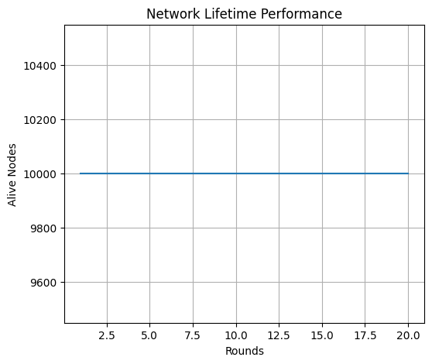
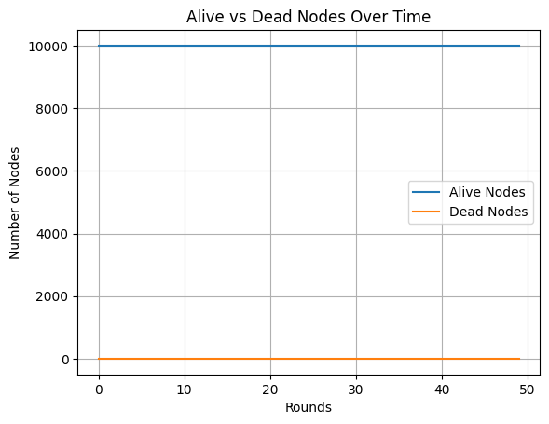
.

Slide 38
FUTURE ENHANCEMENT
Introduce Deep Q-Learning (DQN) for more intelligent routing
Add mobile sensor node support
Incorporate real-time environmental factors
Integration with IoT cloud platforms
Introduce anomaly detection for node failure prediction
Enable adaptive sleep scheduling

Slide 39
CONCLUSION
The proposed K-Means + Q-Learning model provides an intelligent, adaptive, and energy-efficient routing solution for WSNs. It improves network lifetime, reduces energy consumption, and enhances communication reliability. Compared to existing LEACH-based protocols, it performs significantly better, especially in large networks. This shows that Artificial Intelligence is a powerful tool for optimizing wireless sensor communication.

Slide 40
REFERENCE
[1] Wan Kyu Yun a nd Sang Jo Yoo “Q Learning Based Data Aggregation Aware
Energy Efficient Routing Protocol for Wireless Sensor Networks ”, IEEE
International conference,2021.
[2] Muhammad Akram, Sibghat Ullah Bazai, Muhammad Imran , EEMLCR:
Energy Efficient Machine Learning Based Clustering and Routing for Wireless
Sensor Networks IEEE International conference,2025.
[3] Salim El Khediri, Awatef Benfradj, “ Integration of artificial intelligence (AI)
with sensor networks: Trends, challenges, and future directions” Journal of King
Saud University Computer and Information Sciences.

Slide 41
[4] Huda Salih Abd , Asaad S Daghul, An Energy Efficient Scheduling and
Routing Protocol Based on Q Learning for WSN Asian Journal of Computing
and Engineering Technology.
[5] Yan Wang, Ke Deng, Yongli Ren , Jeffrey Chan, Reinforcement Learning for
Tackling Energy saving and Energy balance Dilemma of Cluster based Routing
Protocols in WSNs IEEE International confer ence,2024.
[6] F. A. Khan, M. Khan, M. Asif, A. Khalid, and I. U. Haq, ‘‘Hybrid and multi hop
advanced zonal stable election protocol for wireless sensor networks,’’ IEEE
Access,2019.

Slide 42
THANK YOU

