Slide 1

Mini PROJECT

Slide 2
Smart Bridge - Automatic Height Increase
P.REENA -21R21A0543
B.RAMESH -21R21A0506
K.SAIPRIYA -21R21A0526
SHAIK MUBEEN -21R21A0554
GUIDE: Mr. PC BALAJI ANBARASAN

Slide 3
CONTENTS
Abstract
Literature Survey
Software Requirements
Hardware Requirements
Functional Requirements
Non-Functional Requirements
Existing System
Proposed System
System Architecture
Advantages & Disadvantages
Conclusion

Slide 4
ABSTRACT
Bridges are the foundation of a country’s transport and they are expensive to build and maintain.
In recent years, due to increase in different global climatic conditions, bridges have been damaged.
To over come this problem, a smart bridge system is introduced to maintain the bridges in a proper conditions at different climatic conditions.
Here,the height of the bridge increases automatically whenever the water level reaches its maximum point, and it prevents from the damage caused to bridge.

Slide 5
LITERATURE SURVEY
Title | Author’s name | Drawbacks
Smart Bridge: An Adaptive Bridge Design for Flooding Events | A. Smith et al (2018) | With the use of IoT devices in Smart bridges, energy consumption can significantly increase, leading to higher operational costs. The energy consumption may not be evenly distributed across the devices, which can further exacerbate the issue.
Automatic Bridge Height Control System for Flood Management | C. Brown et al (2020) | The interactions between multiple IoT devices in an Smart bridge network can lead to increased latency in data transmission. This can result in slow or unreliable performance, especially for applications that require real-time data processing, such as autonomous vehicles.
Sensing and Control Technologies for Flood Adaptive Bridges | G. Li et al. (2020) | Without IoT devices, automatic height increase bridges may have limited monitoring and control capabilities. This can make it difficult to detect and respond to issues in real-time, potentially leading to delays or disruptions in bridge operation

Slide 6

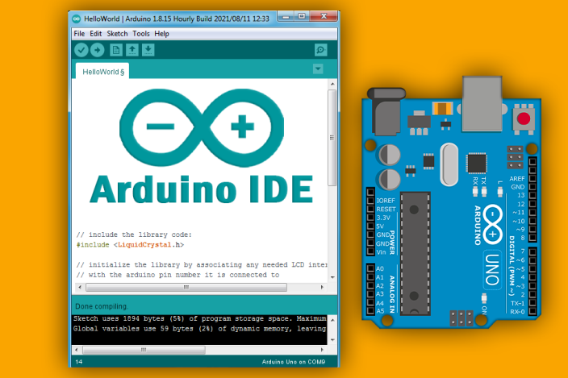
Software Requirements
C++ Language
Arduino IDE

Slide 7
Hardware Requirements
Arduino UNO
Servo Motor
Bread Board
Soil Moisture Sensor
Jumper Wires
Arduino Cable

Slide 8
Functional Requirements
Flood Detection: The system should be equipped with flood detection sensor.
Height Adjustment Mechanism: The bridge should be equipped with a height adjustment mechanism that allows it to be raised when flooding is detected.
Safety Measures: The system should incorporate safety features, such as barriers or warning signs, to prevent vehicular or pedestrian access to the bridge while it is being raised or during flooding conditions.
Maintenance and Testing: Regular maintenance and testing procedures should be established to ensure the proper functioning of the flood detection sensors.

Slide 9
Non-Functional Requirements
Reliability: Make sure the bridge works well in different weather conditions and that the height adjustment always works when it's supposed to.
Security: Keep the system safe from hackers or unauthorized access, especially when sending important flood-related information.
Scalability: Plan the system so it can grow or change easily in the future, like adding more sensors or bridge parts.
Power Efficiency: Use power wisely so the devices can last a long time on batteries or use as little external power as possible.
Fault Tolerance: Design the system so that if something breaks, it doesn't break everything, and the bridge can still work as much as possible.

Slide 10
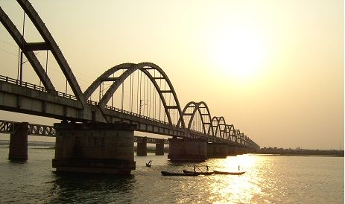
Existing System
Bridges are structures built to span physical obstacles like rivers, valleys, or roads.
They provide passage over these obstacles, making it easier to cross.
Bridges can be damaged due to changes in global climatic conditions.
There are different designs of bridges, each serving a specific purpose.
The design of a bridge depends on factors such as its function, the terrain it's built on, the materials used, and the available funds.

Slide 11
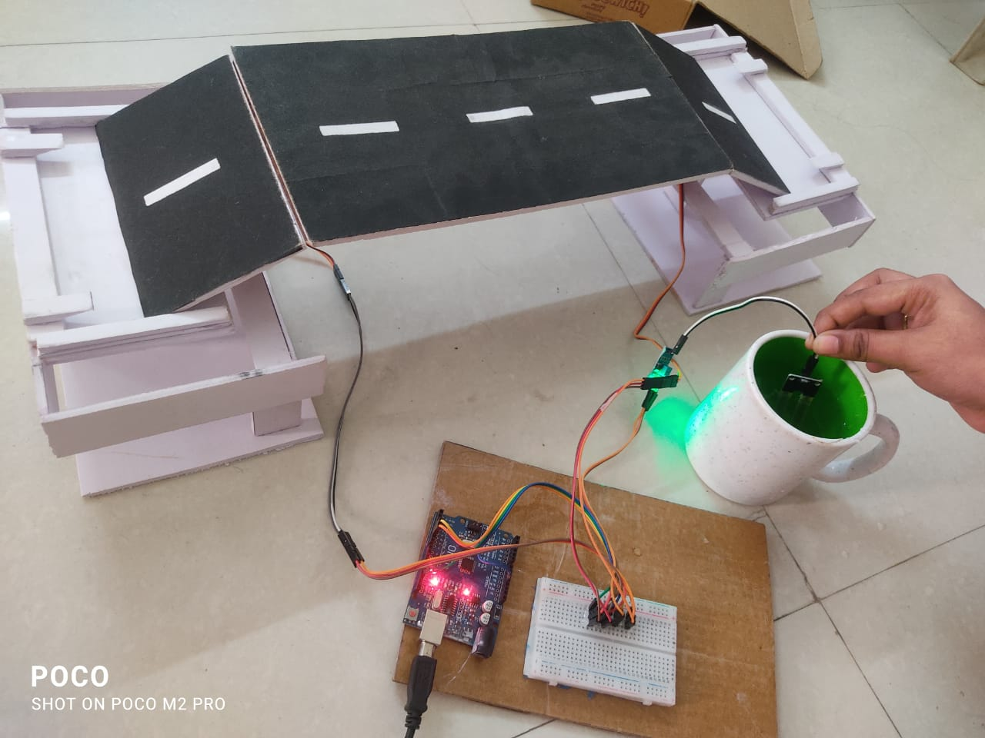
Proposed System
The proposed system for the bridge automatically increases its height when the water level reaches its maximum point, preventing damage.
Smart bridges are equipped with advanced technologies for monitoring, maintenance, and improved functionality.
They utilize sensors and communication systems to enhance efficiency and safety.
Sensors provide real-time data on structural health, traffic, and environmental conditions.
The integration of these technologies improves safety and efficiency of bridges.

Slide 12
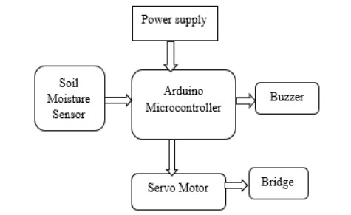
System Architecture

Slide 13
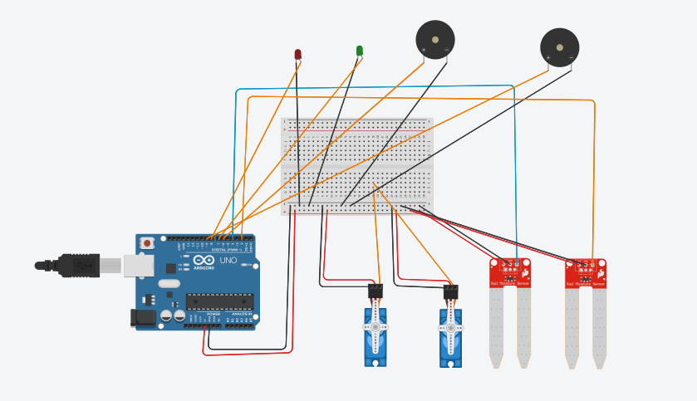
Proposed System

Slide 14
Advantages & Disadvantages
Advantages | Disadvantages
1.Enhanced Safety 2.Quick Response: 3.Reduced Human Error 4.Improved Efficiency 5.Integration with Flood Warning Systems | 1.Initial Cost 2.Maintenance and Upkeep 3.Power Dependency 4.System Complexity
It is important to carefully consider the advantages and disadvantages of automatic bridge height increase systems when planning for flood management strategies. Site-specific requirements, cost-effectiveness, and the expected benefits in terms of safety and operational efficiency should be evaluated before implementing such systems.

Slide 15
Conclusion
The smart bridge is very advance type of bridge
monitoring system.
Bridges can reduce network traffic and it can provide
safety during natural disasters.
The cost of the project is not so high and it can be
used and implemented in all movable bridges without
much increment of cost.
This smart bridge is best in its field and will be most
widely used.

Slide 16


