Slide 1
MRA Project ML 1
Reena ROY
DSBA-NOV’20
Dr.reenaroy@gmail.com

Slide 2
Agenda [Table OF CONTENT
Agenda & Executive Summary of the data
Problem statement
About Data (Info, Shape, Summary Stats, your assumptions about data)
Exploratory Analysis and Inferences
Univariate, Bivariate, and multivariate analysis using data visualization
Weekly, Monthly, Quarterly, Yearly Trends in Sales
Sales Across different Categories of different features in the given data
Customer Segmentation using RFM analysis (make 4 segments)
Which tool used?
What all parameters used and assumptions made
Output table head
If KNIME used, Workflow image to be put
Inferences from RFM Analysis and identified segments
Who are your best customers? (give at least 5)
Which customers are on the verge of churning? (give at least 5)
Who are your lost customers? (give at least 5)
Who are your loyal customers? (give at least 5)

Slide 3
PROBLEM STATEMENT
An automobile parts manufacturing company has collected data of transactions for 3 years. They do not have any in-house data science team, thus they have hired you as their consultant. Your job is to use your magical data science skills to provide them with suitable insights about their data and their customers.
The given sales dataset of a retail industry requires to analyse the dataset based on product and customer segementation against the Sales/ Revenue, Quantity Ordered and the Ordernumber. Here I have used Python for performing the pre-processing of the dataset, tableau for visualization and comparison of records against different attributes and finally Knime for RFM analysis

Slide 4
DATA DICTIONARY
ORDERNUMBER : | Order Number | CUSTOMERNAME : | customer
QUANTITYORDERED : | Quantity ordered | PHONE : | Phone of the customer
PRICEEACH : | Price of Each item | ADDRESSLINE1 : | Address of customer
ORDERLINENUMBER : | order line | CITY : | City of customer
SALES : | Sales amount | POSTALCODE : | Postal Code of customer
ORDERDATE : | Order Date | COUNTRY : | Country customer
DAYS_SINCE_LASTORDER : | Days_ Since_Lastorder | CONTACTLASTNAME : | Contact person customer
STATUS : | Status of order like Shipped or not | CONTACTFIRSTNAME : | Contact person customer
PRODUCTLINE : | Product line – CATEGORY | DEALSIZE : | Size of the deal based on Quantity and Item Price
MSRP : | Manufacturer's Suggested Retail Price
PRODUCTCODE : | Code of Product

Slide 5
Data SET- Head COUNT
 | ORDERNUMBER | QUANTITYORDERED | PRICEEACH | ORDERLINENUMBER | SALES | ORDERDATE | DAYS_SINCE_LASTORDER | STATUS | PRODUCTLINE | MSRP | PRODUCTCODE | CUSTOMERNAME | PHONE | ADDRESSLINE1 | CITY | POSTALCODE | COUNTRY | CONTACTLASTNAME | CONTACTFIRSTNAME | DEALSIZE
0 | 10107 | 30 | 95.7 | 2 | 2871 | ######## | 828 | Shipped | Motorcycles | 95 | S10_1678 | Land of Toys Inc. | 2.13E+09 | 897 Long Airport Avenue | NYC | 10022 | USA | Yu | Kwai | Small
1 | 10121 | 34 | 81.35 | 5 | 2765.9 | ######## | 757 | Shipped | Motorcycles | 95 | S10_1678 | Reims Collectables | 26.47.1555 | 59 rue de l'Abbaye | Reims | 51100 | France | Henriot | Paul | Small
2 | 10134 | 41 | 94.74 | 2 | 3884.34 | ######## | 703 | Shipped | Motorcycles | 95 | S10_1678 | Lyon Souveniers | +33 1 46 62 7555 | 27 rue du Colonel Pierre Avia | Paris | 75508 | France | Da Cunha | Daniel | Medium
3 | 10145 | 45 | 83.26 | 6 | 3746.7 | ######## | 649 | Shipped | Motorcycles | 95 | S10_1678 | Toys4GrownUps.com | 6.27E+09 | 78934 Hillside Dr. | Pasadena | 90003 | USA | Young | Julie | Medium
4 | 10168 | 36 | 96.66 | 1 | 3479.76 | ######## | 586 | Shipped | Motorcycles | 95 | S10_1678 | Technics Stores Inc. | 6.51E+09 | 9408 Furth Circle | Burlingame | 94217 | USA | Hirano | Juri | Medium
The dataset has 2474 rows and 20 columns. It is sales dataset from retail and requires EDA before we proceed for final analysis based on customer segmentation and RFM analysis. The dataset is read into the Jupyter Notebook and then head count is uploaded.

Slide 6
Descriptive Stats – Numerical Variables
 | ORDERNUMBER | QUANTITYORDERED | PRICEEACH | ORDERLINENUMBER | SALES | DAYS_SINCE_LASTORDER | MSRP
count | 2747 | 2747 | 2747 | 2747 | 2747 | 2747 | 2747
mean | 10259.762 | 35.103021 | 101.09895 | 6.491081 | 3553.0476 | 1757.0859 | 100.69166
std | 91.877521 | 9.762135 | 42.042548 | 4.230544 | 1838.9539 | 819.28058 | 40.114802
min | 10100 | 6 | 26.88 | 1 | 482.13 | 42 | 33
25% | 10181 | 27 | 68.745 | 3 | 2204.35 | 1077 | 68
50% | 10264 | 35 | 95.55 | 6 | 3184.8 | 1761 | 99
75% | 10334.5 | 43 | 127.1 | 9 | 4503.095 | 2436.5 | 124
max | 10425 | 97 | 252.87 | 18 | 14082.8 | 3562 | 214
In [162]:
The descriptive analysis of the numerical variables like Ordernumber, Quantity Ordered, Price, OrderLine No, sales, Days since last order and MSRP shows statistical details. Maximum Sales is 14082 and Mean is 3553. Mean Quantity Ordered is 35 and Maximum Order Number is 10425.

Slide 7
Descriptive STATS- Cat Unique count
 | count | unique | top | freq
STATUS | 2747 | 6 | Shipped | 2541
PRODUCTLINE | 2747 | 7 | Classic Cars | 949
PRODUCTCODE | 2747 | 109 | S18_3232 | 51
CUSTOMERNAME | 2747 | 89 | Euro Shopping Channel | 259
PHONE | 2747 | 88 | (91) 555 94 44 | 259
ADDRESSLINE1 | 2747 | 89 | C/ Moralzarzal, 86 | 259
CITY | 2747 | 71 | Madrid | 304
POSTALCODE | 2747 | 73 | 28034 | 259
COUNTRY | 2747 | 19 | USA | 928
CONTACTLASTNAME | 2747 | 76 | Freyre | 259
CONTACTFIRSTNAME | 2747 | 72 | Diego | 259
DEALSIZE | 2747 | 3 | Medium | 1349
CUSTOMER_FULLNAME | 2747 | 89 | Diego Freyre | 259
The Categorical variables like status of Shipping / Cancelation , Product Line, Product Code, Customer name, contact details etc. the descriptive stats gives the unique count and the topmost value of each variable. Segmentation is done based on Customer name and Product line.

Slide 8
EDA- Pre-Processing Summary
The Shape of the dataset has 2747 rows and 20 columns
Using isnull().sum()…we find null values which is 0
There are no duplicate rows present in the dataset
There are dtypes: datetime64[ns](1), float64(2), int64(5), object(12)
The descriptive stats for numerical variables shows that mean orderno is 10,259, and min is 10100
The mean quantity ordered is 35 and the mean sales is 3553
The Categorical variables have unique customer name as 89 with Euro Shipping Channel as highest
The Product line has unique no 7 with Classic Cars as highest
Out of 2747 counts the shipped status is 2541

Slide 9
CROSSTAB – COUNTRY wise & City wise sales
 | ORDERNUMBER | QUANTITYORDERED | PRICEEACH | ORDERLINENUMBER | SALES | DAYS_SINCE_LASTORDER | MSRP
COUNTRY
USA | 9520546 | 33020 | 94391.449547 | 5946 | 3355575.69 | 1611953 | 93819
Spain | 3513645 | 12429 | 33393.630000 | 2186 | 1215686.92 | 636152 | 33201
France | 3223513 | 11090 | 31118.079232 | 2028 | 1110916.52 | 546245 | 31330
Australia | 1898841 | 6246 | 18755.950000 | 1181 | 630623.10 | 297223 | 18493
UK | 1476792 | 5013 | 13817.420000 | 1027 | 478880.46 | 269669 | 13876
 | ORDERNUMBER | QUANTITYORDERED | PRICEEACH | ORDERLINENUMBER | SALES | DAYS_SINCE_LASTORDER | MSRP | Total_Profit
CITY
Madrid | 3125051 | 10958 | 29952.370000 | 1950 | 1082551.44 | 549799 | 29801 | 1695.44
San Rafael | 1850123 | 6366 | 18485.340417 | 1290 | 654858.06 | 298001 | 18451 | 3155.06
NYC | 1557804 | 5294 | 16172.630000 | 968 | 560787.77 | 259841 | 15787 | 15736.77
Singapore | 806424 | 2760 | 8304.880000 | 544 | 288488.41 | 138285 | 8378 | -2783.59
Paris | 717819 | 2521 | 7418.900000 | 388 | 268944.68 | 112254 | 7367 | 5015.68

Slide 10
Crosstab- Shipping status for Product Category
STATUS | Cancelled | Disputed | In Process | On Hold | Resolved | Shipped | All
PRODUCTLINE
Classic Cars | 3702.675625 | 8670.956667 | 4125.761429 | 4086.637500 | 3224.917500 | 4045.773672 | 4049.387292
Motorcycles | NaN | 5303.650000 | NaN | 4992.610000 | NaN | 3485.940131 | 3525.598051
Planes | 2952.725833 | 1921.920000 | NaN | 3858.614444 | 2877.743333 | 3199.949517 | 3188.563882
Ships | 3148.091667 | 3070.400000 | NaN | 2958.076250 | 3321.975833 | 3019.763613 | 3043.648783
Trains | 5082.420000 | NaN | NaN | 5808.480000 | NaN | 2871.367600 | 2938.226883
Trucks and Buses | NaN | NaN | 3911.491818 | 5048.322500 | 4094.550000 | 3737.697236 | 3767.997254
Vintage Cars | 2927.991538 | 3731.925000 | 2746.430625 | 4505.891111 | 3004.956000 | 3112.670076 | 3120.337962
All | 3241.458000 | 5158.061429 | 3529.999024 | 4067.708864 | 3206.771915 | 3549.426974 | 3553.047583

Slide 11
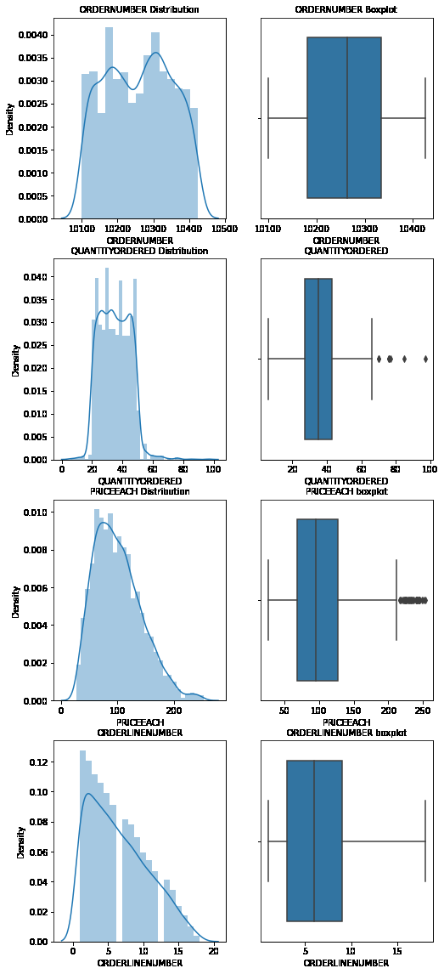
BOXPLOT and Distribution of NUM Variables

Slide 12
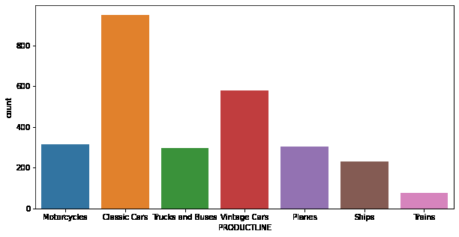
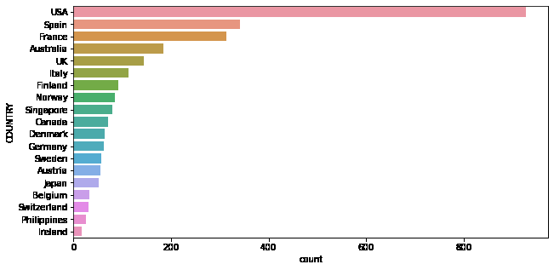
COUNTPLOT- Product LINE & COUNTRY

Slide 13
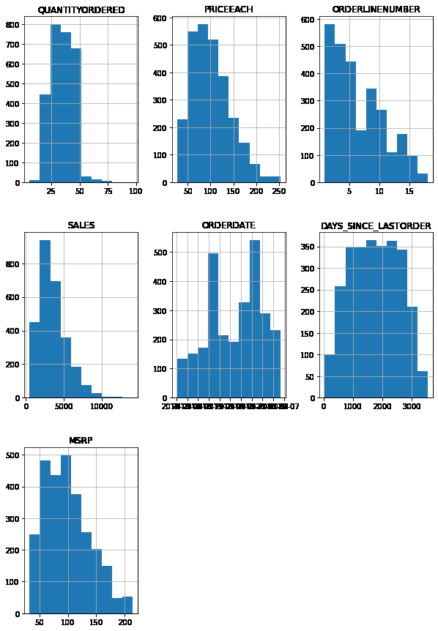
Histoplot

Slide 14
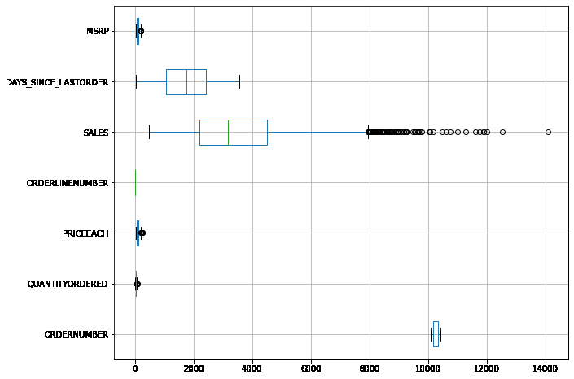
BOXPLOT-NUM Variables
Outliers present in MSRP, SALES, PRICE, QUANTITYORDERED, Used quartile method for upper and lower range removal of outliers

Slide 15
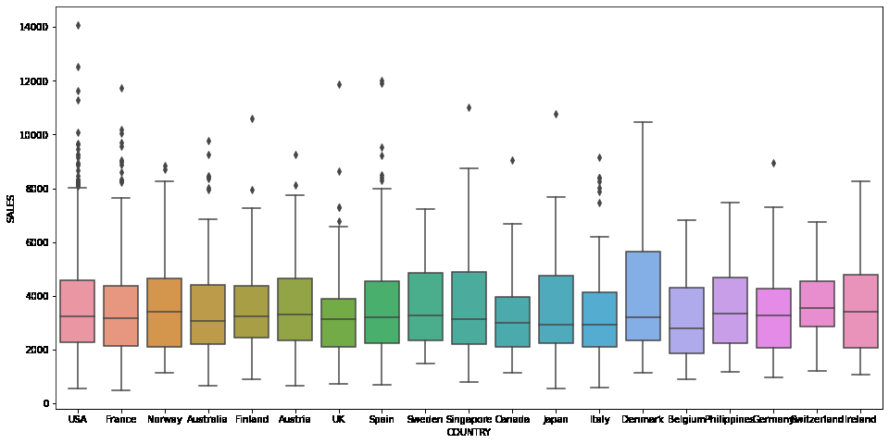
BOXPLOT- SALES VS COUNTRY
The median sales for USA, France, Norway, Spain, Australia and UK is similar. Sum of sales is highest for USA wherein Denmark has highest upper quartile range

Slide 16
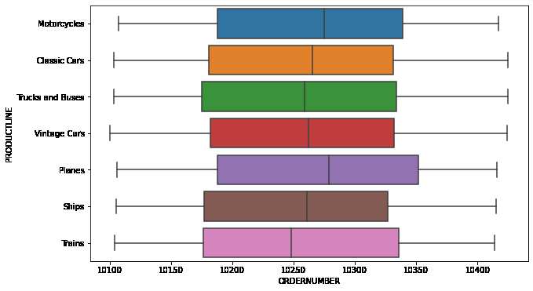
BOXPLOT- ORDERNUMBER VS PRODUCTLINE
The median order number is highest for planes . Minimum lower range is at 10,100 order numbers and highest upper range is at 10425

Slide 17
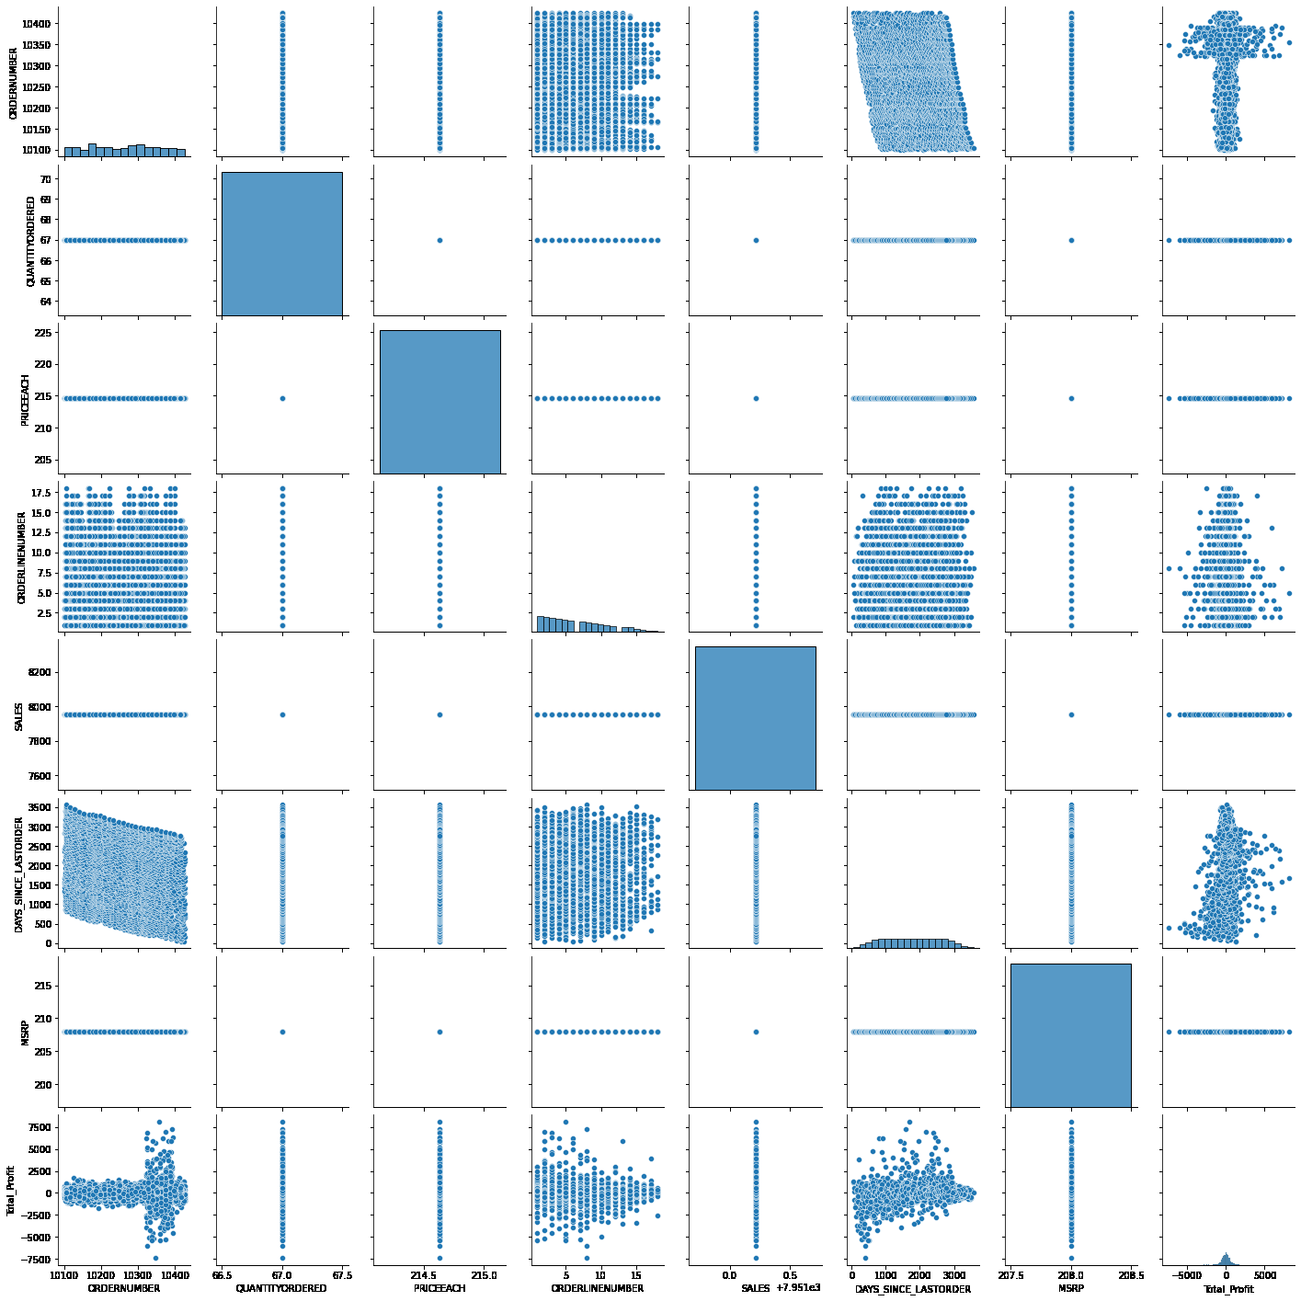
Scatter PLOT

Slide 18
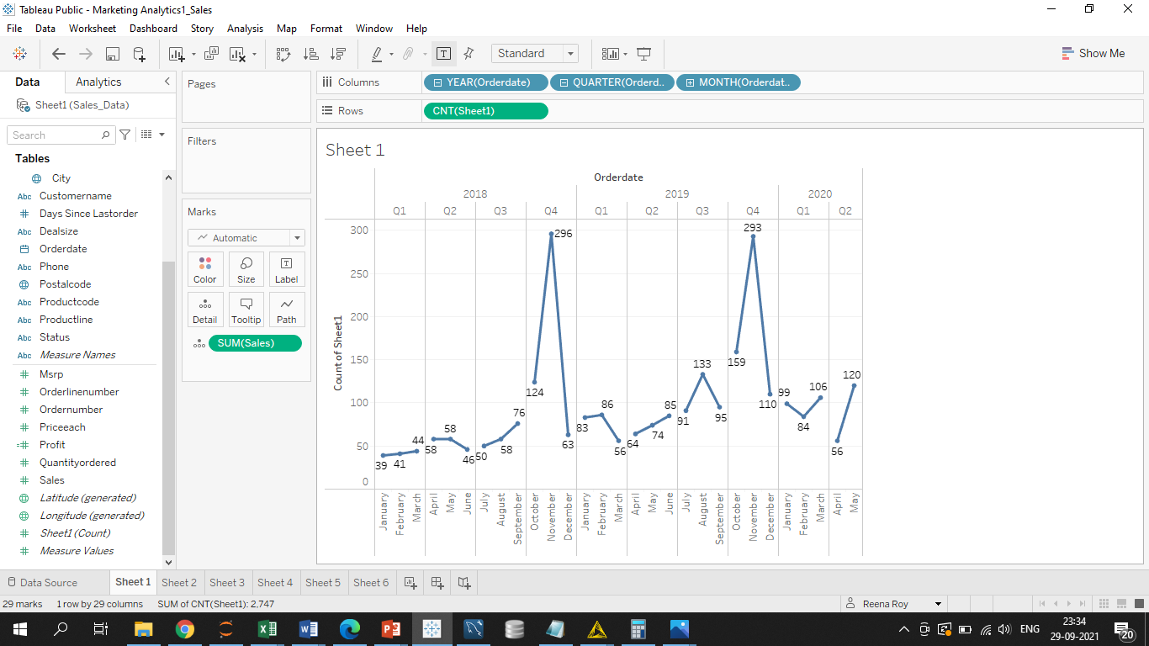
ORDER DATE- LINE GRAPH
The image screen shot is from tableau. Line graph shows the periodical change in Count of Sales against Order Date taken on Year, Quarterly and Monthly basis, Q4 shows peak values in sales in Year 2018 and 2019
Pls. sue below link to view the graphs
https://public.tableau.com/app/profile/reena.roy/viz/MarketingAnalytics1_Sales/Linechart?publish=yes

Slide 19
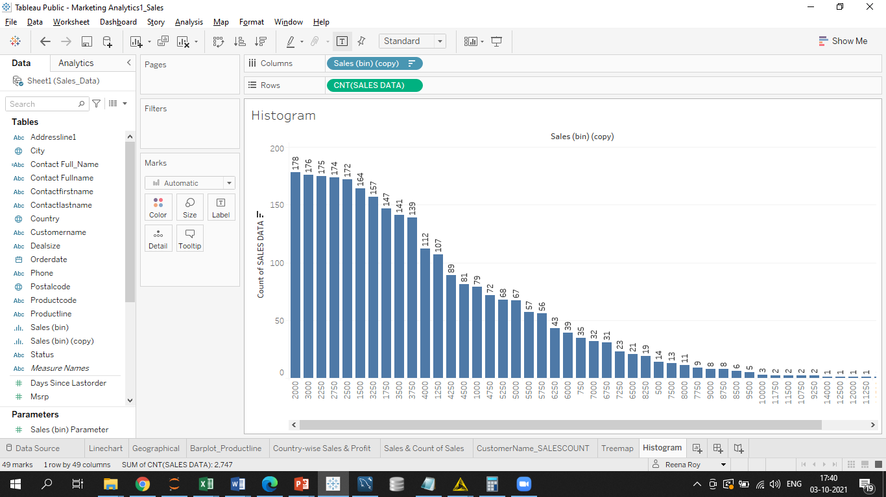
Histogram-Count of sales

Slide 20
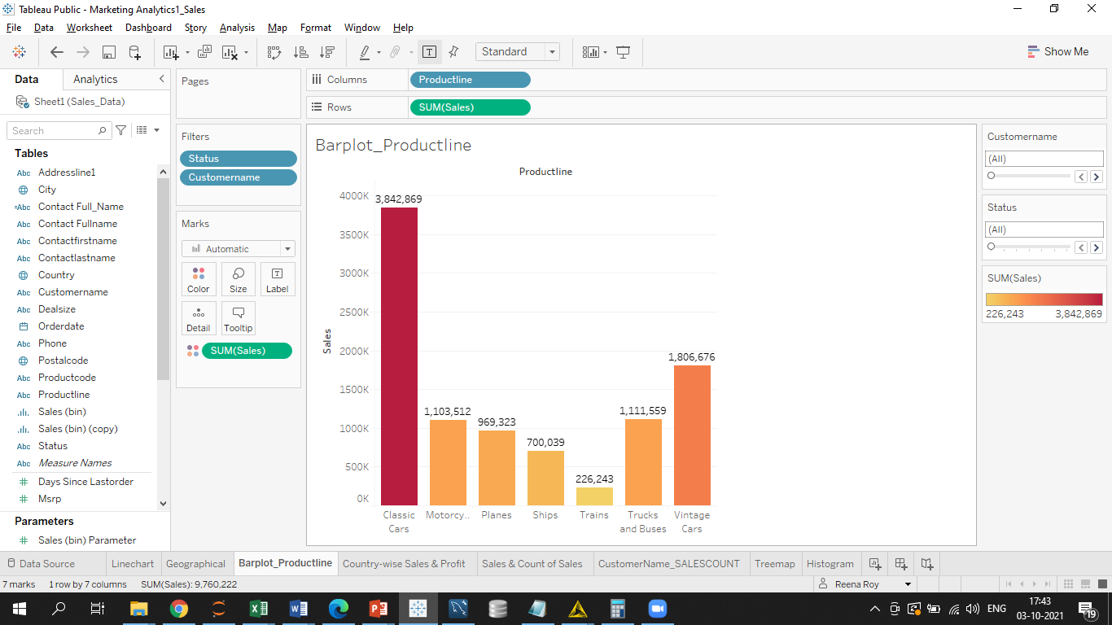
Barplot- Count of Sales Vs Productline
The barplot shows that Classic Cars have highest sales .

Slide 21
Eda SUMMARY [INFERENCES]
ORDERNUMBER -0.006995 QUANTITYORDERED 0.369286 PRICEEACH 0.697222 ORDERLINENUMBER 0.575327 SALES 1.155940 DAYS_SINCE_LASTORDER -0.002983 MSRP 0.575646 Total_Profit 0.624441 dtype: float64
Country wise USA has highest sales followed by Spain, France, Australia and UK
City wise highest sales is for Madrid followed by San Rafael, NYC, Singapore and Paris
The countplot shows highest count of Product wise sales for Classic Cars followed by Vintage cars
The boxplot and distplot shows comparative visualization for numerical varibles boxplot and the respective distribution. Sales has slight Left skew with outliers present . Outliers are present in Sales, MSRP, PRICE and Quantity ordered
SKEW
ORDERNUMBER -0.006995
QUANTITYORDERED 0.369286
PRICEEACH 0.697222
ORDERLINENUMBER 0.575327
SALES 1.155940
The Scatterplot shows that most variables don’t have much correlation

Slide 22
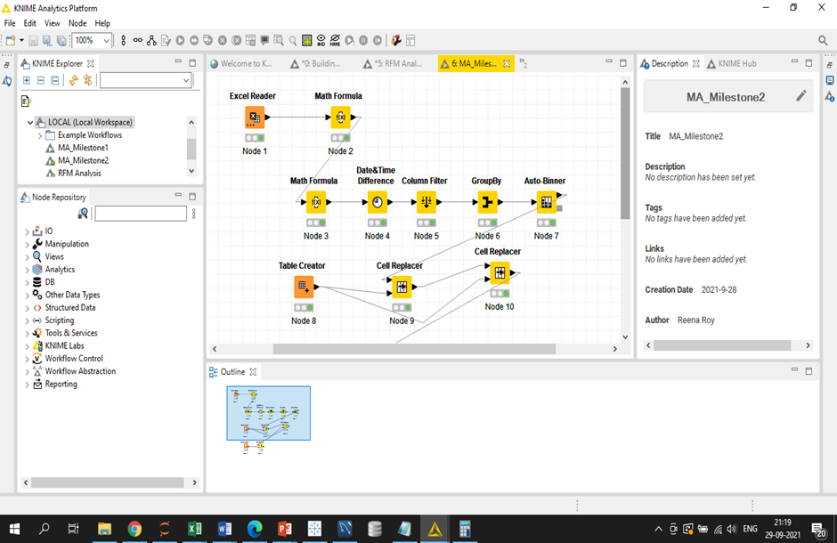
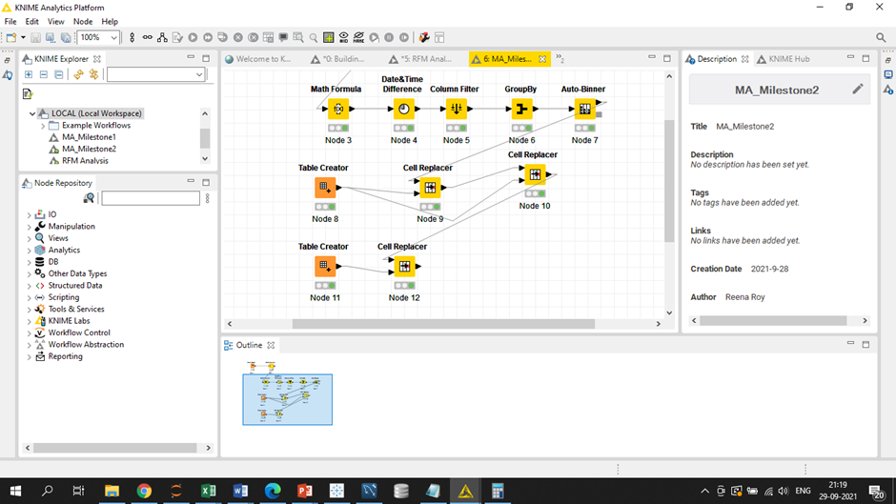
RFM –KNIME workflow
Above is the screenshot of KNIME workflow. 1. open the excel reader node and upload the excel file from browser. 2). Insert a calculated field called Profit.
3). Again using Math Formula node insert the calculated field Monetary 4) Using Date and Time difference node calculate Recency 5). Use Column Filter to filter out columns like Address and Pincode 6) Groupby to segregate the customers by customers name 7) Use Auto bin to allot 4 Bins or segments to the customers
8) Use Table creater and Cell Replacer to assign the Recency, Frequency and Monetary segementation like High for H, Medium High for MH, Low Medium for LM and Low for L to the four Bins 1, 2, 3, 4 from High to low order wise

Slide 23
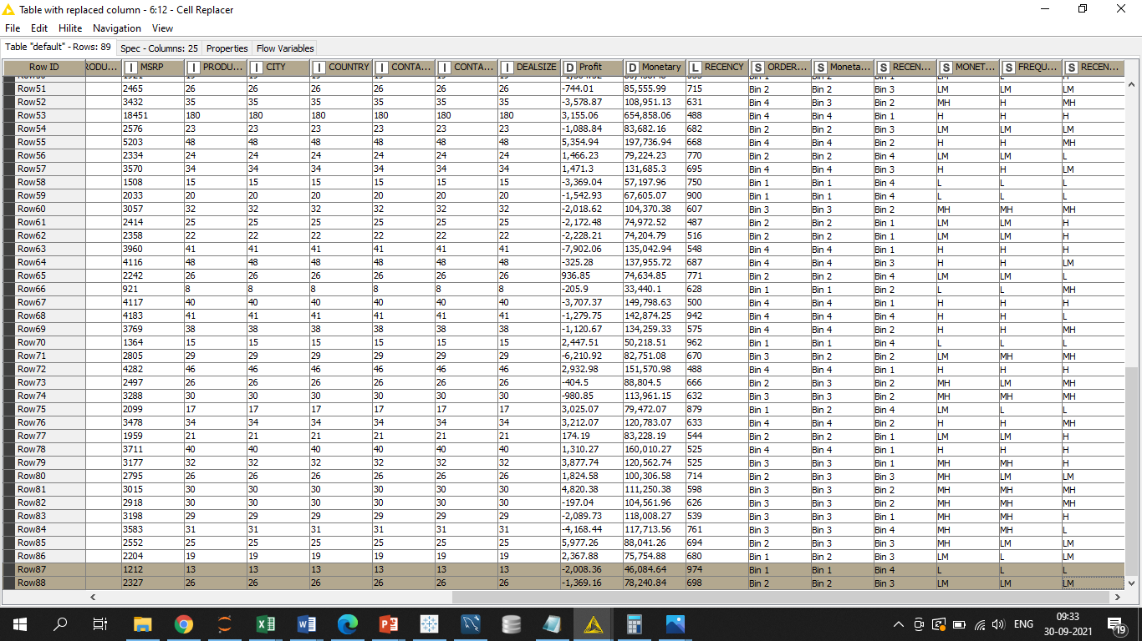
OUTPUT TABLE- AUTOBIN

Slide 24
Customer Segementation
Sum of Count of CUSTOMERNAME | Column Labels
Row Labels | H | L | LM | MH | Grand Total
H | 765 | 43 | 133 | 149 | 1090
H | 734 |  |  | 36 | 770
L |  | 20 | 39 |  | 59
LM |  | 23 | 94 | 25 | 142
MH | 31 |  |  | 88 | 119
L | 41 | 182 | 110 | 113 | 446
H | 41 |  |  |  | 41
L |  | 182 | 35 |  | 217
LM |  |  | 75 | 26 | 101
MH |  |  |  | 87 | 87
LM | 214 | 38 | 181 | 159 | 592
H | 182 |  |  |  | 182
L |  | 17 | 39 |  | 56
LM |  | 21 | 142 | 100 | 263
MH | 32 |  |  | 59 | 91
MH | 264 | 68 | 78 | 209 | 619
H | 264 |  |  | 35 | 299
L |  | 68 |  |  | 68
LM |  |  | 49 | 52 | 101
MH |  |  | 29 | 122 | 151
Grand Total | 1284 | 331 | 502 | 630 | 2747
 |  | Monetary
Recency | Frequency | H | L | LM | MH
H | H | 734 |  |  | 36
 | L |  | 20 | 39
 | LM |  | 23 | 94 | 25
 | MH | 31 |  |  | 88
L | H | 41
 | L |  | 182 | 35
 | LM |  |  | 75 | 26
 | MH |  |  |  | 87
LM | H | 182
 | L |  | 17 | 39
 | LM |  | 21 | 142 | 100
 | MH | 32 |  |  | 59
MH | H | 264 |  |  | 35
 | L |  | 68
 | LM |  |  | 49 | 52
 | MH |  |  | 29 | 122

Slide 25
Autobin Extract- Best and LOST customers
Row Labels | Sum of SALES | Min of DAYS_SINCE_LASTORDER | Count of CUSTOMERNAME | MONETARY | FREQUENCY | RECENCY
Auto Assoc. & Cie. | 64834.32 | 275 | 18 | L | L | L
Bavarian Collectables Imports, Co. | 34993.92 | 801 | 14 | L | L | L
CAF Imports | 49642.05 | 625 | 13 | L | L | L
Cambridge Collectables Co. | 36163.62 | 484 | 11 | L | L | L
Clover Collections, Co. | 57756.43 | 659 | 16 | L | L | L
Daedalus Designs Imports | 69052.41 | 573 | 20 | L | L | L
Double Decker Gift Stores, Ltd | 36019.04 | 670 | 12 | L | L | L
Iberia Gift Imports, Corp. | 54723.62 | 904 | 15 | L | L | L
Online Mini Collectables | 57197.96 | 467 | 15 | L | L | L
Osaka Souveniers Co. | 67605.07 | 563 | 20 | L | L | L
Signal Collectibles Ltd. | 50218.51 | 836 | 15 | L | L | L
West Coast Collectables Co. | 46084.64 | 523 | 13 | L | L | L
Row Labels | Sum of SALES | Min of DAYS_SINCE_LASTORDER | Count of CUSTOMERNAME | MONETARY | FREQUENCY | RECENCY
Euro Shopping Channel | 912294.1 | 42 | 259 | H | H | H
Mini Gifts Distributors Ltd. | 654858.1 | 219 | 180 | H | H | H
La Rochelle Gifts | 180124.9 | 139 | 53 | H | H | H
The Sharp Gifts Warehouse | 160010.3 | 182 | 40 | H | H | H
Souveniers And Things Co. | 151571 | 186 | 46 | H | H | H
Salzburg Collectables | 149798.6 | 188 | 40 | H | H | H
Danish Wholesale Imports | 145041.6 | 499 | 36 | H | H | H
L'ordine Souveniers | 142601.3 | 493 | 39 | H | H | H
Reims Collectables | 135042.9 | 287 | 41 | H | H | H

Slide 26
RFM- Most Favorable to CHURN aND most loyal Customers
Row Labels | Sum of SALES | Min of DAYS_SINCE_LASTORDER | Count of CUSTOMERNAME | MONETARY | FREQUENCY | RECENCY
Toms Spezialitten, Ltd | 100306.6 | 395 | 26 | MH | LM | LM
La Corne D'abondance, Co. | 97203.68 | 387 | 23 | MH | LM | LM
Cruz & Sons Co. | 94015.73 | 971 | 26 | MH | LM | LM
Vitachrome Inc. | 88041.26 | 432 | 25 | MH | LM | LM
Mini Classics | 85555.99 | 295 | 26 | LM | LM | LM
Blauer See Auto, Co. | 85171.59 | 705 | 22 | LM | LM | LM
Motor Mint Distributors Inc. | 83682.16 | 484 | 23 | LM | LM | LM
Enaco Distributors | 78411.86 | 659 | 23 | LM | LM | LM
giftsbymail.co.uk | 78240.84 | 327 | 26 | LM | LM | LM
Canadian Gift Exchange Network | 75238.92 | 364 | 22 | LM | LM | LM
Row Labels | Sum of SALES | Min of DAYS_SINCE_LASTORDER | Count of CUSTOMERNAME | MONETARY | FREQUENCY | RECENCY
Diecast Classics Inc. | 122138.1 | 228 | 31 | H | MH | H
Corrida Auto Replicas, Ltd | 120615.3 | 407 | 32 | H | MH | LM
Tokyo Collectables, Ltd | 120562.7 | 259 | 32 | MH | MH | H
UK Collectables, Ltd. | 118008.3 | 76 | 29 | MH | MH | H
Vida Sport, Ltd | 117713.6 | 440 | 31 | MH | MH | L
Baane Mini Imports | 116599.2 | 245 | 32 | MH | MH | LM
Suominen Souveniers | 113961.2 | 317 | 30 | MH | MH | MH
Herkku Gifts | 111640.3 | 567 | 29 | MH | MH | L
Toys of Finland, Co. | 111250.4 | 259 | 30 | MH | MH | MH
Toys4GrownUps.com | 104562 | 649 | 30 | MH | MH | MH
Oulu Toy Supplies, Inc. | 104370.4 | 241 | 32 | MH | MH | MH
Marta's Replicas Co. | 103080.4 | 292 | 27 | MH | MH | L
Heintze Collectables | 100595.6 | 414 | 27 | MH | MH | LM
Auto Canal Petit | 93170.66 | 127 | 27 | MH | MH | H

Slide 27
RFM INFERENCE
Inferences from RFM Analysis and identified segments
Who are your best customers? (give at least 5)
The top best customers are:
1. Euro Shopping Channel
2. Mini Gifts Distributors
3. La Rochelle Gifts
4. The Sharp Gifts Warehouse
5. Souveniers And Things Co.
Though we have 9 customers with total count of 734 the above are top customers based on high Recency, Frequency and Monetary and again sorted based on sales value
Which customers are on the verge of churning? (give at least 5)
1. Toms Spezialitten, Ltd
2. La Corne D'abondance, Co.
3. Cruz & Sons Co.
4. Vitachrome Inc.
5. Mini Classics
These are top five customers on the verge of churning based on LM categorization for Recency, Frequency and Monetary and also MH for Monetary. Then we also sort based on monetary values. There are total 11 customers and 242 counts

Slide 28
RFM-INFERENCE………………………………Contd…
Who are your lost customers? (give at least 5)
Auto Assoc. & Cie,
Bavarian Collectables Imports, Co. ,
CAF Imports,
Cambridge Collectables Co,
Clover Collections,
Total count of 182 have Recency, Frequency and Monetary all at low measures. Hence they are the lost customers.
Who are your loyal customers? (give at least 5)
Diecast Classics Inc.
Corrida Auto Replicas, Ltd
Tokyo Collectables, Ltd
UK Collectables, Ltd.
Vida Sport, Ltd
These are the top five loyal customers out of total 15 customers and total count of 419

Slide 29
RFM Reference Summation
I have used KNIME workflow for the RFM analysis. (attached the slides for the workflow)
Created three columns for Recency ( Current Date – Order Date), Frequency( No of Order Nos), Monetary(Sum of Sales). Categorized the customers into four segments or bins through Autobin feature. Use Auto bin to allot 4 Bins or segments to the customers
Use Table creater and Cell Replacer to assign the Recency, Frequency and Monetary segementation like High for H, Medium High for MH, Low Medium for LM and Low for L to the four Bins 1, 2, 3, 4 from High to low order wise
Then finally use pivot in excel to get the four segments customerwise details based on RFM
There are 734 customers who are categorized under best customers gold as they belong to high RFM . Overall 1323 customers come under gold who are high valued. Theses customers should be catered well by the company and give special benefits to retain them
There are 242 customers who have not contributed much to monetary and order the product on and off basis. These are the customers who can be wooed to churn to next level of siver and gold by introducing special offers and discounts
There are 419 customers who have been consistent though not valued monetarily as gold but they are the customers who are loyal and buy products regularly. These customers should be given loyalty benefits in terms of loyalty coupons, priority based deliveries etc
There are 182 customers who are poor contributors to monetary, seldom make a purchase and are low in RFM metrics. Such customers have very less chance to churn to next upgraded level. Company should not waste much time on such customers as they are very slippery and might not stick to one product or company for long.

Slide 30


