Slide 1



Environmental Monitoring and Pollution Control

Slide 2

Learning Objectives
Analyze pollution trends using weather data
Build and evaluate ML models for PM2.5 prediction.
Simulate real-world deployment with saved models.
Present insights with clarity and reproducibility.
Document modular workflows for peer learning.
GOAL
Source :
www.freepik.com/

Slide 3
Tools and Technology used
Python – Core language for data processing and modeling
Pandas – Data cleaning, manipulation, and analysis
scikit-learn – Model training, evaluation, and pipelines
Joblib – Saving and loading trained models
Jupyter Notebook – Modular development and documentation
VS Code – Primary IDE for coding and debugging
Git & GitHub – Version control and deployment
Matplotlib / Seaborn (optional) – Data visualization
Firebase Hosting (if deployed) – For hosting frontend dashboards
Voice-to-text (via VSport or Copilot) – For rapid prototyping and debugging

Slide 4
Methodology
Week 1 – Dataset Preparation Cleaned raw pollution and weather data, explored seasonal/hourly trends, and saved a structured dataset for modeling.
Week 2 – Model Implementation Trained Linear Regression and Random Forest models using weather features. Evaluated performance using MAE ,RMSE and saved the best model.
Week 3 – Deployment & Presentation Loaded the saved model, simulated predictions with sample inputs, and presented insights using tables and charts. Final project deployed via GitHub for reproducibility.

Slide 5
Problem Statement:
Air pollution—especially fine particulate matter like PM2.5—is a growing environmental and public health concern. These microscopic particles can penetrate deep into the lungs and bloodstream, causing respiratory issues, heart disease, and other long-term health effects. PM2.5 levels fluctuate based on weather conditions and time of day, making manual tracking unreliable and reactive.
This project addresses the challenge of predicting PM2.5 levels using accessible weather features such as temperature, humidity, hour, and month. By building a machine learning model that anticipates pollution spikes, we enable proactive monitoring, smarter decision-making, and the potential for real-time integration into dashboards or alert systems.

Slide 6
Solution:
To address the unpredictability of PM2.5 pollution levels, this project builds a machine learning model that uses accessible weather features—temperature, humidity, hour, and month—to forecast pollution trends. The raw data was first cleaned and structured to ensure reliability and reproducibility. Exploratory analysis revealed seasonal and hourly patterns that influence pollution levels, forming the basis for feature selection.
Using these insights, two models—Linear Regression and Random Forest—were trained and evaluated, with Random Forest emerging as the more accurate predictor based on MAE and RMSE scores. The best-performing model was saved and later used to simulate predictions on sample inputs, demonstrating its practical application. The entire workflow was documented and deployed via GitHub, making it reproducible and beginner-friendly. This solution not only enables proactive environmental monitoring but also serves as a scalable blueprint for future integration into dashboards, alert systems, or educational platforms.

Slide 7
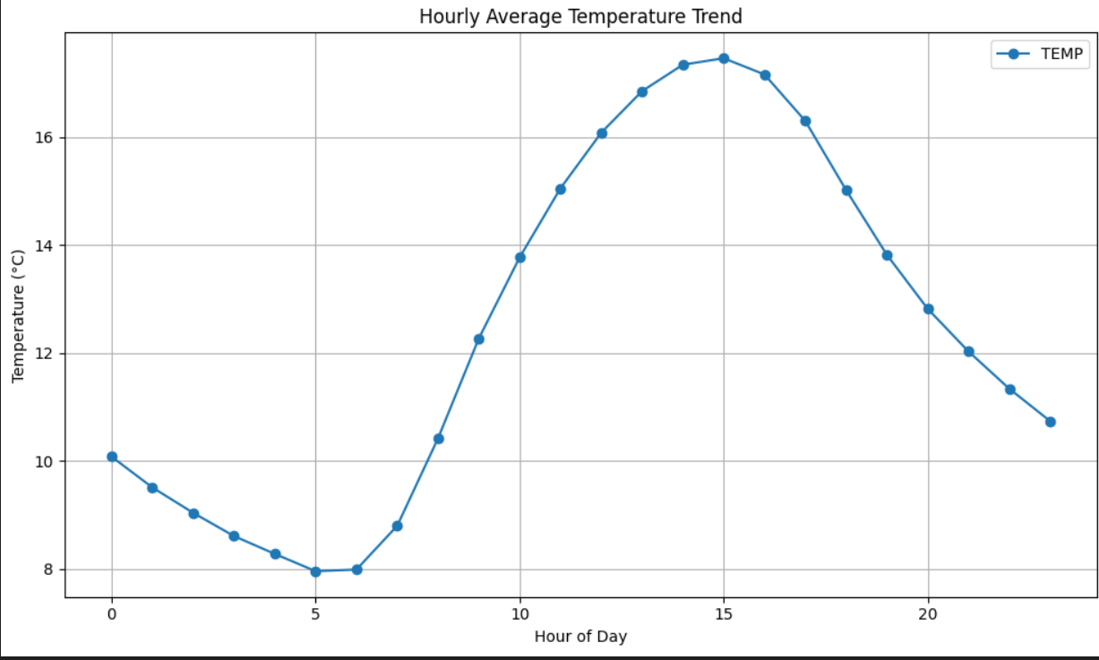
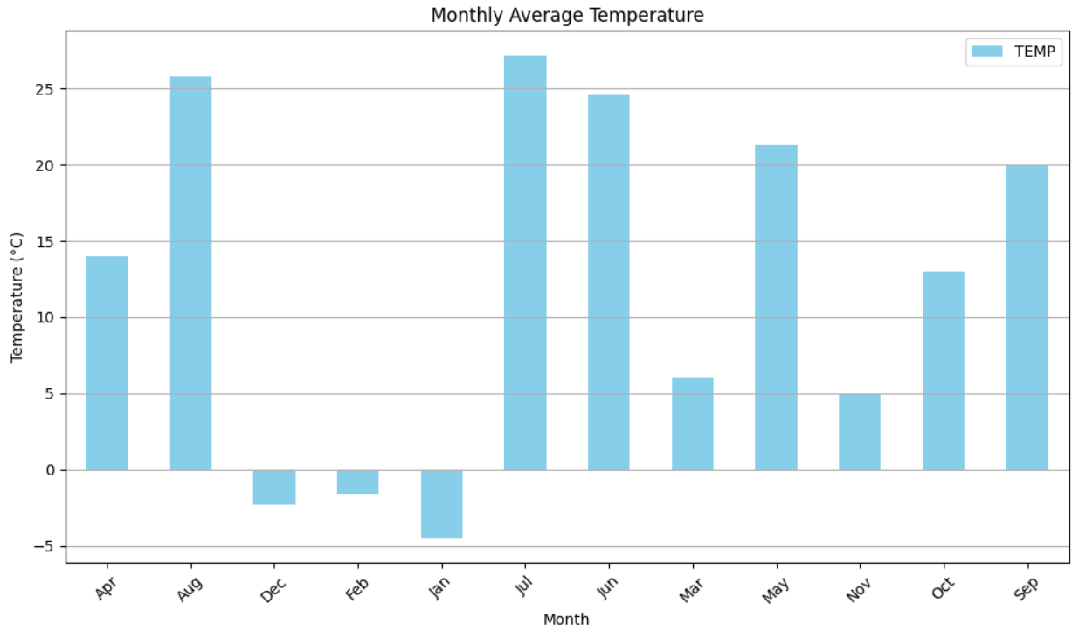
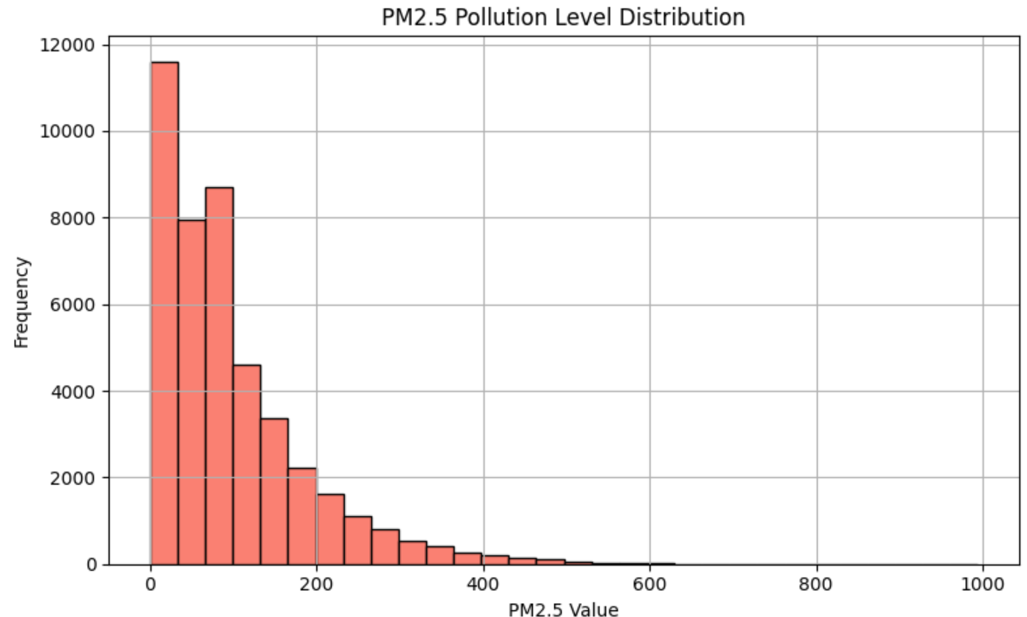
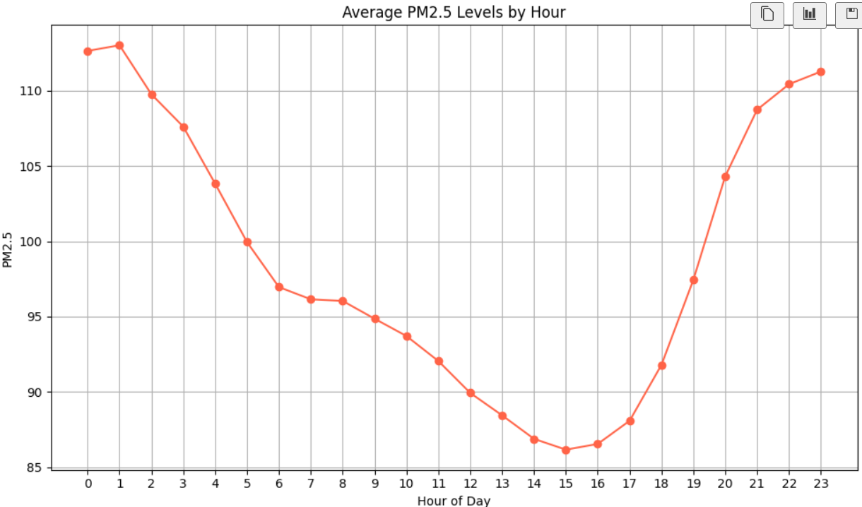
Screenshot of Output:

Slide 8
Conclusion:
This project demonstrates how simple weather features—temperature, humidity, hour, and month—can be used to effectively predict PM2.5 pollution levels using machine learning.
From data cleaning to model training and deployment, every step was designed to be modular, reproducible, and beginner-friendly.
The saved model and visual outputs offer a scalable foundation for future dashboards, alert systems, or educational tools.
Beyond technical accuracy, this project reflects a commitment to clarity, environmental awareness, and peer learning.
It’s not just a prediction engine—it’s a blueprint for how data, design, and purpose can come together to make impact visible.

